Slide 1
Special Edition Community Event
28 January 2021
Action Plan 2021

Slide 2

Housekeeping Rules
To help ensure everyone can participate, please note the following:
Please use the chat for all questions. Keep your questions brief and to the point.
Kindly format your questions with your first name and country (e.g., Jane, Kenya; Roberto, Chile).
Feel free to type questions in French or Spanish. These will be translated and sent to the moderator.
We do have translation on this call. If you want to listen to the French or Spanish part of the presentation, please select the preferred language on your zoom panel.
Closed Caption is also available in English.
Keep your microphone on MUTE at all times unless you are asking a question.
This session will be recorded and a link for future viewing will be shared after the call.
Notes:
If you wish to speak, select the hand icon in Zoom. A moderator will add
you to the queue.

Slide 3
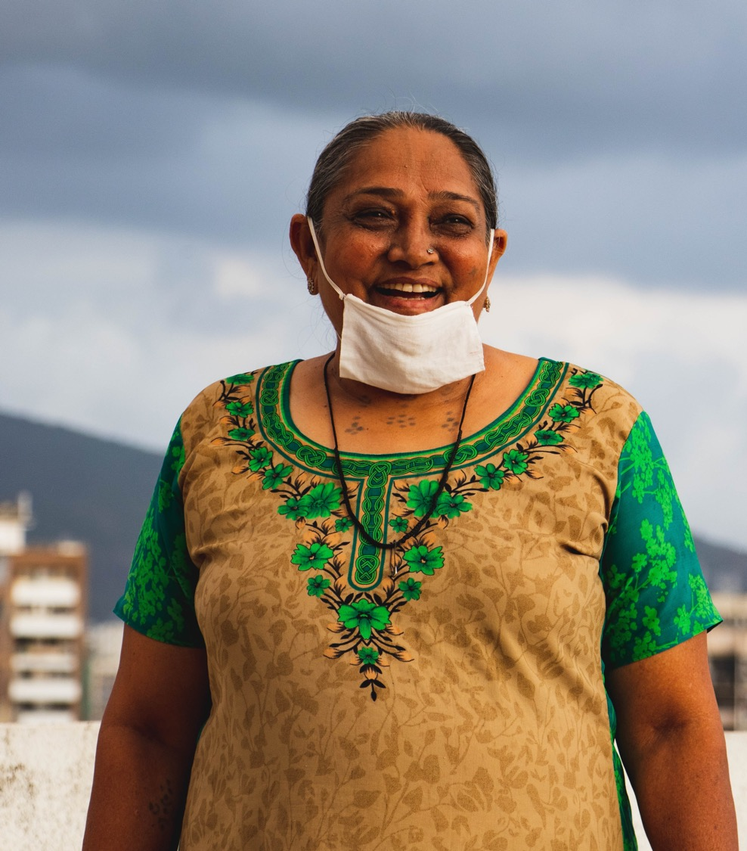
The Internet Endures
No one could have predicted the events of 2020.
Through it all, the Internet has been the one constant in many people’s lives. It has been our unwavering connection to the world around us.
Because of its underpinnings, the Internet has remained reliable, and resilient - a lifeline for so many people throughout the globe.
More than any other year, 2020 has reminded us of the importance of our mission.
Photo by Pradnyal Gandhi on Unsplash

Slide 4
We need to keep working to ensure the Internet is there for everyone.

Slide 5
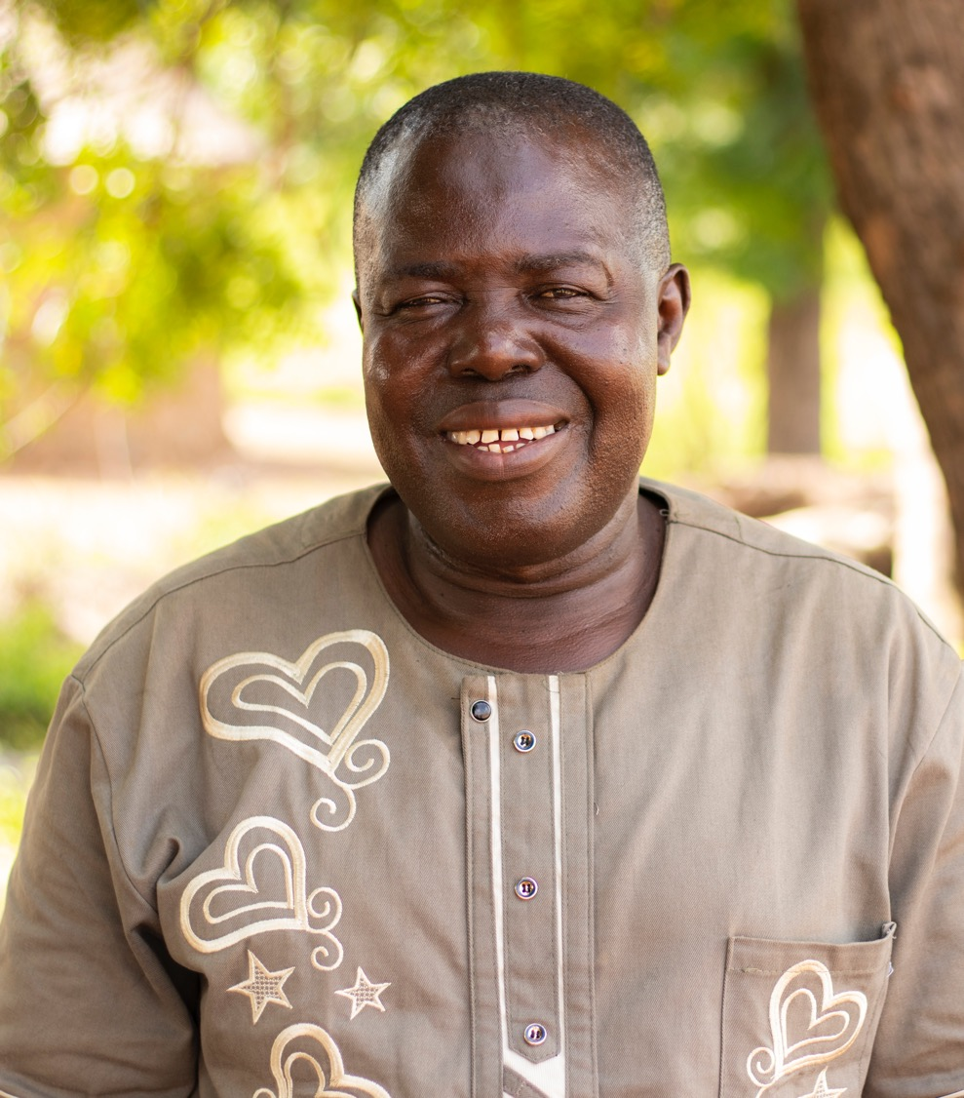
Continuing on the path to 2025
As we do so, we are marching toward our strategic goals for the Internet to be open, globally-connected, secure, and trustworthy.
Our Action Plan for 2021 is the next step in this journey.
We will stay focused on building, promoting and defending the Internet alongside our community and partners in the areas where we can make the most difference, so that it remains a force for good in the world, and brings opportunity to all.
© Elliot Adombila, Internet Society Ghana Chapter

Slide 6
A renewed sense of purpose and urgency

Slide 7




Overview of our work
We need to grow the Internet.
Nearly half the
world’s population
is not
connected.
We need to make the Internet stronger.
The Internet needs our help to maintain its critical properties and be there for everyone.
We need to
empower people.
Attract, engage,
and strengthen our
whole community.

Slide 8
Growing the Internet

Slide 9
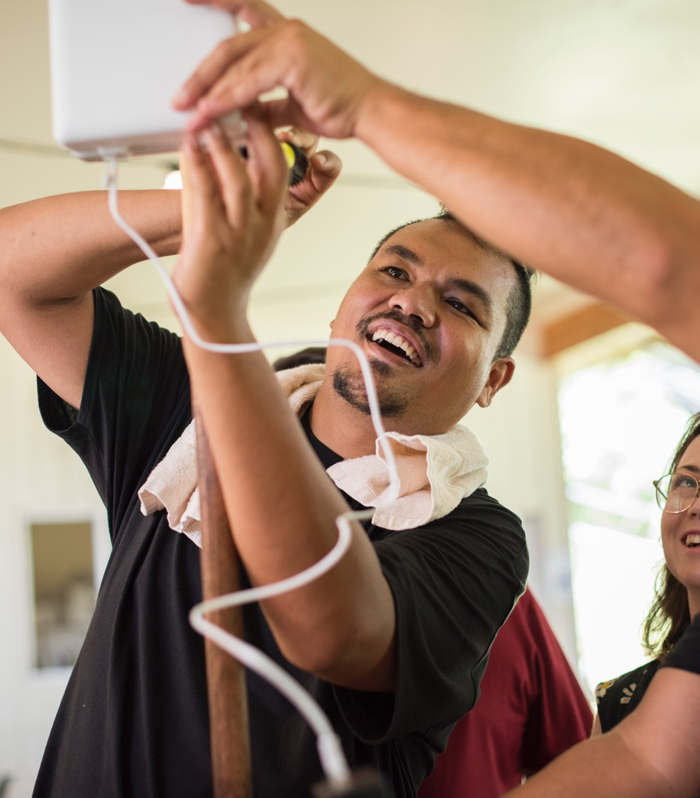






Building Community Networks
Each day without Internet connectivity is a day of lost opportunity.
We plan to bring more people online by
Bridging the connectivity gap and expanding access
Supporting the human networks
Supporting new and existing Community Networks (CNs)
Building a global network of CN champions
Focusing on local capacity
Advocating for countries or international organizations to introduce policy or regulatory language enabling the deployment of CNs
Support 10 new or existing CNs
Number of countries and organizations that change policies, regulations, rules, or projects to support CNs
Train 300 individuals and deliver more advanced training to 15 CN Leaders
Collaborate with 5 new partners
© Elise Butler

Slide 10
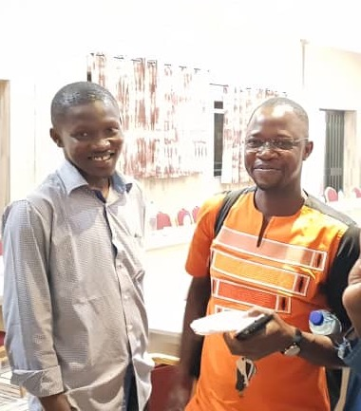



Fostering Infrastructure and Community Development
In many places, Internet access is marked by slow speeds, high costs, and unreliable service.
We plan to support the Internet’s infrastructure by
Building the communities (e.g. NOGs, NRENs) that build the Internet
Creating new and enhancing existing IXPs
Building technical capacities and leadership
Advocating for an enabling policy environment
Engage with 5 partners to help expand local and regional efforts
Improve 15 existing IXPs and establish 5 new ones
Train 500 individuals
Engage policymakers and regulators in 5 countries
© Internet Society

Slide 11
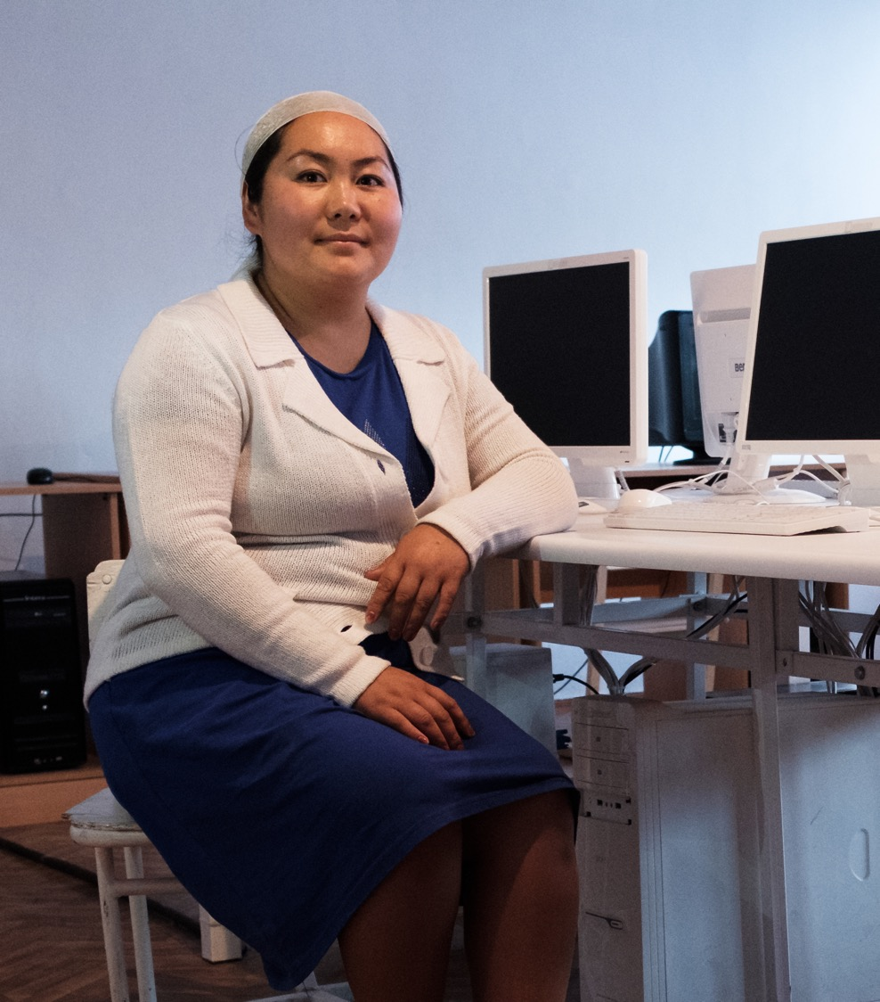


Measuring the Internet
We can be a leader in helping the world to understand how the Internet is changing.
We will use data to help others strengthen their understanding of the Internet by
Offering insights into the health, availability, and evolution of the Internet
Continuing to provide a valuable platform that anyone can reference to identify trends, generate reports, and tell data-driven stories about the Internet
Partnering with measurement groups and economists to further enhance the platform
Release Version 2 of the platform
Expand the platform to a total of 4 focus areas
© Internet Society / Nyani Quarmyne / Panos Pictures

Slide 12
Strengthening the Internet

Slide 13



Promoting the
Internet Way of Networking
If we don’t consider how our actions could harm the Internet, we risk breaking the underlying foundation that makes it work for everyone.
We will advocate for the “Internet Way” by
Keeping the Internet strong, resilient, and a place for infinite opportunities
Protecting the “network of networks” that is the Internet
Training others about the critical properties of the Internet Way of Networking
Promoting the use of the Internet Impact Assessment Toolkit (IIAT)
Train 200 individuals
See the IIAT used to assess the impact of new or existing policies in at least 4 policymaking processes
© Internet Society / Nyani Quarmyne / Panos Pictures

Slide 14
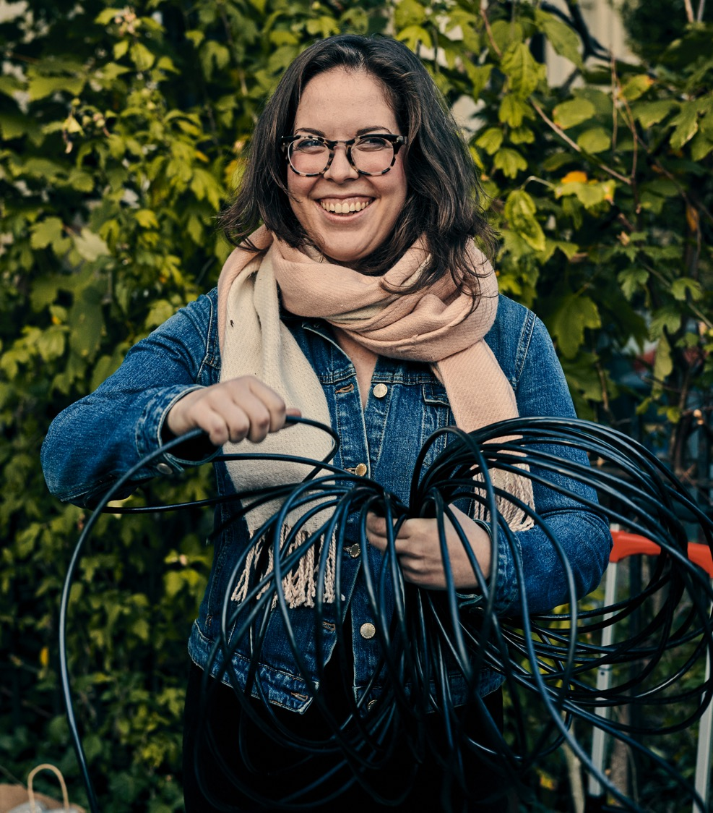




Extending Encryption
The Internet is under threat - governments around the world are finding new and unique ways to undermine the use of strong encryption.
We will stand up for encryption by
Addressing the threats to protect and promote encryption through 2021 and beyond
Mitigating government attacks on encryption
Increasing the adoption of end-to-end (e2e) encryption by growing Global Encryption Coalition membership
Rallying around strong encryption with the launch of Global Encryption Day
Increase adoption of e2e encryption by 10% globally
Mitigate government attacks on encryption in 8 target countries
© Chris Gregory

Slide 15
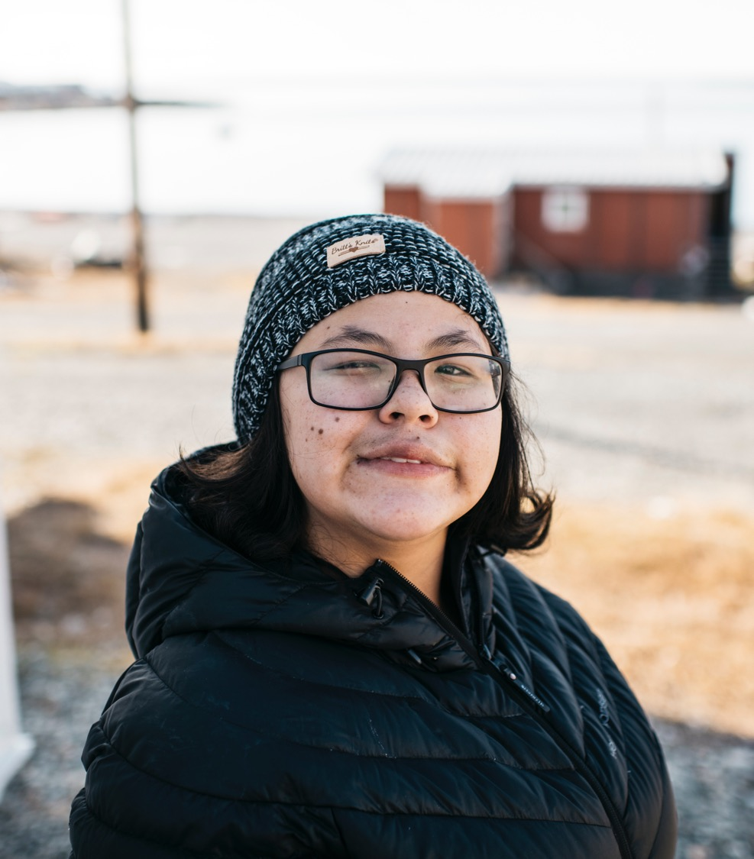


Securing Global Routing
Mutually Agreed Norms for Routing Security (MANRS) are vital to our trust of the Internet.
We will help improve the security and stability of Internet routing for everyone by
Reducing global routing incidents
Increasing uptake in routing security measures
Assessing the community’s readiness to lead MANRS
10% decrease in routing incidents
10% increase in ROA (Route Origin Authorization) by MANRS participants
30% improvement in MANRS participants’ conformance
Implement ROV (Route Origin Validation) by 5% of MANRS participants
© Angela Gzowski

Slide 16
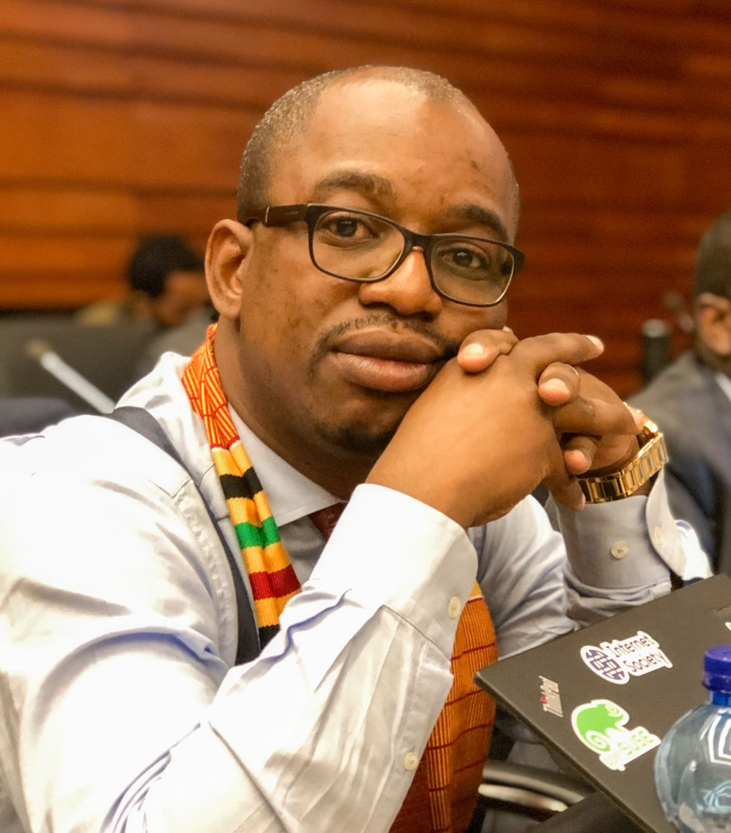
Preserving the
Open Internet Model
Open standards are as critical now as they were in the early development of the Internet.
We will protect the open standards that underpin the open Internet model by
Taking a proactive approach to the World Telecommunication Standardization Assembly (WTSA)
Advocating for greater openness, transparency, and collaboration
Getting the message out to our community and partners
In the lead-up to or during WTSA, we aim to have 4 governments or governmental agencies express support for our positions
©Victor Ndonnang / Internet Society

Slide 17
Empowering People to
Take Action

Slide 18
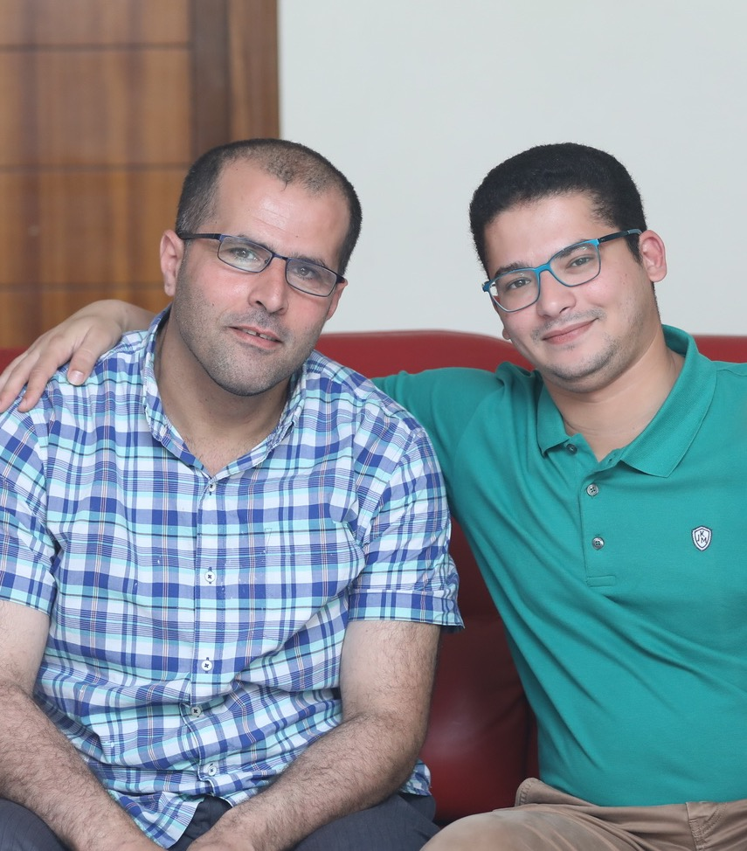
Supporting
Community Participation
People who champion the Internet are at the heart of what we do.
We will better support their participation by
Attracting and engaging Individual Members
Providing fundamental information to our Chapters
Improving the function of Special Interest Groups
Strengthening our community connections and participation
Focusing on content to support participation
Total Individual Members participating in Internet Society activities
Equip 500 Chapter members with essential information related to our 2021 projects
Establish 5 topics for 2022 as identified through SIG Community Consultations
© Urban Pixel Lebanon

Slide 19




Building Expertise and Capacity
We can build up those who support our mission with knowledge-sharing and learning opportunities.
We will strengthen our community by
Driving action through knowledge
Preparing future Internet advocates
Sharing cutting-edge knowledge
Offer 30 e-learning courses
Facilitate 1 collaboration between NDSS research community and open standards community
Secure 2 partners to help with course accreditation
Secure 4 partners to support Fellowships
© Internet Society

Slide 20
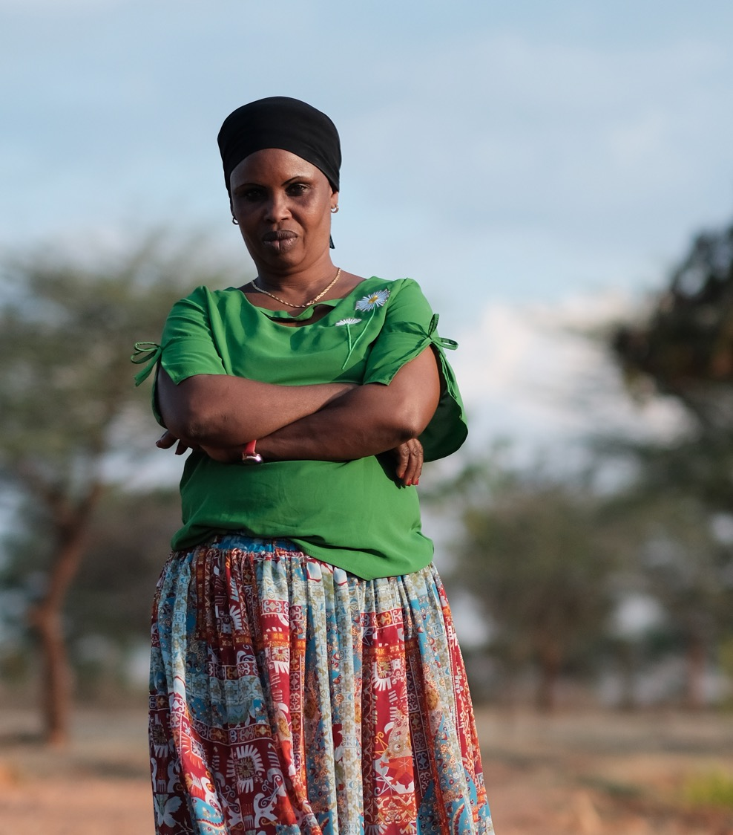

Securing Resources for
Growth and Greater Impact
By cultivating broader financial support for the work of the Internet Society, we can do more, include more people, and ensure our work responds to people’s needs.
Targeting outreach for new, diversified funding and partnership
Through this outreach, which complements our member contributions, we will secure 10 new funding sources and 50 new partners who actively participate in our work.
© Internet Society / Nyani Quarmyne / Panos Pictures

Slide 21

Conclusion
This Action Plan represents our focus on achieving tangible outcomes that make a positive difference for the Internet.
We will work directly in areas that affect Internet access, and the security of the Internet.
We will advocate for the true, global Internet through sustained and focused communications efforts that link to our objectives.
We will work to strengthen our standing as an influencer in Internet decision-making around the world, and as a trusted source of balanced insight and opinion.
We will make improvements and drive initiatives to help us be more effective in our work.
© Elyse Butler

Slide 22
We will do more for the Internet.
And we will work with, and alongside our global community, building our reputation as a movement of people who are driven by the shared vision:
The Internet is for everyone.

Slide 23
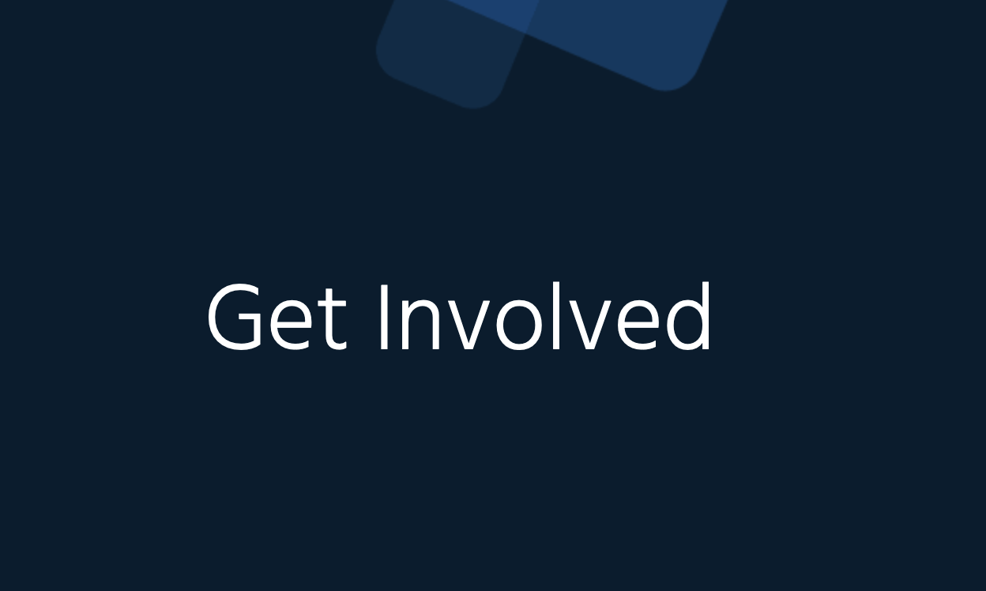
Call to Action
Would you like to be involved in any of our projects!
You can follow the instructions here: https://www.internetsociety.org/take-action/2021-projects/
Update your profile in our member portal and let us know where you’d like to contribute

