Slide 1






Public Funding for Community Networks
12:00 – 14:00 UTC
Wednesday 25 November 2020

Slide 2
Agenda
Welcome Session – Verengai Mabika
Opening Session– Eleanor Sarpong
Panel Discussion: Public Funding for Community Networks – Eleanor Sarpong
Panelists:
  Dr. Charley Lewis
  Nthabiseng Pule
  Victor Asante
Q&A Session – Eleanor Sarpong
Closing Session – Verengai Mabika
Virtual Social Event – Michuki Mwangi

Slide 3
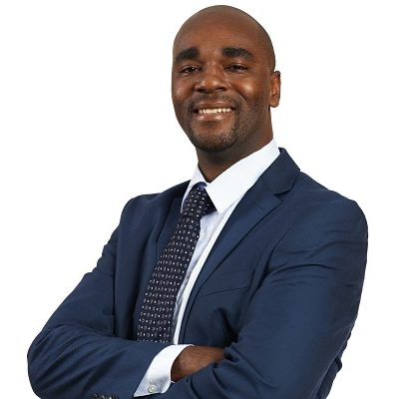
Welcome Session
Verengai Mabika
Senior Policy Advisor, Internet Society

Slide 4
Housekeeping Rules
This session is being recorded and the recording will be made available after the session. It is also streamed live on social media (Facebook, Twitch and Periscope).
Engage respectfully and responsibly.
When asking questions or speaking, please keep it short, straight to the point and simple.
Kindly format your questions with your first name and country (Emily, Ethiopia; Jesinta, Uganda; Theo, Mali, etc.).
Get familiar with the Internet Society’s Code of Conduct: https://www.internetsociety.org/become-a-member/code-of-conduct/

Slide 5
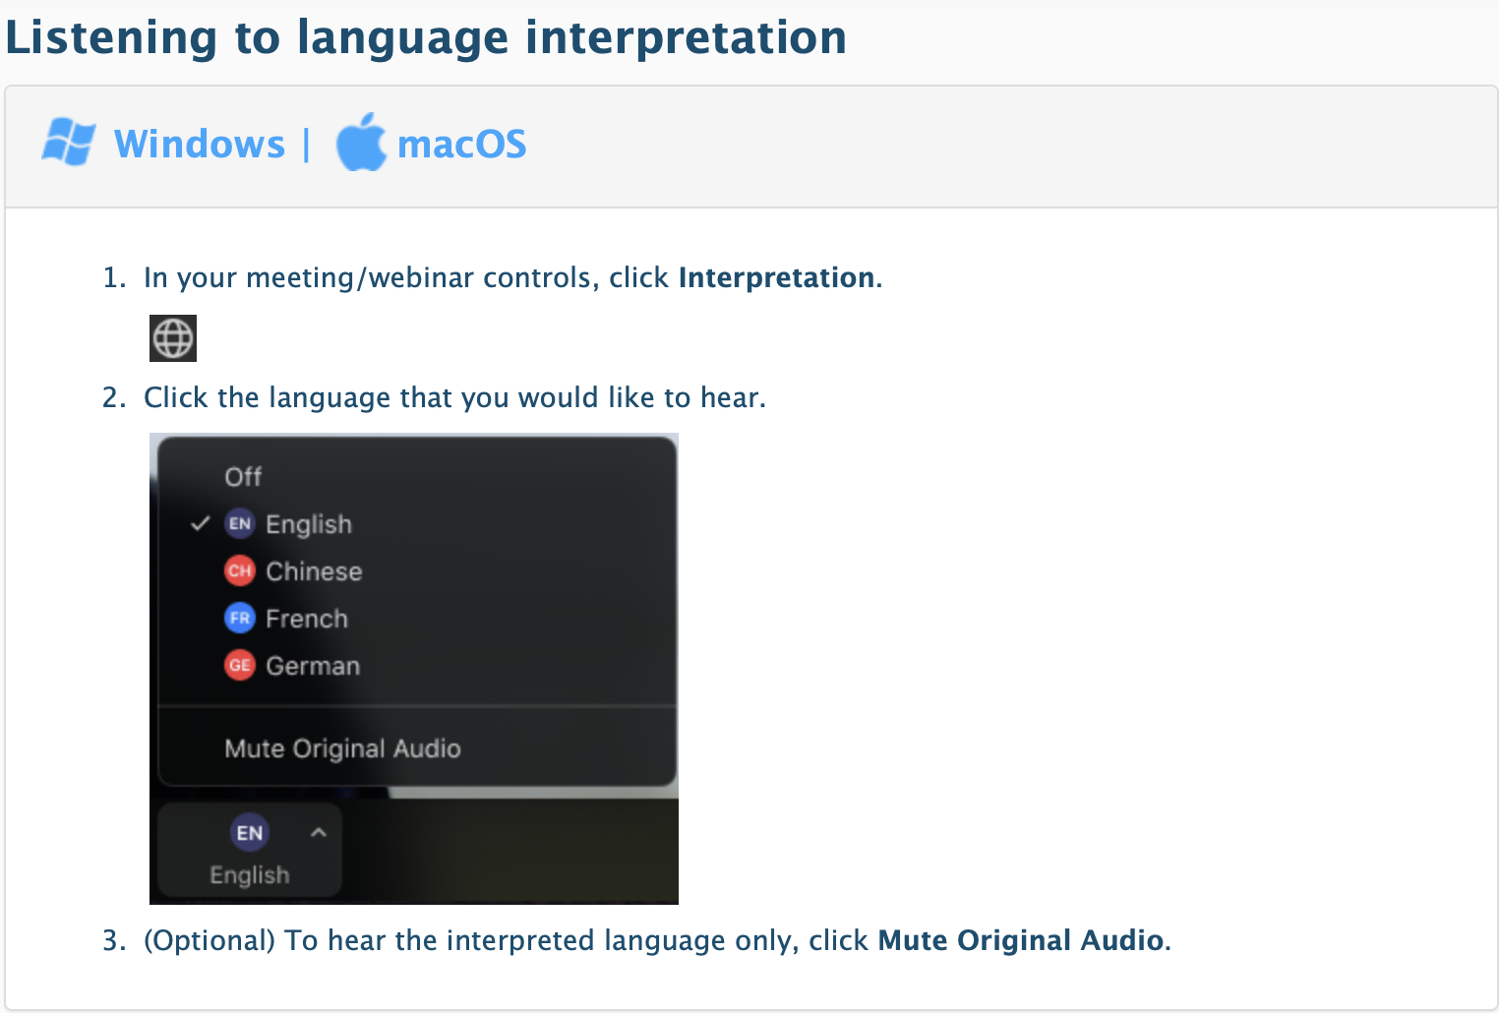
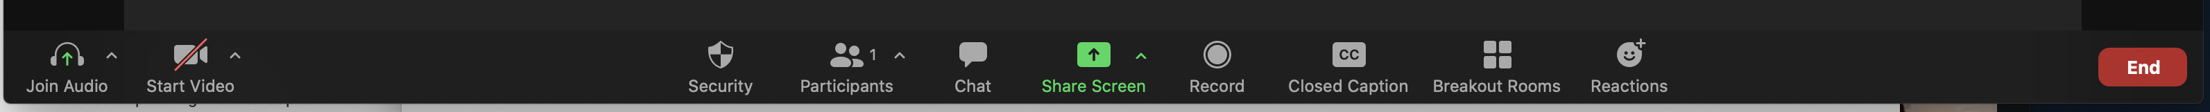
How to Engage
Social Media
#CommunityNetworks #SwitchItOn
Interpretation
Audio languages supported: English and French
Captioning
Captioning available in English.

Slide 6
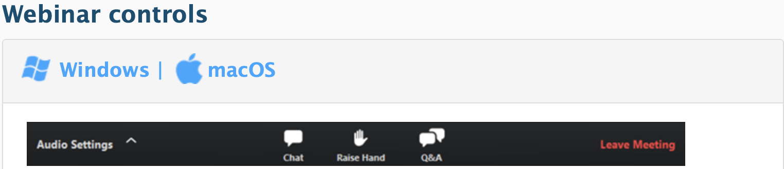
How to Engage
Chat-Room
Use the chatroom to discuss with other attendees. Please raise your hand if you want to speak. If not speaking, hit the button to deactivate it.
Questions
Post your questions in the Q & A room, not in the Chat-room.

Slide 7
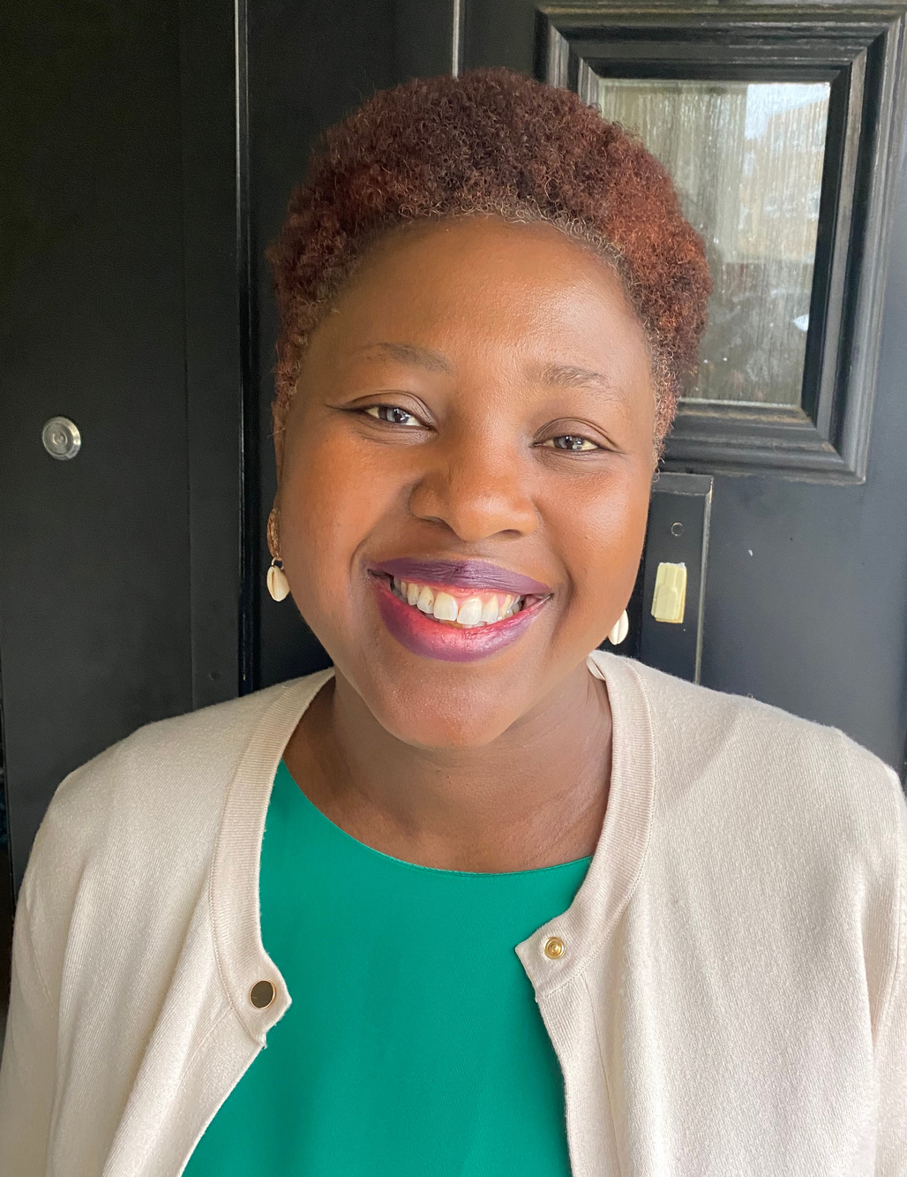
Opening Session
Eleanor Sarpong
Deputy Director and Policy Lead, A4AI

Slide 8
Session Objectives
The objectives of this third event is to expose community networks to the existence of public funding such as universal service/access funds, to facilitate community network development by:
Explaining the nature of such funds
Exploring the mandates they have
Identifying case histories of interaction between funds and CNs
Identifying possible existing partnerships.

Slide 9
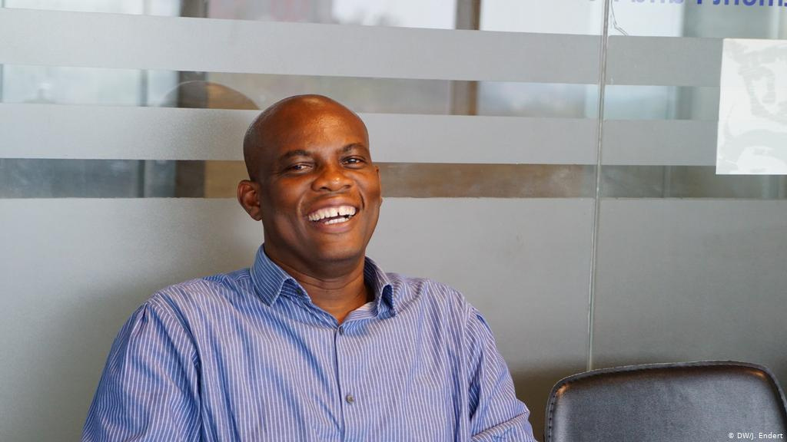
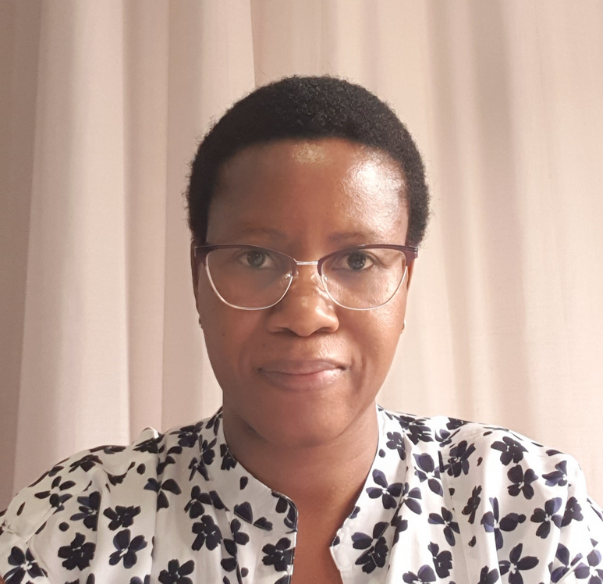
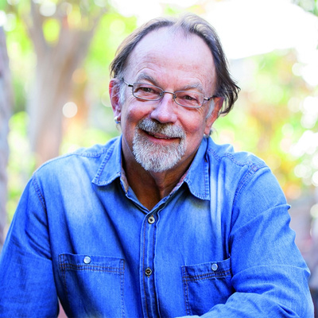
Panel Discussion
Public Funding for Community Networks
Victor Asante
Senior manager, Research, Monitoring and Evaluation, Ghana’s Universal Service Fund-Ghana Investment Fund for Electronic Communications (GIFEC).
Nthabiseng Pule
Outreach Manager, the Cybersecurity Capacity Centre for Southern Africa (C3SA), former Head of Lesotho USF
Dr. Charley Lewis
Independent Analyst, Research and Educator

Slide 10
Q & A
Your questions to the panelists.

Slide 11
Thank You!

Slide 12
Next Session
Session 4: Sustainability Models for Community Networks, 27 January 2021
Registration link will be posted in the Chat-room.

Slide 13

Virtual Social for Community Networks in Africa

Slide 14
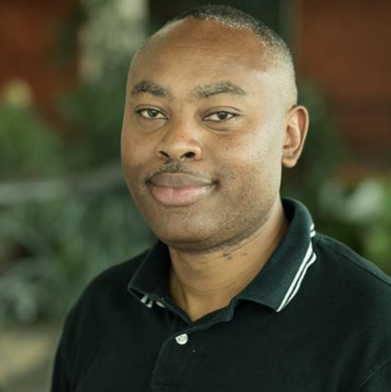
Virtual Social for Community Networks in Africa
Michuki Mwangi
Senior Director, Internet Technology and Development, Internet Society

Slide 15
Thank You!

