Slide 1




Virtual Social for Community Networks in Africa

Slide 2
Virtual Social for Community Networks in Africa
What is Gather.town Platform?
Gather.town (https://gather.town/) is a virtual space for people to live and interact more effectively online.
It is a web-based virtual platform that also integrate audio and video calling experience, along with other social feature for online users.
This presentation contains brief demonstration videos and basic instructions on how to use it. A direct link to access the platform online will be provided during the event.

Slide 3
Virtual Social for Community Networks in Africa
How to Use gather.town Platform
General Requirements
Use Chrome/Firefox
No registration is required
Enter your name and organization/CN in brackets - i.e. Michuki (Internet Society)

Slide 4
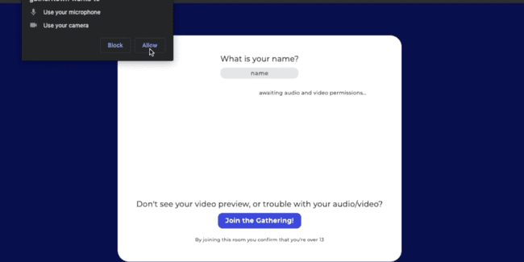
Virtual Social for Community Networks in Africa
How to join
The link will take you to this window in your browser.
Enter your name
Enable audio and camera settings
Click “Join the Gathering” to join the virtual social event

Slide 5
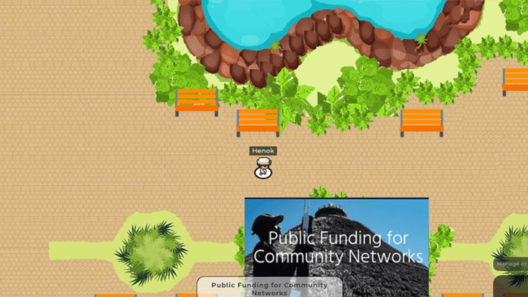
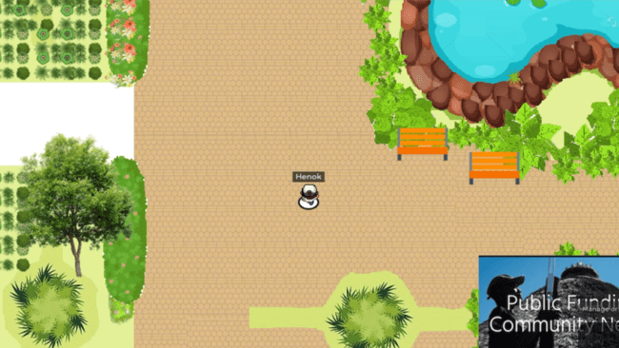
Virtual Social for Community Networks in Africa
How to move
Use LEFT and RIGHT arrow key to move left and right.
Use the UP and DOWN arrow key to move up and down inside the platform.

Slide 6
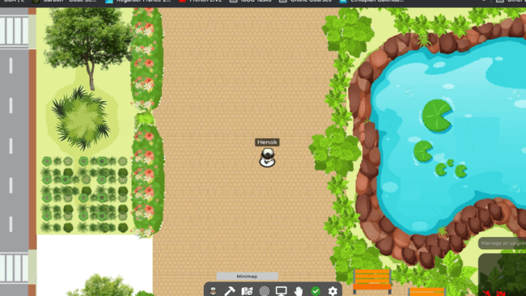
Virtual Social for Community Networks in Africa
How to orientate
Find the mini map of the place by clicking the map icon (the 3rd item in the menu) from the middle-bottom of the screen.
It shows the map of the entire virtual space in a simple view.

Slide 7
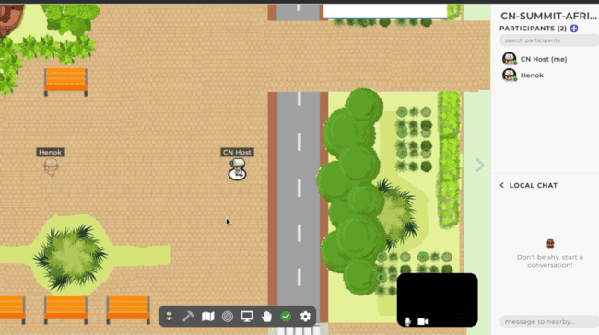
Virtual Social for Community Networks in Africa
How to connect with other participants
As you get closer to others, you automatically get connected.
You can see their camera view and hear their audio.
They will be able to see and hear you as well.

Slide 8
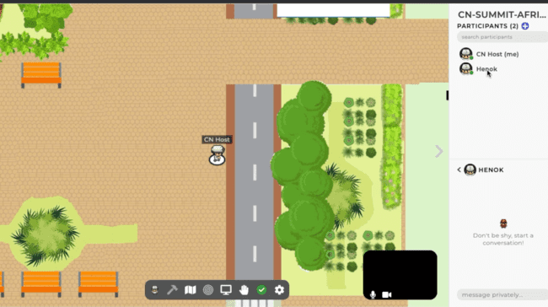
Virtual Social for Community Networks in Africa
How to chat/find other participants
How to chat: you can use global chat (goes to all people in your map), local chat (goes to the people you are currently video chatting with) or send a direct message to a participant. All features are in the right sidebar.
How to locate someone: find a person in the Participants list, click the name and click blue ‘Locate’ button. To stop locating, click red ‘Stop locating’ button in the same sidebar.

