Slide 1




2.5GHz Rural Tribal Priority Window
LTE Networks and 2.5GHz Spectrum Channels
Closes on Wednesday, September 2nd, 2020 at 6PM EDT.

Slide 2

Agenda
Background - Networks & Spectrum
A Call to Action - The FCC Tribal Priority Window
First Steps - Qualification Details
The Process
Resources for you and your Tribe

Slide 3

Networks & Spectrum

Slide 4

A Spectrum License is both a Resource and an Asset
Spectrum is a very valuable piece of the Digital Divide Puzzle. Corporations spend massively in auctions to obtain spectrum. Tribes now have a very short window to obtain spectrum over their Rural Tribal Lands for free.
Exercising your Tribal Sovereignty to control this resource brings options…
Establish or enhance a broadband network
Leverage to obtain service
Lease
Trade
Sell

Slide 5
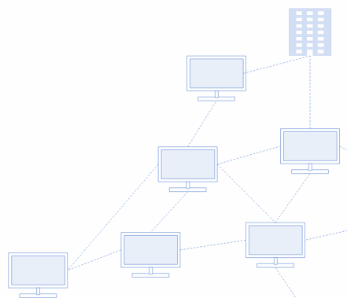
Networks are a powerful tool to serve Tribal Communities and support development, education, healthcare, or public safety--and provide revenue as an internet service provider.
Building a wireless network could be easier than you think.
Networks can be as simple as connecting two locations, or as complex as connecting every Tribal Community, Building, and Home. Networks can be Fully Administered by a Tribe, or owned and leased to a third party to provide services.
You need access to spectrum before you build a wireless network. Just like you need to access the land before you build roads.

Slide 6
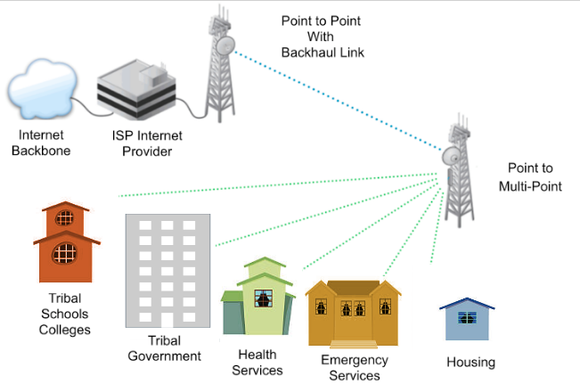
Building or Enhancing Tribal Infrastructure
Methods of Connecting Tribal Services:
Point to Point with Backhaul link
ISP Internet Service Provider
Internet Backbone
Point to Multi-Point
Network Base Connecting
Tribal Schools, Colleges
Tribal Government
Health Services
Emergency Services
Housing
Tribal Casinos
Gyms, Community Centers
Leasing of Spectrum
Monies earned by leasing Spectrum

Slide 7

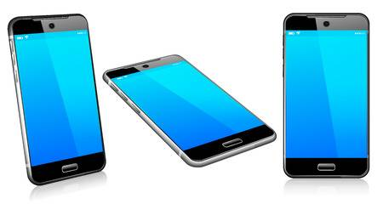
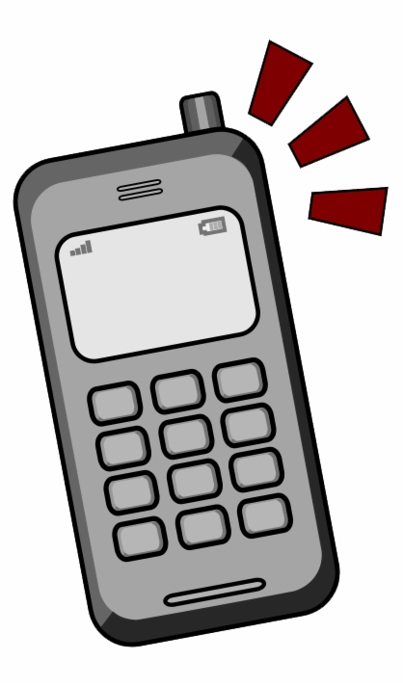

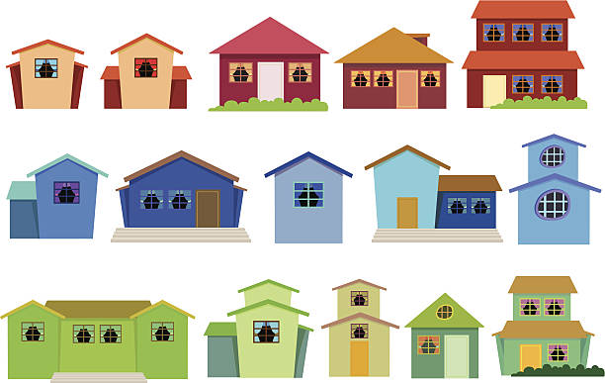
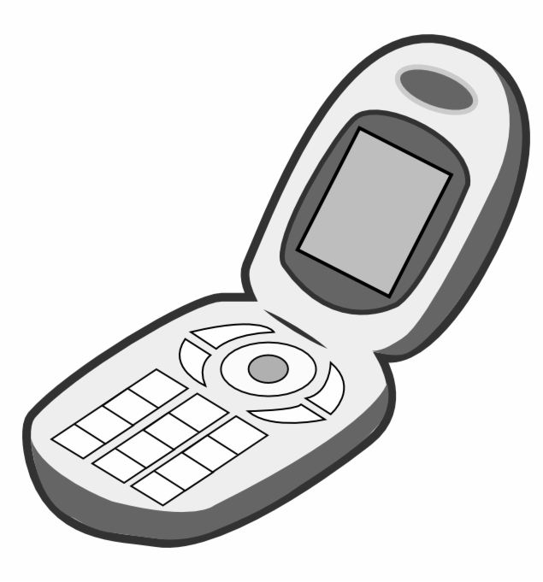
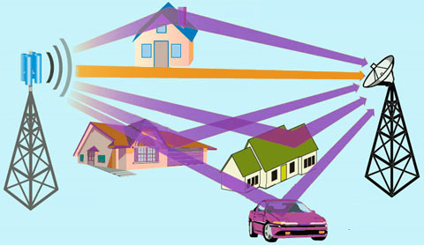
It could eventually grow...
Notes:
Stop thinking about this as a consumer, and more like the Operator.

Slide 8

The Tribal Priority Window - ACT NOW

Slide 9
The FCC is about to auction valuable spectrum to the highest bidder.
The first ever Tribal Priority Window,
for broadband spectrum over rural Tribal Lands is available, for free to Tribes only.
Apply NOW.
Deadline: September 2, 2020
Notes:
The FCC is about to auction off valuable spectrum that has been unavailable to public corporations for over 20 yrs. Tribes have a very short window now to exercise sovereignty to claim that spectrum for free before private interests have the opportunity to bid on it. Window closes 3 August, 2020. If you don’t apply, and secure spectrum now, you’ll have to rely on someone else who controls spectrum if you ever hope to provide a network. there will be plenty of time to figure out what to build and how, but none of that matters if you don’t secure the spectrum.

Slide 10
Key Benefits of a WiFi Spectrum Network
Tribal Government Services
Emergency Services - Law Enforcement, Fire, Medical Services
Health Services
Medical Health Equipment communicating with a doctor
Educational Online Learning - Distance Learning
Electronic Mail
Internet Service Provider
Public Transportation

Slide 11
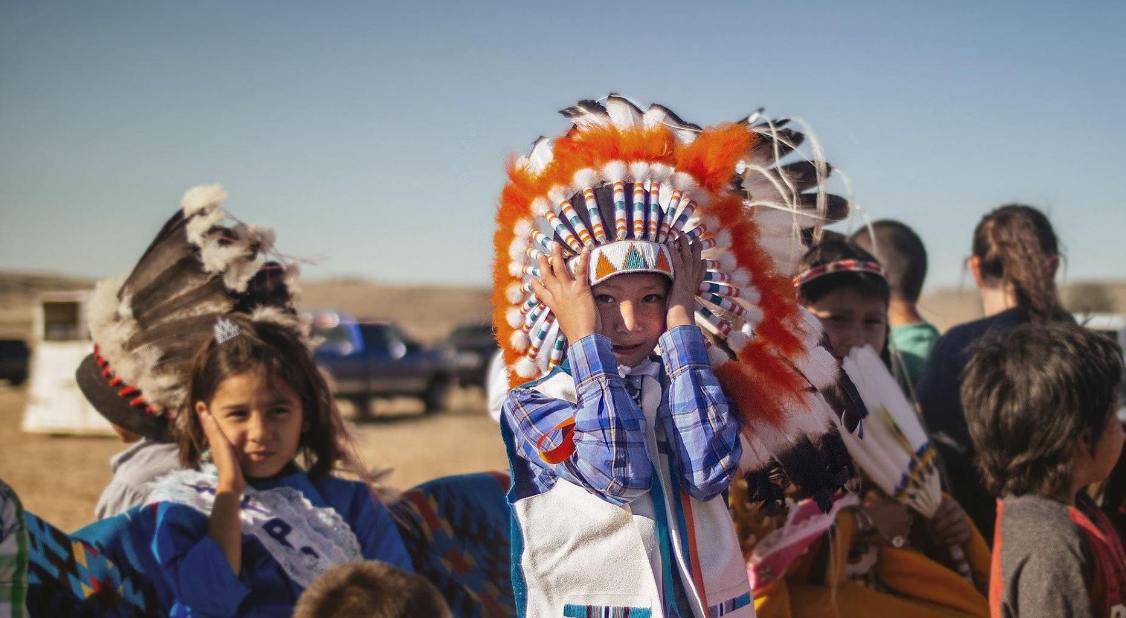
Qualifying Details

Slide 12

Eligible Tribal Entities Requirement
Who can apply?
Any Federally Recognized Tribe or Alaska Native Village
A Consortium of Federally Recognized Tribes and/or Alaska Native Villages
An Entity “majority-owned” and controlled by a Federally Recognized Tribe or Alaska Native Village. Entity must provide sufficient documentation to demonstrate such ownership and control. For more, read: Public Notice DA20-18 from the Rural Tribal Window, FCC.gov. #16/17
Does not include Alaska Regional Corporations, or other Entities owned by Tribal Members as individuals
2.5 GHz Rural Tribal Priority Window

Slide 13
Eligible Tribal Lands Requirement
A Federally Recognized Tribe’s Reservation, Pueblo, or Colony
A former Reservation in Oklahoma
An Alaska Native Region established pursuant to ANCSA (85 Stat.688)
An Indian allotment
A Hawaiian Home Land, pursuant to the Hawaiian Homes Commission Act
Off-reservation lands if designated as “Tribal land” by the FCC as of July 10, 2019
2.5 GHz Rural Tribal Priority Window

Slide 14
Rural Requirement
Applicants are required to demonstrate that all of the Tribal land for which they are applying is rural
Spectrum availability is limited to the unassigned spectrum on rural Tribal Lands
Rural Tribal Lands = not part of an urbanized area with a population of 50,000 or more
Use of an unmodified Commission-provided shape file to define the applicant’s proposed service area will be “prima facie”(accepted as correct until proved otherwise) evidence that the service area is rural
  Unless the shape file shows the existence of an urbanized area or urban cluster within the Tribal land
2.5 GHz Rural Tribal Priority Window

Slide 15
Local Presence Requirement
If the applicant is a Tribe, the Tribe is presumed to have a Local Presence on its own lands
Tribal Entity applicants must demonstrate and explain their Local Presence in each Tribal Land for which they are applying by ...
  they physically occupy those lands, residents live in these areas
  they provide goods or services over the Eligible Tribal Land
In Alaska, Local Presence outside ANCSA can be demonstrated by showing Community connection to those Lands
Local Presence in a smaller area does not automatically demonstrate Local Presence throughout a larger area
Applicants applying for multiple Tribal Lands, must demonstrate Local Presence in each separate Tribal Land
2.5 GHz Rural Tribal Priority Window

Slide 16
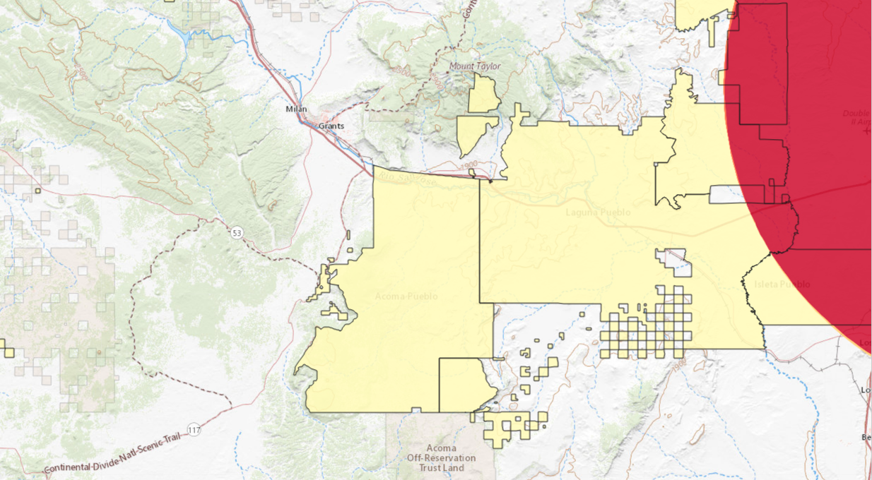
Overlay Licenses
If you get the license…
Tribe will immediately to be able to operate in the areas of your land where someone else does not have a license.
If another license holder in your land cancels or defaults on their license, that license goes automatically to you.
Channel Selection
Applicants may apply for 1, 2, or all 3 channels, as long as there is some unassigned spectrum in each channel for which you apply.
Goto: https://www.fcc.gov/25-ghz-rural-tribal-maps
Query Tribe and verify Channels are not all red (unavailable)
2.5 GHz Rural Tribal Priority Window

Slide 17
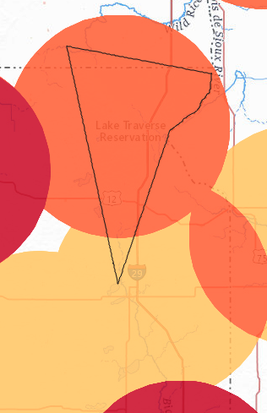
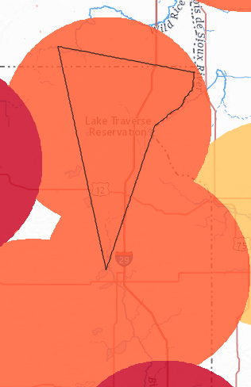
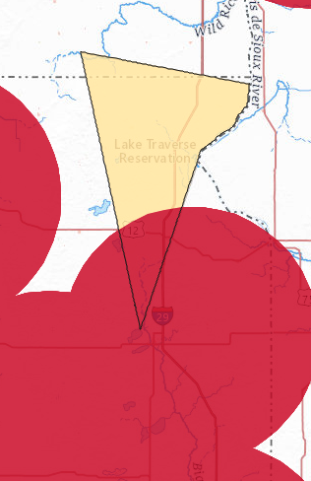
Sisseton Wahpeton Oyate
(Lake Traverse Reservation)
Channel 1
Channel 2
Channel 3
2.5 GHz Rural Tribal Priority Window

Slide 18
Waiver
A Waiver is required if an applicant wants to request, for example, a different Land area for the License. The FCC has established the Eligible Tribal Lands areas, and any changes must be requested via a Waiver. Waivers must be submitted with the Application.
If you are considering a Waiver request, Consult an Attorney.
Requests for Waiver must contain a statement of reasons sufficient to justify a Waiver
Applicants should provide detailed information about their specific Tribal need, and provide the best, most complete story of how the Waiver will be in the public interest.
A Waiver request should be filed as an exhibit attachment to the application
Waiver requests will be considered pursuant to the FCC’s waiver rules
There is no guarantee of Waiver Approvals, and may be unlikely.
2.5 GHz Rural Tribal Priority Window

Slide 19
Mutual Exclusivity
If there are two applications filed for spectrum over the same Tribal Land area, it becomes Mutually Exclusive, and neither is awarded the license.
90 Day Settlement Window will occur after the Tribal Priority Window closes on August 3rd, 2020
If the mutually exclusive applications are unresolved after the 90 day window, the FCC will auction off the spectrum to the highest bidder, in a limited Tribal parties-only auction.
If you recognize this may occur, it's best to reach out and begin discussions
right now to resolve before closing of the Tribal Priority Window.
2.5 GHz Rural Tribal Priority Window

Slide 20
Build-out Requirements
 | After 2 years... | After 5 years...
Mobile or Point-to-multipoint Service | 50% of the population in your license area must be covered | 80% of the population in your license area must be covered
Fixed Point-to-point Service | 20 links per million (one link per 50,000) | 40 links per million (one link per 25,000)
Broadcast Service | 50% of the population in your license area must be covered | 80% of the population in your license area must be covered
Consequence | final deadline speeds up, you will be required to meet final requirements in year 4 | You will lose the license
2.5 GHz Rural Tribal Priority Window

Slide 21
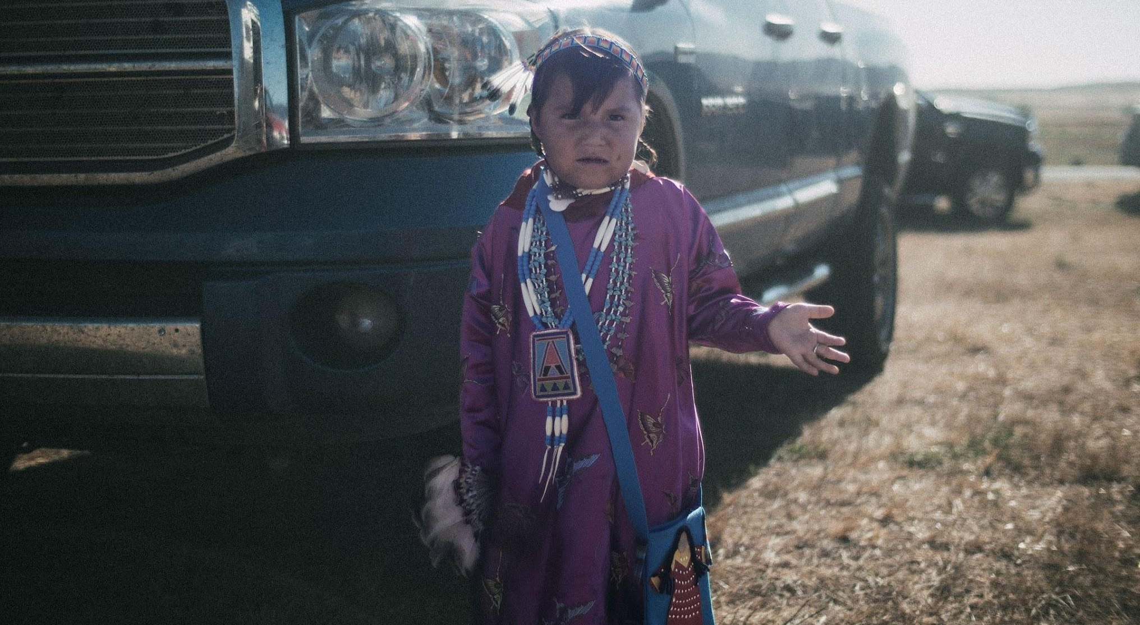
Process

Slide 22
What to Expect
Decide
Assess spectrum availability
Identify & Educate Tribal Authority
Coordinate Competing Claims
Authorized Signatory
Planning & Feasibility
Use case, needs assessments, funding options
Network Security
Policy, security, and administration needs
2025 (5 yr)
Network construction 80% complete
2 Sept 2020
Tribal Window closes
Tribal Priority Window
Deployment Period
Apply
Apply for FRN (Username and password for access to FCC)
Submit Form 602 (Ownership Disclosure Information)
Create Shapefile
Submit Form 601
2023 (2yr)
Network construction 50%
complete
Network Design
Detailed Network Design partner, costs, and plan

Slide 23
Process
Application Window
Deployment Period
Verify Spectrum available over Tribal Lands
  https://www.fcc.gov/25-ghz-rural-tribal-maps
Tribal Leaders/Tribal Councils must designate Authorized Signatory
Tribes must apply for FRN Username and Password for submission
Tribes must submit Form 602 Ownership Disclosure Information
Are there other Entities who are applying for Spectrum over land?
  If so, begin discussion with them to coordinate and avoid overlapping claim
  If not, complete application
Shape File for Tribal Lands
Applications and Exhibits (supporting documents); Due by September 2nd, 2020
Notes:
overall timeline
Discuss (available spectrum, competing demand and coordination, decision makers)
apply (preparing, submitting)
planning & feasibility (defining use case, network and land assessment, defining business case) -grants and funding
network design (hardware, administration)
construction
network security

Slide 24
Requirements
What do you need?
Determine what License Channels are available.
Prove you are a Federally Recognized Tribe or an Eligible Entity Owned & Controlled by a Tribe or group of Tribes
Prove that the Land is Rural*
Prove you are providing Service on/to the Land
Prove that you have Local Presence in the Land
*The FCC provided shape files will establish this proof, if accurate enough to leverage during application.

Slide 25
FCC.gov Application
FRN - Register for an FCC Number (Username and Password) then log in
Form 602 - Ownership Disclosure Information
  Each applicant must have a current FCC Form 602 Ownership submitted
Form 601 - Rural Tribal Window Application
  Applicants are required to file an attachment demonstrating they meet each of the requirements to obtain a License
  Statement for Local Presence, “Tribal Government, Tribal Services and Members exist on this Tribal land”
  Select all available Channels
  Shapefile for Tribal Lands
  Eligibility support
  Name and Title of the Authorized Signatory party to sign
  Waiver (if necessary)
Notes:
if you see all red, don’t bother.

Slide 26

Resources
FCC.gov
http://fcc.gov
FCC - Rural Tribal Window
https://www.fcc.gov/25-ghz-rural-tribal-window
FCC - How to File
https://www.fcc.gov/25-ghz-rural-tribal-window-how-file
FCC - Rural Tribal Maps
https://www.fcc.gov/25-ghz-rural-tribal-maps
Email FCC at
RuralTribalWindow@fcc.gov
Volunteer support (Amerind/GAIN)
RuralTribalWindow2020@gmail.com

Slide 27
Appendix

Slide 28
Waiver Suggestions
A Waiver is your opportunity to tell your story to the FCC and explain your unique circumstances.
Provide specific background and sufficiently detailed information about the Tribe or Tribal entity
  Such as the Tribe’s History, connectivity challenges, etc.
Specifically explain why the FCC’s rules should not apply in your case. What are your special circumstances?
  Narrowly tailor your reasons for the Waiver to your special circumstances.
  Explain why granting the Waiver would be in the “Public Interest”
    Why is the 2.5 GHz License important to the Tribe?
    How will it expand connectivity and benefit the community?

Slide 29
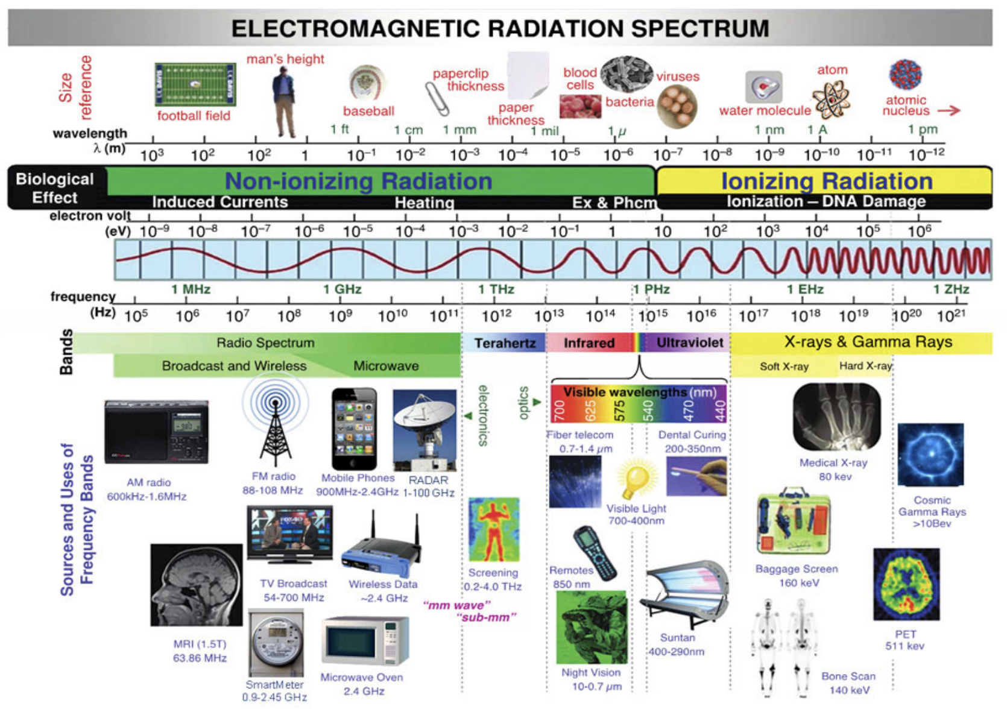
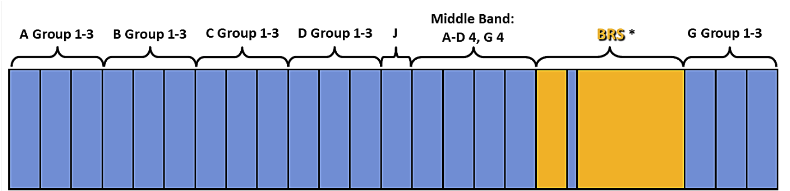
2.5GHz Spectrum channels for Priority and Auction.
Spectrum in Scope
Tribes can claim that spectrum for free when...
Federally Recognized Tribe or Alaska Native Village
On Rural Tribal Land 117.5 MHz of Available - 1 @ 50.5MHZ, 1 @ 49.5, 1 @ 17.5MHz
The Window closes September 2nd, 2020.
If you don’t apply, and secure spectrum now, someone else will buy it.
*BRS is the Broadband Radio Service; spectrum shown in yellow is not available as part of this window
Notes:
The FCC is about to auction off valuable spectrum that has been on reserve for over 20 yrs. Tribes have a very short window now to exercise sovereignty to claim that spectrum for free before private interests have the opportunity to bid on it. Window closes 3 August, 2020. If you don’t apply, and secure spectrum now, you’ll have to rely on someone else who controls spectrum if you ever hope to provide a network. there will be plenty of time to figure out what to build and how, but none of that matters if you don’t secure the spectrum.

Slide 30
FCC Listing of Channel Groups
Groups: D, JA, JB, JC, JD Channel: 1,2,3 Total Spectrum 50.5MHz Part 2
Channel Block | Frequency Band
D1 | 2551.50 - 2557.00
D2 | 2557.00 - 2562.50
D3 | 2562.50 - 2568.00
JA1 | 2568.00 - 2568.33
JA2 | 2568.33 - 2568.66
JA3 | 2568.66 - 2569.00
JB1 | 2569.00 - 2569.33
JB2 | 2569.33 - 2569.66
JB3 | 2569.66 - 2570.00
JC1 | 2570.00 - 2570.33
JC2 | 2570.33 - 2570.66
JC3 | 2570.66 - 2571.00
JD1 | 2571.00 - 2571.33
JD2 | 2571.33 - 2571.66
JD3 | 2571.66 - 2572.00
Groups: A, B, C Channels 1,2,3 Total Spectrum 49.5MHz
Channel Block | Frequency Band
A1 | 2502.00 - 2507.50
A2 | 2507.50 - 2513.00
A3 | 2513.00 - 258.50
B1 | 2518.50 - 2524.00
B2 | 2524.00 - 2529.50
B3 | 2529.50 - 2535.00
C1 | 2535.00 - 2540.50
C2 | 2540.50 - 2546.00
C3 | 2546.00 - 2551.50
Groups: G, K Channels 1,2,3 Total Spectrum 17.6MHz
Channel Block | Frequency Band
G1 | 2673.50 - 2679.00
G2 | 2679.00 - 2684.50
G3 | 2684.50 - 2690.00
KG1 | 2615.00 - 2615.33
KG2 | 2615.33 - 2615.66
KG3 | 2615.66 - 2616.00
Groups: A, B, C Channel: 4 Total Spectrum 50.5MHz Part 1
Channel Block | Frequency Band
A4 | 2572.00 - 2578.00
B4 | 2578.00 - 2584.00
C4 | 2584.00 - 2590.00
D4 | 2590.00 - 2596.00
G4 | 2596.00 - 2602.00

Slide 31
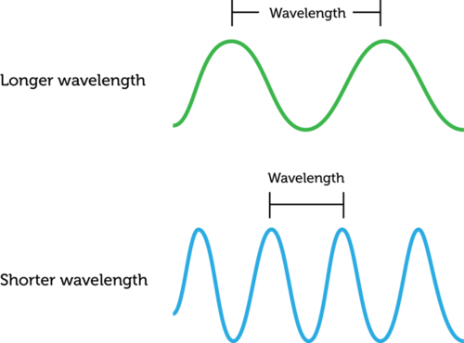
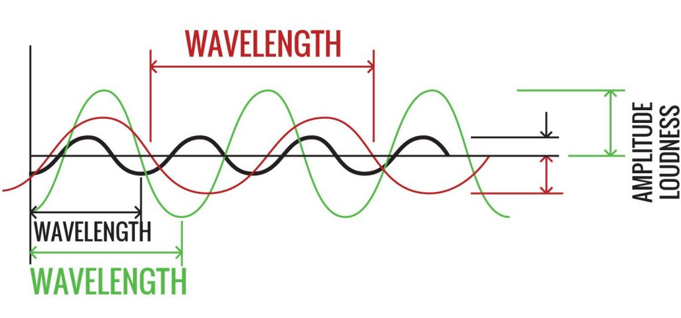

Radio Signals - airwaves for all wireless communication
Longer
Wireless signals are energy centered around a frequency
Frequency, measured in Hertz, is the number of cycles within a 1 second period
Energy is correlated to the square of the wave’s amplitude
Shorter
Notes:
too much

Slide 32
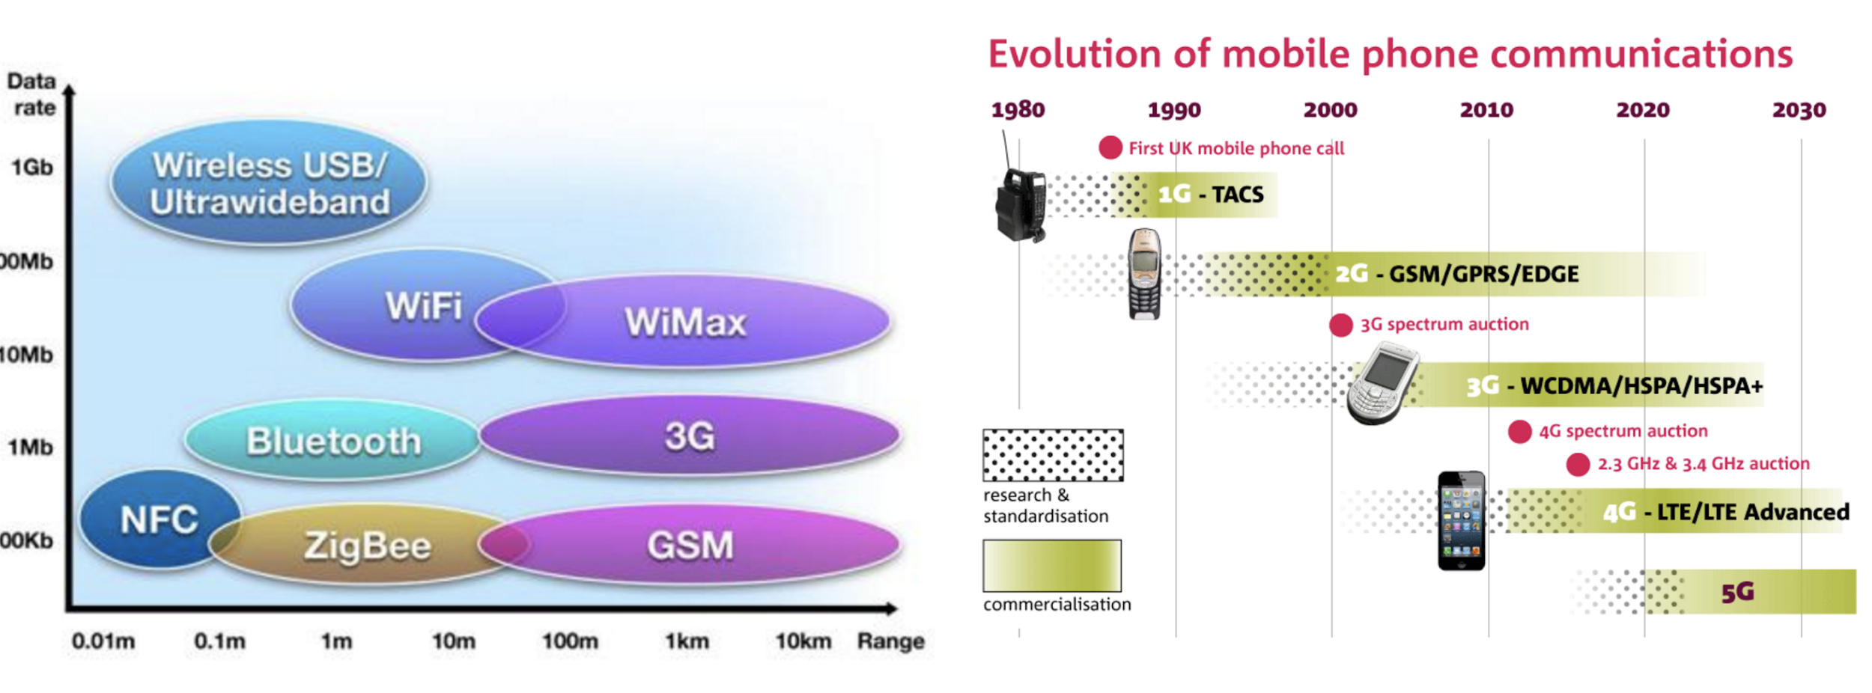
Technologies combine spectrum and transmission schemes

Slide 33
Radio
Signals

Slide 34
Build-out Requirements
Mobile or Point-to-Multipoint Service:
Year 2: 50% of the population in your license area must be covered
Year 5: 80% of the population if your license area must be covered
Fixed Point-to-Point Service:
  Year 2: 20 links per million (one link per 50,000)
  Year 5: 40 links per million persons (one link per 25,000)
Broadcast Service:
  Year 2: 50% of the population in your license area must be covered
  Year 5: 80% of the population in your license area must be covered
Build-out requirements not met:
  Year 2 requirements not met: your final deadline speeds up, you will be required to meet the requirements by year 4.
  Year 5 requirements not met: you will lose the License.
2.5 GHz Rural Tribal Priority Window

