Slide 1

What can Ethiopia learn from Kenya ICT Landscape
Bitange Ndemo
University of Nairobi

Slide 2
The Beginning: ICT Policy Objectives
Infrastructure
Content, Innovation and applications
Capacity Development
Public Private Partnership
Employment Creation

Slide 3
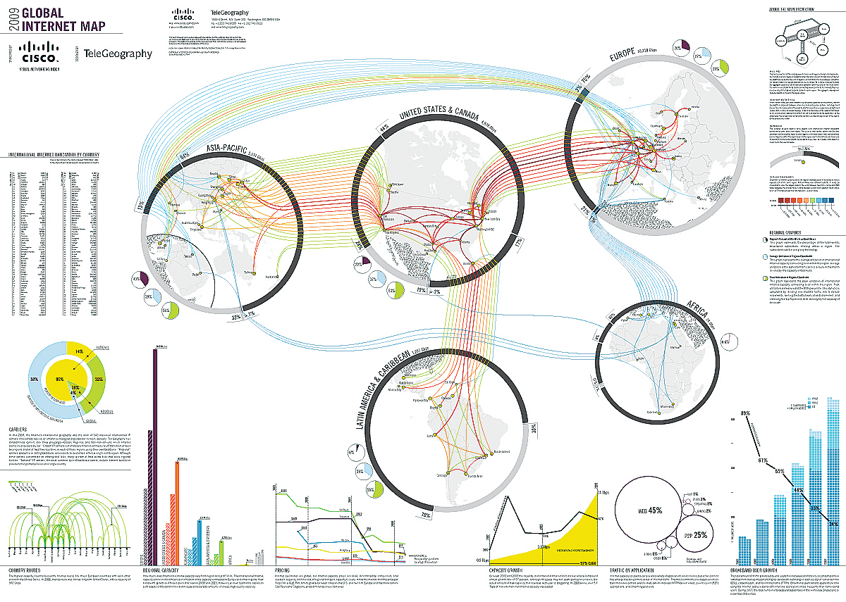
What inspired us
Notes:
3

Slide 4
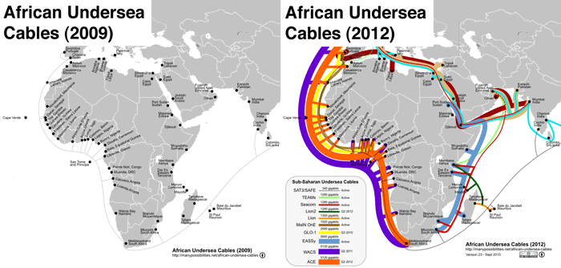
The start of digital transformation

Slide 5
National Optical Fiber Backbone Infrastructure (NOFBI)
Lokichoggio
Ethiopia
Mandera
Lodwar
Moyale
577
Eastern
912
Marsabit
Wajiir
Kitale
Uganda
Rift Valley
Somalia
__
Weybuye
Eldoret
Central region
70
Nyahururu
Nanyuki
Isielo
Coat and North Eastern region
Kakamega
Meru
North Eastern
129
Western
Nakuru
Nyeri
318
Kisumu
Embu
Telkom Kenya Network
Muranga
321
Garissa
Nyanza
Central
Thika
Makau
Mwingi
Kisii
Kericho
Tala
Kitui
Western Region
Rongo
Bomet
Nairobi
159
82
501
770
Isebania
Narok
Kaljiado
159
Coast
Garsen
INDIAN OCEAN
Namanga
Malindi
Kilifi
Mobasa
Tanzania

Slide 6
Incentives that Changed the Country
Subsidized broadband to all Universities (public and private through KENET)
Subsidized acquisition of laptops to University Students
Developed Rural Digital Centers
Subsidized operators to provide rural last-mile broadband infrastructure
Kenya Open Data Initiative

Slide 7
Early Outcomes
Several Innovation and incubator Hubs have come up;
Several mobile applications commercialized;
Digitalization of Public sector starts – Lands Ministry shows promise;
Improved Agricultural productivity (mshamba, Icow etc);
Global research institutions moving into Kenya
Evidence of internal efficiencies and Governance – Huduma Centers

Slide 8
Impact of the interventions
Broadband use soared and prices tumbled
New Applications, e.g. Mobile money spread across the country
Online enterprises increased
Number of Kenyans in the Social Media soared

Slide 9
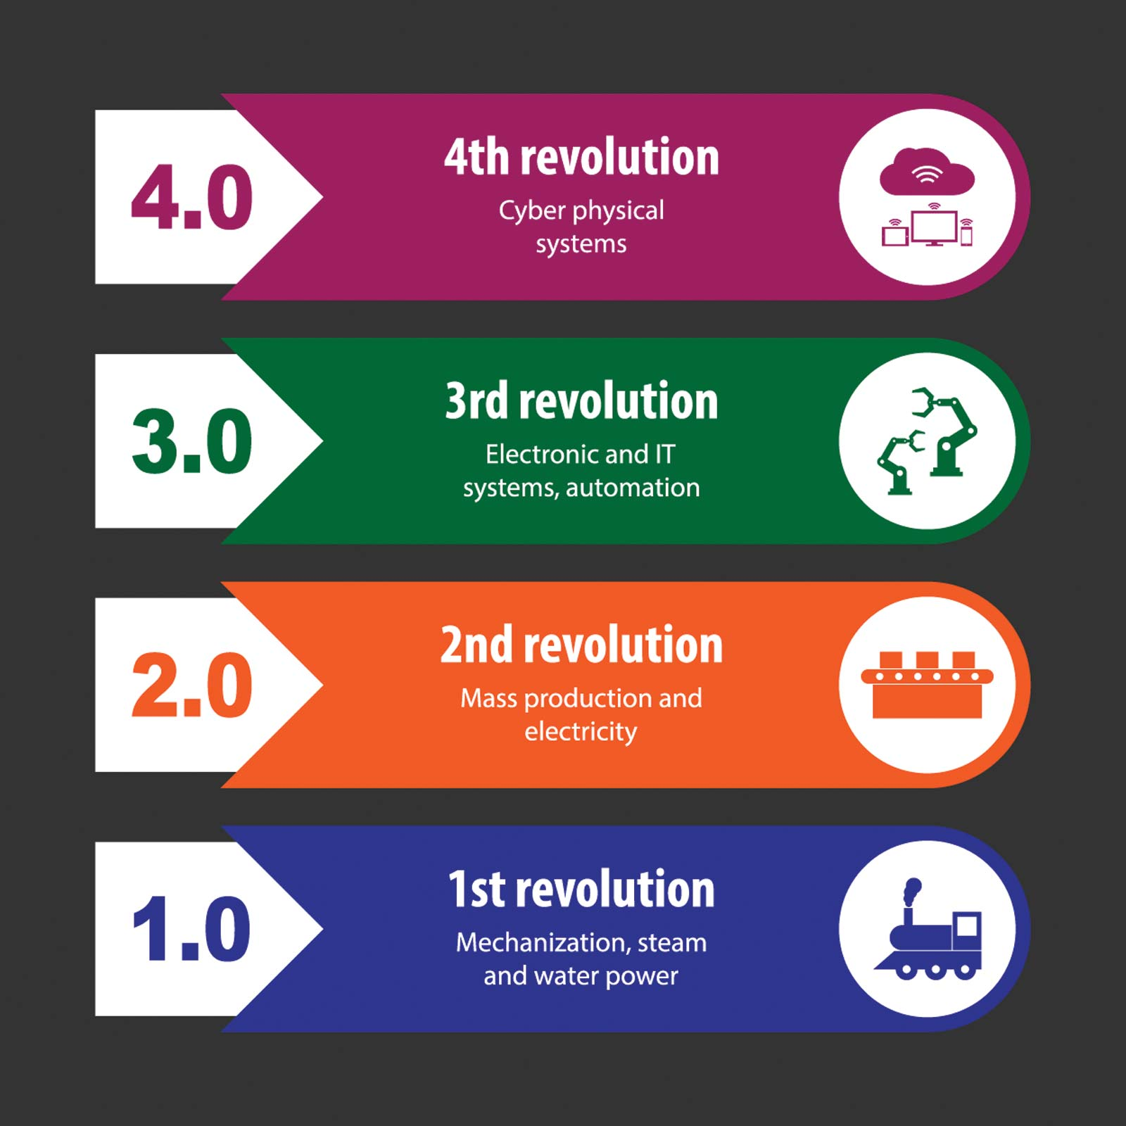
Industrial Transformations

Slide 10






Fourth Industrial Revolution Technologies

Slide 11
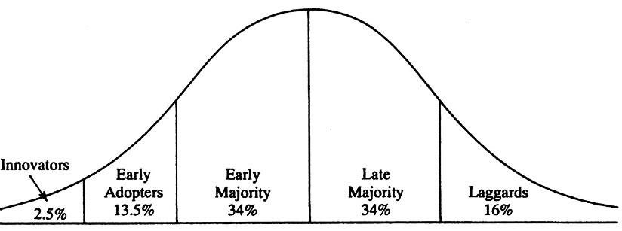
Innovation Adoption Waves
Internet
1990s
Mobility
2000
Blockchain
2018
Mobile Platforms
Social Media Platforms
Cryptography
Cryptocurrency
Disruptive Solutions
Search Engines
Web browsers

Slide 12
Thank You
“If you can dream it, you can do it.”
Walt Disney
Notes:
In Slide Show mode, click the arrow to enter the PowerPoint Getting Started Center.

