Slide 1
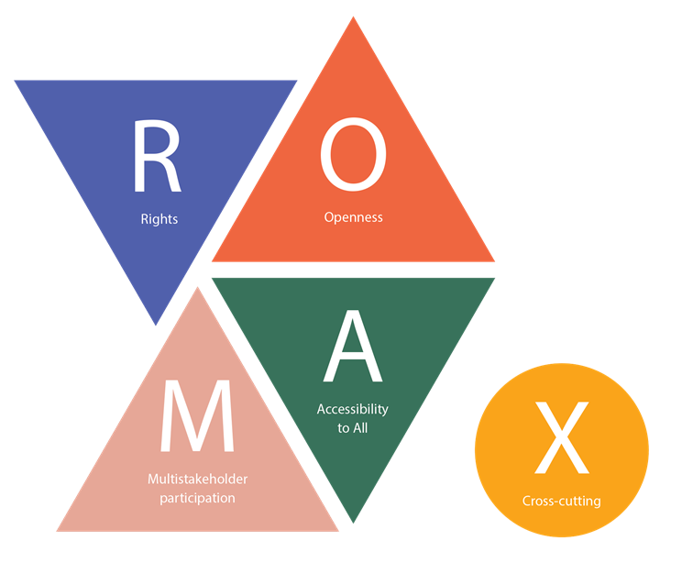
Internet Universality Indicators
Assessing Internet Development in your country!
By Lydia Gachungi,
Regional Adviser on Freedom of Expression,
UNESCO Liaison Office to AU and UNECA
Email: L.gachungi@unesco.org
Notes:
Start by thanking the ISOC, APC-Association for Progressive Communications- an international network of civil society organisations
Over three years, UNESCO has developed a internationally recognized research tool for conducting national assessments of Internet development, international standards, - Internet Universality Indicators (IUIs), that has been arrived at through a global, open, inclusive, and multistakeholder process
Why? To support Member states to \achieve evidence-based policy reform through supporting national assessments using the Internet Universality Indicators
As with other UNESCO indicator frameworks, the new Internet instrument is a way (1) to take scientific stock of the situation in a given country, and then (2) to use the findings to recommend specific changes to address internet problems and achieve SDGs

Slide 2
PRESENTATION OUTLINE
Genesis of Internet Universality
What are the Internet Universality Indicators (IUIs) and how were they developed
What are their relevance to improving the Internet ecosystem at the county level
Importance of the Universality Indicators framework
Categories of the IUIs
Application
Ongoing assessment, highlights of emerging issues and recommendations from countries that have applied the IUIs

Slide 3
Genesis of the UNESCO’s Internet Universality Indicators
In 2013, UNESCO initiated a consultative research on the concept of Internet universality.
The concept was based on four (ROAM) principles -pillars underpinning the growth and evolution of the Internet.
R – that the internet be based on human Rights
O – that it is Open
A – that it is Accessible to all,
M – that it is nurtured by Multistakeholder participation
X- Cross cutting issues
Concept was approved in 2015 by the UNESCO General Conference
Notes:
UNESCO recognizes these four “pillars” underpin the growth and evolution of the Internet, fundamental to the development of the Internet, in ways that are conducive to achieving the Sustainable Development Goals.
Known as the ROAM principles, these hold out an Internet that respects human Rights, is characterised by Openness, is Accessible to all, and is governed in a Multistakeholder way.
This concept was approved in 2015 by the UNESCO General Conference, and served as a basis for creating indicators appropriate to measure the universality of the Internet. The background was the need to strengthen these principles because the Internet was increasingly directly involved in all human affairs.

Slide 4
What are Internet Universality ROAM-X Indicators
A set of 303 indicators that aim to assess how well national stakeholders, including governments, companies, and civil society perform in adhering to the ROAM principles of Rights, Openness, Accessibility, and Multi-stakeholder participation.
Notes:
UNESCO recognizes these four “pillars” underpin the growth and evolution of the Internet, fundamental to the development of the Internet, in ways that are conducive to achieving the Sustainable Development Goals.
At national level, these indicators aim to assess achievement and gaps of Internet development and policies via an inclusive multi-stakeholder methodology.
Known as the ROAM principles, these hold out an Internet that respects human Rights, is characterised by Openness, is Accessible to all, and is governed in a Multistakeholder way.
This concept was approved in 2015 by the UNESCO General Conference, and served as a basis for creating indicators appropriate to measure the universality of the Internet. The background was the need to strengthen these principles because the Internet was increasingly directly involved in all human affairs.

Slide 5
Development of the UNESCO’s Internet Universality Indicators
developed from 2015 and endorsed in Nov 2018 (IPDC)
303 indicators, divided into the four categories, plus cross cutting category
21 contextual indicators
55 Rights indicators.
57 Openness indicators
70 Accessibility to All indicators
21 Multistakeholder approach indicators
79 Cross cutting indicators (X)
Notes:
Partners such as APC- The Association for Progressive Communications
Of these, 109 are identified as the core indicators for basic-level assessments of national Internet contexts.
It also includes 79 cross-cutting Indicators (category X) concerning gender and the needs of children and young people, sustainable development, trust and security, and legal and ethical aspects of the Internet.
Both the full set and the core set gather quantitative, qualitative and institutional indicators

Slide 6
Importance of the Internet Universality Indicators
IUI is a holistic tool to assess the state of Internet development in a given country,
Enables new insights, and evidence-based policy improvements
Present a comprehensive and substantive understanding of the national Internet environment and policies;
Assess their alignment to the R.O.A.M. principles and their contribution to sustainable development;
Develop policy recommendations and practical initiatives that will enable the country to improve their Internet ecosystem as advanced ICTs evolve
Notes:
The Internet Universality ROAM-X Indicators framework is a set of 303 indicators that aim to assess how well national stakeholders, including governments, companies, and civil society perform in adhering to the ROAM principles of Rights, Openness, Accessibility, and Multi-stakeholder participation.
Reason: The ROAM-X indicators framework is a unique and powerful resource which is relevant to all countries, whether developed or developing, to gain a holistic diagnosis of its Internet policies, digital environment and thereby the structural causes of digital inequalities.
The outcome of the assessment does provide insights and options for actions that trigger fruitful policy discussions, and thereby help bring the Internet in different a step closer to universality and relevance to sustainable development
The framework of indicators was designed to be applied through carrying out concrete research on the concept of Internet universality at the country level.
This framework is intended to assist governments and stakeholders who wish to assess their national Internet environment voluntarily, as a means to enable the formulation of evidence-based public policies.
With this term, UNESCO refers to four big principles that form the ROAM framework: we stand for an Internet that is based on human Rights; that is Open, Accessible to all, and nurtured by Multistakeholder participation.

Slide 7
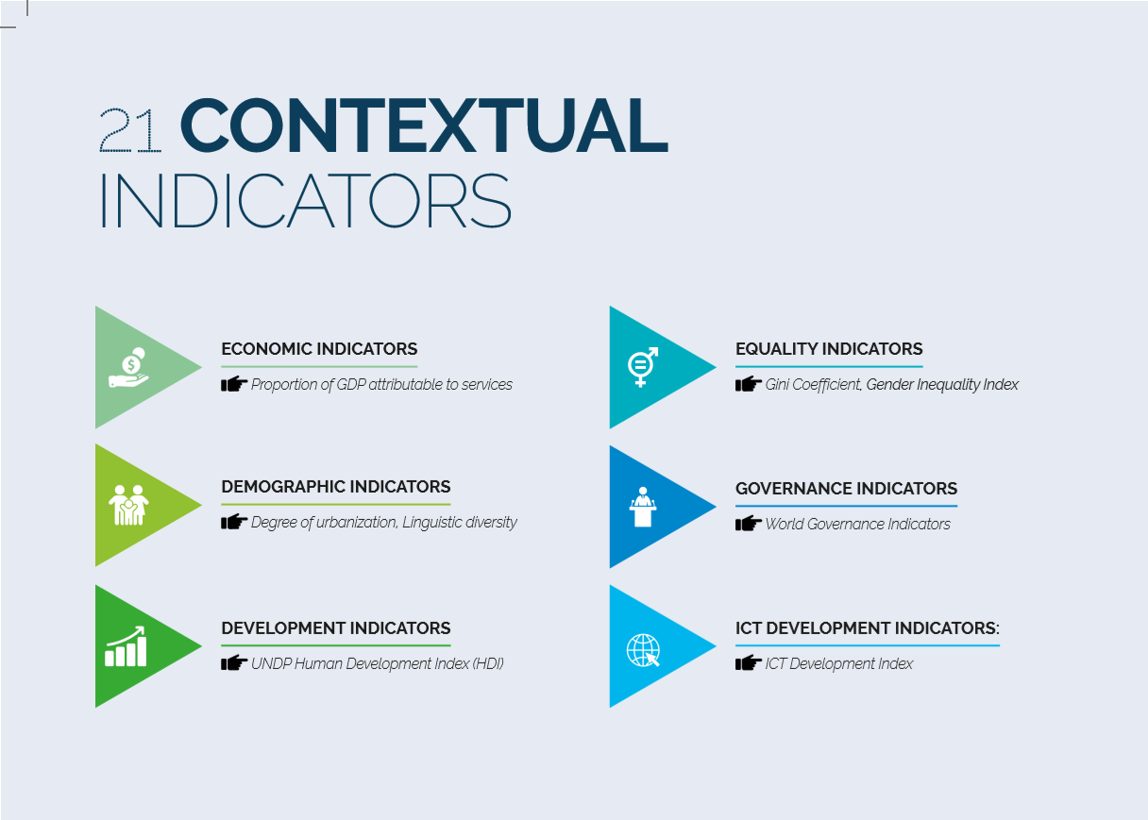

Slide 8
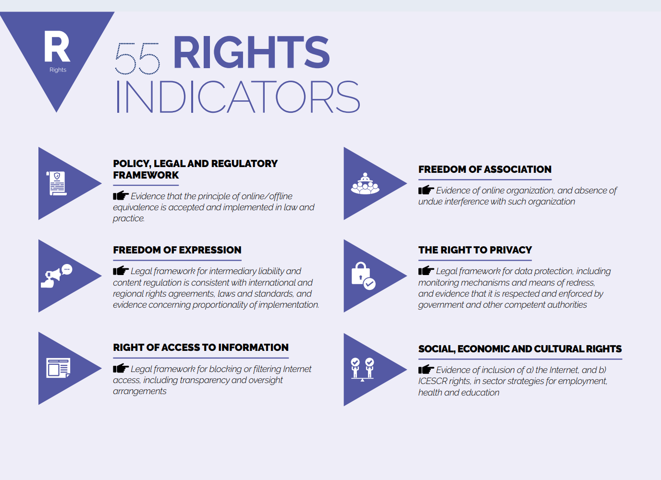
Access to information
Legal framework for blocking or filtering Internet access, including transparency and oversight arrangements

Slide 9
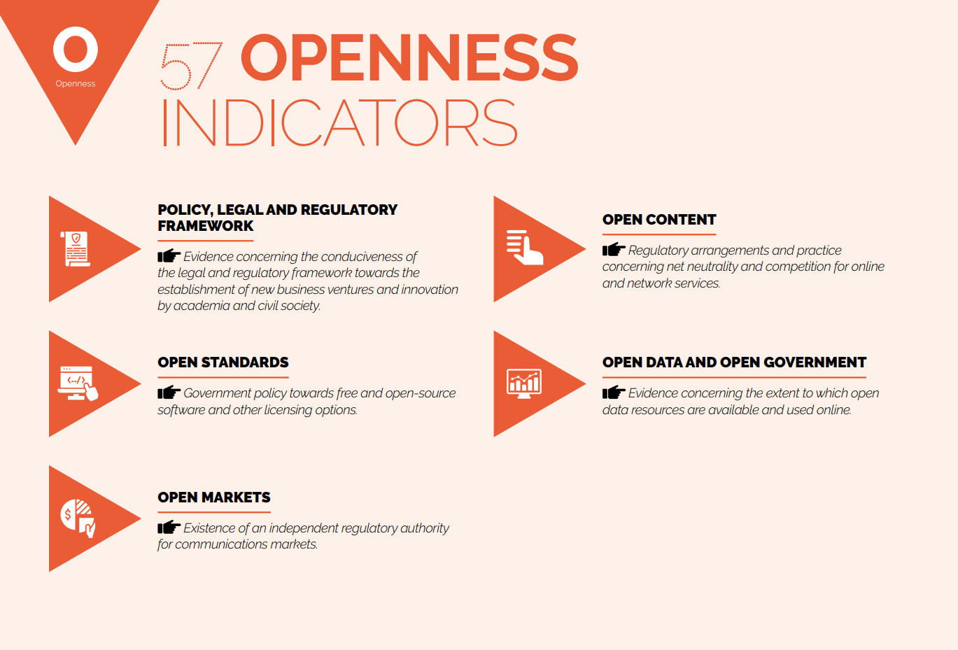

Net neutrality
Regulatory arrangements and practice concerning net neutrality and competition for online and network services
“Users have the right to access, disseminate the information and legal content of their choice.”
- Electronic Communications Code (Article 25)

Slide 10
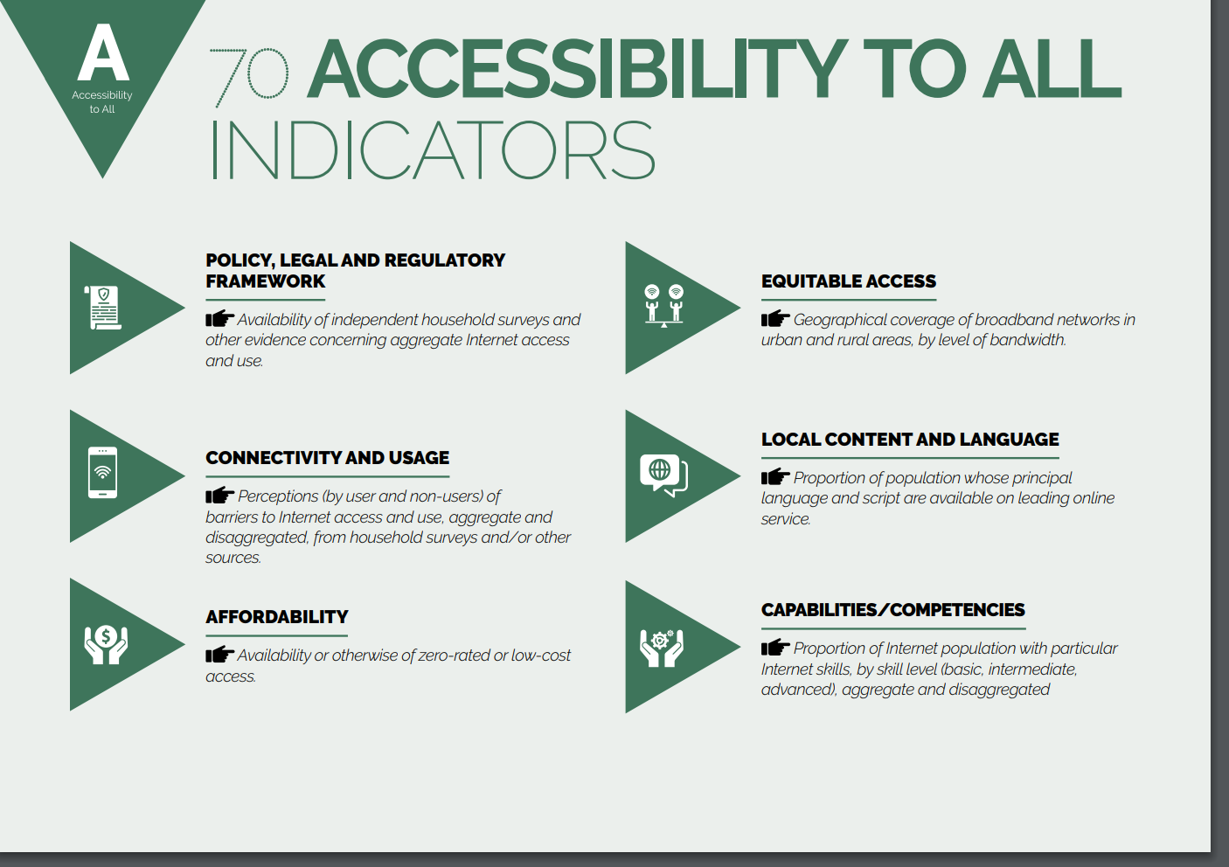

Slide 11
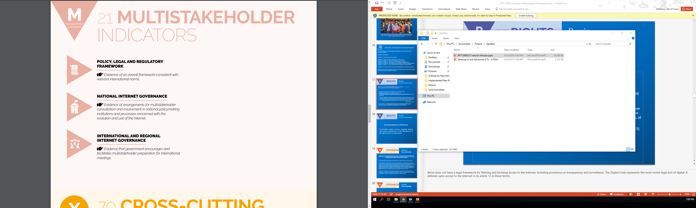

Slide 12
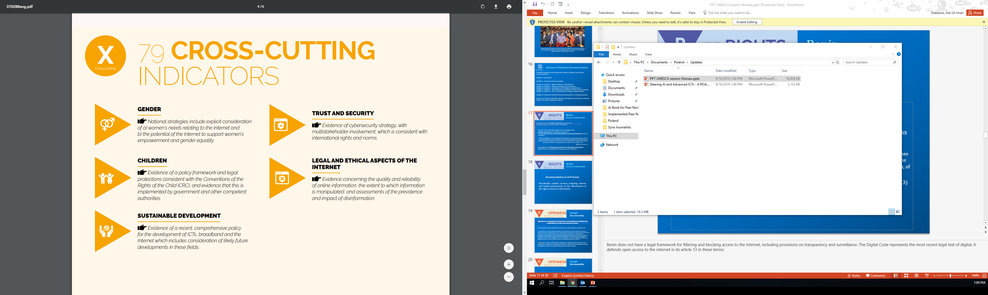

Slide 13

Methodology: 8 Action Steps
Establishing a Multistakeholder Advisory Board
Building a collaborative research team
Developing a research action plan
Data gathering
Data analysis
Report-writing and recommendations
Organizing a national validation multistakeholder workshop
Impact assessment and monitoring

Slide 14
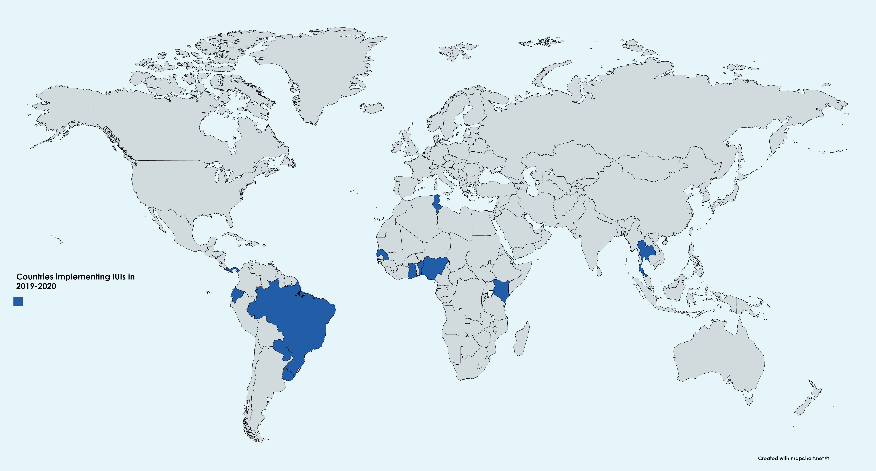
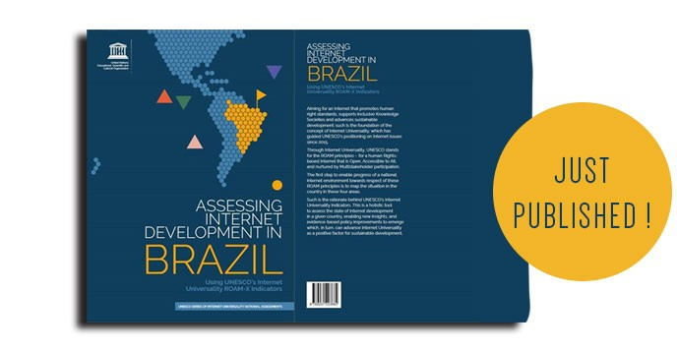
Ongoing national assessments
Bénin, Brazil, Ghana, Ecuador, Nepal, Kenya, Sénégal, Paraguay, Sudan, Serbia, Thailand, Tunisia, Uruguay
Notes:
All countries that have begun research as of today (MAB created, Research kicked off), 12 indeed.
Benin, Senegal, Kenya, Ghana, Tunisia, Thailand, Brazil, Paraguay, Uruguay, Ecuador, Serbia, Nepal.
---------------------------------------------
All countries under discussions, with Sudan to kick off 2020, more than a dozen.
Nigeria, Jordan, Sudan, South Korea, Pakistan, Peru, Germany, France, Bulgaria, Poland, Sweden, Slovenia, South Africa, etc.
Brazil report was just published!

Slide 15
Examples of Emerging issues: Case of Kenya
Emerging findings
Rights - Laws and policies provide widely for human rights. However, implementation of key policies and legislation remains a challenge
Openness - Access to information, lack of standards and weak legislation still a challenge.
Accessibility - Cost of internet, devices, access to networks and language barriers still a challenge.
Multistakeholder - weak engagement, weak policy or legislative framework & lack of standards for engagement still a challenge
Cross-cutting Issues - implementation of policies and laws, capacity of relevant institutions is a challenge.

Slide 16
Recommendations highlight on Rights based: Case of Kenya
Government Establishment of the office of the Data Protection Commissioner to ensure the protection of personal data.
Private sector should collaborate with other stakeholders including civil society to advance human rights within their operations.
Civil Society: They should work towards raising awareness of the public on their rights online.
Academia: should conduct more evidence-based research on the use and impact of technology on human rights in Kenya.
Media : They should monitor and report on the violations or abuses of human rights in the online context.

Slide 17
Recommendations : Case of Brazil
Government- Create an independent National Personal Data Protection Authority and a National Council for the Protection of Personal Data
Expand and improve policies for the preservation and promotion of cultural heritage online.
Guarantee full accessibility for persons with disabilities on government portals and public websites.
Private Sector: Monitor and report on governmental or judicial attempts to hold companies liable for content that infringes on third parties, in conflict with the Brazilian Civil Rights Framework for the Internet
Civil Society: Monitor and periodically report on violations of the rights supported by the Brazilian Civil Rights Framework for the Internet.
• Deepen and strengthen civil society participation, on a gender-sensitive basis, in multistakeholder processes of Internet governance.
Academia: Develop systematic research on new challenges to ensuring freedom of expression, access to information and privacy in the digital realm

Slide 18
To Note!
Because AI and other new technologies have been evolving within the ecosystem of the Internet, UNESCO believes that Internet Universality ROAM principles can serve as a well-grounded and holistic framework for stakeholders to help shape the design, application, and governance of AI.
UNESCO urges states to implement Internet Universality ROAM-X Indicators to measure human Rights, Openness, Accessibility and Multi-stakeholder participation and to thereby map and improve the ecosystem in which AI is developed, applied, and governed.

Slide 19
Improving the Net!
We can improve the Net by applying UNESCO’s Internet Universality R.O.A.M Indicators for evidence-based policy-making . How?
USE IUIs findings not only to assess and improve Internet policies at the national level, but also to foster digital collaboration at the international and regional levels.
Use the findings to recommend specific changes to address problems and achieve Internet development in your countries
Assess if our national Internet comes closer to the Internet Universality that contributes to sustainable development.

Slide 20
Way to Go!
Join the voluntary national assessments of ROAM-X indicators in your respective countries to bring about a better Internet for all!

Slide 21
General enquiries: internet.indicators@unesco.org
Internet Universality Indicators: https://en.unesco.org/internetuniversality
UNESCO Series on Internet Freedom: http://en.unesco.org/unesco-series-on-internet-freedom

