Slide 1
Ethiopia Successes and Failures Under Monopoly Regime- Implication to the Internet Development
Ethiopia Internet Development Conference 2020

Slide 2
Ingredients to achieve good Internet ecosystem– did we get them right?
Internet- Availability, Accessibility, Affordability, Ability, Awareness and QoS
Policies and regulation
Investment in Infrastructure – telecom and energy
Institutions, management, leadership
Local ICT sector entrepreneurship development
Research and Policy Influence – learning and adjustment

Slide 3
Ethiopia Communication Sector Development Phases
Pre – 1996 (Pre-Internet)
1996-2008 (Cash Cow)
2008-2018 (Let us Catch up period)
Post 2018 (break the rule and reform)

Slide 4
Pre-Internet
Self-satisfied incumbern with its achievement for over 100 years, since Menelik time
Low cost communication was introduced (PADISnet)
Bringing Internet to Ethiopia (BITE), and registration of the domain (.et)
Reform in Latin America, Asia and some countries in Africa – “ because there were more telephone in Manhattan than Africa” Telecommunications regarded as a luxury
Early use of low cost communication for social interaction

Slide 5
Cash Cow Era 1996 - 2008
Mobile services and Internet were introduced
Mobile regarded as cash cow thus no interest in reform
A series of policies were crafted to improve telecom sector
Five institutions were created
  Ethiopian Telecommunications Corporation – operator as public corporation
  Ethiopian Telecommunications Agency – regulator working for Ministry
  Ethiopian IT Development Agency – to promote a series of projects – woredanet, ethernet, agrinet, schoolnet, community access, e-government
  Ethiopian Broadcasting Authority – regulator for broadcast sector
  Information Network Security Agency -

Slide 6
Government policies and regulation
2007 | Proclamation No. 533/2007 – Broadcast Service Proclamation
2006 | Council of Ministers Regulation No. 130/2006 - Information Network Security Agency Establishment Council of Ministers Regulation
2004 | Council of Minister’s Regulation No. 99/2004
2003 | Proclamation No. 360/2003 – Ethiopian Information and Communication Technology Development Agency Establishment Proclamation
2003 | Proclamation No. 375/2003, Investment (amendment) Proclamation)
2003 | Council of Ministers Regulation No. 93/2003
2002 | Proclamation No. 280/2002
2002 | Proclamation No. 281/2002
1999 | Proclamation No. 178/1999 – Ethiopian Broadcasting Agency Establishment
1999 | Broadcasting proclamation N°187
1998 | Investment proclamation No 166/1998
1996 | Ethiopian Telecommunications Agency Proclamation 49/1996
1996 | Proclamation for the establishment of Ethiopian Telecommunications Corporation 10/1996

Slide 7
Institutional Arrangement
Prime Minister
Council of Ministers
Ministry of Capacity Building
EICTDA
Ministry of Transport and Communication
ETC
ETA/SRD
Ministry of Information
EBA
INSA

Slide 8
Pickup of of mobile sector, but slower than African average
Low Internet Innovation and growth

Slide 10
Implication of the cash cow period
Monopoly was unable to meet demand and track global growth
By 2006, the government began to look for resources to meet unsatisfied demand and network expansion and secured US$1.5 billion from the Chinese Exim Bank and engaged ZTE to rollout infrastructure
Plummeting ARPU resulted in lower revenue - cash cow was not achieved as desired
Government started to look for change of management of the operator
Limited improvement in ICT standing in global indices
Falling quality of service

Slide 11
Time to Change Period (2008-2018)
Infrastructure Investment US$3.1 billion loan – rolling out fiber across the country, mobile network expansion, introduction of 3G network, universal access to Kebeles/rural areas
Change of management and engagement of France Telecom to restructure Ethio Telecom
Establishment of Ministry of Communication and Information Technology
Ethio IT village
Expansion of bandwidth
Increased revenue

Slide 13
Comparison of Penetration in Recent Years
Country | ICT Development Index (2017) | Mobile penetration (2017) | Internet penetration (2017) | Fixed broadband penetration (2016)
Kenya | 2.91 (138th) | 94.3 % | 89.4% | 0.3
Sudan | 2.55 (145th) | 70.1% | 29.5% | 0.1
Egypt | 4.63 (103rd) | 106% | 48% | 5.2
Nigeria | 2.60 (143rd) | 84% | 51% | 0.01
Mali | 2.16 (155^{th)} | 127% | 65.3% | 0.03
Rwanda | 2.18 (153rd) | 75.5% | 33% | 0.2
China | 5.60 (80th) | 107% | 55.8% | 22.9
Ethiopia | 1.50 (170th) | 45% | 15% | 0.6

Slide 14
Pricing
Prices have dropped, but still high, considering income.
1GB Internet cost of US$3.5 was above the 2% of the target that was set by the ITU Broadband Commission

Slide 15
Quality of Service
Low quality Internet service
Frequent disruptions and shutdowns –disinformation and misinformation related violence, securing public safety and national security, preventing cheating during exams.
When security at stake “Internet is not water or Internet is air”, PM Abiy Ahmed…
Inadequate International bandwidth, which contributes to lower throughput – 70 Gbps in 2018 compared to 1150 Gbps in Kenya

Slide 16
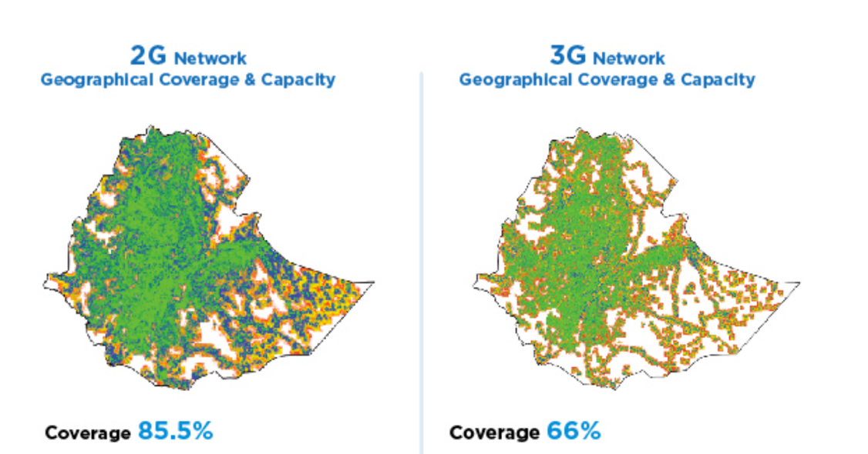
Implications of the catchup period
Substantial network rollout, but unable to catch up in terms of coverage, affordability and quality
Government debt at the expense of private investment
Shortage of foreign currency
Low access to electricity and handsets,
Safety and security of infrastructure.
Low level of applications and content

Slide 17
Reform Phase 2018-
In 2018, the PM announced the plans to liberalise the country's telecoms markets
In 2019, the Ethiopian Parliament passed a new telecom law, which saw the establishment of an independent communication regulator- the Ethiopian Communications Authority (ECA).
Efforts are also underway to partially privatise the incumbent public operator, Ethio Telecom and open the market to two new licenses during the first quarter of 2020.

Slide 18
Benefit of the reform is beyond earning foreign currency
Financial Inclusion
Economic Growth
Coverage and Information access and participation (access to information on health, education and democratic and political participation)
Innovation and efficiency gains
Local ICT sector growth
Foreign Direct Investment
wages, business operating surplus and taxes,
Productivity impact from increased access
Purchase of goods by and services
Jobs
Direct employment in the sector
Indirect employment for

Slide 19
Reform issues

Slide 20
Licensing of three operators
Refining draft licensing document based on feedback
Ensuring the participation of local ICT sector, potential grassroot community networks,
What specific license Tower Companies will be granted, if they want to operate?
What provisions will be there for alternative providers, like EEP, and Railway Corporation, if they want to enter the market.

Slide 21
Spectrum (and other scarce resources) management and fees
Assessing current use of spectrum by incumbent
Defining a flexible spectrum allocation that balances economic returns and also affordable communications
Decide on a method of award spectrum and value (fee)

Slide 22
Competition and Economic Regulation
What obligation should new entrants and Ethio Telecom should meet in terms of coverage, rollout target, how much they should contribute to universal service fund? Is the fund necessary?
How can they compete with each other – interconnect, set fees, access to Ethio Telecom Infrastructure?
How will the regulator address the SMP of Ethio Telecom?

Slide 23
Access to right of way
How can new entrants access to public and private land, at what cost?
What are the roles of local authorities?
What lessons can be learned from similar projects in terms claims and compensation payment of the land(e.g. railway)
Can new entrants ride on ET right of way?

Slide 24
Interconnection, Collocation and Infrastructure sharing
Access to alternative infrastructure (e.g. EEP infrastructure, railway infrastructure)
What point of interconnection, collocation and active and passive infrastructure sharing are available for entrants, at what cost?
Is ET ready and has fee schedule for collocation, interconnection and infrastructure sharing with two other licensees?

Slide 25
Universal access
What will be the goal of universal access (broadband supply/demand for content, applications and services)?
What is an optimum fee percentage to go to the universal fund
How can it be disbursed and to whom, (e.g. what will be the role of community networks)

Slide 26
Privatization of Ethio Telecom
What is the implication of privatisation –
    Positive in terms of innovation, QoS improvement, revenue,
    Negative – pricing and selling of public asset, workforce, morale

Slide 27
Regulatory capacity and legitimacy (not necessarily independent)
Staffed by experts from multiple fields
Fast track training and capacity building on economic and technical regulation- to build expertise
Assert authority (attain procedural legitimacy)
Transparent and seen on its web site doing the right thing (i.e. communicating)
Works with others with expertise and consults widely and show results
Deals with disputes through a robust appeal procedure

Slide 28
Conclusion
From optimism of the impact of communication in early 1990s, Ethiopia went through a period of stagnation, reflection and now back on track.
This has costed the country - economic growth, innovation,
The future is bright, but needs to be managed well through analysis of pros and cons, learning from failed experiences of other countries and the great things that happened.
The many unanswered questions during reform means that the new regulator needs capacity and legitimacy to function.

Slide 29
Thank you

