Slide 1
Africa Interconnection Economics
03-03-2020
  Michuki Mwangi
  Sr. Director Internet Technology & Development
    mwangi@isoc.org

Slide 2
How much should I pay for broadband access ?

Slide 3
Proximity

Slide 4
Internet interconnection cash flow
Global ISP
Global ISP
$
$
$
$
$
$
$
$
$
$
$
$
$
$
$
Global ISP
Global ISP
Regional ISP
Regional ISP
Regional ISP
Regional ISP
IXP
IXP
Access ISP
Access ISP
Access ISP
Access ISP
Access ISP
Access ISP

Slide 5
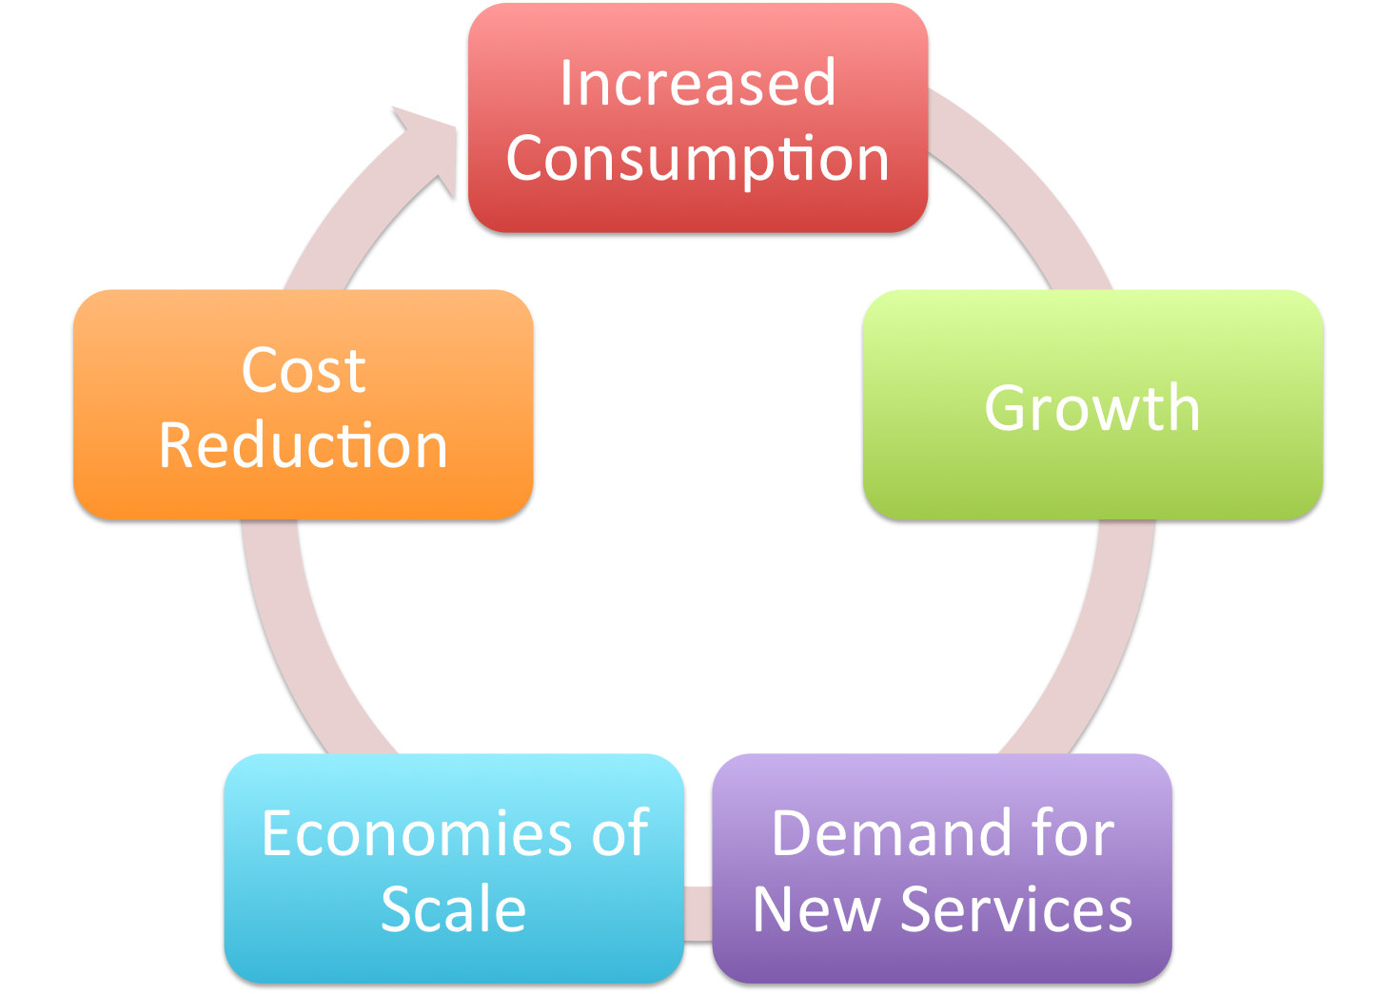
The Virtuous Cycle

Slide 6
Proximity factors

Slide 7
Connecting to the Edge of the Internet
INTERNET TRANSIT
7
Notes:
7

Slide 8
Internet Transit
Definition: Internet Transit is the business relationship whereby an entity provides (usually sells) access to the Internet.
"Internet → this way”
Definition: An Internet Service Providers (ISP), also called a “Transit Provider”, is an entity that sells access to the Internet.
8
Notes:
From a high level perspective, Internet Transit can be thought of as a pipe in the wall that says "Internet this way". The customer connects its network to the Internet Transit Provider and the Transit Provider does the rest.
8

Slide 9
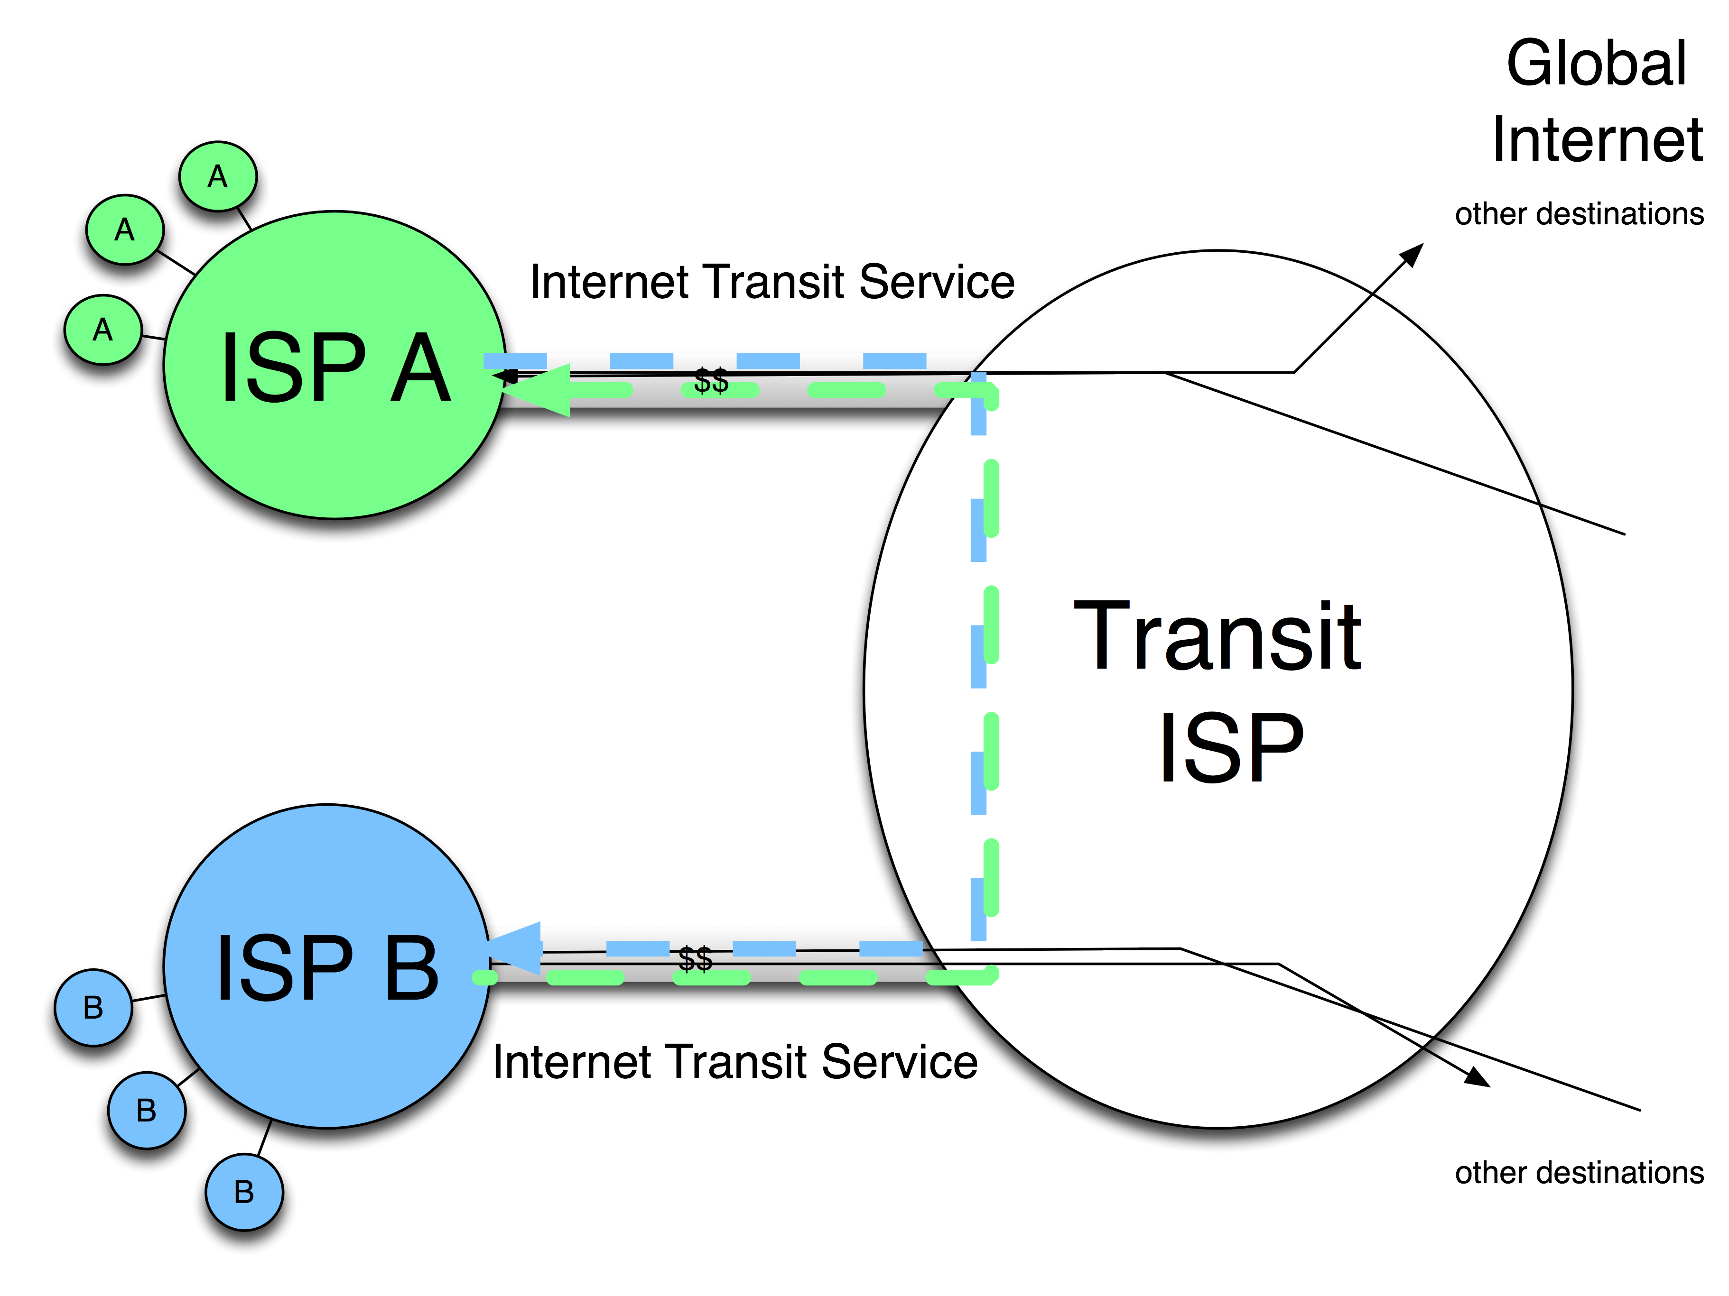
Internet transit
9

Slide 10
Connecting to the Core of the Internet
INTERNET PEERING
10

Slide 11
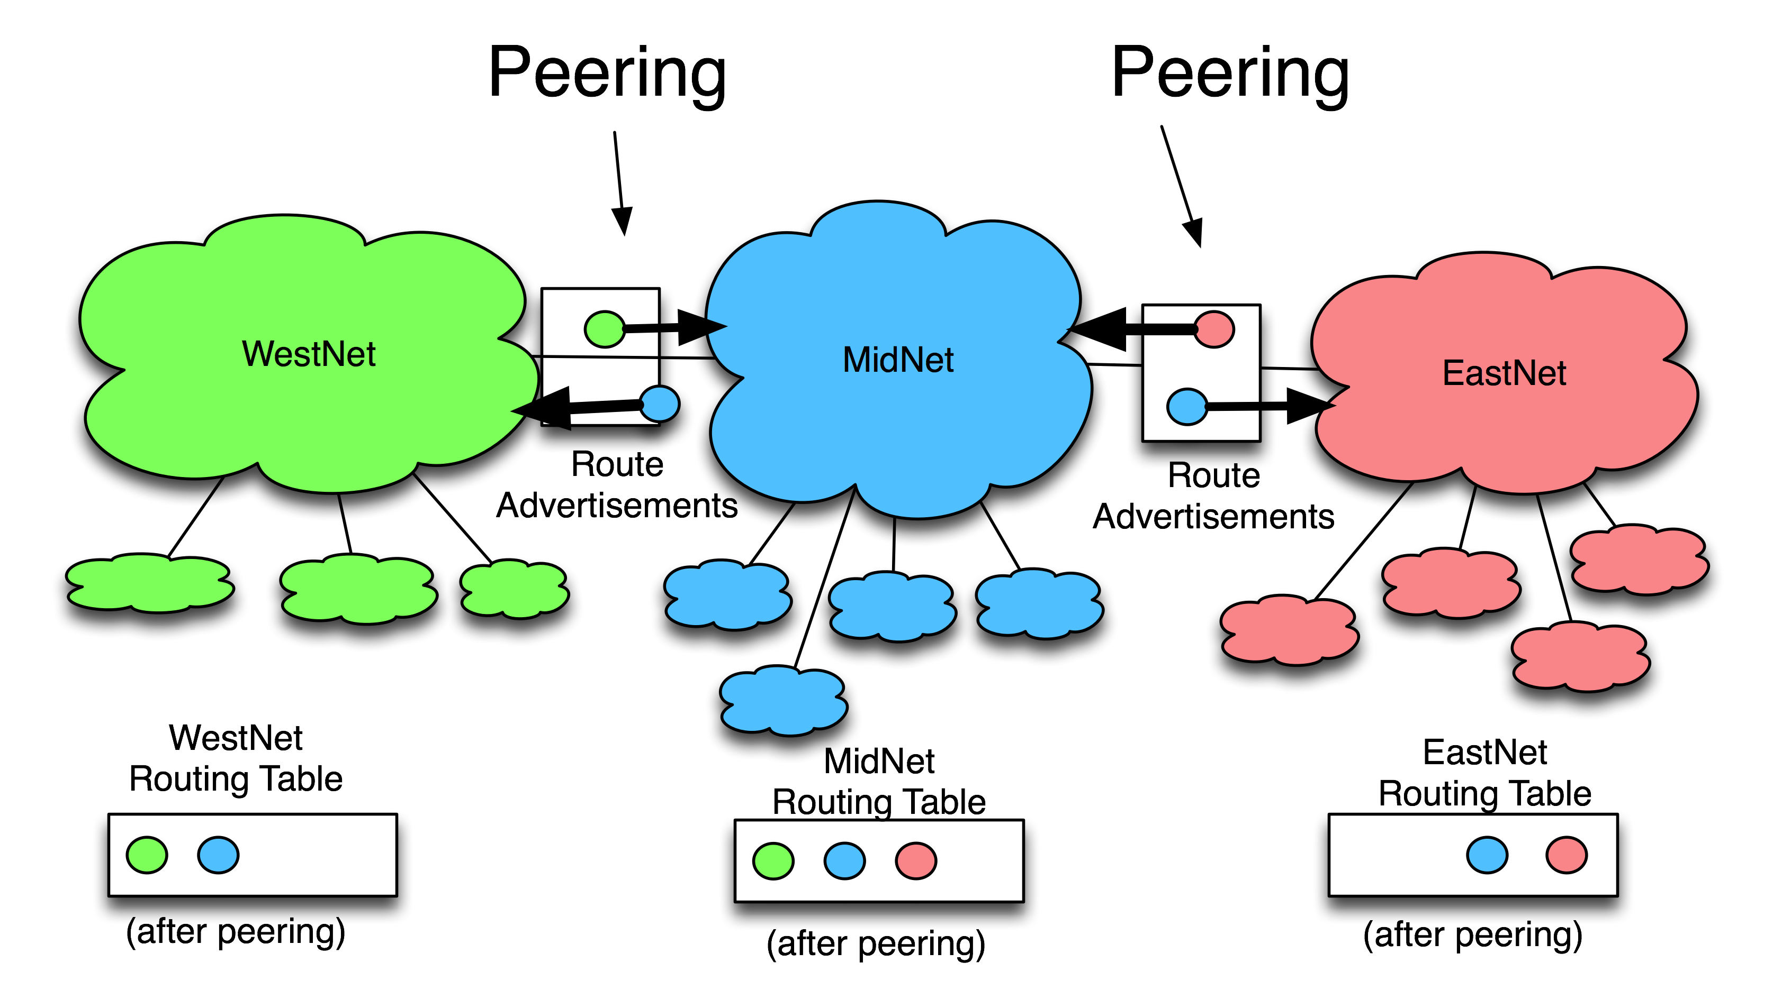
What is Internet Peering?
Definition: Internet Peering is the business relationship whereby two companies reciprocally provide access to each others’ customers.
11
Source: drpeering.net

Slide 12
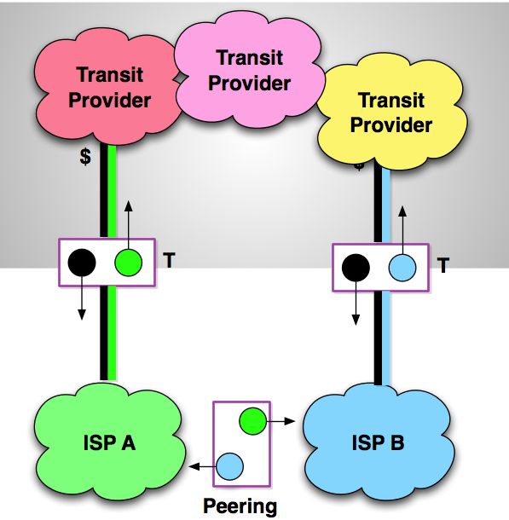
Transit and Peering Relationship
This is a simplified peering and transit business relationships
The relationships are important in developing interconnection strategies of Where to buy, sell and peer.
$T = Transit
P = Peering
$PP = Paid Peering
12
Source: drpeering.net

Slide 13
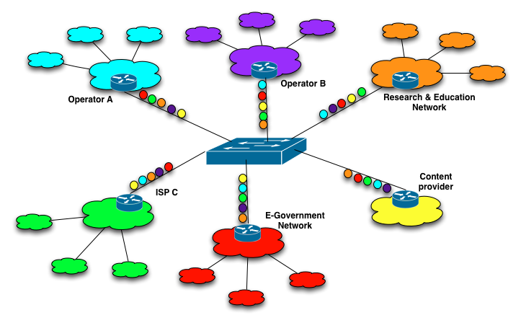
Internet Exchange Points (IXPs)
    Keep local Internet traffic within local infrastructure and reduce costs associated with traffic exchange between networks
    Improve the quality of Internet services and drive demand by reducing delay and improving end-user experience
    Create a convenient hub for attracting key Internet infrastructures within countries
    Act as a catalyst for overall Internet development including commercial, governmental and academic stakeholders

Slide 14
Resolving Proximity

Slide 15

Terrestrial Infrastructure

Slide 16
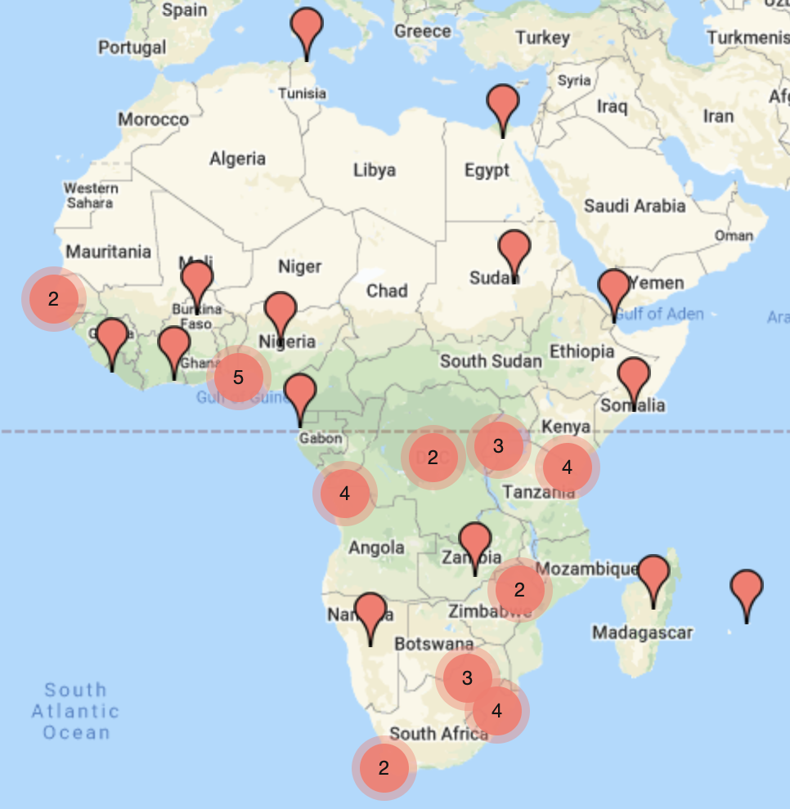
45 IXPs in 32 Countries or 113% increase since 2008
Total Traffic exchanged at African IXPs >400Gbps
More IXPs in West & Central Africa
Data shows more cross-border interconnection/peering in East and Southern Africa
Source: www.af-ix.net

Slide 17
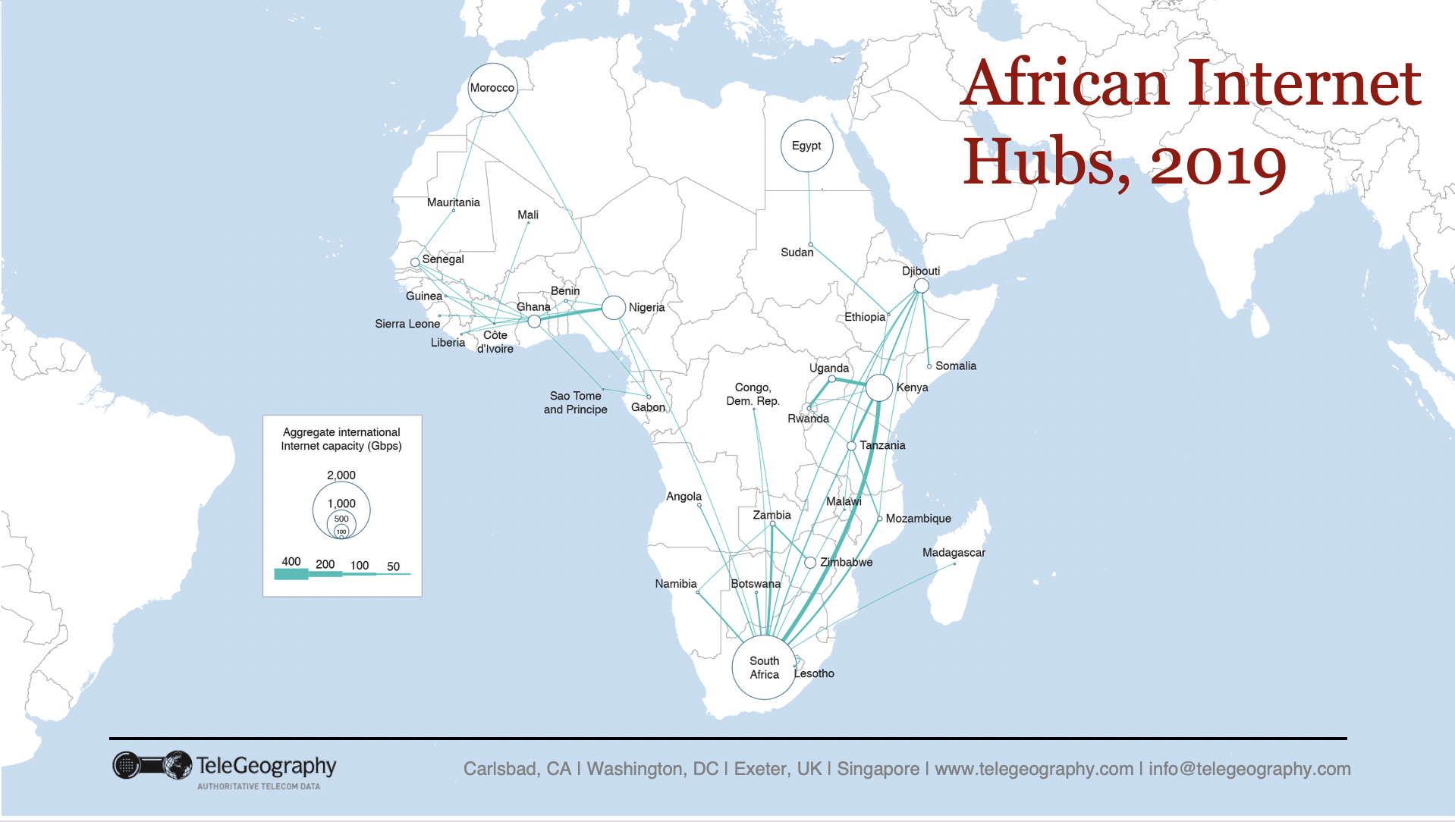
Source: Telegeography AfPIF-10

Slide 18

Hosting Infrastructure
Carrier neutral data centres (DCs) are key for the development of the local interconnection ecosystem
  DCs are ideal locations for public (IXP) and private interconnection (PNI)
  DCs facilitate local hosting
There is limited carrier neutral capacity available in Africa
  Majority of the white space is in South Africa
  Kenya, Nigeria, Djibouti and Morocco are upcoming with DC investments
Carrier neutral DCs emerge as a result of favorable market environment i.e competitive terrestrial fibre, competing networks, an IXP, etc

Slide 19
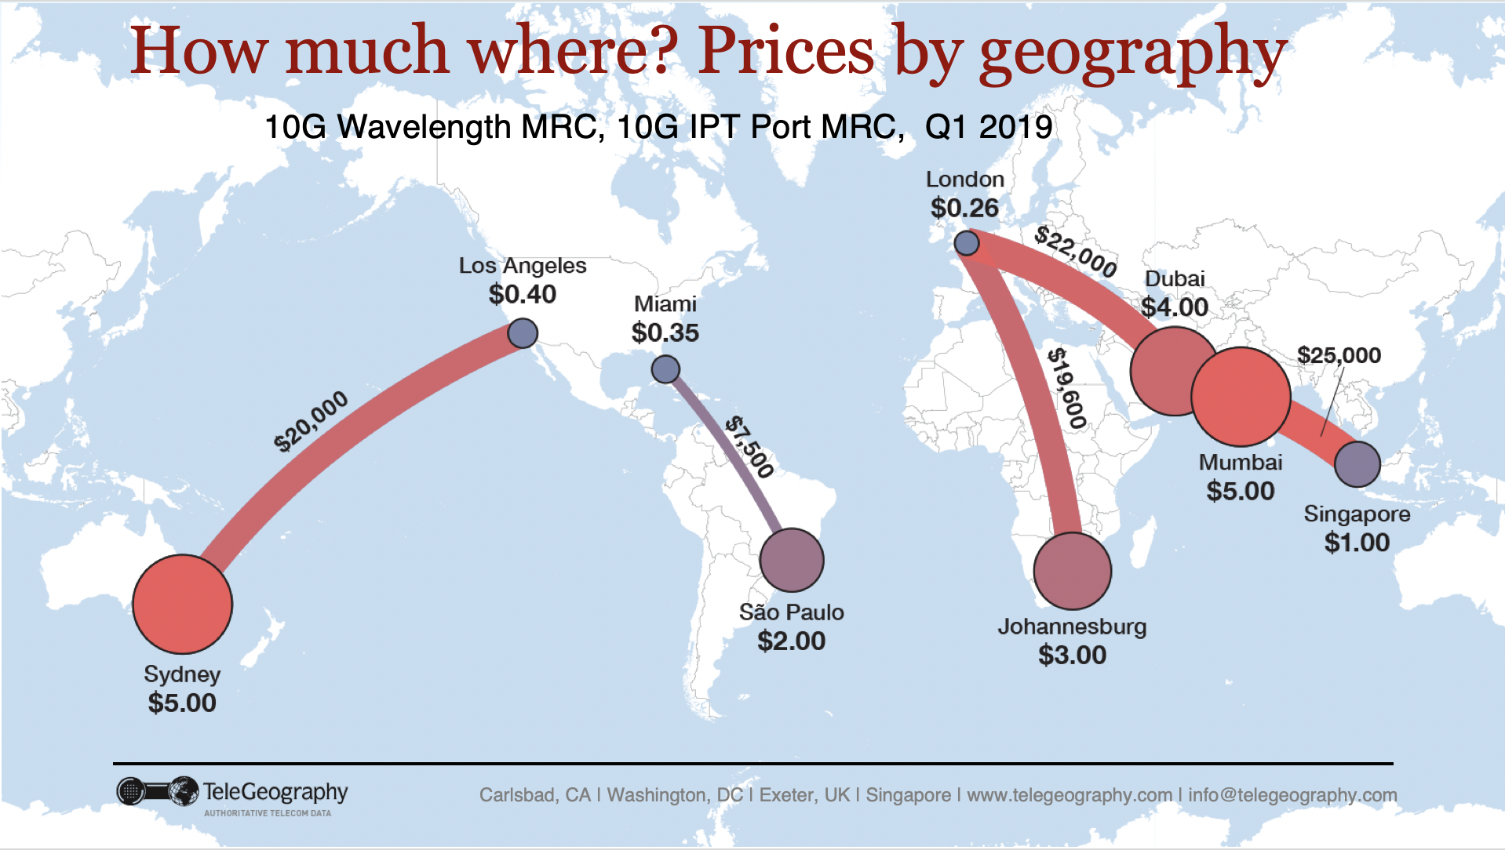
Source: Telegeography AfPIF-10

Slide 20
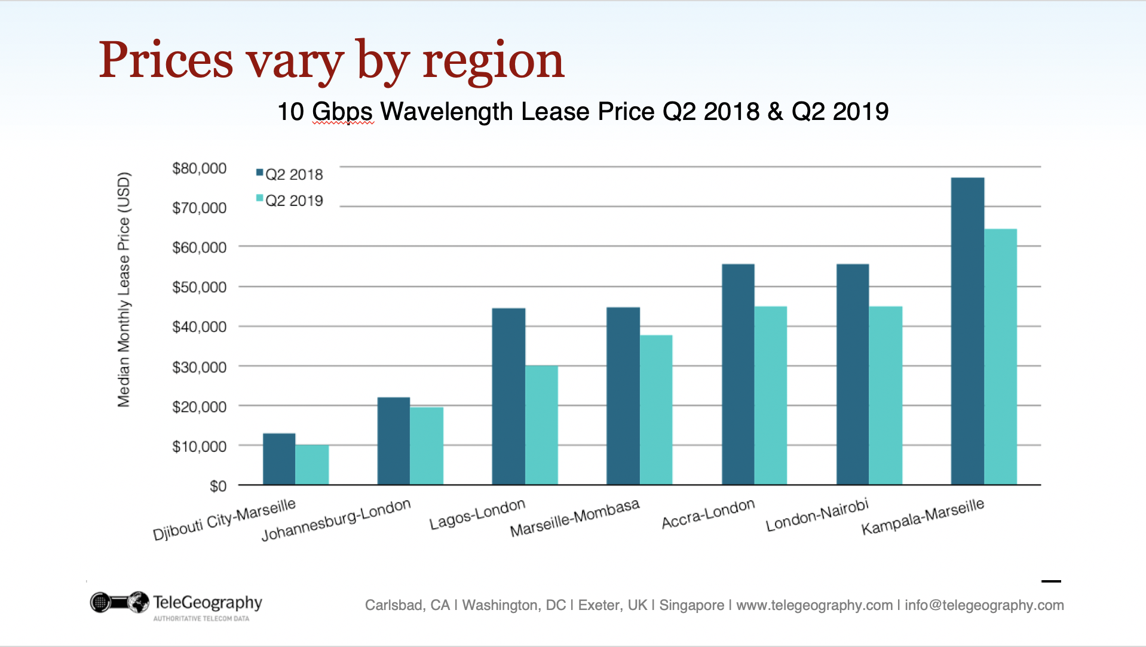
Source: Telegeography AfPIF-10

Slide 21
Michuki Mwangi
    mwangi@isoc.org

