Slide 1
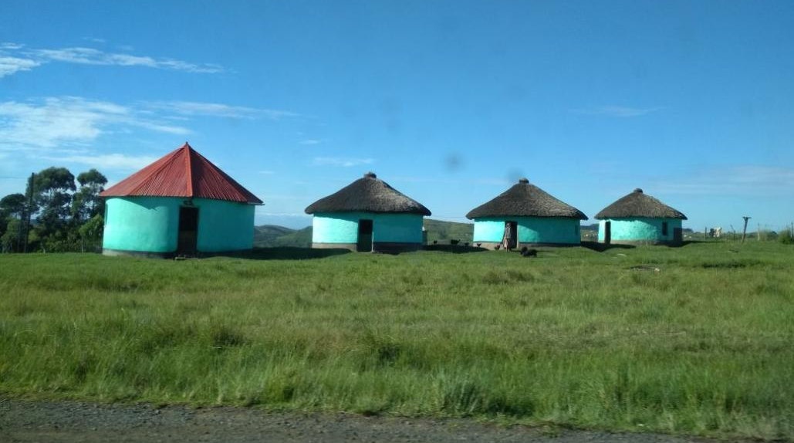

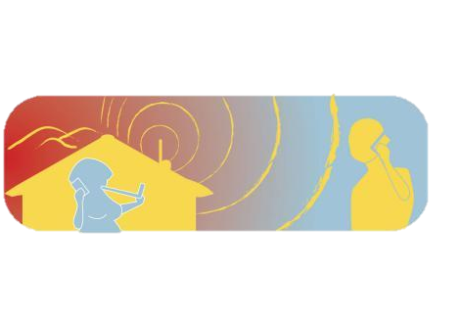
Zenzeleni networks
4th African Summit on Community Networks
Notes:
Good morning, thank you for giving me the opportunity to participate in this panel and share some of the work from the South African community Network Zenzeleni. I am Sol Luca de Tena, a director in Zenzeleni non for profit company.
In this presentation I will briefly introduce Zenzeleni, some our our main achievements in 2017, and what lies ahead for us in 2018, showing both our imminent growth and some of our challenges.

Slide 2
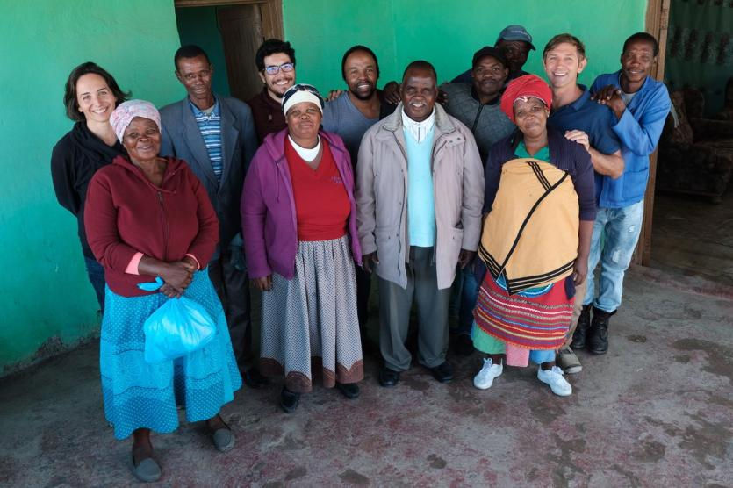
Zenzeleni Networks Mankosi Cooperative
(2014)
&
Zenzeleni networks non-for-profit
(2017)
&
Zithulele
networks Cooperative (2019)
Mankosi, March 2018
Notes:
Zenzeleni started in 2012 as an initiative to support people to provide telecommunications services to themselves in the rural Eastern Cape region. There have been various phases Zenzeleni. at first as an wireless intranet for people in the community to communicate, then giving mobile phone charging services as the area had no power grid, then gaining a gateway to internet through a 3G modem and eventually - through creating our own backbone - a connection first to the National research and education network, and then to fibre - providing internet in 5 villages, 3 to schools, and 7 local businesses.
Over the years Zenzeleni has grown into two legal entities - constituted by people from the locality and a few experts from SA and abroad. The locally owned cooperative, Zenzeleni Networks Mankosi, is the local, legal internet service provider that focuses on giving services and liaising with what is relevant at a local level - user needs, local tribal authorities, retaining and reinvesting the network income into locally relevant development, and Zenzeleni non for profit company - where I sit- which firstly provides support to the local cooperative in addressing technical, legal, financial (business) and social barriers that arise, and secondly is the liaison with the greater national and international ecosystem which the CN has to manage - government policies, other operators, seed funders, engaging new communities, and gaining lessons and exposure from forum such as this one.
We are in the process of seeding another local Cooperative.

Slide 3
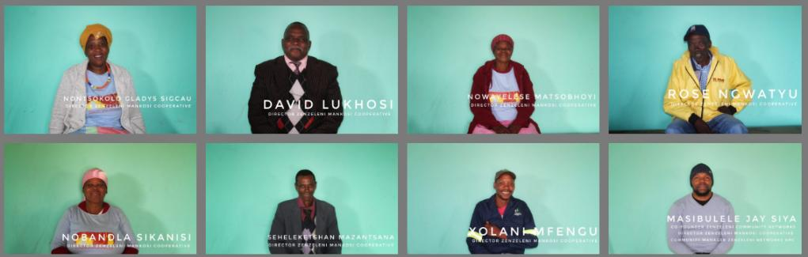
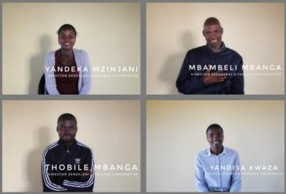
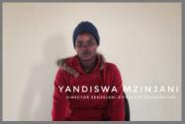
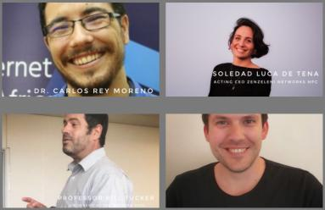
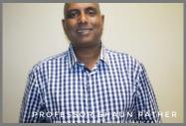
NEW PICS

Slide 4
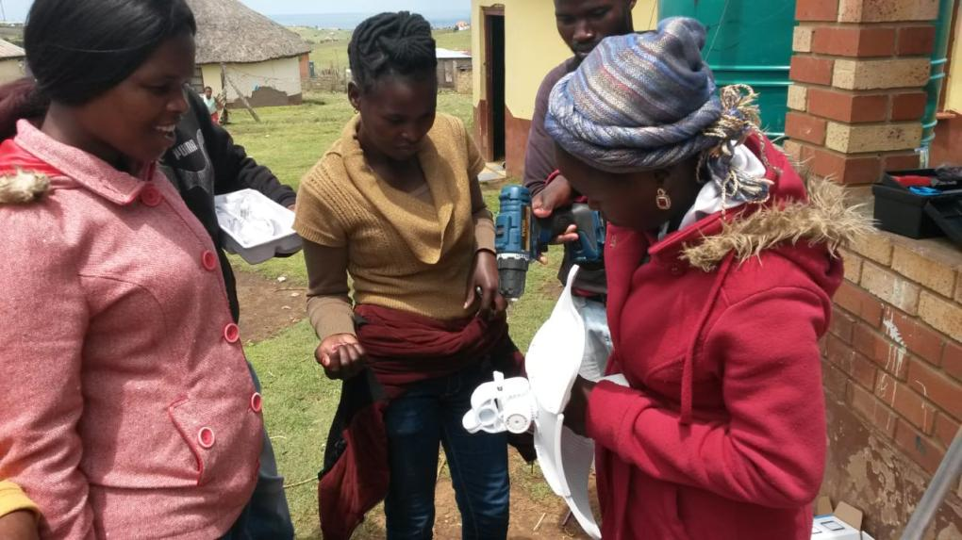

Slide 5
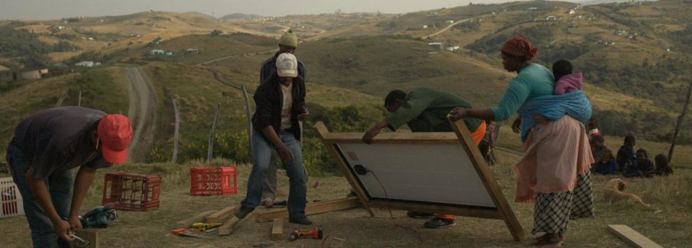
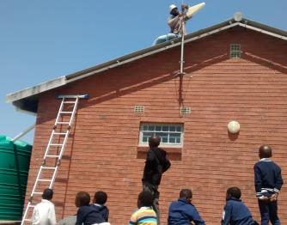
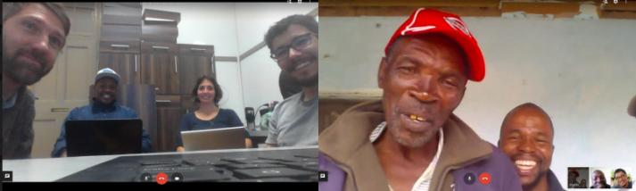
Notes:
But for all the logic this makes it has taken massive perseverance, creativity and patience to get anything done….facing countless challenges along the way, requiring work to shift technical, legal, financial and social status quos that simply does not cater for the people and conditions we are working in.
This slide shows some of the installation, and our team at our weekly meeting speaking remotely between Cape Town and Mankosi. You can see in the top picture the first frames for the solar panels. Incidentally were power for the network really is the by far the most costly element in some cases 80% of the cost. Just to illustrate how difficult it really is for some one to locally “do it themselves”, firstly one needs skills or research capacity to find the panels and batteries, and even wood for the frames as roofs are either thatched of not the right angle, the you need to organise transport, then mount them without power tools, and so on. Requiring heaps of resilience, creativity and patience.

Slide 6
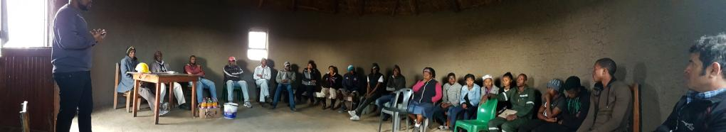
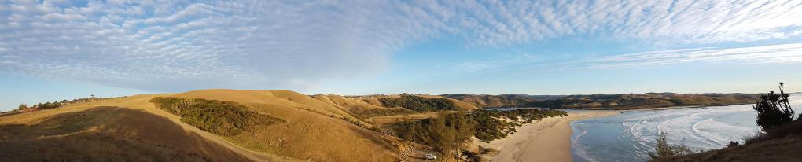
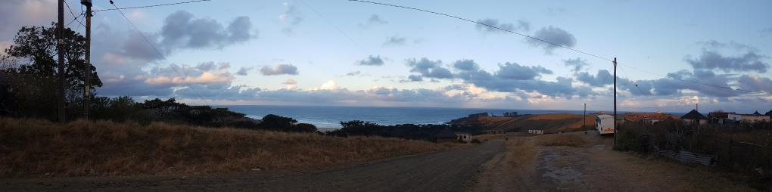

Slide 7
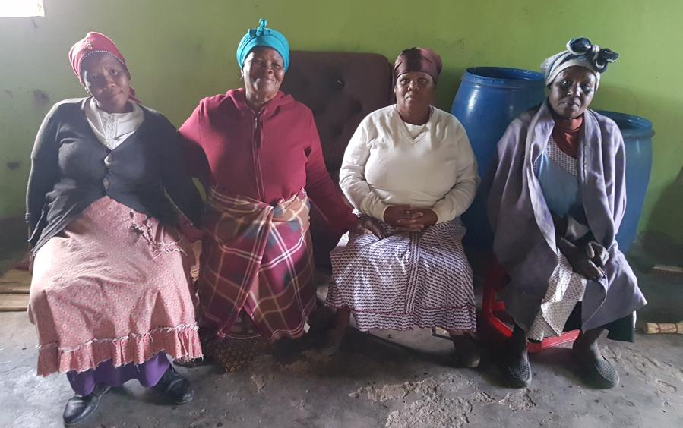

Slide 8
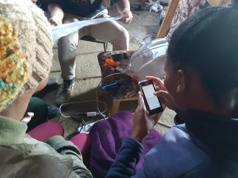
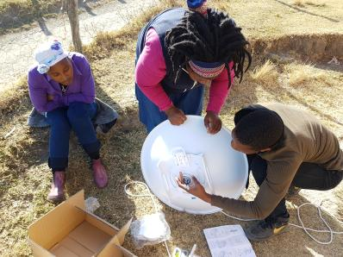
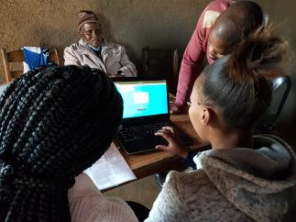
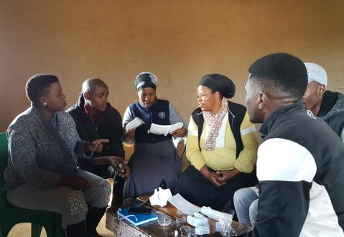
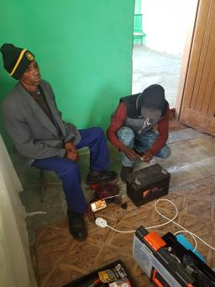
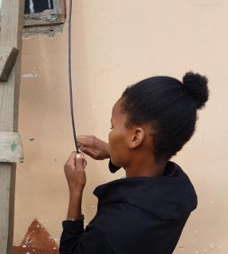
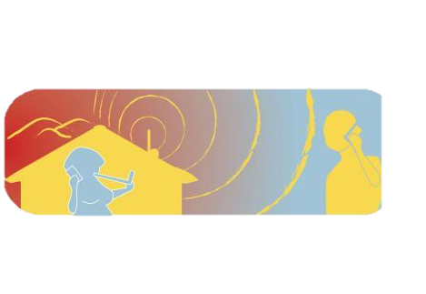

Slide 9
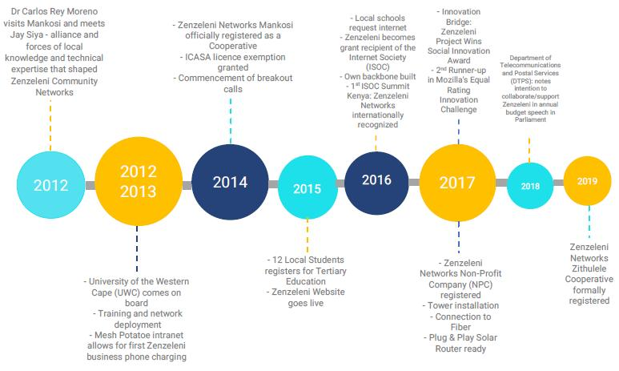

Slide 10
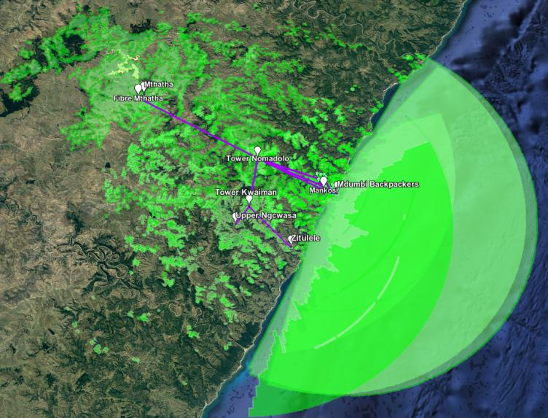
Some context
100,000 people
93% unemployed, 90% not completed school
Non/poor basic infrastructure and services
Most people live on 1USD daily threshold, up to 25% of monthly income spent on Telecoms
Notes:
Now a brief picture into the context in which Zenzeleni exists. We are located in the Mthatha river valley in the Eastern Cape Province of South Africa. This is a beautiful region, birthplace of the amaXhosa peoples, and still today a severely underserviced area - with little or no basic infrastructure (roads difficult to travel on, no or poor power and water supplies, etc) -, with people living in difficult financial and social circumstances, in a country riddled with socio-economic inequalities vestiges of colonial, apartheid regime which deliberately restrained development – education, health and other basic infrastructure and services. The name Zenzeleni in IsiXhosa means “do it yourselves” echoing our people centred mission - common in CN - and also alludes to the major challenges we face. Here there are few businesses and job opportunities, so people rely on welfare grants and remittance from family members in the cities and mines. In these circumstances people spent up to ¼ of their monthly income on telecommunication services, this is often money spent that is needed for food, transport, clothing or other basic needs. People also pay for the most expensive rates, as they cannot afford contracts and often buy re-sold prepaid data vouchers. Furthermore the mobile networks that are available have poor connectivity, last week a doctor in the area told me he has contracts with all 3 other telecoms companies to try and always have access to one, even then his signal drops. This luxury of having 3 contracts is obviously not accessible to local people.
In this scenario the impetus of “Zenzeleni/ do it yourselves” is for local, indigenous people to be able to access affordable, reliable internet, while also retaining the expenditure in a local ISP business and - through the coop - to reinvest it in their community needs.
Addresses multiple policy issues.

Slide 11
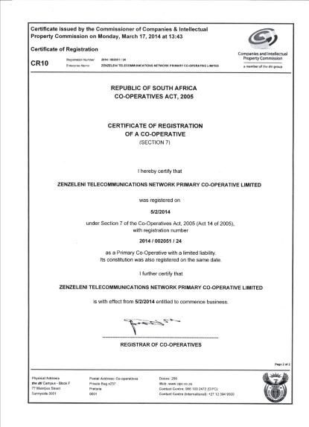
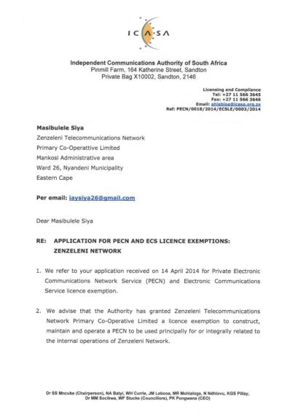
Legal
License exemption to deploy and offer telecommunications services

Slide 12
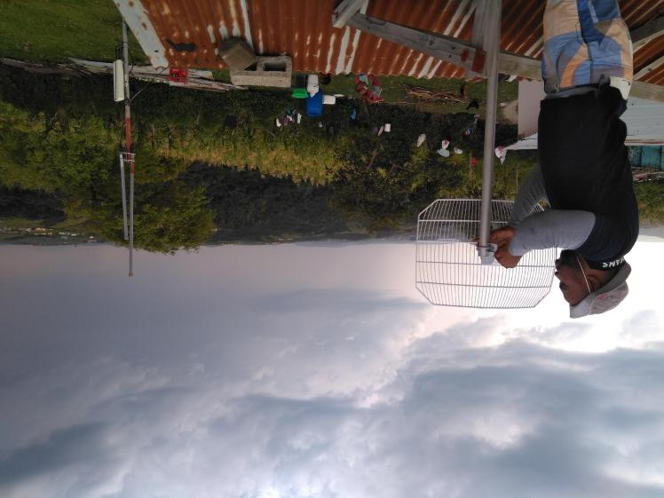
WiFi Internet Backhaul, Mesh & Hotspot (solar and grid powered)
Current backhaul (intranet) capacity 160-600 Mbps
Current speed
50 Mbps (Up from 40 Mbps)
WiFi
Hotspot
WiFi Internet Backhaul
WiFi
Mesh
Solar
Panel
Back up battery power

Slide 13
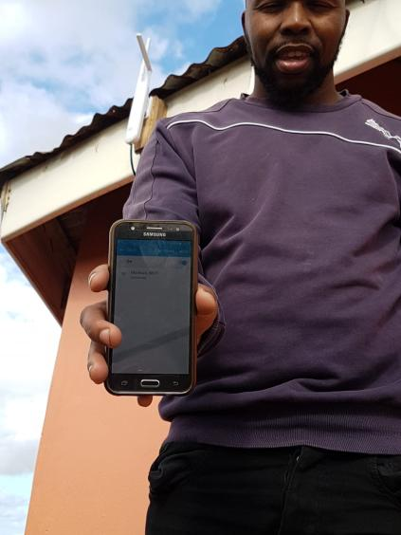
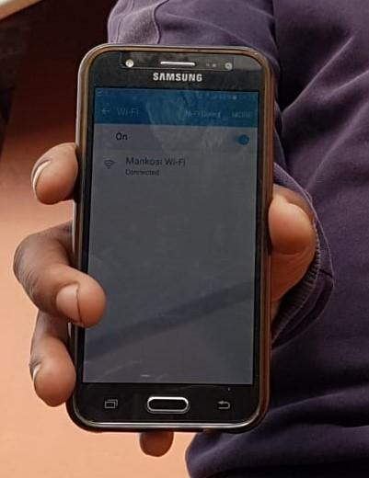

Slide 14
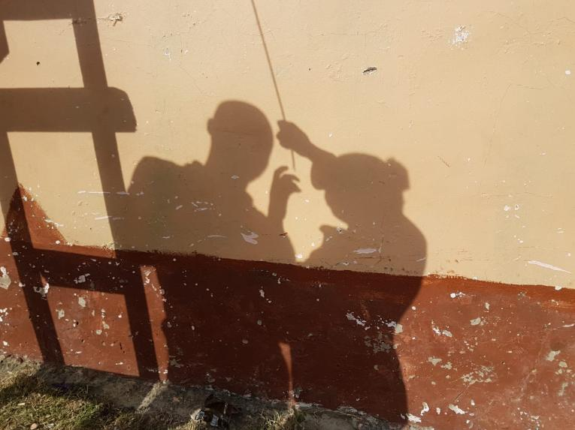
Thank you!
https://zenzeleni.net/

