Slide 1
What Makes Community Networks Resilient? Community
http://www.boscouganda.com/
info@boscouganda.com
@BOSCOUganda
limmaculate@boscouganda.com

Slide 2
Battery Operated System for Community Outreach (BOSCO) Uganda
NPO Started in 2007 as a pilot project
Located at ForGod parish, Bardege division P.O BOX 200 Gulu- Northern Uganda
29000 square kilometers, 13 districts
Local one in Uganda
48 ICT Centres

Slide 3
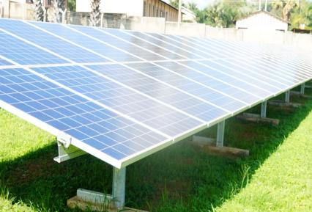
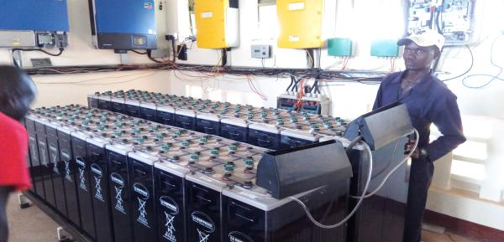
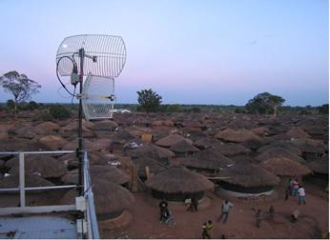
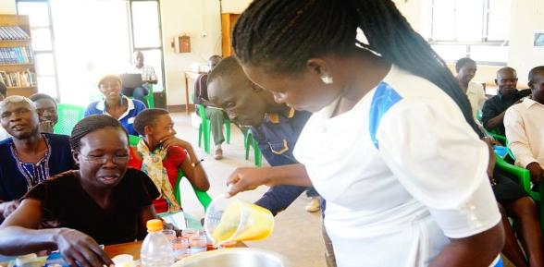

Slide 4
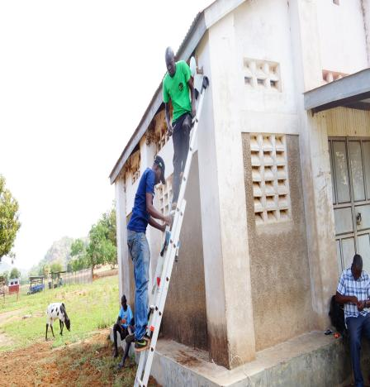
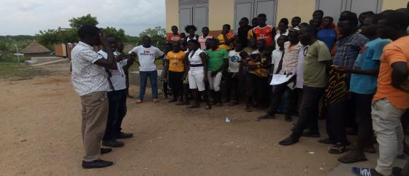
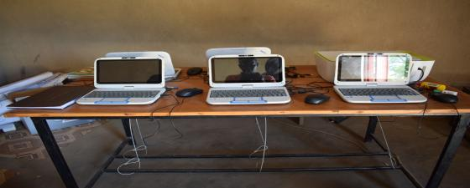
Community Ownership

Slide 5
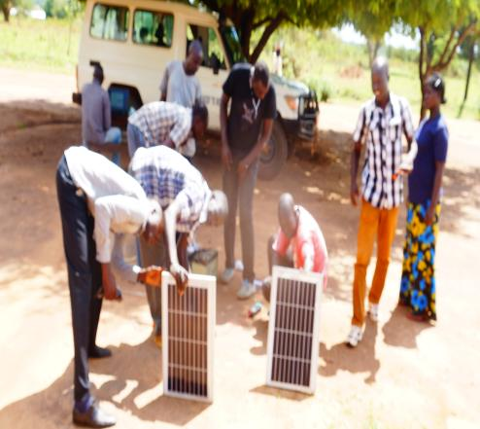
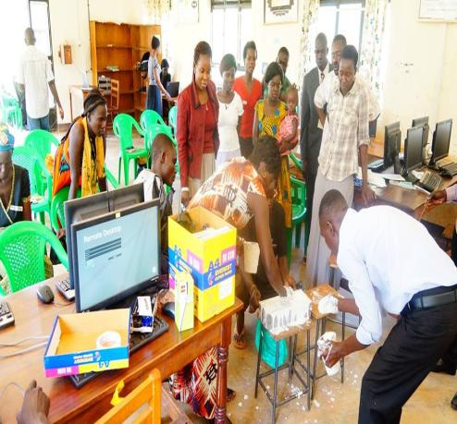
Community skilling

Slide 6
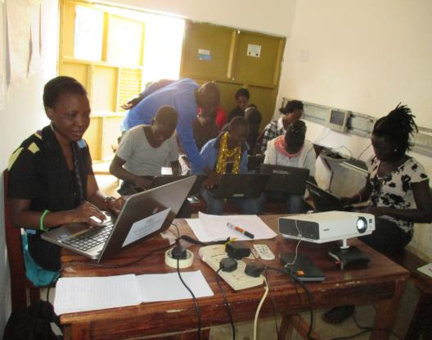
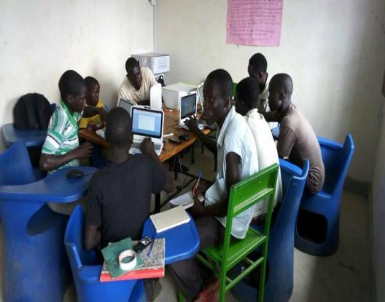
Community Skilling

Slide 7
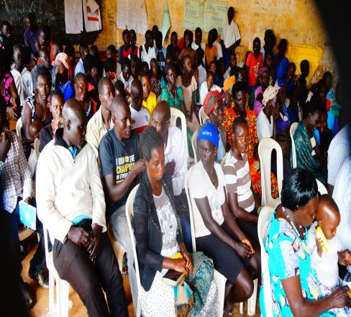
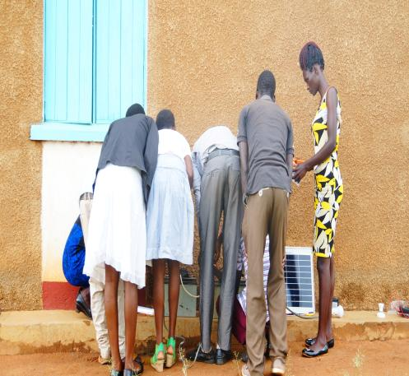
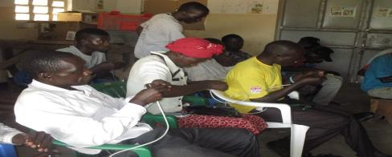
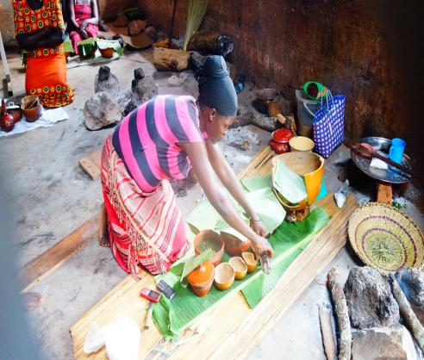
Community engagement or involvement

Slide 8


