Slide 1
Human resources in CN- our biggest assets and challenges
Michuki Mwangi
Regional Development Manager for Africa

Slide 2
Resourcing a CN

Slide 3
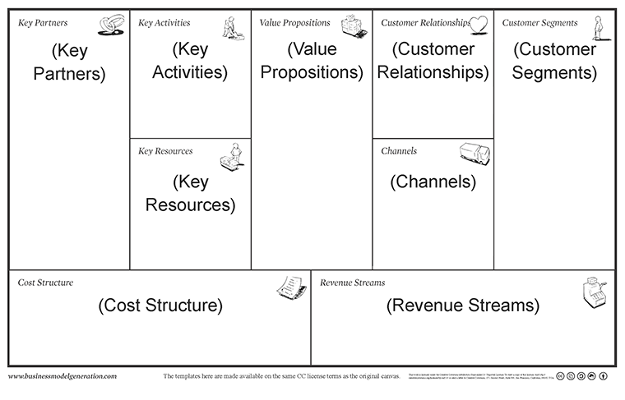

Identifying Human Resource requirements
Business Model Canvas

Slide 4
Job Analysis

Slide 5
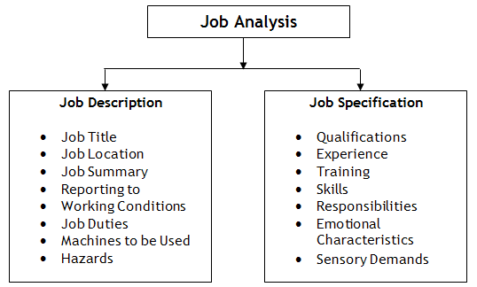
Job Analysis
Why is it important?
Identify the skills needed for the job
Knowing how many positions need to be filled
Hiring the right persons for the position

Slide 6
Scaling Human Resources
Human Resource Planning

Slide 7



HR Recruitment Types
CNs are similar to startups and are likely to have;
Volunteer staff ;
Internship programs (paid or unpaid)
Part time employees
Full time employees

Slide 8
How to Scale up
Plan for growth
Identify your needs and gaps
Succession planning

Slide 9
Most Important
Employee contract is a MUST
Onboarding of employees is Critical
Resourcing new employees is Absolute

Slide 10
Attracting and Retaining Good teams

Slide 11
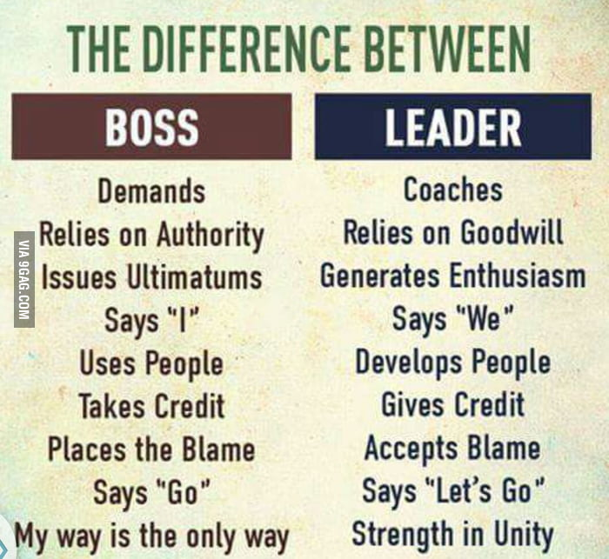
Leadership
The Role of leadership in the work environment
    Boss vs leader - Which are more successful ?

Slide 12

Career Growth & Development
What Difference between career growth and development ?
Upwards (vertical) growth vs Horizontal growth
Skill vs education ?

Slide 13

Be open to feedback

Slide 14

I love my job!
Innovative and creative workplace
Interesting and fun workplace
Safe environment
Personal gratification

Slide 15
Thank You.

