Slide 1
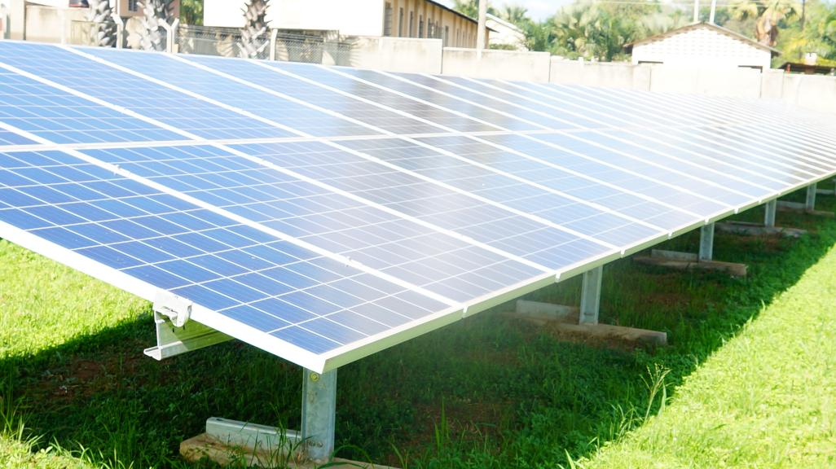
Off grid Solar system
Presentation by solomon okot NONO
BOSCO Uganda(battery operated systems for community network)

Slide 2

CONNECTING PEOPLE,
PRESERVING CULTURE
BOSCO UGANDA
Battery Operated System for Community Outreach

Slide 3


Slide 4
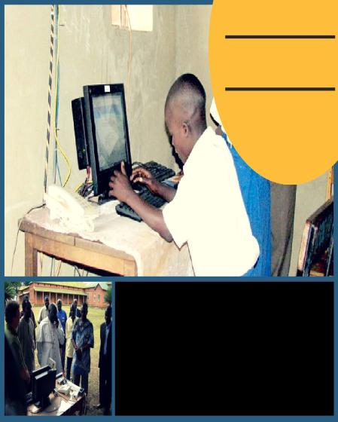
Battery Operated System for
Community Outreach
Non-for-Profit Organization (NPO) under the Catholic Archdiocese of Gulu, located at ForGod parish , Bardege division, northern Uganda.
BOSCO Uganda was founded as an emergency response to the 1986-2008 government of Uganda and rebel of the Lord’s Resistance Army conflict.
aims to use ICT to help end the isolation of Communities in rural areas that were affected by the Lord’s Resistance Army(LRA) war with the government of Uganda.
began in 2007 as an effort to put wireless and VolP telephony into the internally dispalced persons’ (IDPs) camps of Northern Uganda, in cooperation with the Archdiocese of Gulu.
This was also done in collaboration with Inveneo to place their low-power PCs Powered by solar panels in the Catechist Center and the Caritas Office in Gulu, at schools, hospitals, colleges and Churches in the Pabbo, Alero, Lacor, Coope, Jengari, Unyama and Pagak IDP camps.

Slide 5
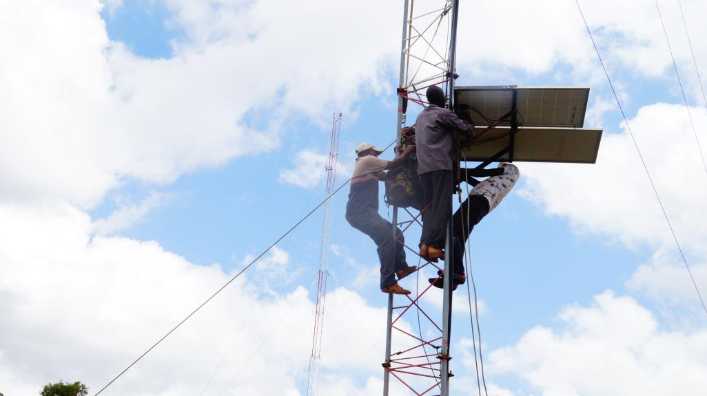
Energy is life

Slide 6


Slide 7
Definitions
Energy = the ability to accomplish work
• Work is accomplished when objects are moved
•Objects moved can be very small, e.g. molecules, atoms, electrons, or protons or they can be much larger objects.
• When forces act on objects and perform work, energy is converted from one form to another (note the law of conservation of energy).

Slide 8
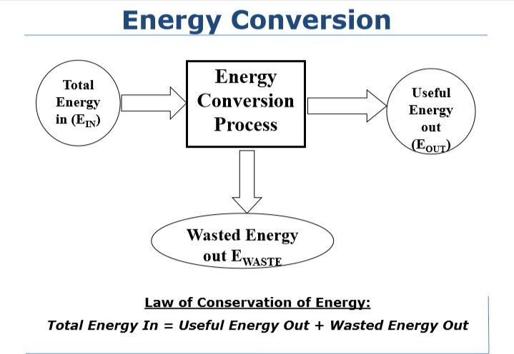

Slide 9
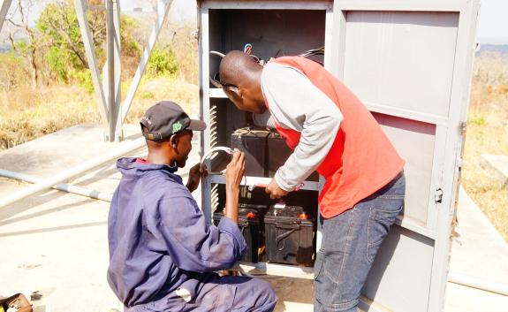
Forms of Energy
Mechanical Energy of Motion
Gravitational Potential Energy
Thermal Energy - Sound Energy
Light energy - Electrical Energy
Magnetic Energy - Radiant Energy
Strain Potential Energy
Chemical Potential Energy

Slide 10
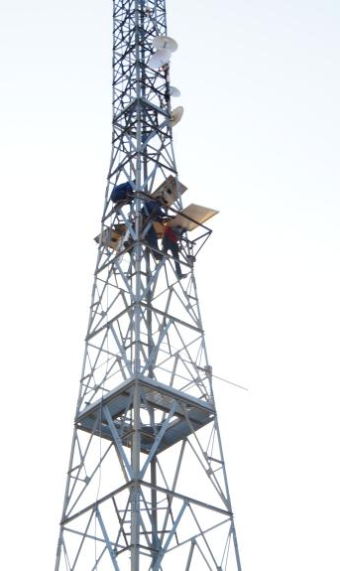
Energy Resources
Energy resources are broadly classified as:
Conventional energy resources (fossil fuels and nuclear)
Non-conventional energy resources or renewable resources
(solar, biomass, wind, hydro, geothermal, ocean etc)

Slide 11
Energy and Development
Modern energy = an engine of development
Essential for meeting basic human needs - improving social welfare - achieving economic development.
Energy demand
Access to media communication including distance, Learning, Transport, Essential for micro-enterprise development, Providing clean water, Lighting to extend activities after dark, Large Industrial applications, Improving health sectors e.g. refrigerators for drugs , Agricultural productivity, Access to energy is essential for improved agricultural methods and irrigation, Increased comfort by mobile phone charging, TV sets and computers

Slide 12
Renewable Energy Sources
Sometimes known as regenerative resources
Energy obtained from continuous or repetitive currents of energy occuring in natural environment
Resources are infinity
Most of them indirectly originate from the sun
These are: Solar, wind, hydropower, waves, biomass, geothermal and tidal energy

Slide 13
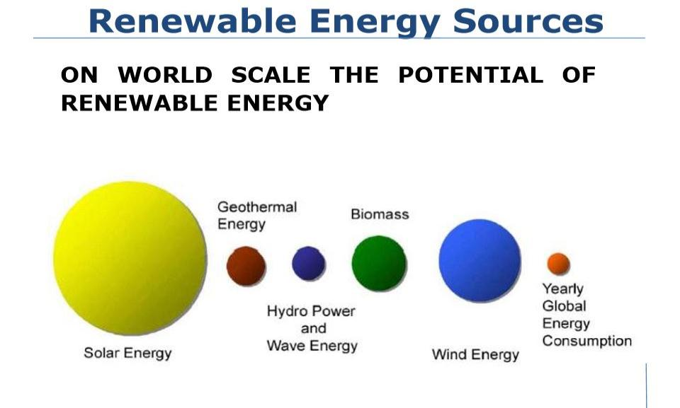

Slide 14
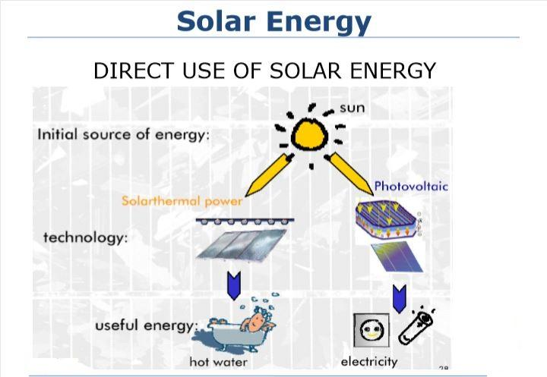

Slide 15
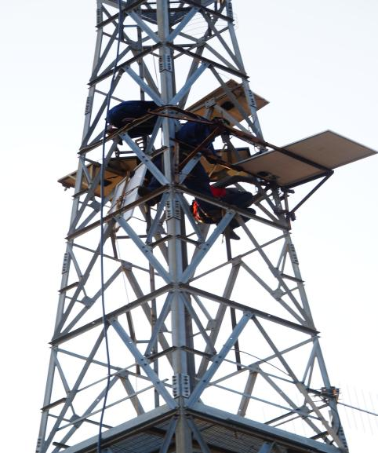
Solar Thermal Applications
Water heating for domestic, swimming pools industrial etc.
Distillation
Drying (agro-products, timber etc.)
Cooking
Room heating
Power generation or solar thermal generation
Space cooling and refrigeration

Slide 16
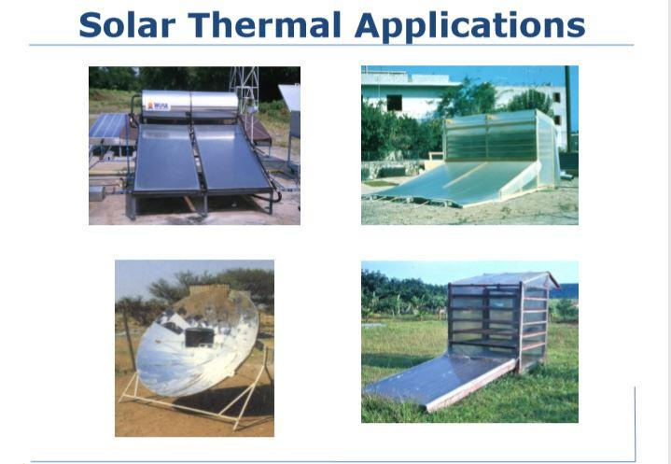

Slide 17
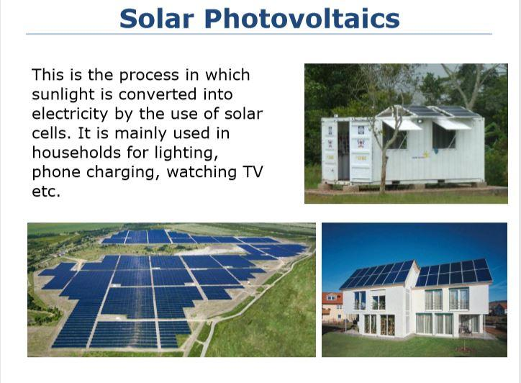
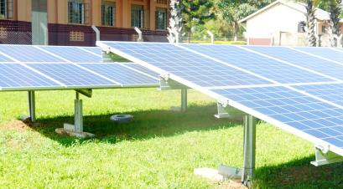

Slide 18
Advantages of Solar Energy | Disadvantages
Renewable Energy source | Costly to acquire
Reduces Electricity bills | Weather Dependent
Diverse Application | Solar Energy storage is expensive
Low maintenance costs | Uses a lot of space
Technology Development | Associated with Pollution sometimes
Solar panel can provide you with power for up to 30years
Creation of Job opportunity
Improves Grid security, it less vulnerable to blackouts

Slide 19
WHY SOLAR POWER
Key Terms
Photovoltaics: This comes from the Greek word; photo, phos which means light and volt which means electricity. Therefore Photovoltic means light-electricity, it’s the process of directly converting light into electricity. A simple photovoltaics example is solar-powered calculators, which use a small photovoltaic cell to power the calculator.
Solar thermal power is used for heating water. It’s a simple technology; the panel on your roof are the collectors of sunlight, thus heating up the liquid in the tubes which is then transported into your cylinder ready for use.

Slide 20
Module power (pmax) =280W
Solar Module Definition: Also called solar panels, a solar module is a single photovoltaic panel that is an assembly of connected solar cells. The solar cells absorb sunlight as a source of energy to generate electricity. An array of modules are used to supply power to buildings
Open Circuit Voltage (VOC) =39.01V
The open-circuit voltage, V_{OC}, is the maximum voltage available from a solar cell, and this occurs at zero current. The open-circuit voltage corresponds to the amount of forward bias on the solar cell due to the bias of the solar cell junction with the light-generated current.
Short Circuit Voltage (ISC) =9.20A
A short circuit is an abnormal connection between two nodes of an electric circuit intended to be at different voltages. This results in an electric current limited only by the equivalent resistance of the rest of the network which can cause circuit damage, overheating, fire or explosion.

Slide 21
Maximum power Voltage (VMPP) =31.81V
The Vmpp is the voltage when the power output is the greatest. It is the actual voltage you want to see when it is connected to the MPPT solar equipment (like an MPPT solar charge controller
or a grid-tie inverter) under standard test conditions
Short Circuit Voltage (ISC) =9.20A
A short circuit is defined as a connection between two nodes that forces them to be at the same voltage. In an 'ideal' short circuit, this means there is no resistance and thus no voltage drop across the connection. In real circuits, the result is a connection with almost no resistance.
Maximum Power current (IMPP) =8.81A
The current at which maximum power is produced by a solar panel
Maximum System Voltage =1000VDC
It means you can string a lot of panels in series, to make a high voltage array, for powering a Grid-Tie inverter. A year ago, 600V was the common voltage, the inverters run up to 500V input, for less amps and less loss. (20 panels in series is only 4 amps, but 550V)
Protection Class =II; there may be several PV strings connected in parallel to achieve higher currents and subsequently
more power. PV systems that have three or more strings connected in parallel need to have each string protected.
Overcurrent Protection rating (A) =15;
An overcurrent protective device must be able to withstand the destructive energy of short-circuit currents.

Slide 22
Short-Circuit Current (ISC): the maximum current produced by the solar cell under given conditions of irradiation and temperature, corresponds to zero output voltage, the power at this point is zero.
• Open-Circuit Voltage (VOC): the maximum voltage under given conditions of irradiation and temperature, corresponding to maximum voltage but zero current flow, the power at this point is zero.
• Maximum power point (MPP): the point at which maximum power can be drawn from the cell
Voltage of the cell is affected by temperature
• Current generated depends on: – Surface area of the solar cell – Incoming Insolation (intensity of radiation)
• A Typical single silicon PV cell of 100cm2 produces about 1.5 watts at 0.5 volts DC and 3 Amps under 1000W/m2 • Power out put is proportional to the intensity of sunlight

Slide 23
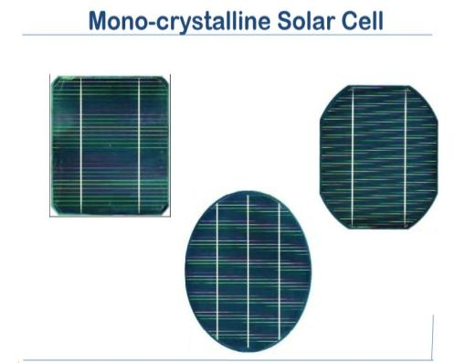
monocrystalline solar panels, silicon is formed into bars and cut into wafers. These types of panels are called “monocrystalline” to indicate that the silicon used is single-crystal silicon. Because the cell is composed of a single crystal, the electrons that generate a flow of electricity have more room to move. As a result, monocrystalline panels are more efficient than their polycrystalline counterparts.

Slide 24
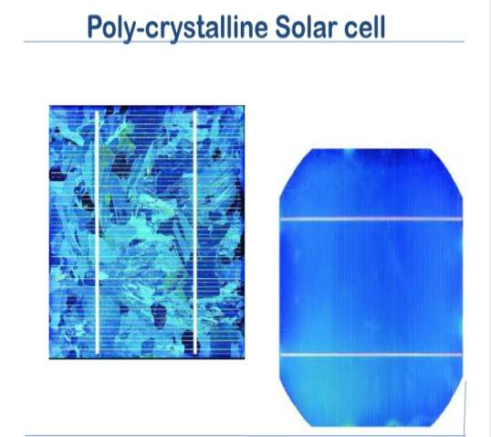
Polycrystalline solar panels are also made from silicon. However, instead of using a single crystal of silicon, manufacturers melt many fragments of silicon together to form the wafers for the panel. Polycrystalline solar panels are also referred to as “multi-crystalline,” or many-crystal silicon. Because there are many crystals in each cell, there is to less freedom for the electrons to move. As a result, polycrystalline solar panels have lower efficiency ratings than monocrystalline panels.

Slide 25
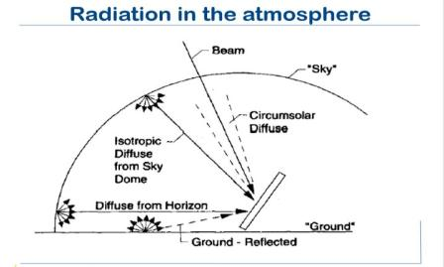
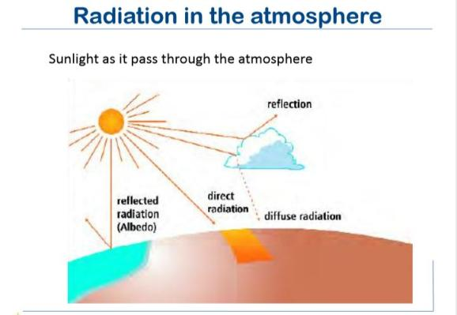
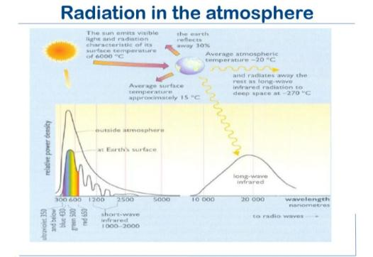

Slide 26
Irradiance; The rate at which radiant energy is incident on a surface per unit area of surface, Solar irradiance integrated over a period of time is called solar irradiance (total power from a radiant source falling on a unit area)
Irradiation; Is the measure of solar energy density incident per unit area on a surface - determined by integration of irradiance over a specified time, usually an hour or a day.
Insolation; is a term used to represent solar energy irradiation.
Irradiance and irradiation; both apply to all components of solar energy The quantities depend on location, weather conditions and time of the year, also they depend whether the surface of interest is shaded or horizontal

Slide 27
Solar Insolation
Daily insolation is the measurement used to estimate the output from a solar PV system.
INSOLATION is a shortened version of the words = INcoming SOLar radiATION
Daily Solar Insolation, H is the total solar energy radiated on a unit surface area over a certain period of time.
The units of H are [peak-hours per day] or [kWh/m2 per day]
Peak-hours = equivalent number of hours of sunlight at irradiance of 1000W/m2
The standard test condition (STC) for which electrical specifications of solar PV modules are measured is using 1000W/m2, too.

Slide 28
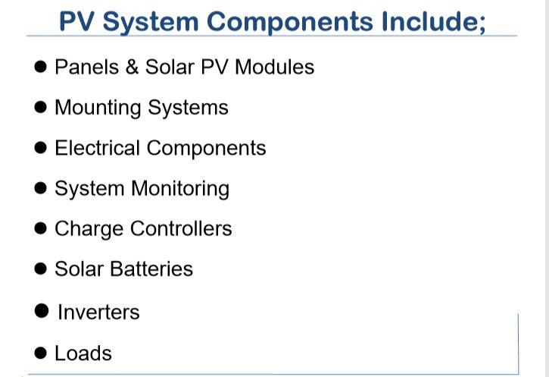

Slide 29
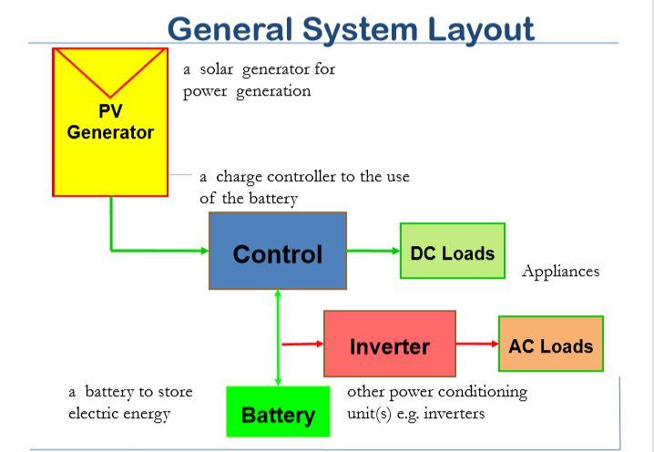

Slide 30
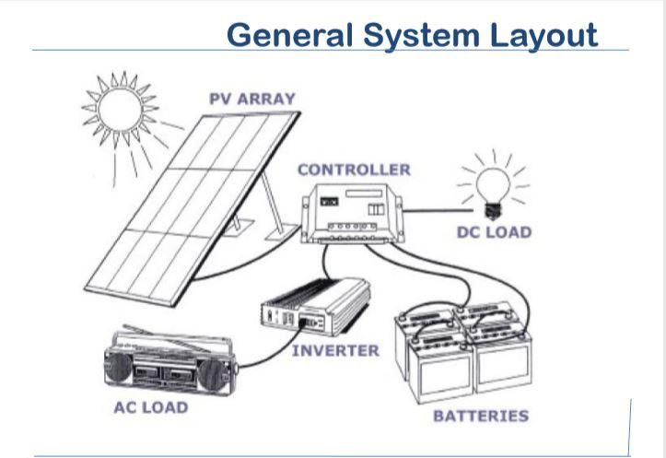

Slide 31
Charging and Discharging of Battery
The voltage of the battery terminals changes during charging and discharging
For a fully charged Pb-acid cell the voltage is about 2.12 volts
During discharge voltage drops
During charging the voltage rises
Continuous charging may lead to undesirable overcharge. H2 and O2 are released visible as bubbles electrolyte level decreases while the density is raised.
Charge controllers maintain the voltage within the required threshold levels (minimum and maximum).

Slide 32
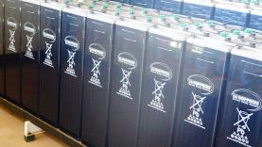
BATTRY Capacity
Measure of amount of electric energy or charge stored in a battery
Determined by the amount of active material coming in contact with the electrolyte
Battery capacity is measured in Ampere-hour (Ah)
Capacity = fixed current drawn x number of hours before the battery reaches complete discharge – (Example: capacity of 100 Ah = (10 A x 10 h) = (20 A x 5 h)
Energy stored = Ah x voltage (assume voltage remains constant)

Slide 33
Cycle Depth
Discharging and then charging back up to the state of charge at the start is called a cycle.
Depth of discharge (DoD) in one cycle not always down to 0% state of charge.
Cycle life
Cycle life = number of cycles obtained from a battery before capacity is reduced to 80% of its value when new
Number of cycles depends on: cycle depth, discharge current and temperature.
Increasing the depth of discharge decreases cycle life.
Increasing the number of cycles performed per year decreases cycle life.

Slide 34
Charging efficiency
Charging efficiency = charge used by the load / charge used to recharge the battery back to the original charge
Example 80% charging efficiency 0.8 of the charge into the battery is recovered during discharge.

Slide 35
Over-charging
Excessive overcharging leads to increase corrosion of electrodes, active material shedding and shortens life
leads to gassing decomposition of H2O into H2 (bubbles on negative electrode) & O2 (bubbles on positive electrode)
Slow gassing is beneficial because breaks stratification of the electrolyte (variation of concentration of electrolyte with depth)
Electrolyte becomes more concentrated water must be replaced when the level drops
Batteries have vents to allow gas to escape
sealed batteries do not have vent as gas due to overcharging is absorbed internally
Overcharging may lead to decomposition of electrodes of lead-acid batteries this is a nonreversible reaction

Slide 36
Self-discharge
Takes place when not in use
Rate of self discharge – Expressed as amount of charge – Given as percentage of capacity, lost over a period e.g. month
Related to how plates gas during overcharging and increases at high operating temperatures
Voltage Characteristics
Batteries have nominal voltage (VN) but varies operation
Open Voltage (VOC) at zero current
Load voltage (VL): voltage drawn by loads during discharging
Charging voltage (VCH): voltage when the battery is being charged
Voltages depend on: SOC, temperature, charging current
Most solar batteries have nominal voltages: 12 V, 24V

Slide 37
Charge Controller
It is an electronic device whose functions are:
To reduce battery maintenance (topping up) by controlling gassing (water loss) during charging
To charge at pre-set voltages to prolong battery life and avoid damage to sensitize loads
To disconnect the load at pre-set voltages to prolong battery life threshold
To facilitate interconnection between modules, battery and loads
System status monitoring and indication
With the factors affecting the capacity of the battery, it is important, that the battery is designed to match the operating and life requirements of the application.
Therefore there is a need for a control unit to control the discharging and charging processes

Slide 38
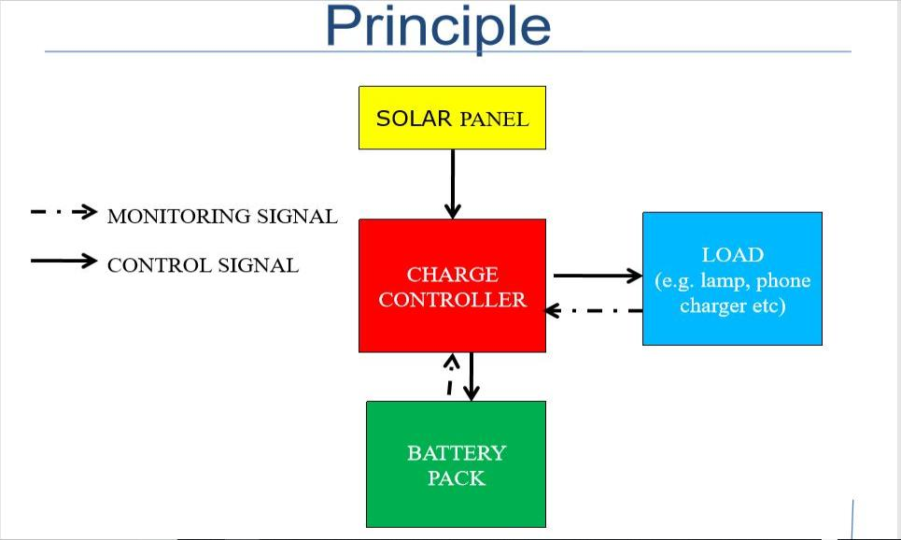

Slide 39
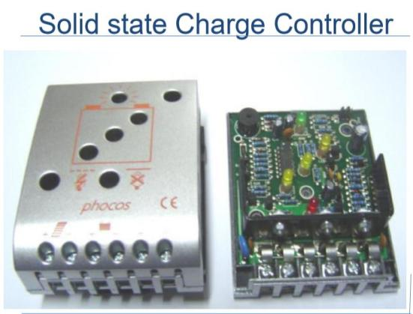
Features of a Charge Controller
Low Voltage (Load) Disconnect (LVD)
High Voltage (Panel) Disconnect (HVD)
Indication of battery charging current
Indication of battery voltage
Voltage compensation for current and temperature

Slide 40
Inverters
Solar modules and batteries operate with DC. The mains electricity, however, is AC. Many electrical appliances, devices and accessories are only available for AC.
An inverter transforms low-voltage DC supplied by a solar system into high-voltage AC. The input of an inverter is designed for 12 V (24 V, 48 V, etc.), depending on the type.
At the output it produces 240 V AC. Inverters are designed for stand-alone as well as for grid-connected systems.
Inverters tend to make systems more expensive not only because they cost money but they also consume some energy making it necessary to increase system capacity to cater for this loss

Slide 41
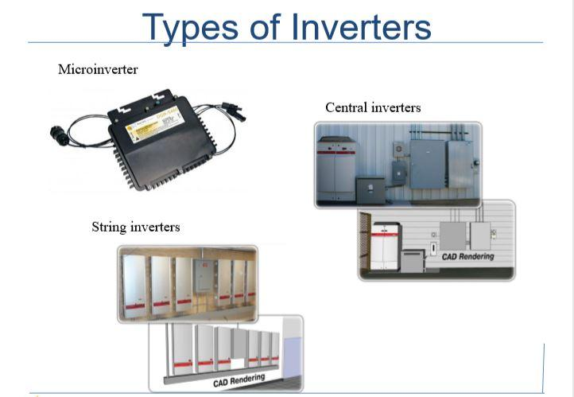
Types of Inverters
Micoinverters (module inverters); These inverters are typically attached directly to individual photovoltaic modules in order to extract the maximum power from each module
String inverters; In a grid-tied system the solar panels are wired together in series (a “string” of panels) which increases the voltage and keeps the current low so that wiring is simpler and wire size can be smaller
This are a type of string inverter used in large scale applications. Some offer easier installation and higher efficiency than smaller string inverters which results in slightly higher cost.

Slide 42
Sizing components of a solar system
Sizing components of a solar system is very important during of designing
Caution! Bearing in minds about the initial investments is a major component
Unnecessary large system (Over sizing) has a detrimental effect on the price of the system
Under sizing has an effect on supply reliability

Slide 43
Evaluation table for direct current(dc) load
Appliance | Number | Power (W) per appliance | Hours(h) of usage | Total Energy usage(wh)
Bulb | 10 | 3 | 12 | 10*3*12 =360wh
computer | 1 | 100 | 2 | 1*100*2=200wh
Total |  |  |  | =360+200=560wh

Slide 44
Evaluation table for ALTERNATING current(Ac) load
Appliance | Number | Power (W) per appliance | Hours(h) of usage | Total Energy usage(wh)
TV | 1 | 50 | 5 | 1*50*5=250wh
Laptop | 1 | 60 | 3 | 1*60*3=180wh
Total |  | 110 |  | =250+180=430wh

Slide 45
Sizing components of a solar syste
Sizing is a process that is used to determine the ratings and capacities of the various systems components that are sufficient to meet the power needs of a client based on weather data, demand and sizing knowledge.
Thus, sizing is a detailed, accurate, time consuming process that can be carried out by specialists
Sizing procedure given here results into a fairly good estimate of system size
Sizing components of a solar system is very important during of designing
Caution! Bearing in minds about the initial investments is a major component
Unnecessary large system (Over sizing) has a detrimental effect on the price of the system
Under sizing has an effect on supply reliability

Slide 46
Loads
Solar electricity is the same as that of a battery – DC It can only run appliances (lights, radios TVs, Fridges etc) that are specially designed to run from DC. Appliances to run from solar electricity have to be chosen by a qualified person to ensure matching and reduce overall system cost Solar electricity can also be modified using special converters (e.g. Inverters) to run even AC appliances.
Load Determination
Decide applications of the system
Decide whether the system will be AC or DC
Determine the rating of the appliance(s)
Establish daily usage hours for each appliance

Slide 47
Determination of daily average Load
Use of some loads may vary daily, monthly or seasonally (e.g. in schools)
For simplicity daily variation of consumption is considered
Where necessary, separate ac loads from dc loads
Determine the daily energy usage for each appliance and then the total (Wh/day)
If dc loads differ in voltage rating then the sizing must put into consideration the possible losses in the dc-dc converters
For ac loads the dc input power into the inverter is determined by considering the efficiency of the inverter
If the system comprises of both dc and ac then the demand for both should be added together
Note that the total ac power is used to determine the size of the inverter
The power demand for the loads is used to determine the wire sizes

Slide 48
Estimating the Load
The steps involved in estimating the load are:
List all the items in the household which would draw electricity from the batteries.
Determine the rated power of each of these items.
Estimate the number of hours per day that the item would be used.
Multiply the power (in Watts) by the number of hours to get the energy used by each item.

Slide 49
System Sizing
The most common reason for the failure of a PV system is that the panels are too small.
Because panels that are too small do not charge the battery enough each day battery life will be shorter than in a system with enough panel capacity.
It is usually cheaper to add extra PV panels, because battery life is increased and fewer battery replacements will be needed.

Slide 50
System Voltage
❑ 12V for 1KWh and below
❑ 24V for 1KWh – 2KWh
❑ 24V with Inverter for above 2KWh
❑ 48V with Inverter for above 10KW

Slide 51
Calculating the proper panel size
The energy used by appliances is measured in watthours and the energy produced by the panels is also measured in watt-hours.
Watt-hours of energy are like litres of motor fuel. When 5 litres of fuel are needed to go from one place to another, if only 4 litres of fuel are provided the motor will stop before the trip is completed.
In a PV system, if an appliance needs 100 watt-hours a day to work properly and if the solar panels only produce 80 watt-hours the appliance will stop working early in the day.
Finding the number of Panels needed
If two panels are joined together, twice as many watt-hours will be produced. Three panels will produce three times the watt-hours, and so on.
The watt-hours produced are the same whether the panels are connected in series or in parallel.
To find the total peak-watt rating for the PV panels needed to operate the appliances, find the number of watt-hours that the panels must provide and divide by the Panel Generation Factor.

Slide 52
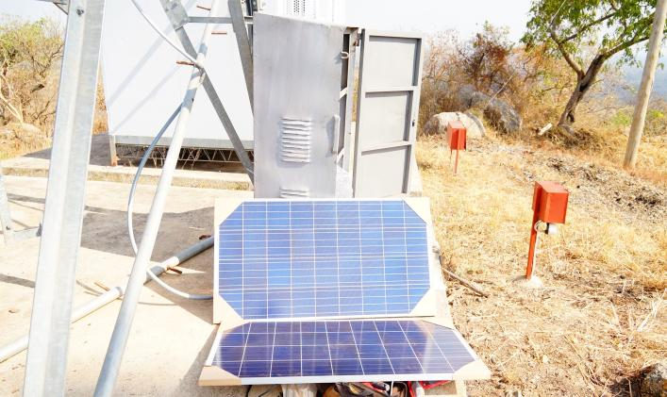
Evaluation of ENERGY NEED
Total DC+Total AC
560+430=990wh

Slide 53
Finding the number of Panels needed
To find the peak-watt capacity that will be needed in a system follow these steps:
Step 1. Calculate the watt-hours per day for each appliance used.
Step 2. Add the watt-hours needed for each of the appliances to find the total watt-hours per day needed by the appliances.
Step 3. Multiply the total appliance watt-hours per day by 1.3 (30% loses considered) to find the total watt-hours per day that the panels must provide
Step 4. Divide the total watt-hours per day by the Panel Generation Factor for your climate (e.g in average 4.5 sunshine hours per day)
Step 5. Divide the total peak-watt capacity by the peak watts of the panels available to you.
This will give you the exact number of panels needed.

Slide 54
Battery Size
A battery is needed because the appliances use electricity at different times and at different rates than the panels produce.
For the system to work properly, the battery should be of the deep-discharge type and be large enough to store enough energy to operate the appliances at night and on cloudy days.
Also, for the battery to last a long time, it should not be discharged too much or too often.
Remember; battery life depends on how much discharge takes place before a recharge.
So another way of sizing a battery is that the battery should be large enough so that one day’s use of the appliances will discharge it no more than one-fifth of its full charge.
The rule for battery size is to install a battery that has at least five times as much capacity as will be needed to operate the appliances for one day.

Slide 55
Summary of Battery size calculation
Step 1. Calculate the watt-hours per day used by each appliance
Step 2. Total the watt-hours per day used by all appliances.
Step 3. Multiply the total appliance watt-hours per day by 5 for a deep-discharge battery, multiply by 7.5 for a maintenance-free battery or multiply by 10 for a vehicle battery.
Step 4. Divide the result of Step 3 by the battery voltage.
Battery Size and Panel Life
It has been shown that increasing the panel size increases battery life, particularly in a climate with frequent cloudy conditions.
With the cost of solar panel capacity falling but the cost of batteries slowly increasing, it makes good economic sense to increase the panel size by 20% to 30% over the minimum.
This can dramatically improve the reliability of the system during cloudy weather and can greatly extend the life of the battery. This reduces the cost over time as battery replacements are now the most expensive component in a home PV system.

Slide 56
Controller Size
The charge controller has to have enough ampere capacity to pass the maximum current that the system can provide / consume.
This can be estimated by dividing the peak-watt rating of the panels by 12 V, and the result multiplied by 1.2 for maximum radiation that can be attained. So a controller connected to a 100 W panel should have a charging capacity of at least 100 ÷ 12 = 8.33 A.
The minimum ampere capacity of a controller should be equal to the sum of the amperes from all appliances times 1.5, plus the amperes from all appliances with motors times 3.
For example, four lights of 12 W capacity have a total operating load of 4 A. So the controller should have a capacity of at least 4 A × 1.5 = 6 A

Slide 57
Solar system sizing
Solar panel sizing
Total power from the panel =Total Energy need*Loss Factor
Hours of sunlight
=990wh*1.3 =286w
4.5h
Estimated average hours of Sunlight eg. Uganda 4.5

Slide 58
Battery sizing
Battery capacity =Total Energy need * Days of Autonomy
Voltage of the system * Depth of Discharge(DoD)
=990wh*2 =1980 =33A
12v*(50%) 6
Depth of Discharge (DoD) at 50%
Days of Autonomy 2 Days

Slide 59
Charge controller sizing
Controller Capacity =Total power from the panel*Safety Factor
Voltage of the system
=300W*1.2 =30A
12
Safety Factors =1.2
Determining Size of a charge controller
Charge controllers are rated either in current input from the panel or current output to the loads
The current output to the loads is calculated using the total load for example power (43 W)
The correction factor of 1.25 is a safety factor for the charge controller to account for energy surpluses in the system
IL ≈ (1.25 x 43 W)/VSYS = 53.75 W / 12 V = 4.48 A (select from standard or available charge controller mainly select that one with a close higher rating) a 5 A charge controller is used

Slide 60
INVERTER SIZING
Inverter size =Total power consumed by AC Loads*Safety Factor
=110*1.5 =165w
Safety Factor =1.5

Slide 61
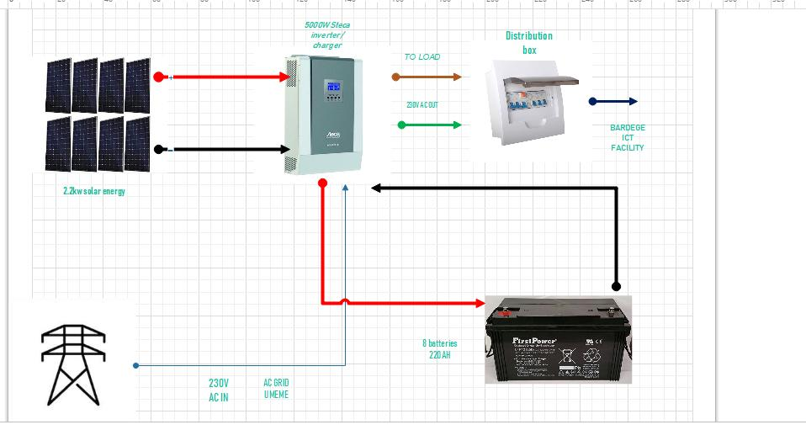
Solar system connection layout

Slide 62
THANKS YOU SO MUCH

