Slide 1
Innovation, Integrity, Quality
Notes:
1

Slide 2
Executive Summary
Sector: Water and energy, renewables
Market: Primary Africa, some Middle East
Solution: Clean energy & water supply efficiency – smart grid
Company - Established in 2011 as engineering, USA Ann Arbor MI, ISO 9001-2015 Certified. Ethiopia Engineering & Manufacturing global marketing.
Team – Over 25 years experienced management team (fortune 500), Innovative and world class trained engineers with advance degrees
Market Focus – High growth, scalable and underserved: Africa Energy and Water Utilities & Private Supply:
Product focus –Smart Utility Meters “Patents Pending” , Data & Operation Management System. Unique and customized solutions.
Customer – Contract with Ethiopian Utilities, pending contracts with regional utilities, Middle East and micro grids, Water Utilities ” USA smart water meters”

Slide 3
dVentus: Company Values
Innovative Technology, Quality Product and Service: Customer Focused, Market Oriented.
Sustainable Growth for Long-term:
Build Local Economy
Good Governance:
Efficiency, Transparency, Integrity
Care for:
People and environment

Slide 4


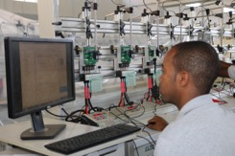
dVentus : Social & Environmental Impact
Social
Environmental
Reduction of losses both electric and water
Reduction of technical and commercial losses
💵
Capacity building of local engineers
Branding Ethiopia as a high quality manufacturing hub for Africa (“Made in Ethiopia”)
Financial
💶
Import substitution and large amount of foreign currency input for the Country
Increase in revenue collection while limiting tampering on water & electrical meters
Notes:
Social Impact:
120 employees in the Addis Ababa Factory (2017) / Additional 220 in Bahir Dar (2018)
Capacity building of local engineers – international standards
Minimum distribution of electricity for non-paying users, allowing a flooring service even to the poorest
Branding Ethiopia as a high quality manufacturing hub for Africa (“Made in Ethiopia”)
Financial Impact
Import substitution and large amount of foreign currency input for the Country
Increase in revenue collection while limiting tampering on water & electrical meters
Environmental Impact:
Smart metering is the solution to:
Technical losses (transformer and wiring) and Commercial losses (billing, tampering, revenue collection) in electrical meters, amounting to 29% (Ethiopia) to 50% in Sub-S. Africa
Distribution (leakages) amounting to 45% in water distribution

Slide 5
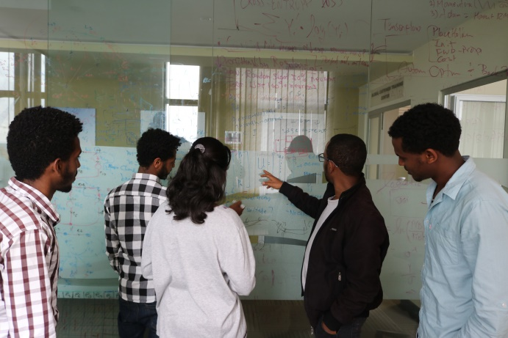
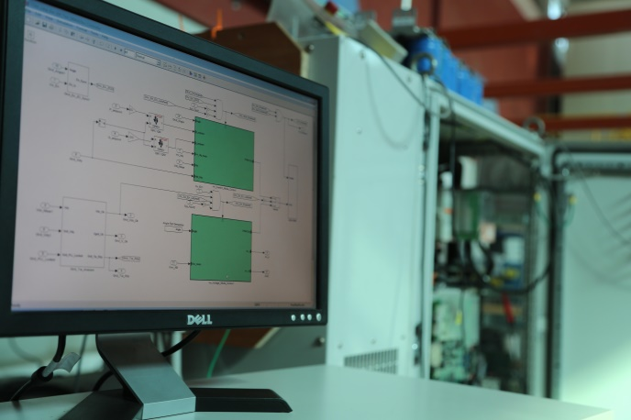
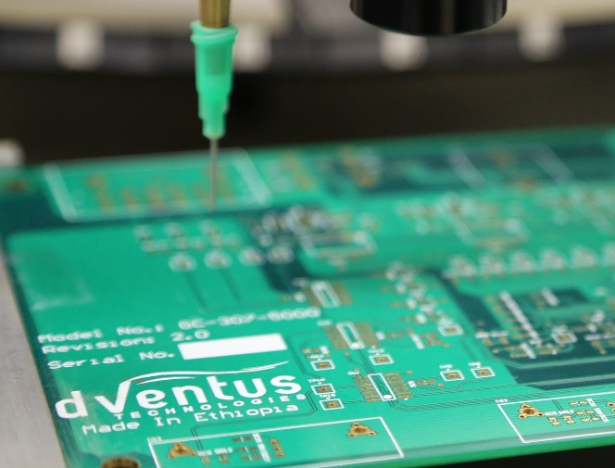
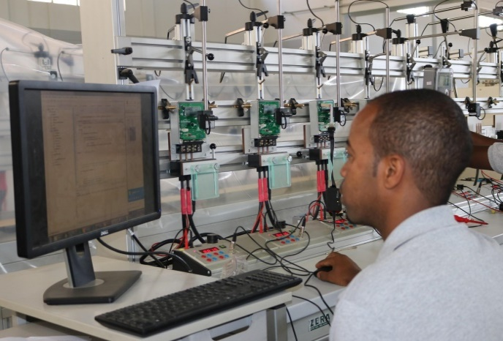
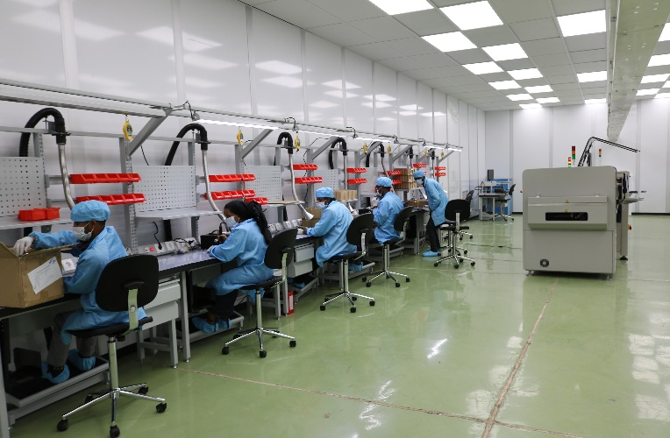
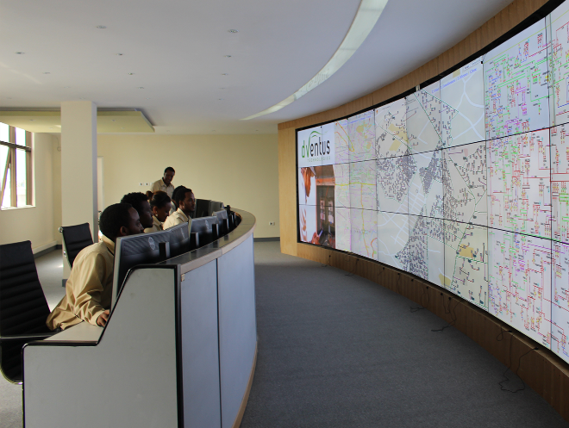
Full Value Chain... 100% by Africans
Concept Design
Analysis
Build
Test
Manufacture
Systems Integration
Vertically integrated, end to end technical solution, full customer service
Notes:
Product focus on smart meters & network equipment while services focus is on installation, commissioning, after sales services, operations and maintenance.
In-house technology development:
digital meters (entry level meters)
1-phase & 3-phases smart electrical meters
Smart water meters
Ultrasonic Based Robust/Reliable Design (for Harsh Environment )
Accuracy improved by 40 folds
Two way communication – data transmission every hour
Extremely low flow, Leakage, reverse flow, tampering detection
Contamination detection “NEW” patent pending
grid monitoring and data management tools
Secured and reliable data transmission (encrypted)
8 different tampering detection
15 programmable features including demand mgmt
Protection and safety feature beyond standards
Flexible communication
Power quality monitoring and control “NEW”
Integrated technologies:
wireless aggregation of data
optional automated billing and payment system
dVentus can provide end-to-end solutions including technology and services for distribution, grid management and maintenance at competitive price.

Slide 6
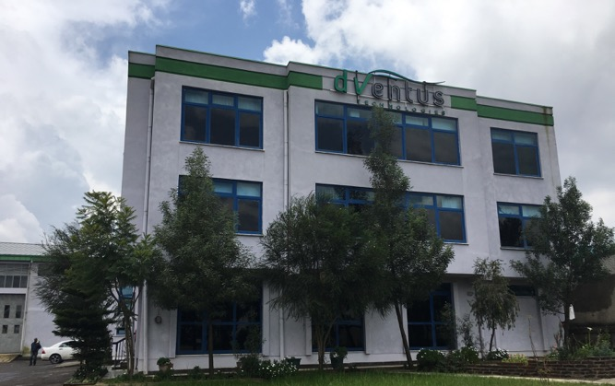
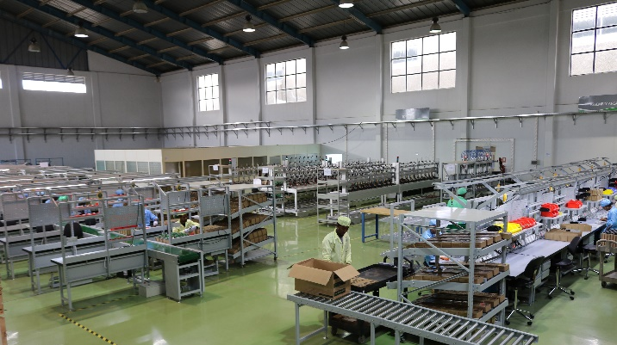
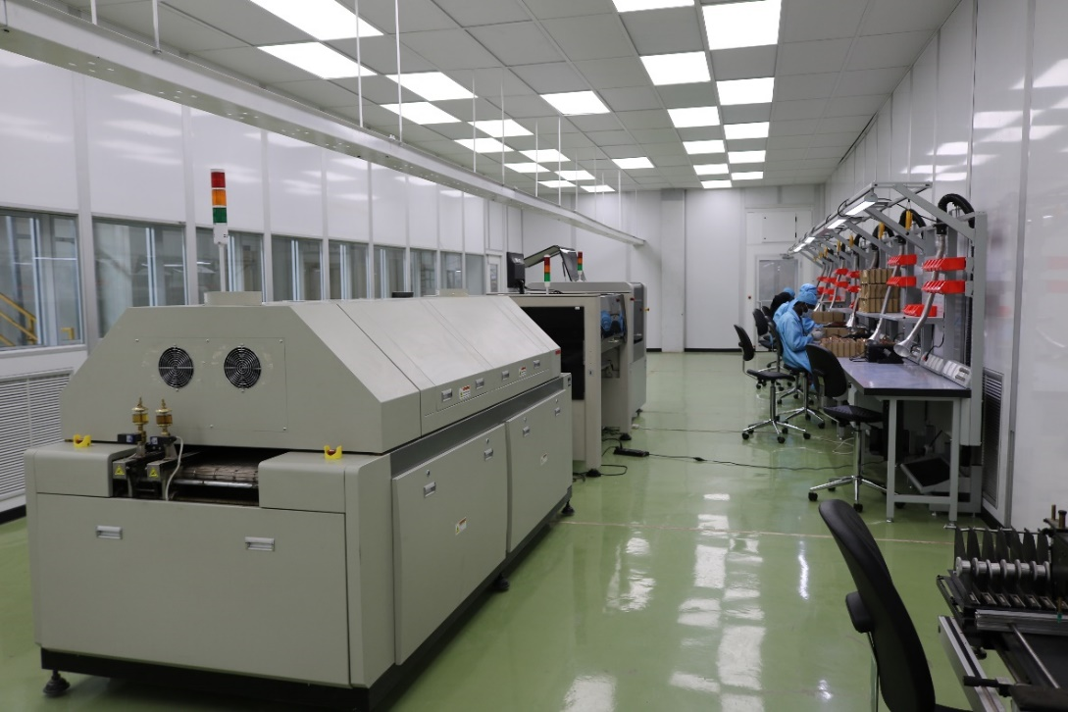
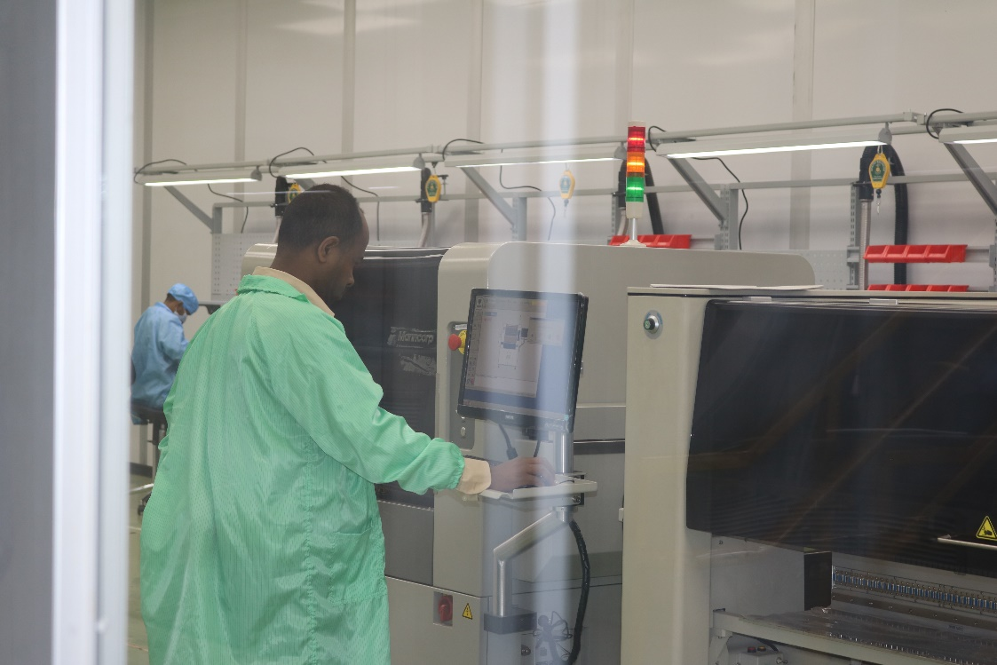
High-tech Manufacturing Facility with a Capacity of 1 Million Units per Annum
ISO 6 – Super Clean Room for PCB Assembly (1 Mil/year)

Slide 7
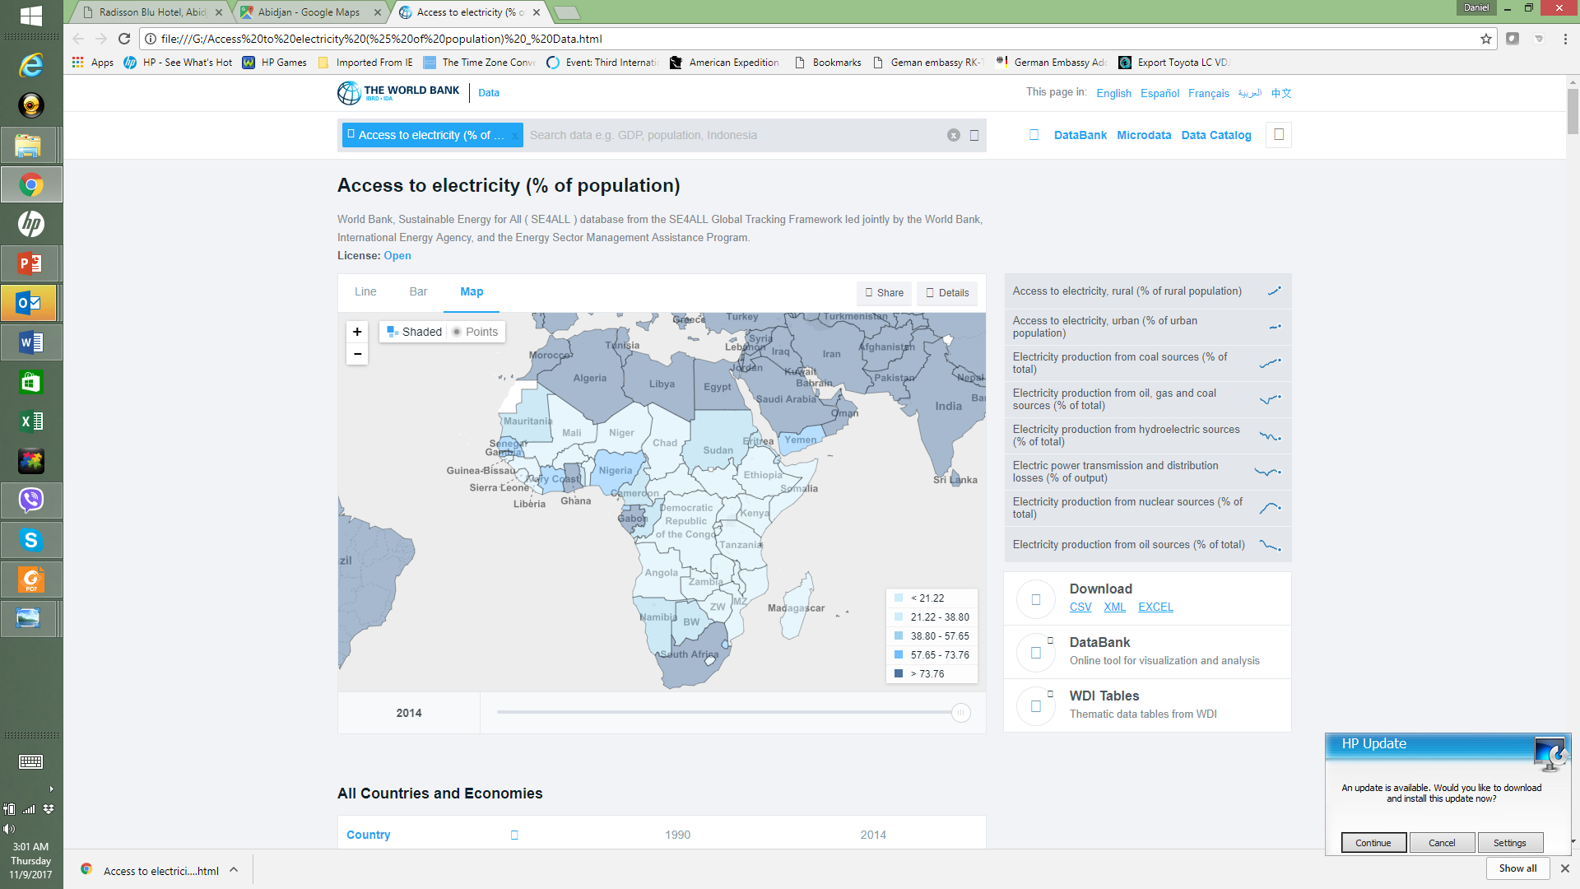
Energy Demand and Key Delivery Challenges in Africa
Population & urbanization growth
Sub-Saharan Africa electrification = 32% [IEA, WEO2014]
ECONOMIC GROWTH Fuel => Energy demand ~ 23%/Yr (eth)
Consumer Energy Problem:
  Shortage & Affordability
  Frequent Outage
  Poor Power Quality
  Poor Customer Service
Utility Challenges:
  Poor Revenue Collection
  Illegal Connection & Energy Theft
  High Technical and Commercial Losses (~40%)
  Outdated Infrastructure
  Lack of real time information, data and monitoring sys
  Smart Grid Regulatory Government Mandate
AfDB financial statement recently stated, that the manufacturing sector in Africa loses 56 days a year in productivity due to Power Outages across the continent. Costing 2-4% of GDP Annually.

Slide 8

Product Focus

Slide 9
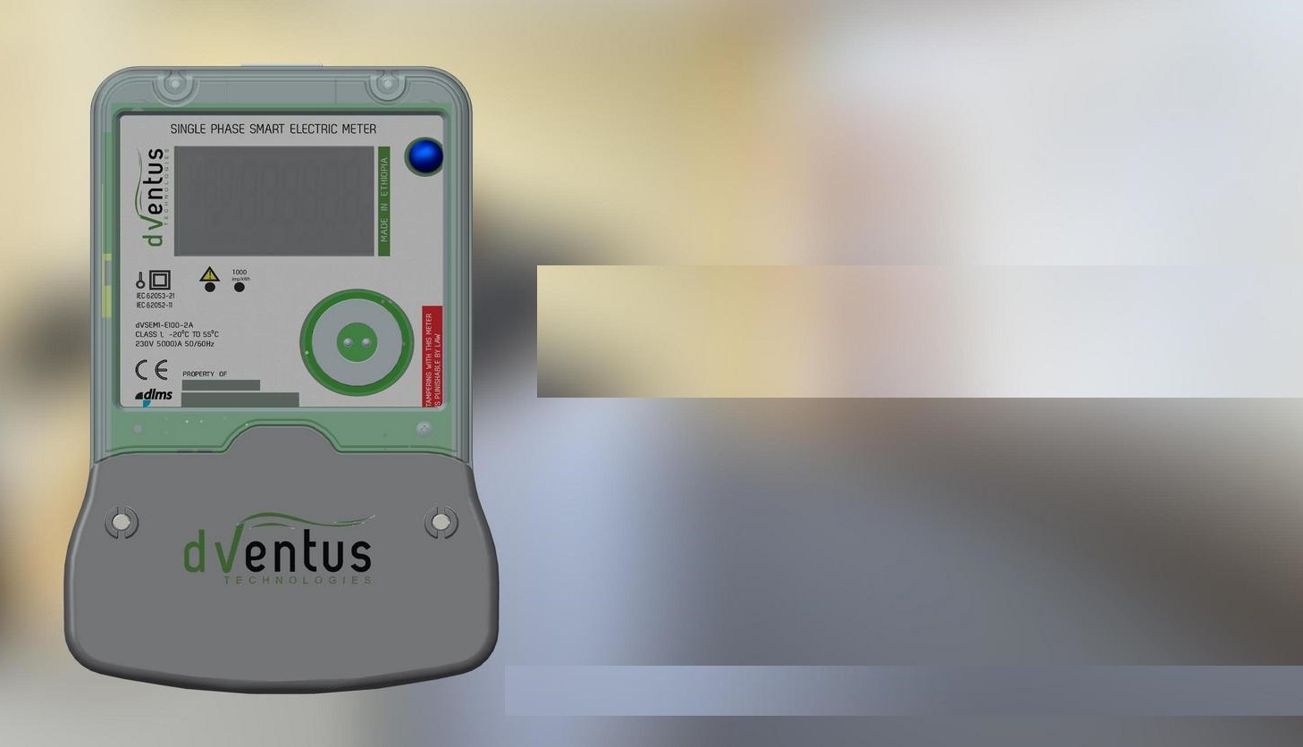
Smart Electric Meters for Africa
Smart Electric Meters:
  Single and three phase smart meters
  Secured and reliable data transmission (encrypted)
  8 different tampering detection
  More than 42 events logging
  15 programmable features including demand management
  Protection and safety feature beyond standards
  Flexible communication
  Power quality monitoring and control “NEW”
Super durable for:
Deseret, high altitude, tropical, donkey step.
Volatile grid, voltage spikes, surges
Energy theft protection and management
Flexible payment plan
Notes:
Product focus on smart meters & network equipment while services focus is on installation, commissioning, after sales services, operations and maintenance.
In-house technology development:
digital meters (entry level meters)
1-phase & 3-phases smart electrical meters
Smart water meters
Ultrasonic Based Robust/Reliable Design (for Harsh Environment )
Accuracy improved by 40 folds
Two way communication – data transmission every hour
Extremely low flow, Leakage, reverse flow, tampering detection
Contamination detection “NEW” patent pending
grid monitoring and data management tools
Secured and reliable data transmission (encrypted)
8 different tampering detection
15 programmable features including demand mgmt
Protection and safety feature beyond standards
Flexible communication
Power quality monitoring and control “NEW”
Integrated technologies:
wireless aggregation of data
optional automated billing and payment system
dVentus can provide end-to-end solutions including technology and services for distribution, grid management and maintenance at competitive price.

Slide 10
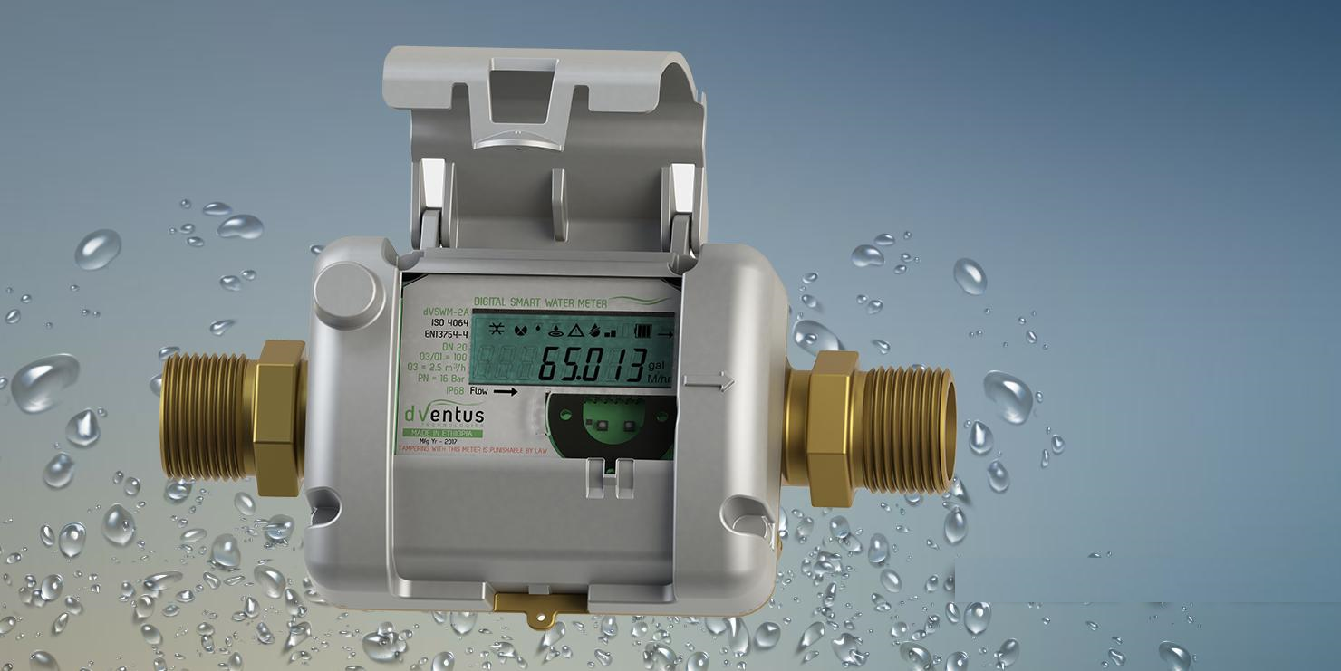
Water Smart Meters
Smart Water Meters:
  Ultrasonic Based Robust/Reliable Design (for Harsh Environment
  Accuracy improved by 40 folds
  Two way communication – data transmission every hour
  Extremely low flow, Leakage, reverse flow, tampering detection
  Contamination detection “NEW” patent pending
Notes:
Product focus on smart meters & network equipment while services focus is on installation, commissioning, after sales services, operations and maintenance.
In-house technology development:
digital meters (entry level meters)
1-phase & 3-phases smart electrical meters
Smart water meters
Ultrasonic Based Robust/Reliable Design (for Harsh Environment )
Accuracy improved by 40 folds
Two way communication – data transmission every hour
Extremely low flow, Leakage, reverse flow, tampering detection
Contamination detection “NEW” patent pending
grid monitoring and data management tools
Secured and reliable data transmission (encrypted)
8 different tampering detection
15 programmable features including demand mgmt
Protection and safety feature beyond standards
Flexible communication
Power quality monitoring and control “NEW”
Integrated technologies:
wireless aggregation of data
optional automated billing and payment system
dVentus can provide end-to-end solutions including technology and services for distribution, grid management and maintenance at competitive price.

Slide 11
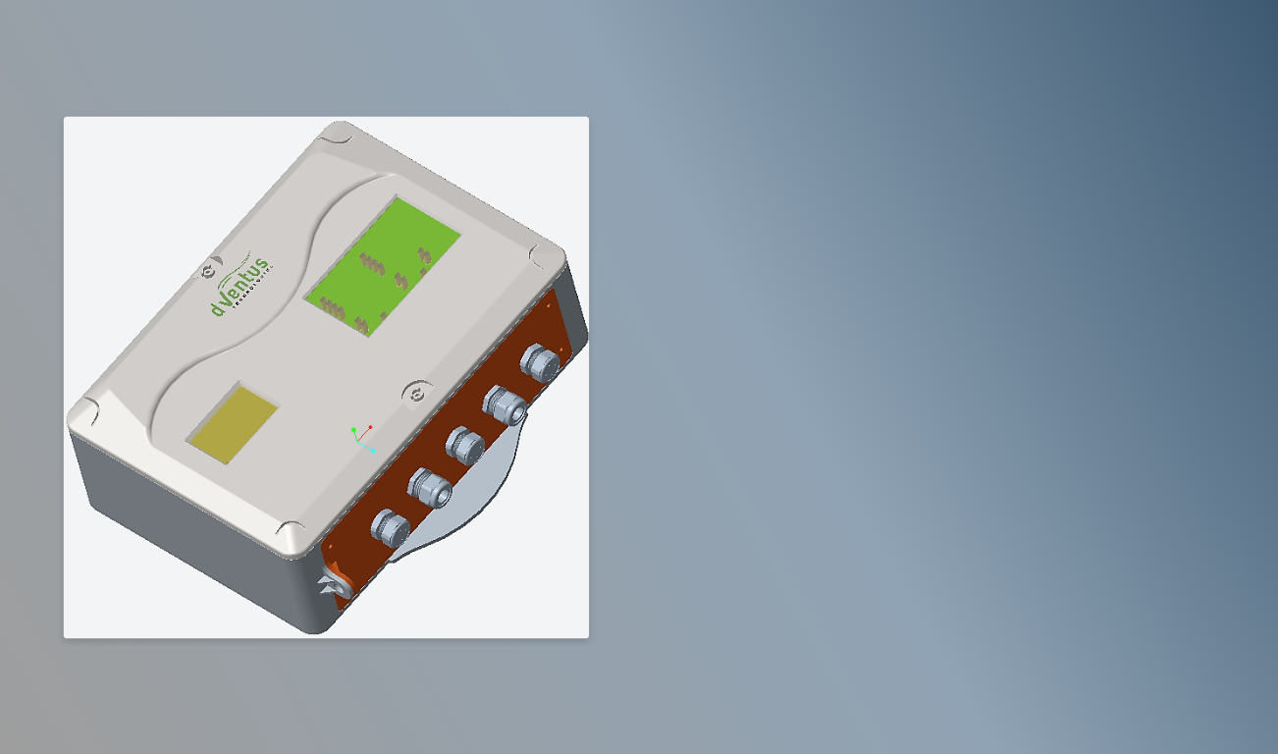
Network Smart Data Concentrator
Smart Data Concentrator Unit
  Secured and reliable data transmission (encrypted)
  Smart Meter Data Integration
  Meter data and LV measurements
  Enables decisions on grid optimization
  Energy Balancing
  Backend Integration
Notes:
Product focus on smart meters & network equipment while services focus is on installation, commissioning, after sales services, operations and maintenance.
In-house technology development:
digital meters (entry level meters)
1-phase & 3-phases smart electrical meters
Smart water meters
Ultrasonic Based Robust/Reliable Design (for Harsh Environment )
Accuracy improved by 40 folds
Two way communication – data transmission every hour
Extremely low flow, Leakage, reverse flow, tampering detection
Contamination detection “NEW” patent pending
grid monitoring and data management tools
Secured and reliable data transmission (encrypted)
8 different tampering detection
15 programmable features including demand mgmt
Protection and safety feature beyond standards
Flexible communication
Power quality monitoring and control “NEW”
Integrated technologies:
wireless aggregation of data
optional automated billing and payment system
dVentus can provide end-to-end solutions including technology and services for distribution, grid management and maintenance at competitive price.

Slide 12
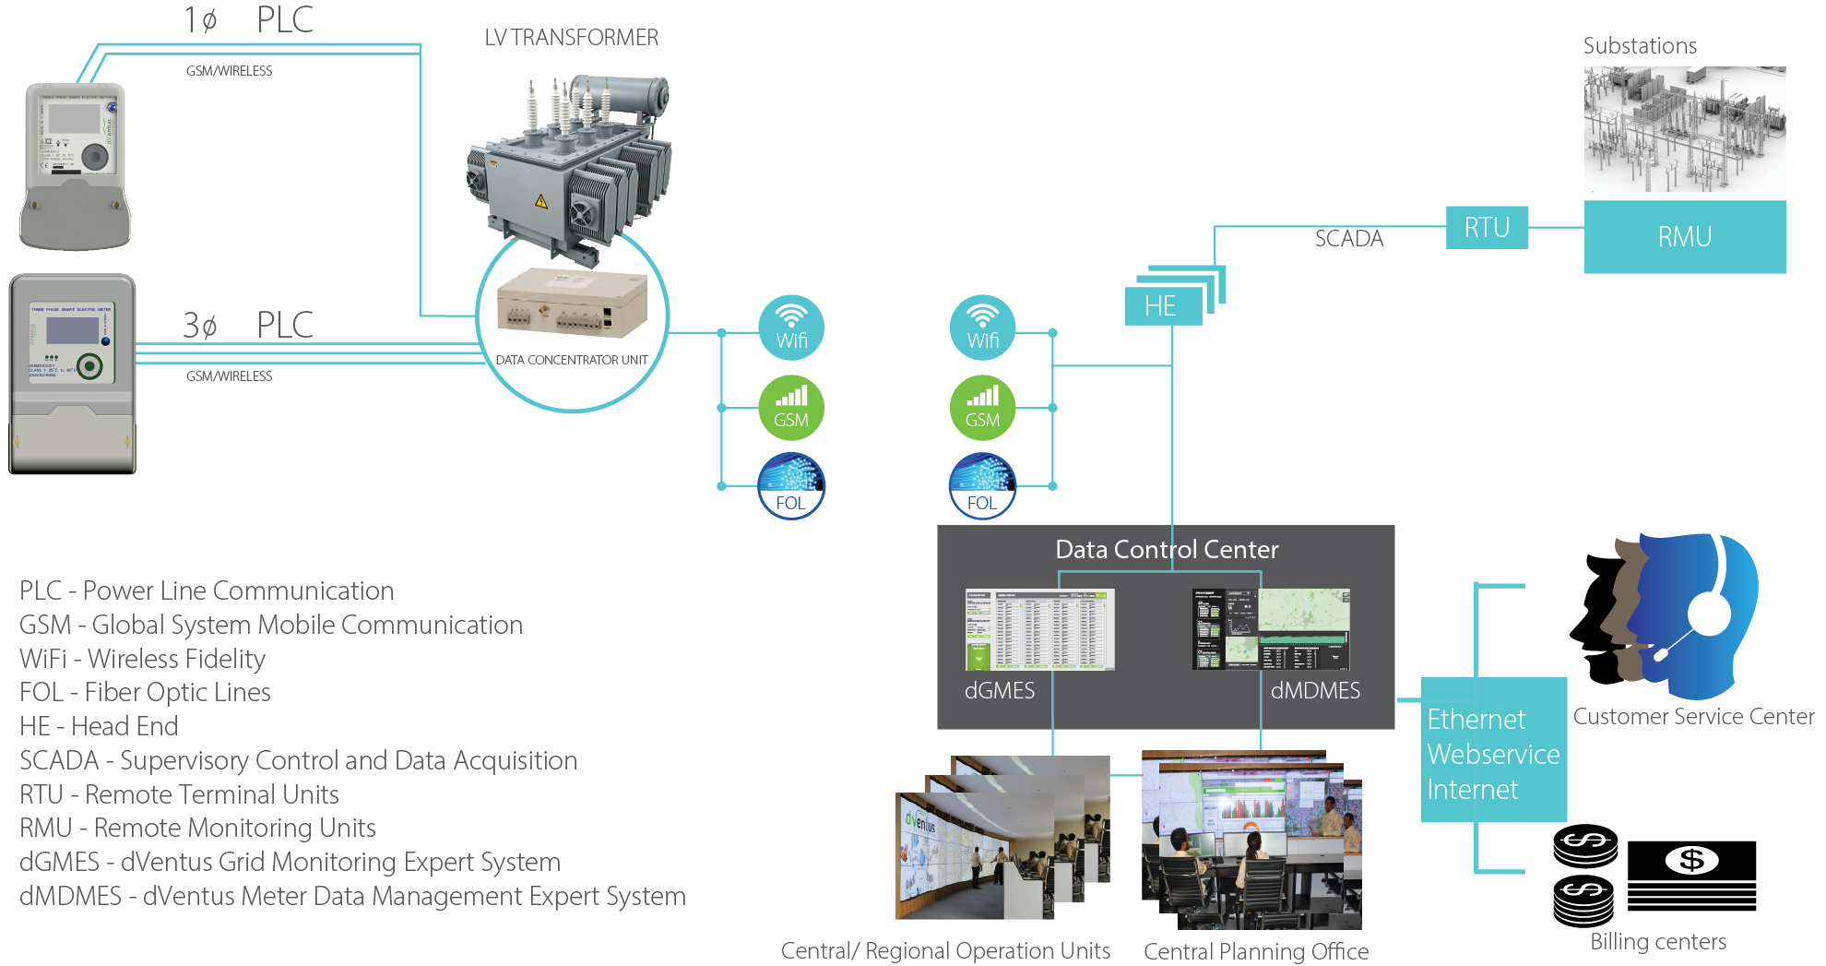
dVentus Smart Electric Distribution Network System – end to end solution

Slide 13
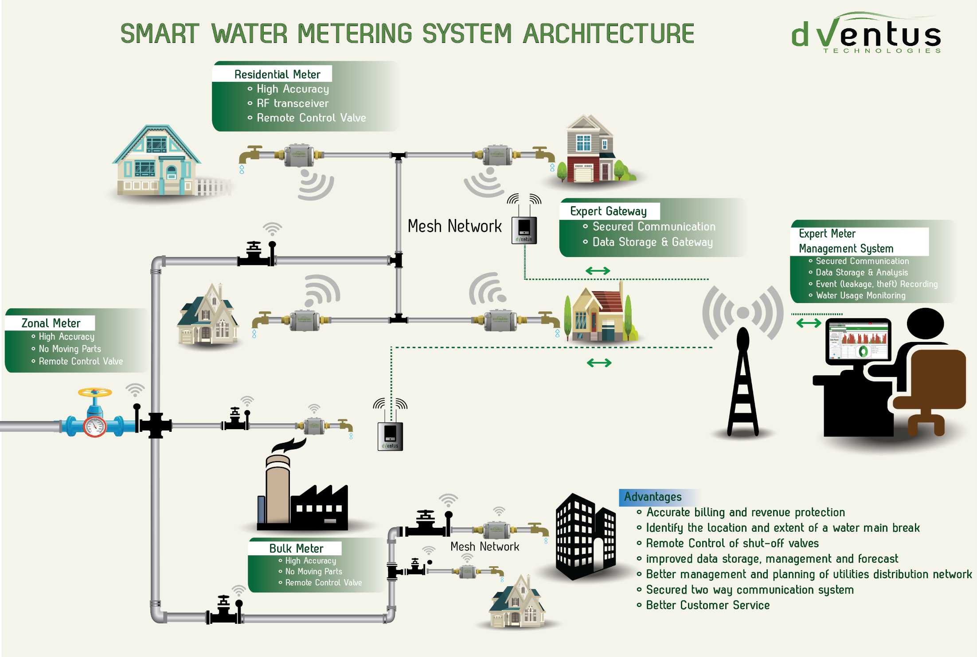
dVentus Smart Water Metering System – end to end system solution

Slide 14
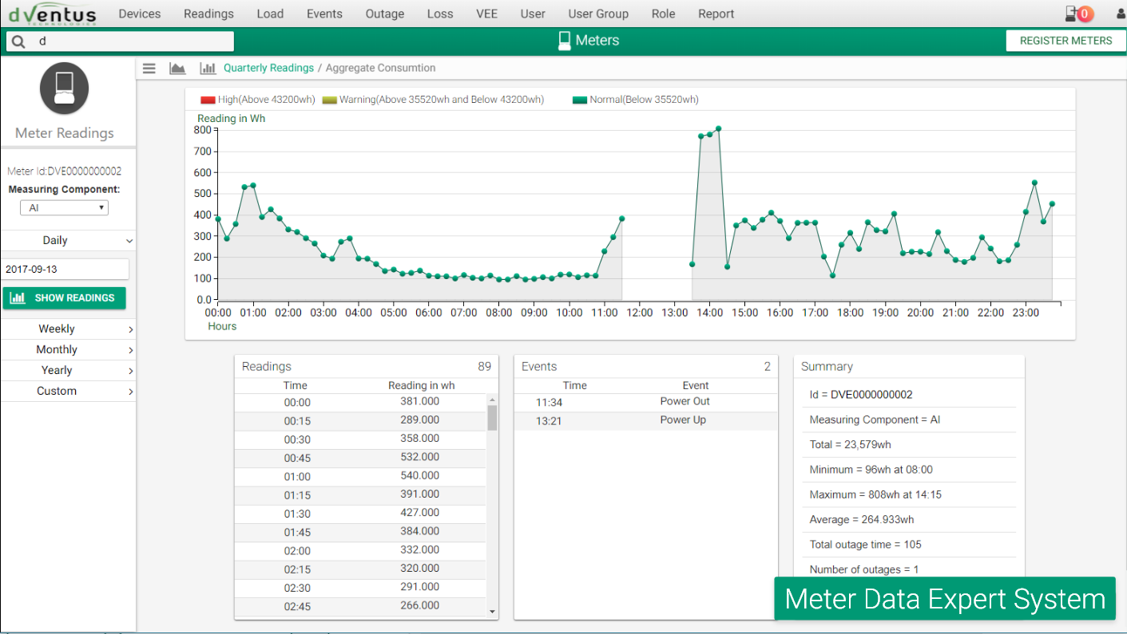
Meter Data Expert System
Smart Water Meter
Smart system integration Consumption profile Pattern identification and analysis Usage and event subscription Smart meter data storage Allows for setting of different tariff regimes based on usage pattern and events Automatic meter registration Provides a rich library of VEE rules that can be individually configured and executed
Notes:
Product focus on smart meters & network equipment while services focus is on installation, commissioning, after sales services, operations and maintenance.
In-house technology development:
digital meters (entry level meters)
1-phase & 3-phases smart electrical meters
Smart water meters
Ultrasonic Based Robust/Reliable Design (for Harsh Environment )
Accuracy improved by 40 folds
Two way communication – data transmission every hour
Extremely low flow, Leakage, reverse flow, tampering detection
Contamination detection “NEW” patent pending
grid monitoring and data management tools
Secured and reliable data transmission (encrypted)
8 different tampering detection
15 programmable features including demand mgmt
Protection and safety feature beyond standards
Flexible communication
Power quality monitoring and control “NEW”
Integrated technologies:
wireless aggregation of data
optional automated billing and payment system
dVentus can provide end-to-end solutions including technology and services for distribution, grid management and maintenance at competitive price.

Slide 15
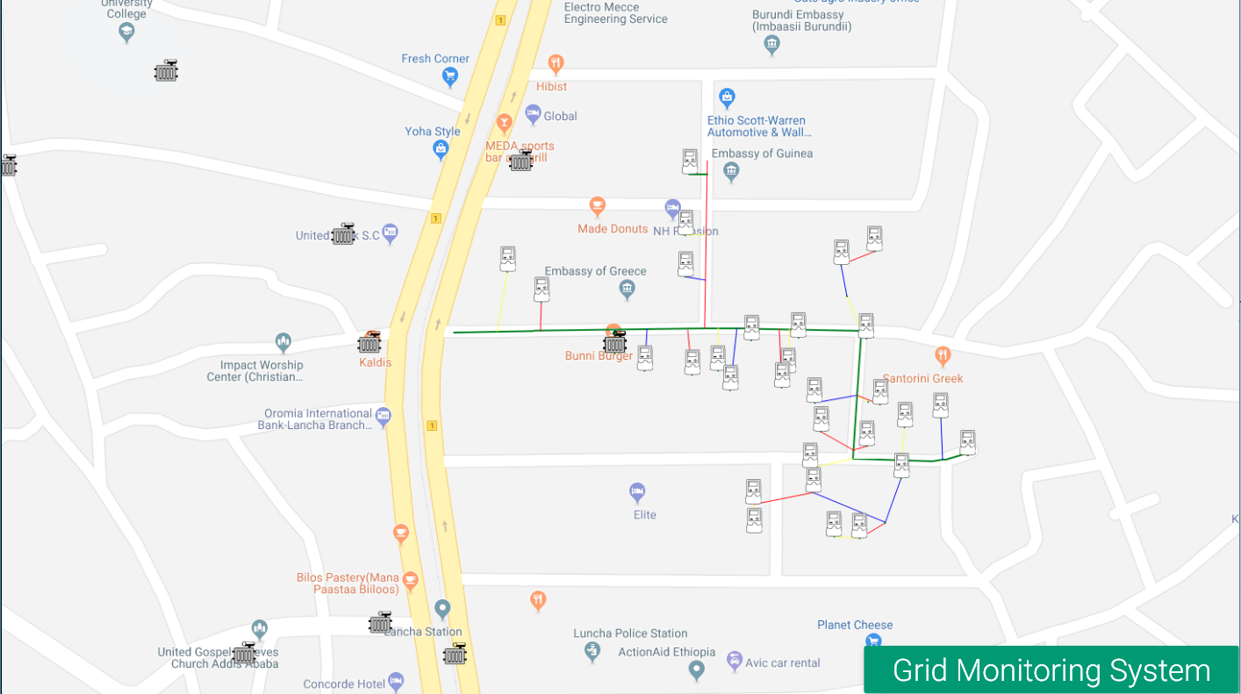
Grid/Distribution network Monitoring Expert System
Smart Water Meter
Live smart meter management and monitoring
Geographical or topological visualization
Event management for maintenance support
Locating network faults including low voltage faults
Notes:
Product focus on smart meters & network equipment while services focus is on installation, commissioning, after sales services, operations and maintenance.
In-house technology development:
digital meters (entry level meters)
1-phase & 3-phases smart electrical meters
Smart water meters
Ultrasonic Based Robust/Reliable Design (for Harsh Environment )
Accuracy improved by 40 folds
Two way communication – data transmission every hour
Extremely low flow, Leakage, reverse flow, tampering detection
Contamination detection “NEW” patent pending
grid monitoring and data management tools
Secured and reliable data transmission (encrypted)
8 different tampering detection
15 programmable features including demand mgmt
Protection and safety feature beyond standards
Flexible communication
Power quality monitoring and control “NEW”
Integrated technologies:
wireless aggregation of data
optional automated billing and payment system
dVentus can provide end-to-end solutions including technology and services for distribution, grid management and maintenance at competitive price.

Slide 16
Thank you!
Grum Ketema
CTO dVentus Technologies grum.ketema@dventus.com
+251930294104

