Slide 1
IoT: Privacy and Security
Chapters Workshop
Addis Ababa, 2019
Kevin G. Chege
ISOC

Slide 2
Privacy, Security and IoT
Privacy is about retaining the ability to disclose data consensually, and with expectations about the context and scope of sharing.
With online privacy, we wish to ensure that our personal data is not disclosed to third parties without our knowledge or consent
As with any online service, IoT Privacy and IoT Security are linked and complement each other:
  Entering your password via a un-secured IoT device risks eaves-droppers from stealing your identity
  If your mobile phone lacks a password and is stolen, your personal data like call logs, messages, photos etc can be accessed

Slide 3
There are two ways to view IoT Security
Inward Security
  Focus on potential harms to the health, safety, and privacy of device users and their property stemming from compromised IoT devices and systems
Outward Security
  Focus on potential harms that compromised devices and systems can inflict on the Internet and other users
Notes:
Example of outward risk:
A home appliance may continue to function well as far as the direct user is concerned, and s/he may be unaware that it is part of a botnet participating in a DDoS attack
Toaster example:
- Someone may use it against you, and remotely decide to burn your hands our even your house (inward security related issue)
Your toaster works ok but is being used for a major DDOS attack (outward)
At ISOC, our focus is on the impact that IoT security and privacy has on the Internet and other users.

Slide 4
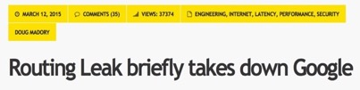
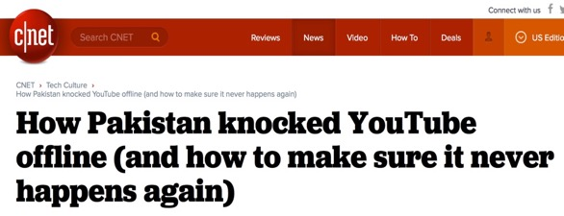
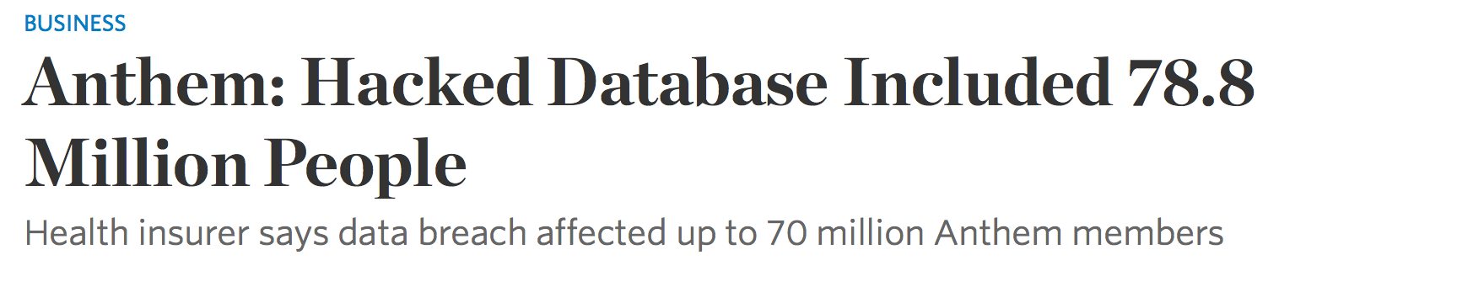

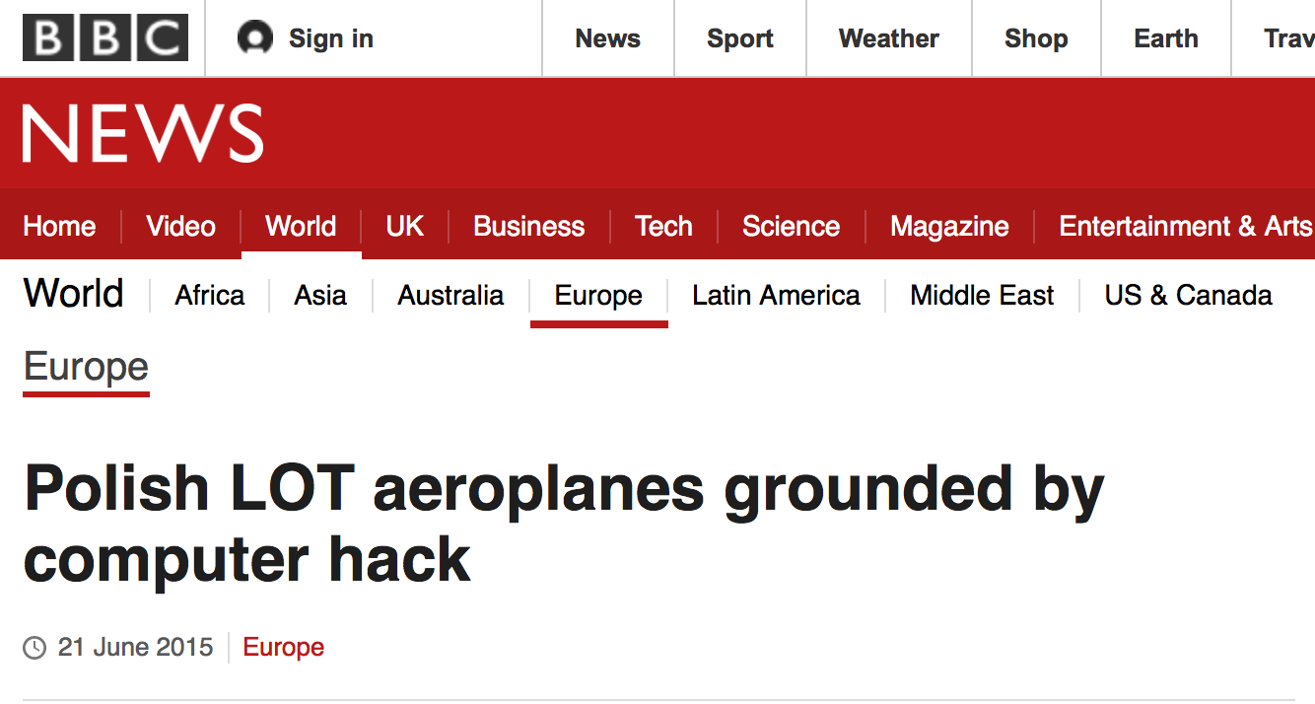
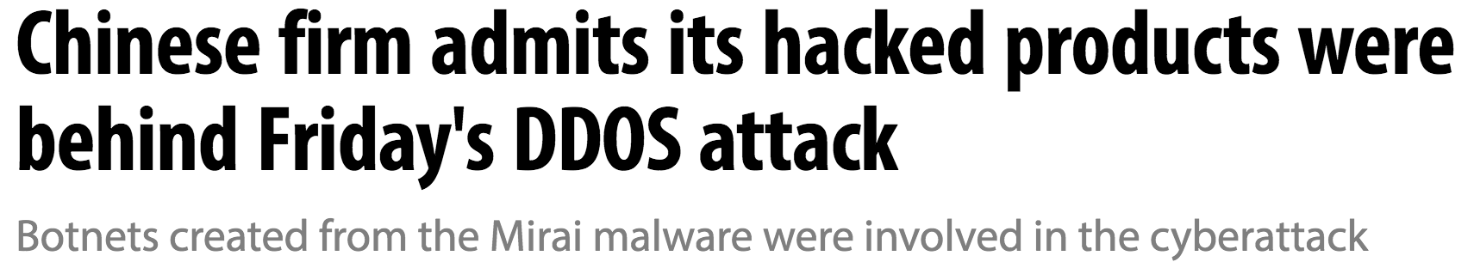

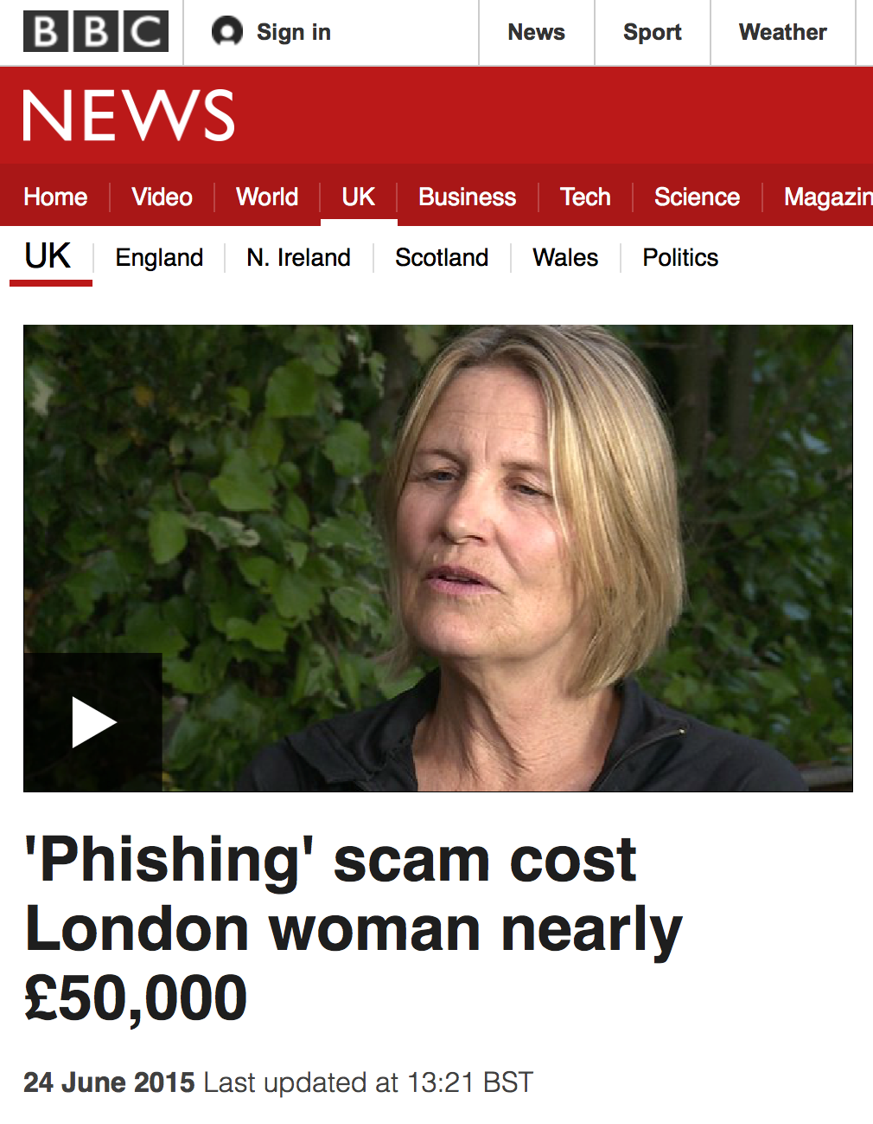


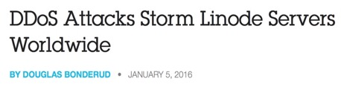
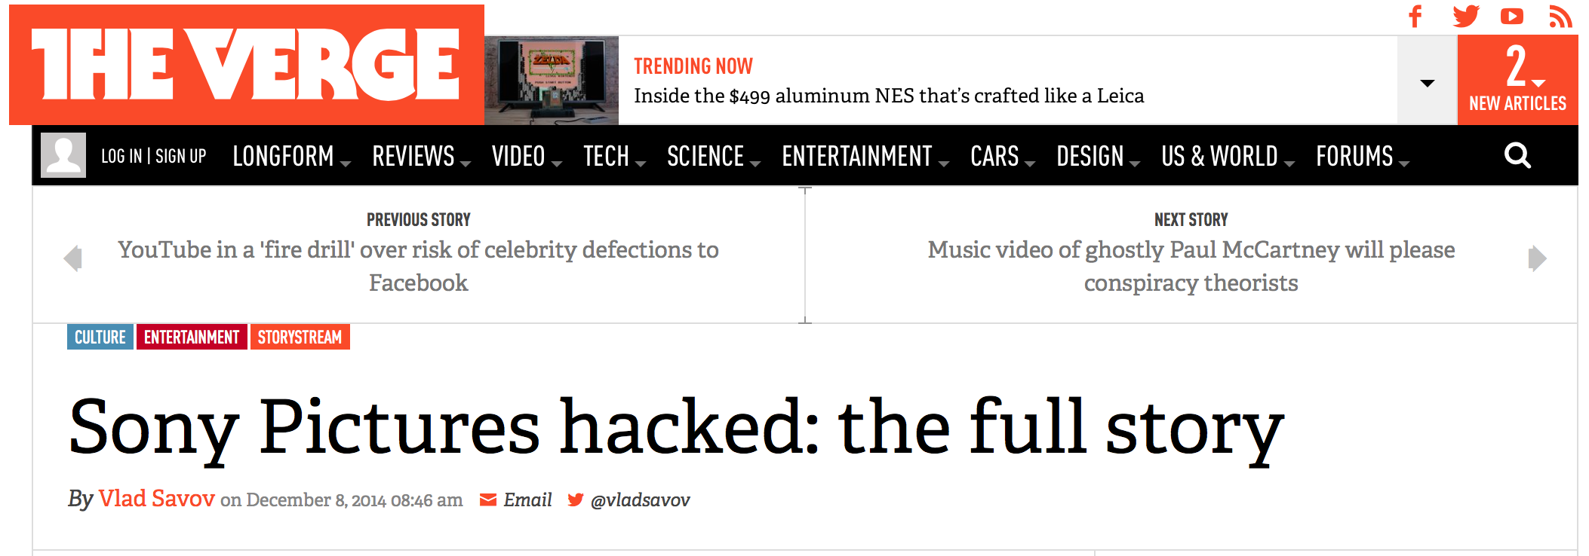



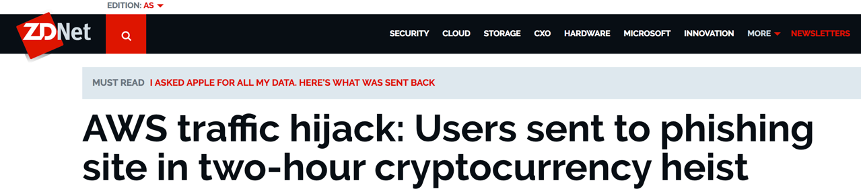
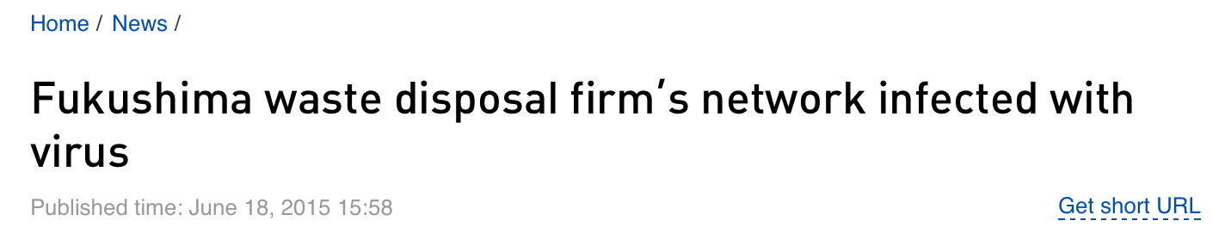


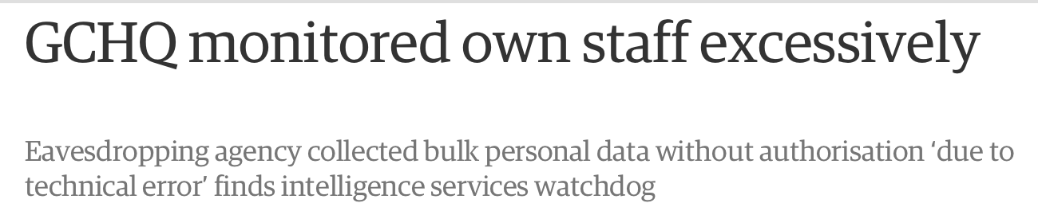
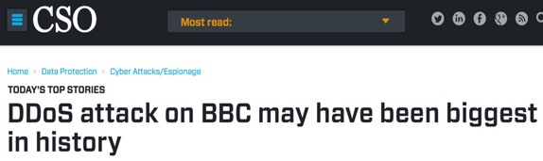

Outward Security: Impact of Cyber Security issues

Slide 5
Inward Security: What risks do insecure IoT devices bring to Privacy and Security?
Using insecure IoT Devices increases the risks of personal data being exposed/stolen and privacy compromised:
A smart camera using default username and password combination can be used to spy on you or be compromised to send junk information to the Internet
A wearable smart device that sends health information over un-encrypted channels can expose personal data
A smart home device like a television that lacks sufficient updates can be vulnerable to new attacks and be used to share private data
Smart vehicles running insecure software can be accessed remotely and compromised to disable certain functions of the car

Slide 6
Economics favor weak IoT security
Strong security can be expensive to design and implement, and it lengthens the time it takes to get a product to market.
The commercial value of user data also means that there is an incentive to hoard as much data for as long as possible
There is currently a shortage of credible ways for suppliers to signal their level of security to consumers (e.g., certifications and trustmarks).
The cost and impact of poor security tend to fall on the consumer and other Internet users, rather than on the producers of IoT systems

Slide 7
How can IoT Security be improved?
Collaborative approach: sharing of information by users, vendors, manufacturers on security breaches and best practices
Strong policy controls for example:
  Requiring encryption in devices: IoT devices should use encryption in order to make it very difficult for a 3rd party to eavesdrop on communications
  Frameworks on device features and capabilities
User Education for example:
  Train users on preferring stronger passwords on IoT Devices
  Consumer Demand for devices to have certain eg using two factor authentication: a password (something you know) and a token (something you have).
  Train users to identify insecure devices and avoid them

Slide 8
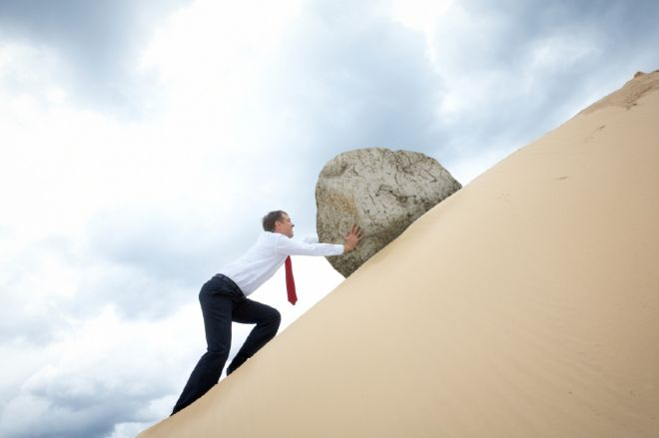
How do we improve things?
Research and Innovation
Open Standards
Certifications and Trustmarks
Policy and Regulation
Frameworks and Best Practices
Notes:
(new technologies, better user interfaces, better development tools)

Slide 9
chege@isoc.org

