Slide 1


Slide 2


outline
About Daam Company
  Daam establish
  Daam team
  Services
Daam Smart Farming Systems
  Smart Agriculture brief
  Daam solutions for farms
  DaamAgri Product
    Features & Specifications
  Our services in smart farming
  Zadna case study
Future Projects
…

Slide 3
outline
About Daam Company
  Daam establish
  Daam team
  Services
Daam Smart Farming Systems
  Smart Agriculture brief
  Daam solutions for farms
  DaamAgri Product
    Features & Specifications
  Our services in smart farming
  Zadna case study
Future Projects
…

Slide 4

About Daam Company
  Daam establish
DAAM is Daam Projects Development Co.Ltd ,established in 2016 as engineering research center named (Projects support and development center - PSDC) to develop embedded systems and IOT solutions for Sudan market.
…

Slide 5
outline
About Daam Company
  Daam establish
  Daam team
  Services
Daam Smart Farming Systems
  Smart Agriculture brief
  Daam solutions for farms
  DaamAgri Product
    Features & Specifications
  Our services in smart farming
  Zadna case study
Future Projects
…

Slide 6

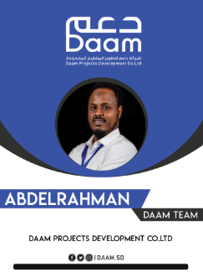






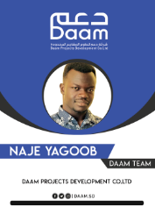


About Daam Company
  Daam team
DAAM have strong team from ,researcher , engineers and developer,..
…

Slide 7
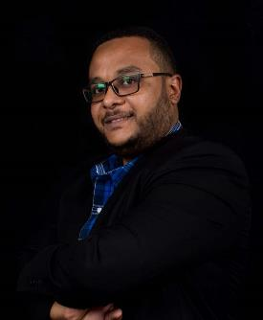
About Daam Company
  Daam team
WALEED BABIKER ELSEDIG
Embedded Systems Engineer ,MSc, Researcher & Systems Developer
CEO
Daam Projects Development Co.Ltd
IOT team leader
Internet Society – Sudan Chapter
Former Deputy Director
Institute of space research and aerospace –ISRA – National Center for Research
Project Manager
Sudanese high altitude balloon project.
  First Sudanese space body reach edge of atmosphere
…

Slide 8
outline
About Daam Company
  Daam establish
  Daam team
  Services
Daam Smart Farming Systems
  Smart Agriculture brief
  Daam solutions for farms
  DaamAgri Product
    Features & Specifications
  Our services in smart farming
  Zadna case study
Future Projects
…

Slide 9

About Daam Company
  Services
DAAM provide a different types of services
  IOT Solutions
  Embedded Systems design
  System Developments
  ICT Solutions
  Research and Development
  Professional Training
…

Slide 10
outline
About Daam Company
  Daam establish
  Daam team
  Services
Daam Smart Farming Systems
  Smart Agriculture brief
  Daam solutions for farms
  DaamAgri Product
    Features & Specifications
  Our services in smart farming
  Zadna case study
Future Projects
…

Slide 11
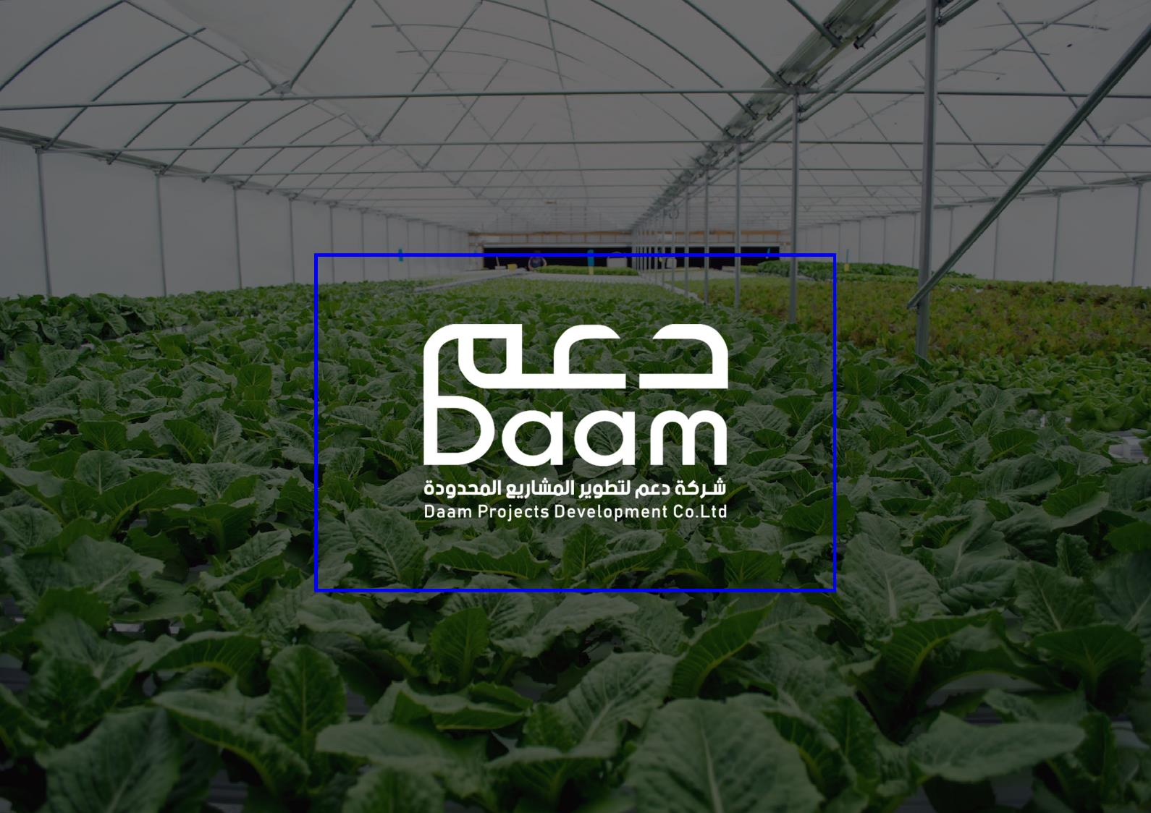
Smart Farming Systems
…

Slide 12
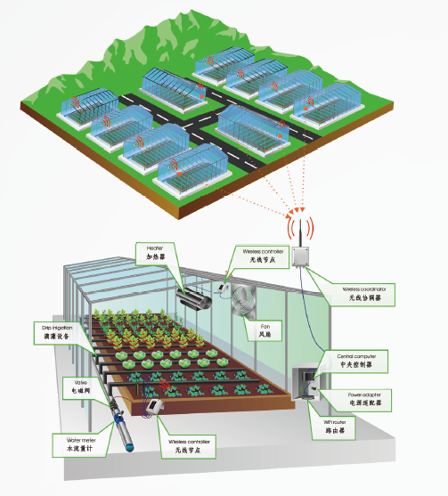
Daam Smart Farming Systems
  Smart Agriculture brief
Precision agriculture is sometimes known as ‘smart farming’, an umbrella term for easier comparison with other M2M based implementations such as smart metering, smart cities and so on. Precision agriculture is based on sensor technologies whose use is well established in other industries.
…

Slide 13
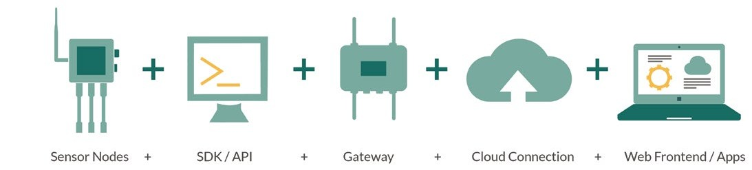
Daam Smart Farming Systems
  Smart Agriculture brief
“ Special sensors collect data regarding soil & crop behavior, animal conduct, machine status, storage tank & out- buildings status emanating from remote sites.”
…

Slide 14
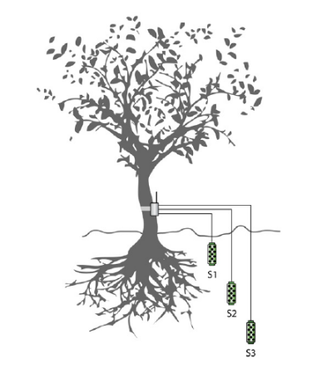
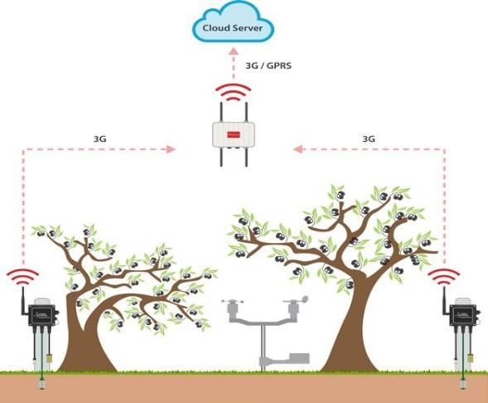
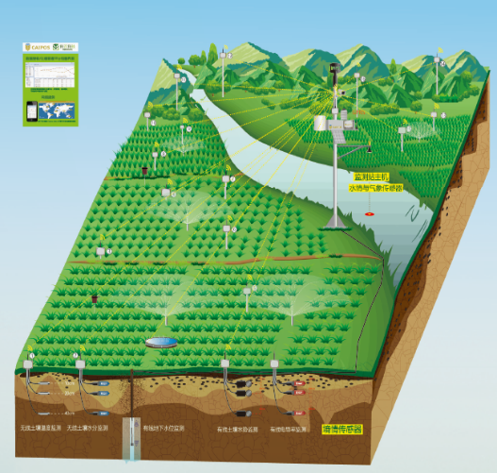
Daam Smart Farming Systems
  Smart Agriculture brief
…

Slide 15
outline
About Daam Company
  Daam establish
  Daam team
  Services
Daam Smart Farming Systems
  Smart Agriculture brief
  Daam solutions for farms
  DaamAgri Product
    Features & Specifications
  Our services in smart farming
  Zadna case study
Future Projects
…

Slide 16
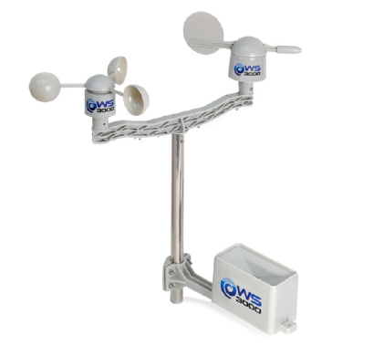
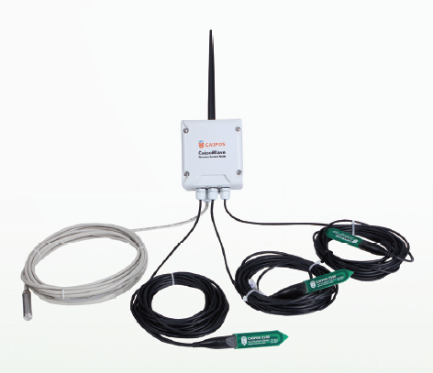
outline
Daam Smart Farming Systems
  Daam solutions for farms
Products
SmartAgri System
…

Slide 17
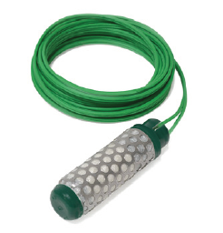
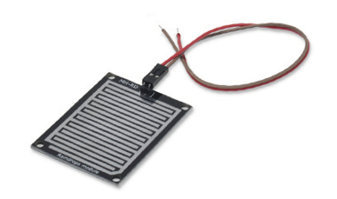
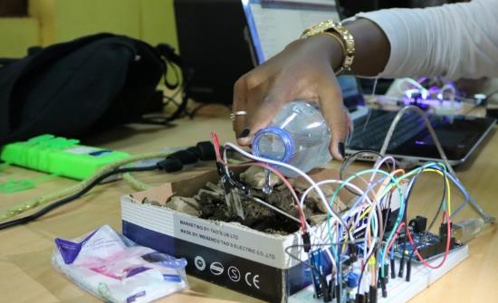
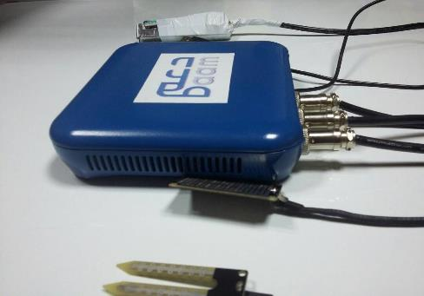
Daam Smart Farming Systems
  Daam solutions for farms
Systems Design as Required
…

Slide 18
outline
About Daam Company
  Daam establish
  Daam team
  Services
Daam Smart Farming Systems
  Smart Agriculture brief
  Daam solutions for farms
  DaamAgri Product
    Features & Specifications
  Our services in smart farming
  Zadna case study
Future Projects
…

Slide 19
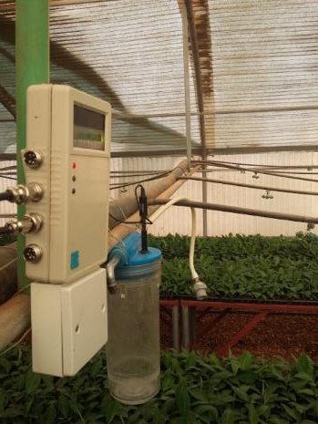
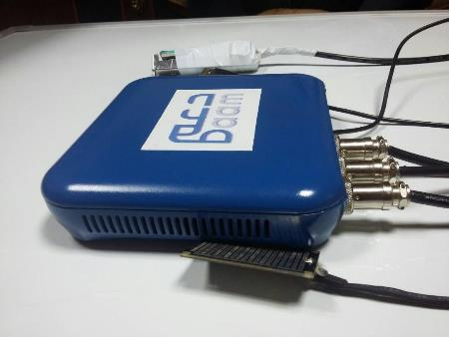
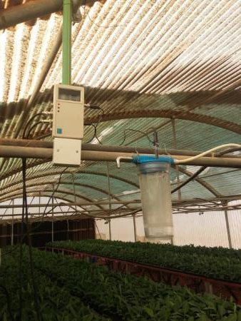
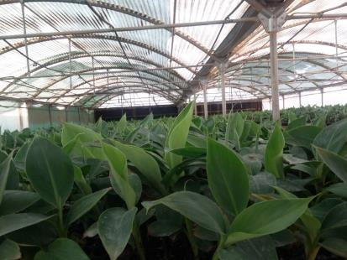
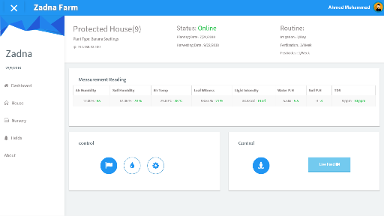
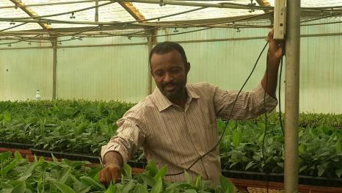
outline
Daam Smart Farming Systems
  DaamAgri Product
DaamAgri is a one of Daam Smart farming Products
…

Slide 20
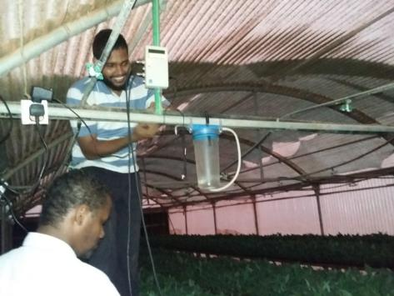
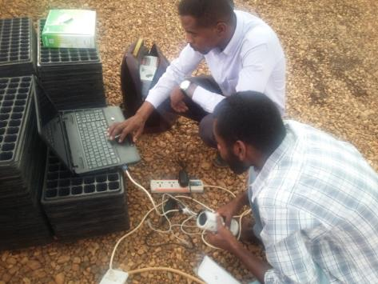
Our services in smart farming
Provide Solution and products
Installation
Provide Support
ICT Services
…

Slide 21
Our target to Make Daam Smart Farming System with every farmer & in every farm.
…

Slide 22
outline
About Daam Company
  Daam establish
  Daam team
  Services
Daam Smart Farming Systems
  Smart Agriculture brief
  Daam solutions for farms
  DaamAgri Product
    Features & Specifications
  Our services in smart farming
  Zadna case study
Future Projects
…

Slide 23

Zadna Case Study
Zadna International Investment Co. Ltd
Khartoum Sudan, ALKADRO Typical farm
…

Slide 24
Zadna Case Study
Zadna International Investment Co. Ltd
Khartoum Sudan, ALKADRO Typical farm
Main Problems and needs
صعوبة التاكد من التزام العمال بوقت وكمية الري المطلوب.
صعوبة معرفة حوجة التربة الحقيقية للمياه لحظيا
صعوبة تقدير الزمن المناسب لتشغيل واطفاء انظمة التبريد.
الحوجة لتحديد وقياس العوامل البيئية المحيطة بدقة
عدم المقدرة على متابعة المزرعه بعد الدوام وفي العطلات
عدم دقة العامل البشري
تلف في بعض المحصول والحوجة للتاكد من السبب الفعلي
عدم توفر سجل دقيق بالنشاطات والمتغيرات داخل المزرعة.
صعوبة جمع المعلومات للتقارير الفنية والتطوير.
…

Slide 25

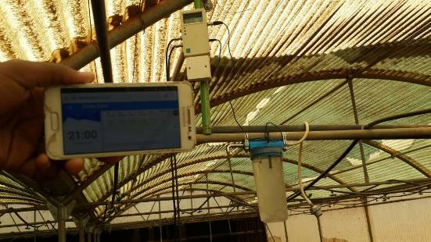
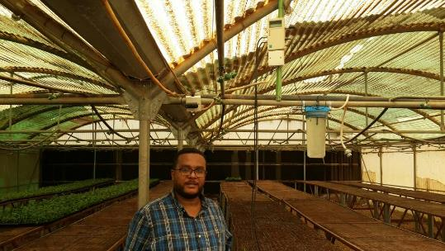
Zadna Case Study
Zadna International Investment Co. Ltd
Khartoum Sudan, ALKADRO Typical farm
…

Slide 26
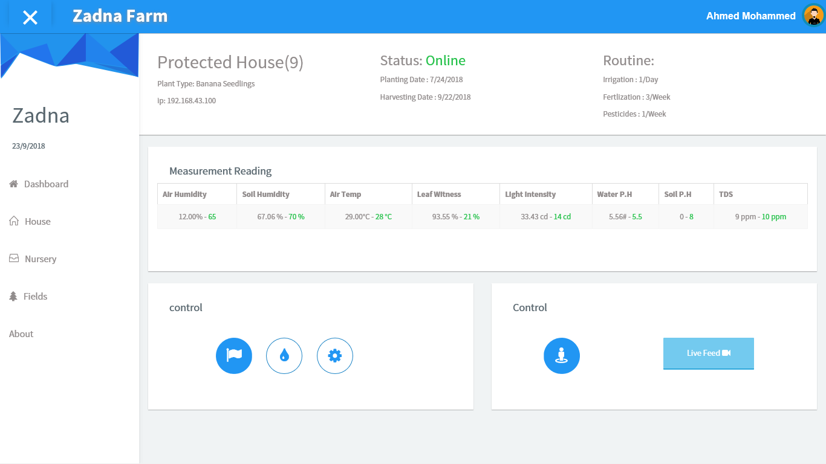
Zadna Case Study
Zadna International Investment Co. Ltd
Khartoum Sudan, ALKADRO Typical farm
…

Slide 27
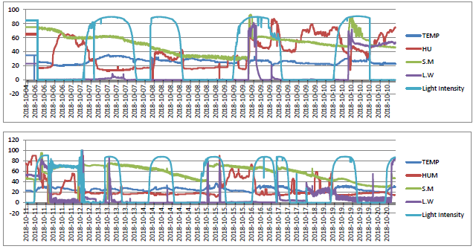
Zadna Case Study
Zadna International Investment Co. Ltd
Khartoum Sudan, ALKADRO Typical farm
…

Slide 28
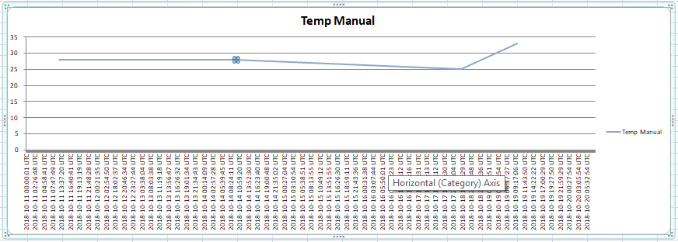
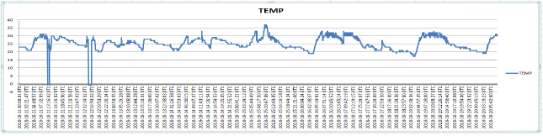
Zadna Case Study
Zadna International Investment Co. Ltd
Khartoum Sudan, ALKADRO Typical farm
Before DaamAgri
After DaamAgri
…

Slide 29
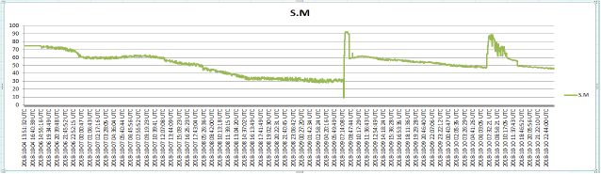
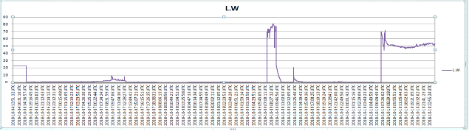
Zadna Case Study
Zadna International Investment Co. Ltd
Khartoum Sudan, ALKADRO Typical farm
…

Slide 30
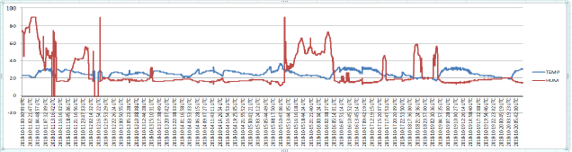
Zadna Case Study
Zadna International Investment Co. Ltd
Khartoum Sudan, ALKADRO Typical farm
…

Slide 31
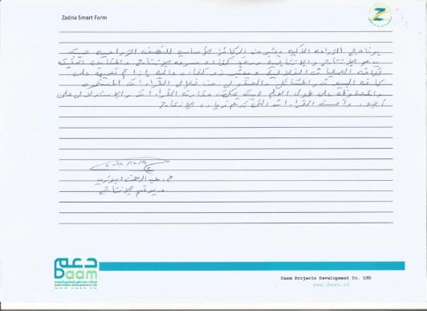
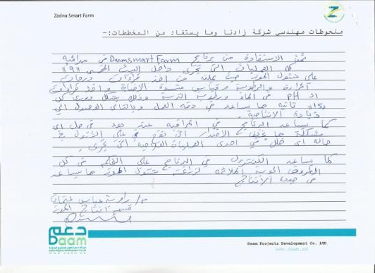
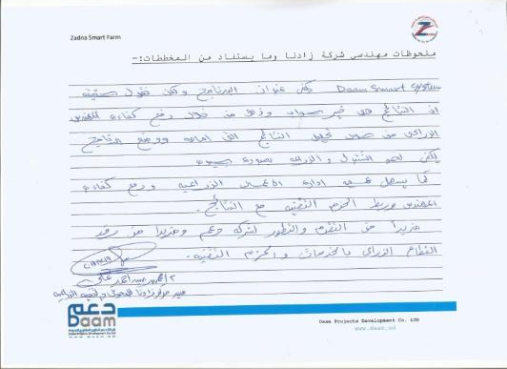
Zadna Case Study
Zadna International Investment Co. Ltd
Khartoum Sudan, ALKADRO Typical farm
…

Slide 32
outline
About Daam Company
  Daam establish
  Daam team
  Services
Daam Smart Farming Systems
  Smart Agriculture brief
  Daam solutions for farms
  DaamAgri Product
    Features & Specifications
  Our services in smart farming
  Zadna case study
Future Projects
…

Slide 33
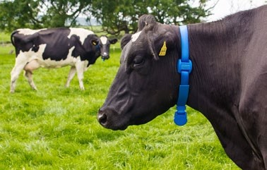
outline
Future Projects
  We are going forward to develop and design solution for animal farms
…

Slide 34

Thank you

