Slide 1

eHealth IoT Solution
Afrimed Medical Center, The Gambia
Bakary Njie
Chair/President sankalanka78@yahoo.com

Slide 2
Objectives of IoT eHealth Solution
To automate patient Data Collection
To Ease Electronic data Transmission for storage and retrieval
Project Timeline
1st September to 16th October

Slide 3
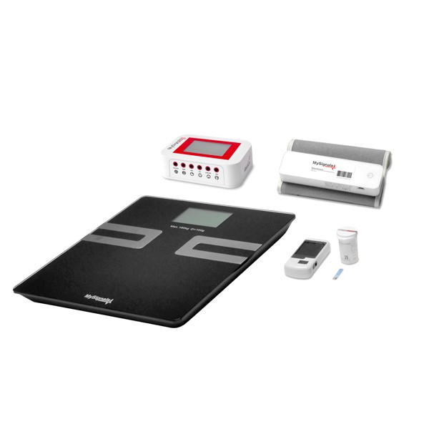
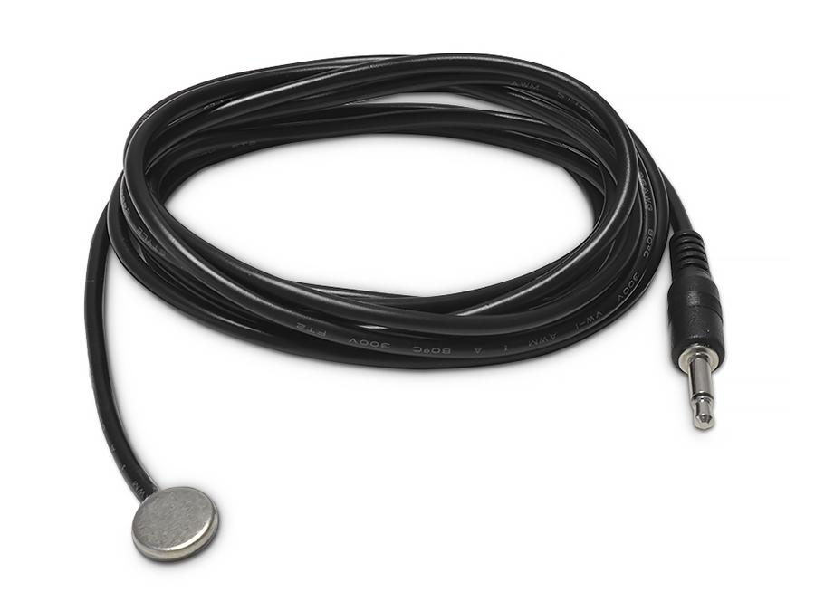
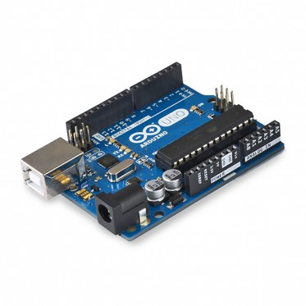
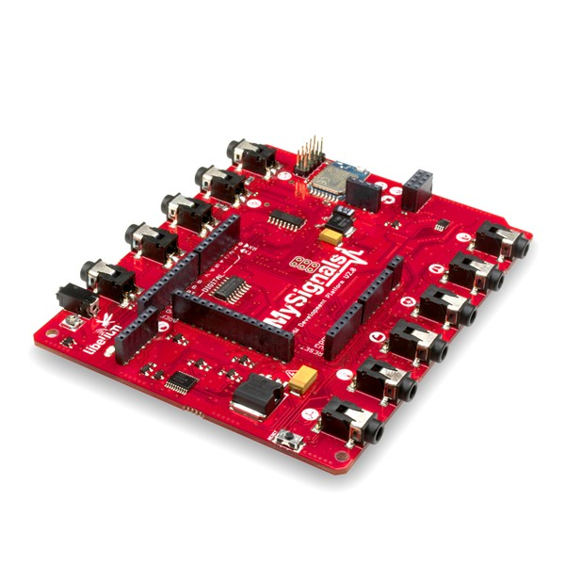
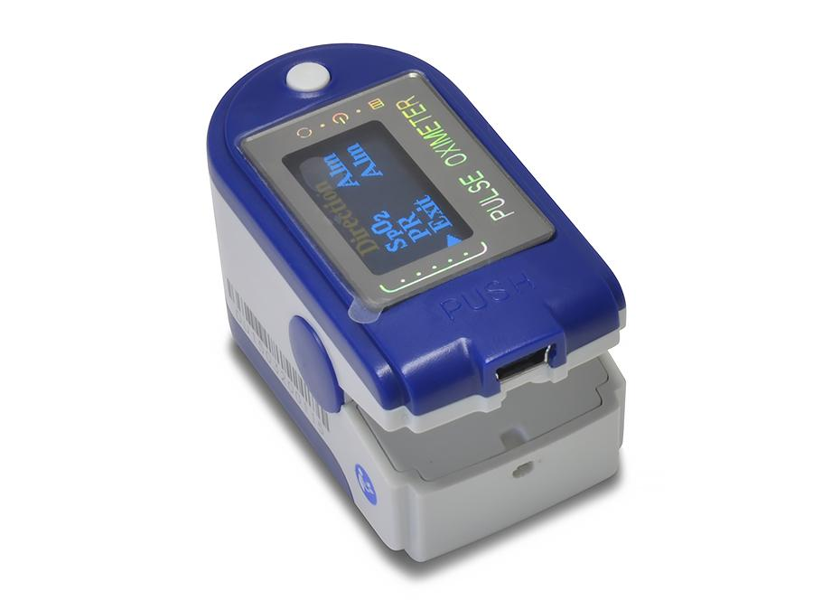
Cost of the Project
$ 2,000
Devises Use
Mysignals Pregnancy Monitoring Development Kit
Mysignals HW
Arduino
Blood pressure
Body Scale BLE
SPO2 pulse Oxygen in Blood Sensor
Temperature Sensor

Slide 4
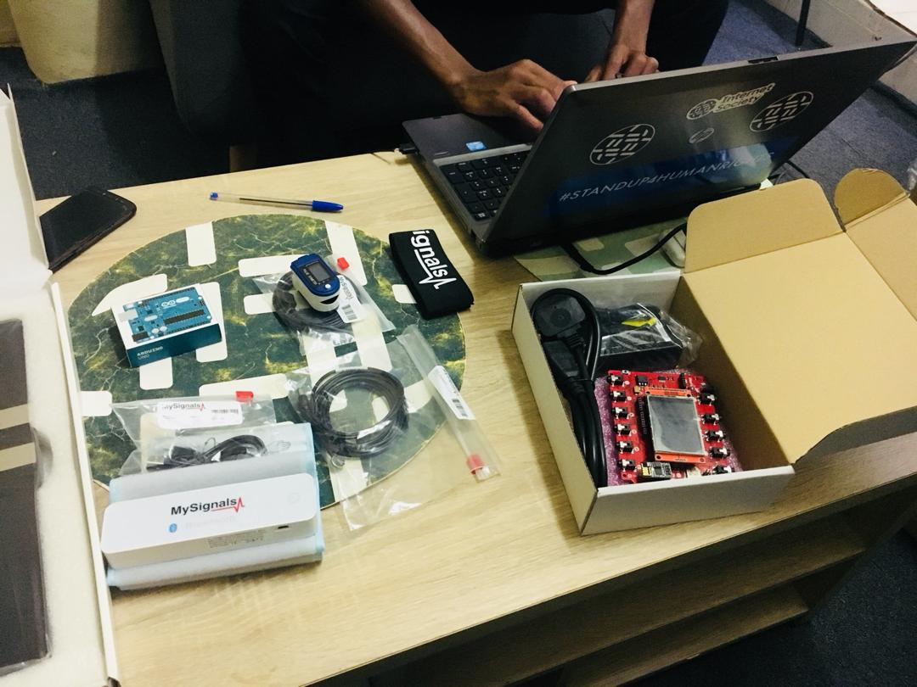
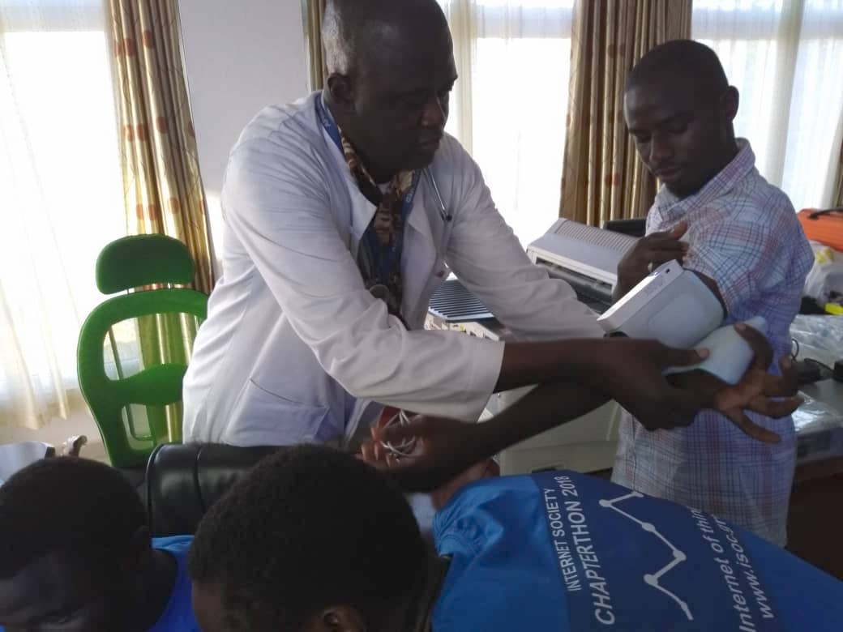
Project Implementation
Staff use IoT devises to administer and collect Biometric Data of Patients:
Blood Pressure
Body weight
Oxygen Level
Body Temperature
Demonstration session
Africmed Medical Center
University of The Gambia

Slide 5
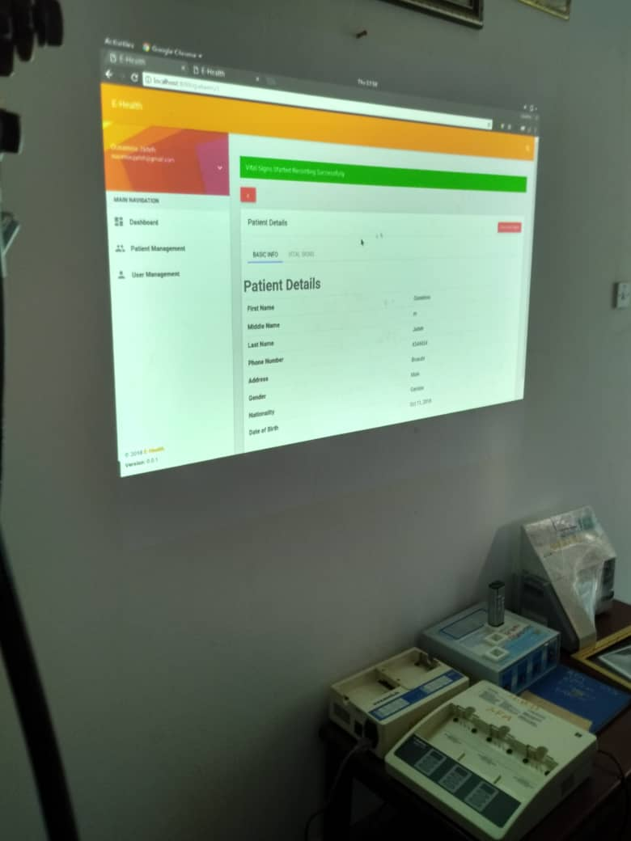
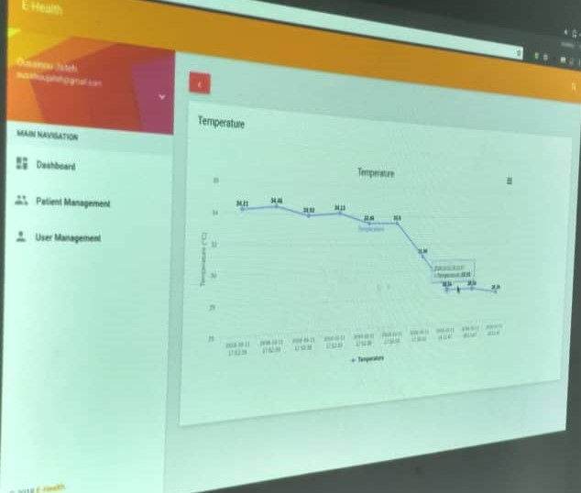
Project Solution
IoT eHealth Solution
Real time Data Collection, storage and Retrieval
Time Saving
Staff focus more other Health care functions

Slide 6
Lesson Learned
Potential deployment of IoT eHealth into Gambia Health Sector
Ease of Real time data collection, Storage and Retrieval
Improve efficiency of staff time and energy at service delivery

Slide 7
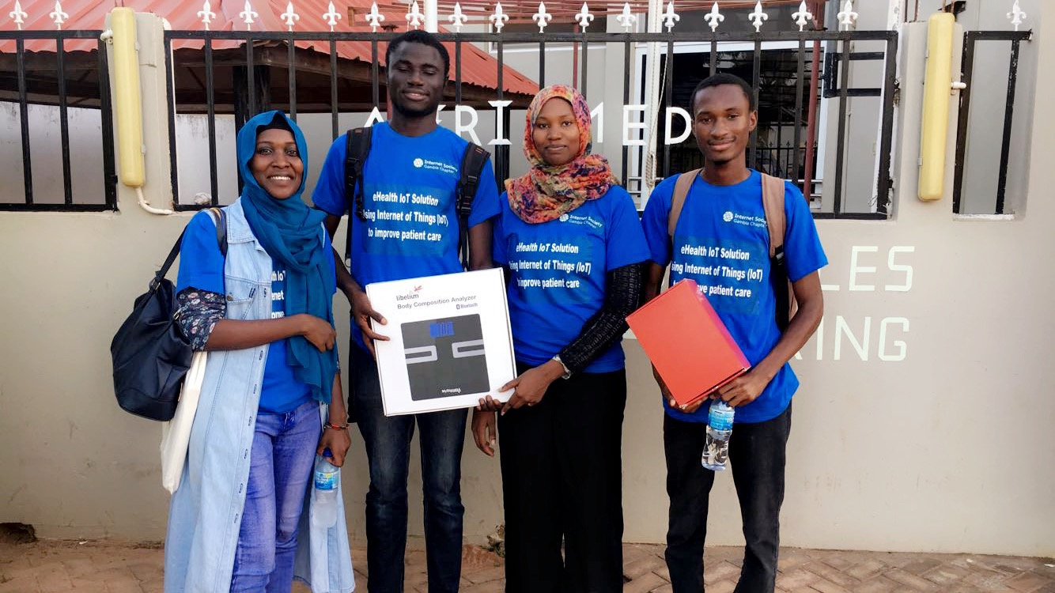
IoT eHealth Chapterthon Team
Amie Njie
Sheriffo Ceesay
Muhammed Baldeh
Ousainou Jaiteh

Slide 8
Data Collection Challenge
Afrimed Medical Center
Nurses conduct periodic manual data collection of patient’s temperature and blood pressure.
IoT eHealth implementation challenge
Low memory of Arduino device and can work with Only one device at a time
Time constraint
Data security (vendors, no appropriate frameworks National level)

Slide 9
Thank You.
For further information contact: info@isoc.gm www.isoc.gm
Tango Building, Fajara M Section

