Slide 1
Trust by Design: The Internet of Things
Chapters Workshop
Addis Ababa, 2019
Security and privacy of smart-home
devices and services
Dr. Dawit Bekele
ISOC

Slide 2
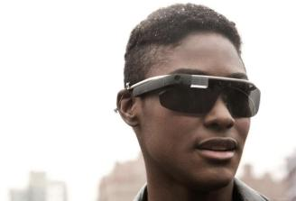
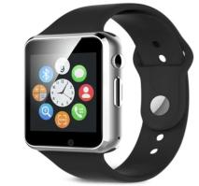
What is the Internet of Things
The Internet of Things refers to new types of devices that are increasingly being connected to the Internet
Traditionally, the Internet was a network of computers, switches and routers all linked together to share knowledge and communicate
With the Internet of Things, day to day devices like televisions, refrigerators, lights, sensors and cameras are increasingly being connected to the Internet
Google Glass¹
Smartwatch²
¹https://www.theglimpse.com/interesting-facts-about-google-glass
²https://www.gearbest.com/smart-watches/pp_800036.html

Slide 3
Some examples of IoT
    Wearable Tech: like smart watches, smart shoes, smart glasses
    Smart Cars: cars that can use the Internet to navigate or send information to other cars on the road
    Smart Cities: use of IoT to improve traffic flows, measure water, measure electricity use, monitor and protect citizens
    Smart manufacturing – use of IoT devices to improve the efficiency of manufacturing and cut costs
    Research – use of IoT to measure air and water quality

Slide 4
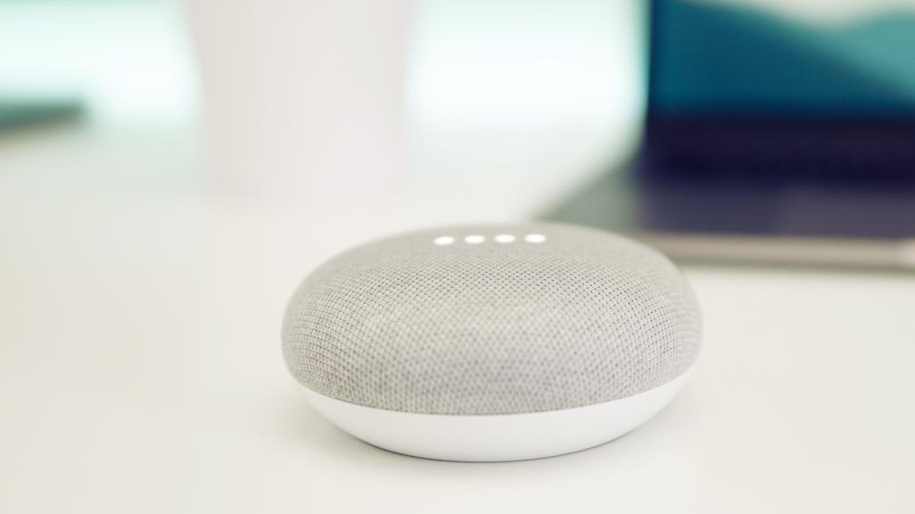
The number of IoT devices and systems
connected to the Internet will be more than
5x the global population
by 2022 (IHS).

Slide 5

As more and more devices are connected, privacy and security risks increase.
And most consumers don’t even know it.

Slide 6
New devices, new vulnerabilities
The attributes of many IoT devices present new and unique security challenges compared to traditional computing systems.
Device Cost/Size/Functionality
Volume of identical devices (homogeneity)
Long service life (often extending far beyond supported lifetime)
No or limited upgradability or patching
Physical security vulnerabilities
Access
Limited user interfaces (UI)
Limited visibility into, or control over, internal workings
Embedded devices
Unintended uses
BYOIoT
Notes:
Industry is not adequately addressing fundamental security, privacy and life-safety issues.
Many manufacturers are new to the networking and Internet arena, and lack experience.
There are STRONG competitive pressures for speed to market and cost reduction.
Security and privacy cost money, require specialized skills, and slow down the development process.
The proliferation of devices, and corresponding interactions with other devices, increase the “surface” available for cyberattack.
Poorly secured devices affect the security of the Internet and other devices globally, not just locally.

Slide 7
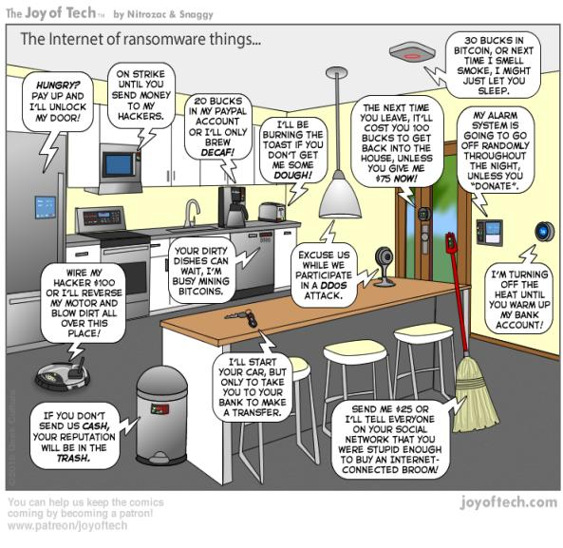
What type of risks?
Unlocking doors, turning on cameras, shutting down critical systems and theft of personal property.
People’s safety or the safety of their family might even be at risk.
Large IoT-based attacks, such as the Mirai botnet in 2016, have crippled global access to high-profile Internet services for several hours.
2

Slide 8
The challenges we face
A connected world offers the promise of convenience, efficiency and insight, but creates a platform for shared risk.
Many of today’s IoT devices are rushed to market with little consideration for basic security and privacy protections.

Slide 9

Challenges
Manufacturers
Services
Consumers
Cost/size
New uses
Cost/convenience
Functionality
Massive volume
Naïve users
Time to market
Naïve players
DIY approach
Future-proofing
Limited insight
Flying “blind”

Slide 10
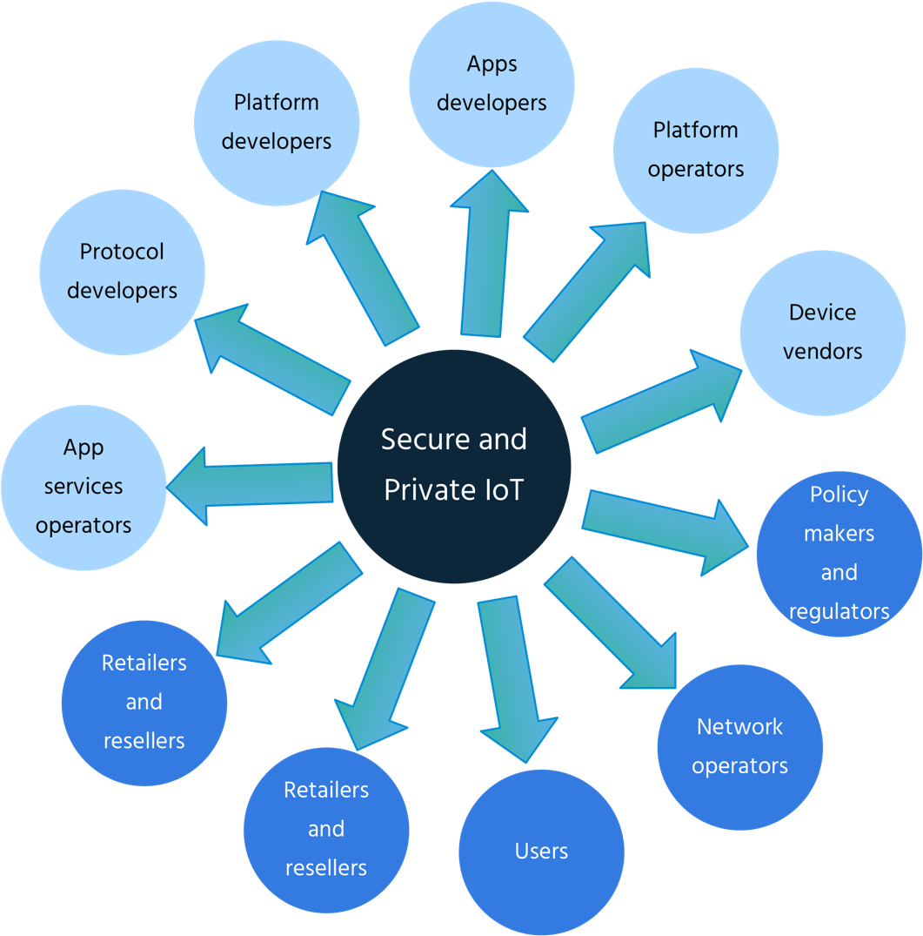
Who is responsible?
  Developers and users of IoT devices and systems have a collective obligation to ensure they do not expose others and the Internet itself to potential harm.
  We need a collective approach, addressing security challenges on all fronts.

Slide 11
The Internet Society is working for a better Internet.
We want manufacturers and suppliers of consumer IoT devices and services to adopt security and privacy guidelines
to protect the Internet and consumers from cyber threats.
We want to educate users on the importance of secure IoT devices and work with stakeholders involved in technology and security to better inform their communities on IoT.
There is a Role for everyone to play in Securing the Internet of Things

Slide 12
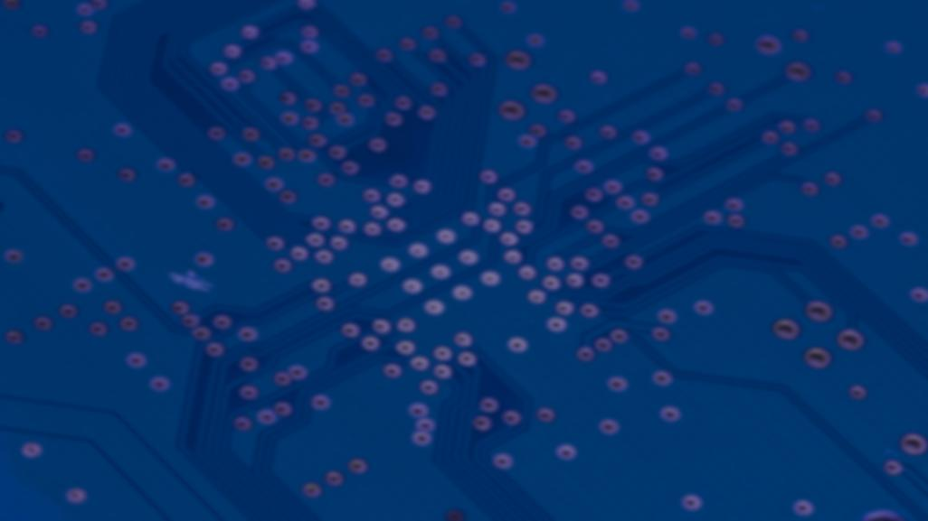
Role of Industry/Service Providers/Retail
Commit to Framework principles
Push back through supply chain
Curate offerings – only carry products that ”clear the bar”

Slide 13

Role of Consumer Organizations
Prioritize security and privacy in reviews
Educate consumers to make smart choices
Announced partnership with Consumers International

Slide 14
IoT Security and Policy Makers

Slide 15

Work with Policymakers
We want policymakers to create a policy environment that favors strong security and privacy features in IoT products and services.
We need smart regulation that strengthens trust and enables innovation.
ISOC can help in this process
2

Slide 16
Actions for Policymakers
Strengthen accountability and stimulate security and privacy best practice adoption
Support industry adoption of the best practice principles from the IoT Trust framework
Support industry adoption of the best practice principles from the IoT Trust framework
Foster technology & vendor neutral solutions
Make smart use of regulatory tools through well-defined responsibilities and clear consequences

Slide 17
Data Gathering: IoT in the African Region
We are working via ISOC Chapters and other partners in the region to gather information on IoT development, IoT related policies and use in the region
This info will help us coordinate efforts in IoT and know what types of IoT devices are being developed in the region and Policies that are working in our environment.
This will allow us to better advise policy makers, users and ISPs on IoT security
If you are aware of any IoT research/development IoT Policy development in the region, please let us know through our chapters or ISOC staff

Slide 18
Bekele@isoc.org

