Slide 1
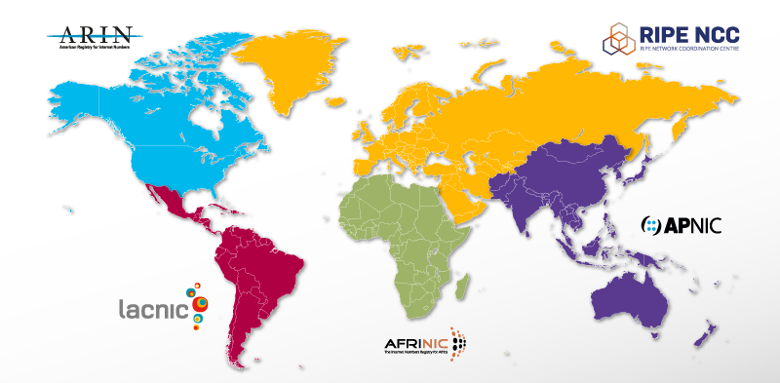
Regional Internet Registries
Notes:
Dates of RIR formation: RIPE NCC – 1992, APNIC – 1993, ARIN – 1997, LACNIC – 2002, AFRINIC - 2005
At its formation in 1997, the ARIN region covered all of what today is part of LACNIC (Central and South America and several Spanish speaking Caribbean islands) and sub Sarahan Africa (with the RIPE NCC covering the remainder of Africa).

Slide 2

Next ARIN Public Policy
& Members Meeting
https://www.arin.net/participate/meetings/fellowship.html

