Slide 1
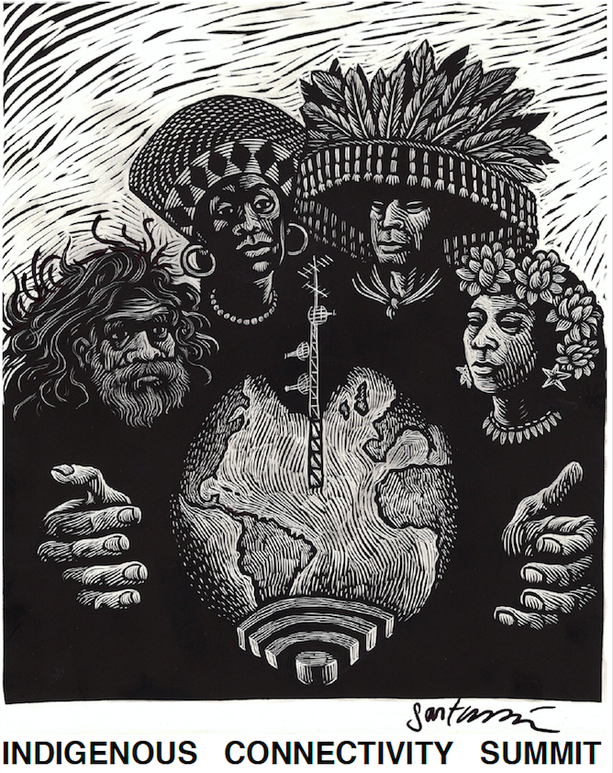
#Indigenet2017

Slide 2
Housekeeping
© 2016 Nyani Quarmyne / Internet Society CC BY-NC-SA
WiFi: HotelSF-FreeWiFi
Hashtag: #Indigenet17
#Indigenet2017
8

Slide 3








Summit partners
Summit sponsors
#Indigenet2017

Slide 4
Fireside chat
© 2016 Nyani Quarmyne / Internet Society CC BY-NC-SA
Brian Tagaban, Sacred Wind Communications
Kathy Brown, Internet Society
#Indigenet2017
8

Slide 5
Community Information Gathering
© 2016 Nyani Quarmyne / Internet Society CC BY-NC-SA
Rob McMahon
University of Alberta/First Mile Connectivity Consortium
#Indigenet2017
8

Slide 6
Stories from the Field:
The many shapes and sizes of community networks
© 2016 Nyani Quarmyne / Internet Society CC BY-NC-SA
Jane Coffin (Moderator), Internet Society
Bill Murdoch, Manitoba First Nations Education Resource Centre
Brian Tagaban, Sacred Wind Communications
Peter Bloom, Rhizomatica
Don Means, Digital Village Associates
#Indigenet2017
8

Slide 7
Flash Presentation:
A community network success story
© 2016 Nyani Quarmyne / Internet Society CC BY-NC-SA
Matthew Rantanen
Southern California Tribal Chairmen’s Association
#Indigenet2017
8

Slide 8
Networking Break
© 2016 Nyani Quarmyne / Internet Society CC BY-NC-SA
#Indigenet2017
8

Slide 9
Table-level Discussion
© 2016 Nyani Quarmyne / Internet Society CC BY-NC-SA
Reporting Back to Plenary
#Indigenet2017
8

Slide 10
Lunch!

Slide 11
Flash Presentation:
IP Addressing
© 2016 Nyani Quarmyne / Internet Society CC BY-NC-SA
Richard Jimmerson, ARIN
#Indigenet2017
8

Slide 12
Community Networks Business Models
© 2016 Nyani Quarmyne / Internet Society CC BY-NC-SA
Rob McMahon (Moderator), University of Alberta
Matthew Rantanen, Southern California Tribal Chairmen's Association
Nico Pace, Alter Mundi
Lope Trujillo, La Loma Projects
Claudia Lezama, La Loma Projects
Luis Reyes, Kit Carson Electric Coop
Margaret Campos, REDI Net
#Indigenet2017
8

Slide 13
Advocating for Community Networks
© 2016 Nyani Quarmyne / Internet Society CC BY-NC-SA
Christian O’Flaherty (Moderator), Internet Society
Madeline Redfern, City of Iqaluit
Elizabeth Belding, UC Santa Barbara
Maria Alvarez, Redes A.C.
Kimball Sekaquaptewa, AMERIND Critical Infrastructure
#Indigenet2017
8

Slide 14
Networking Break
© 2016 Nyani Quarmyne / Internet Society CC BY-NC-SA
#Indigenet2017
8

Slide 15
Personal Story
© 2016 Nyani Quarmyne / Internet Society CC BY-NC-SA
Connecting Artic Communities
Madeline Redfern, City Iqaluit
#Indigenet2017
8

Slide 16
Table Level Discussion
Reporting Back to Plenary

Slide 17
Plenary Discussion
Thoughts on Day 1
Looking Forward to Day 2

Slide 18
Summit partners
Summit sponsors
#Indigenet2017

Slide 19
Reception
Amaya Patio

Slide 20
#Indigenet2017

Slide 21
Welcome Back
Brian Tagaban, Sacred Winds Communications

Slide 22
Flash Presentation
Network Security
Brandon Benallie, Benallie Consulting

Slide 23
Panel
Leveraging Digital Tools for Social and Economic Good
Vanessa Roanhorse (Moderator), Roanhorse Consulting, LLC
Jeff Ward, Animikii
Jesse Fiddler, KNET (virtual)
Sandy Campbell, Digital Library North

Slide 24
Networking

Slide 25
Arts Presentation
Issa Nyaphaga, Cameroonian artist

Slide 26
Table Level Discussion
Reporting Back to Plenary

Slide 27
Flash Presentation
Coding with Kids
Vanessa Roanhorse

Slide 28
Lunch

Slide 29
Flash Presentation
Graham Biyale, Navajo Youth

Slide 30
Panel
Using Digital Platforms to Protect and Preserve Culture
Soledad Roybal (Moderator)
Jason Ordaz, Institute of American Indian Arts
Vanessa Roanhorse, Roanhorse Consulting, LLC
Sandy Campbell, Digital Library North
Brandon Benallie, Benallie Consulting

Slide 31
Break

Slide 32
Panel
Community Networks – the Unique Challenges of Indigenous Communities
Brian Tagaban (Moderator), Sacred Wind Communications
Geoffrey Blackwell, AMERIND Risk
Sally Braun (virtual), Western James Bay Telecommunications Network
Lyle Fabian, Katlotech Communications, Northwest Territories
Godfrey Enjady, National Tribal Telecommunications Association

Slide 33
Networking

Slide 34
Extended Plenary Discussion
What do we need to create sustainable, effective community networks in Indigenous Communities?
Rob McMahon (Moderator), University of Alberta

Slide 35
Summit Closing
Richard Lowenberg, 1st Mile Institute
Jennifer Case Nevarez, Internet Society New Mexico Chapter; New Mexico Techworks
Rob McMahon, First Mile Connectivity Consortium
Mark Buell, Internet Society

Slide 36

Summit partners
Summit sponsors
#Indigenet2017

Slide 37
Optional Social Event
Explore Santa Fe’s Railyard

