Slide 1
Advocating for Community access
Mayor Madeleine Redfern

Slide 2
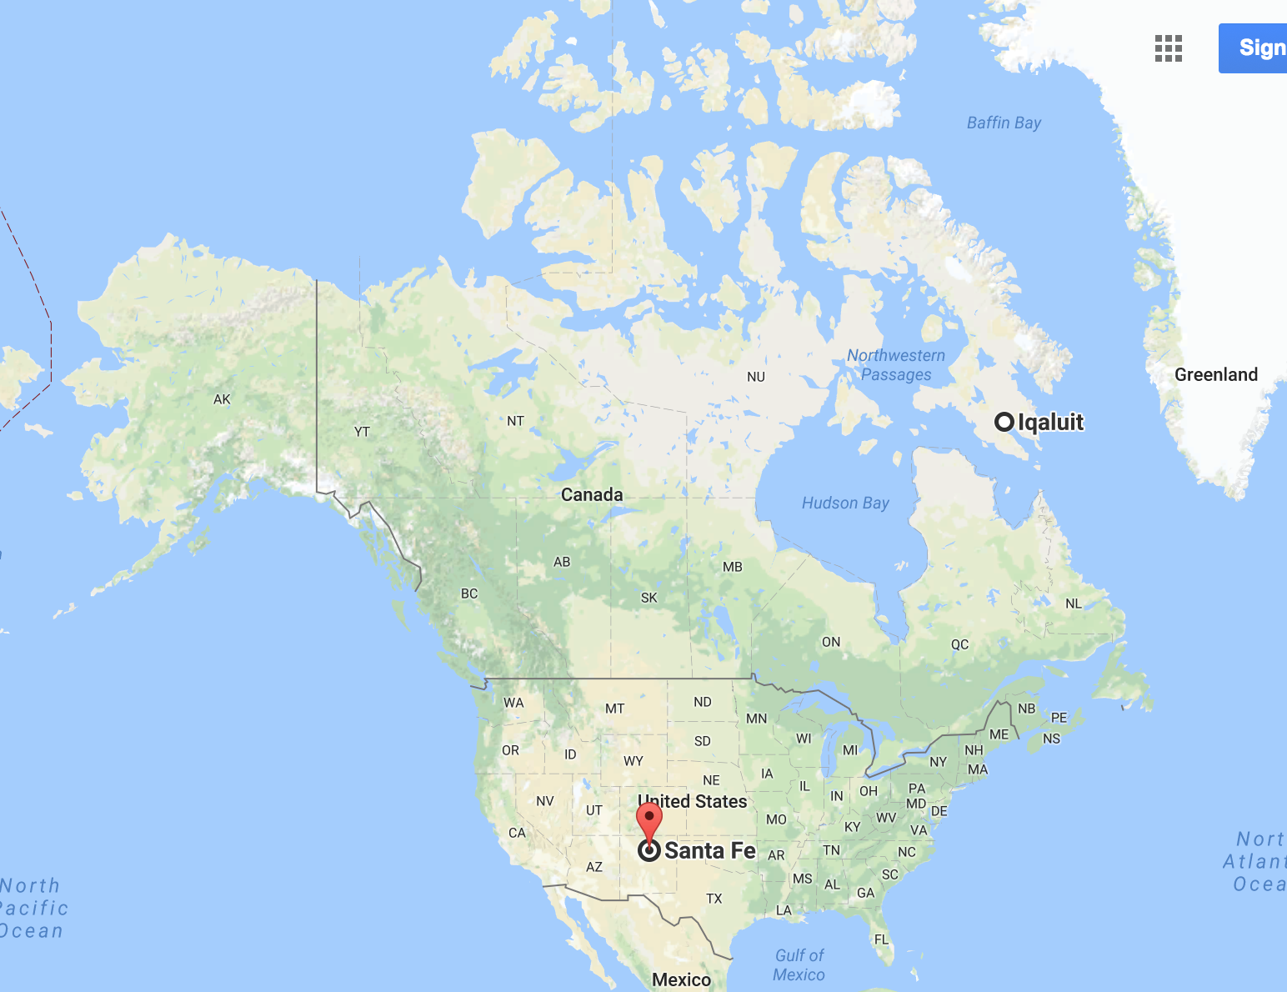

Slide 3
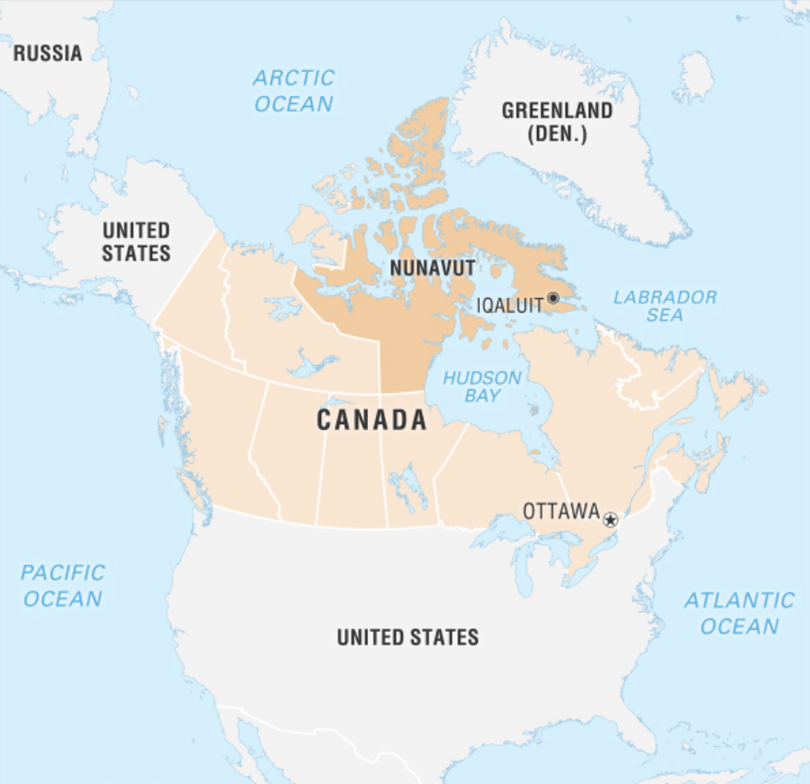
Nunavut: 2M sq km or 808,000 mi²

Slide 4
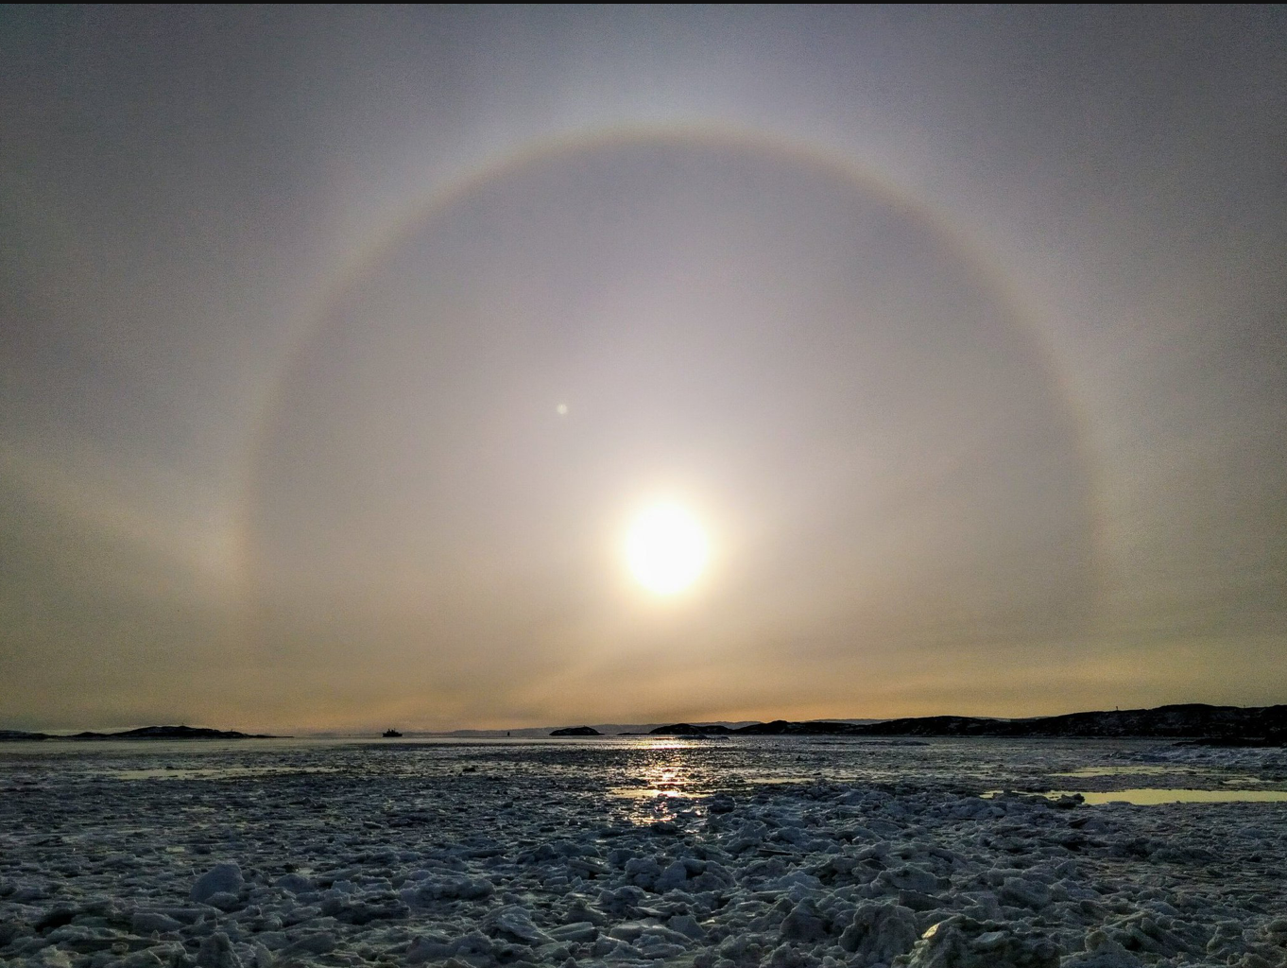
Iqaluit: This Morning

Slide 5
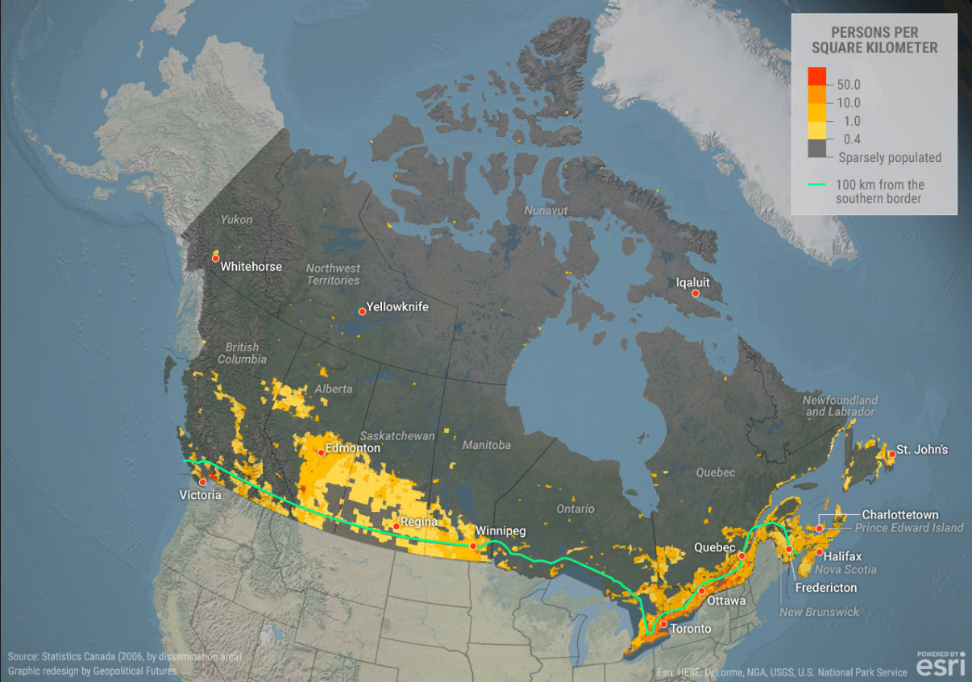
Canada: Population Density Map
90% live 100 miles of USA Boarder

Slide 6
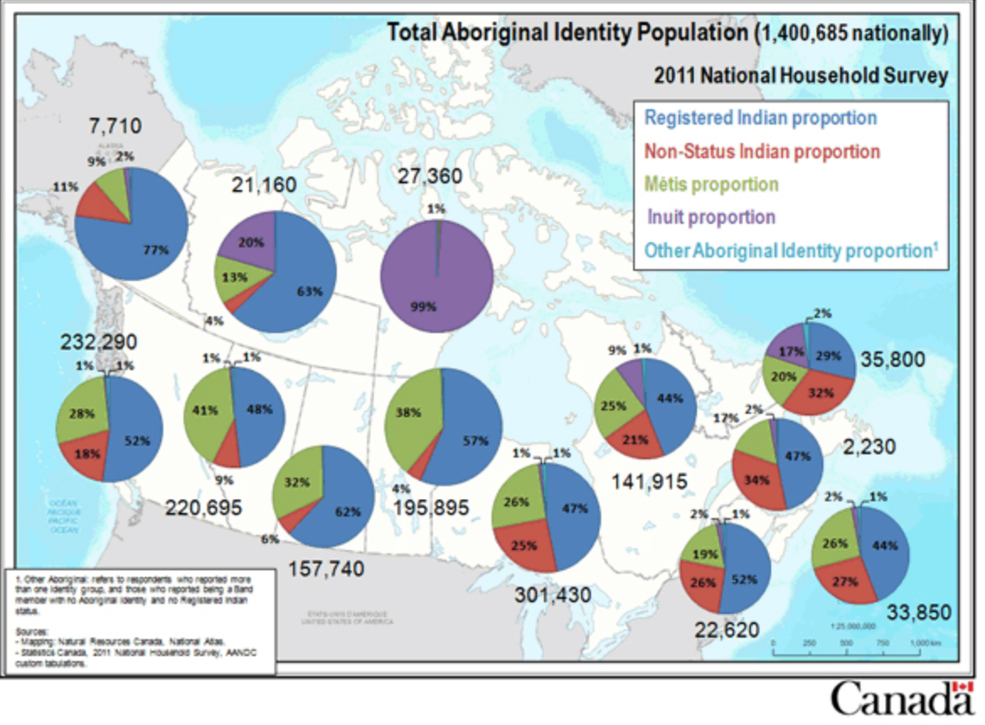
Indigenous Population Density

Slide 7
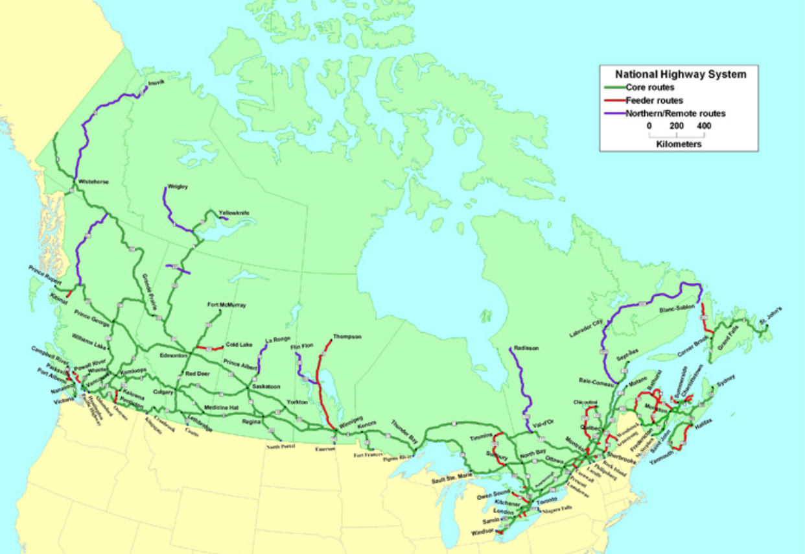
Canada’s highway Map
No Roads to most northern areas

Slide 8
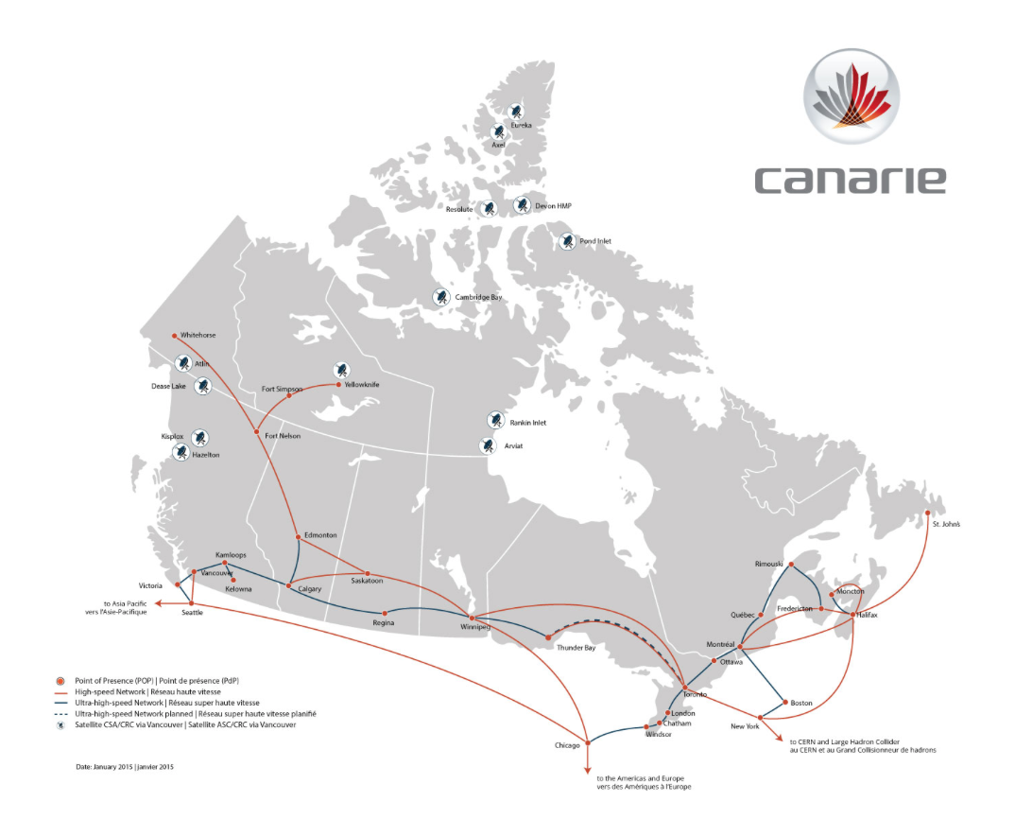
Canada’s Telecommunication Service

Slide 9
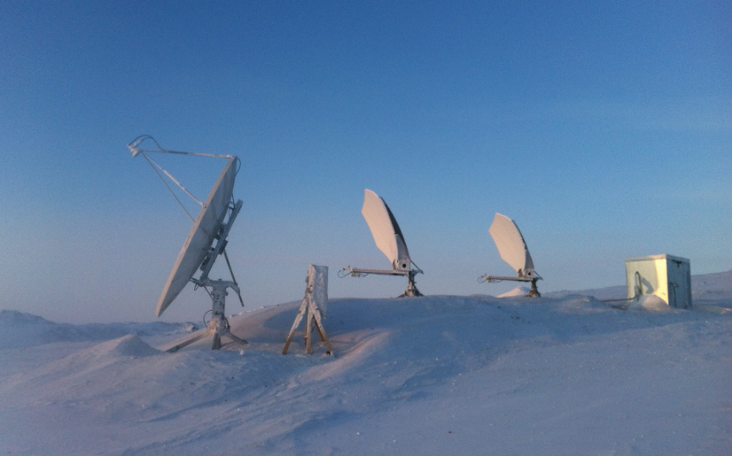
Nunavut: totally satellite dependent, expensive, unstable, slow

Slide 10
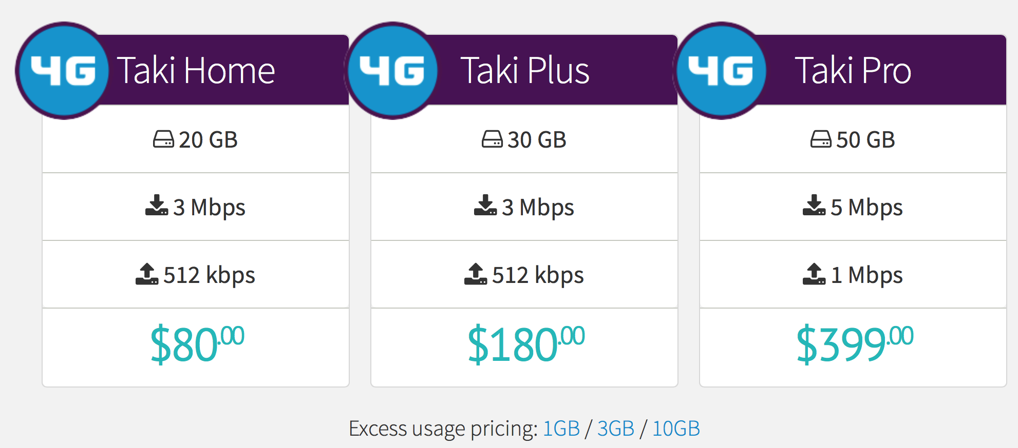
$80 a month for 20 gB + high charges for overages

Slide 11
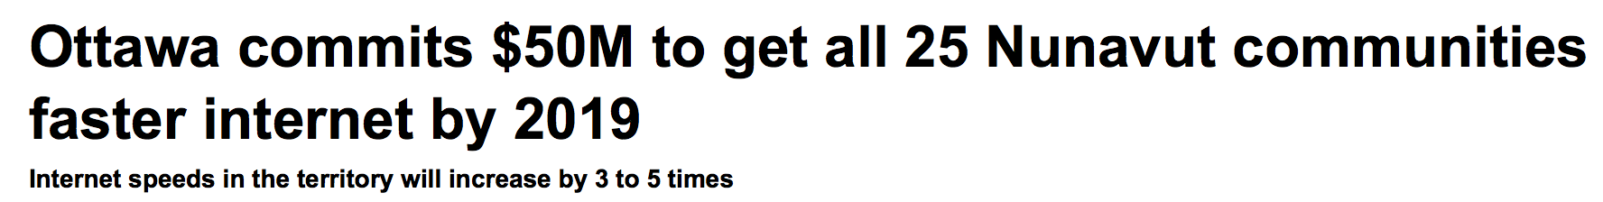
“We’re moving from megabytes to gigabytes”
Goal: 5 Mbps to 15 Mbps (3x faster)

Slide 12
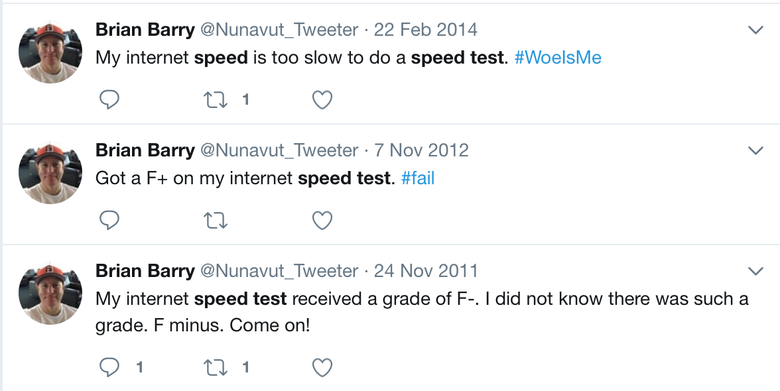
Instability & High Latency Woes

Slide 13
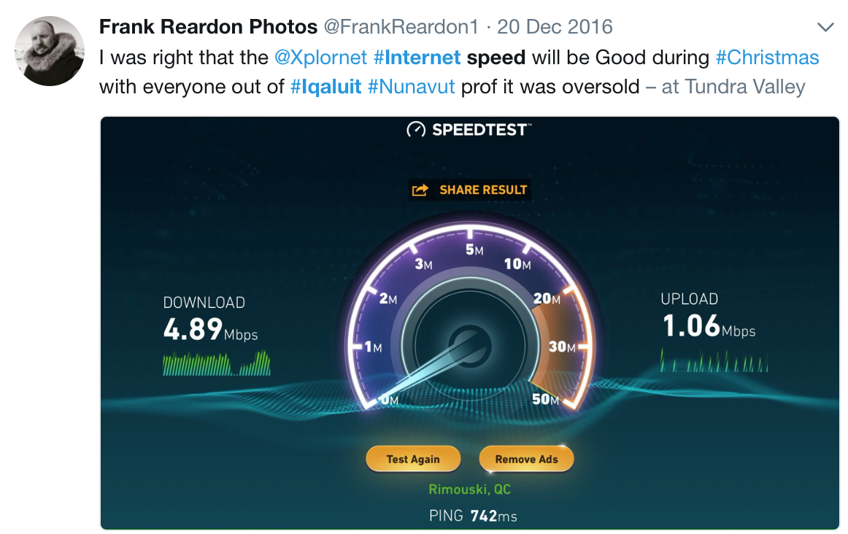
½> Town leaves = *still* slow Internet

Slide 14

Help … is anyone listening?

Slide 15

Speed improves, month data Cap used w/in 2 days: $40 download tv episode

Slide 16
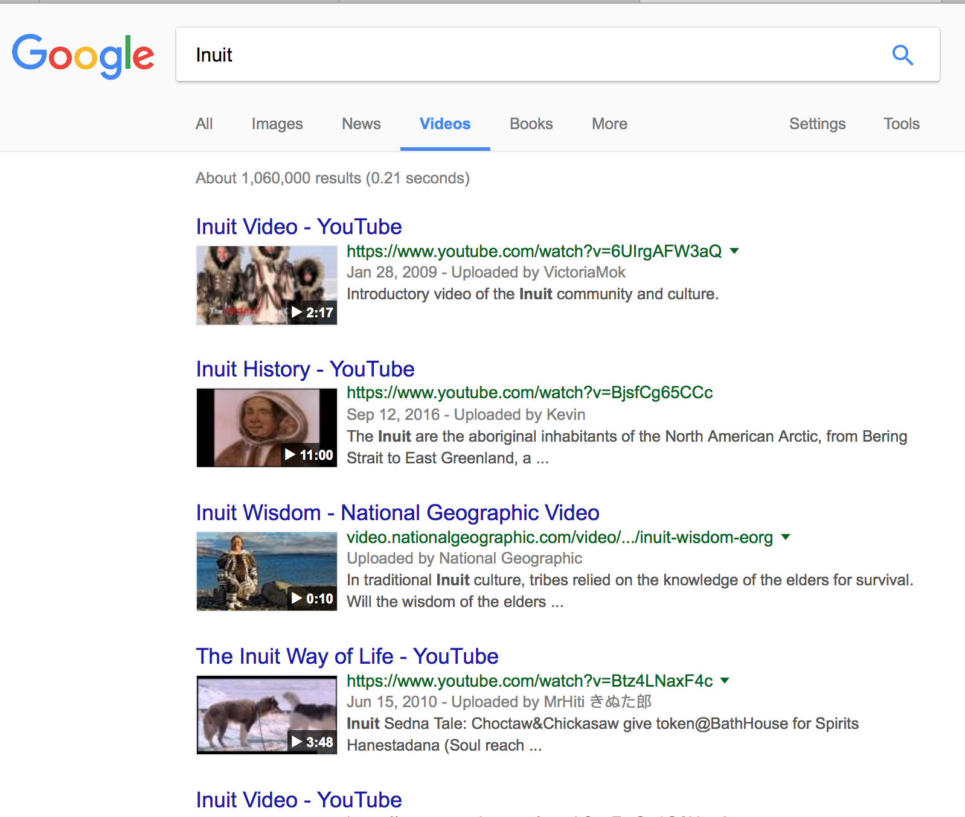
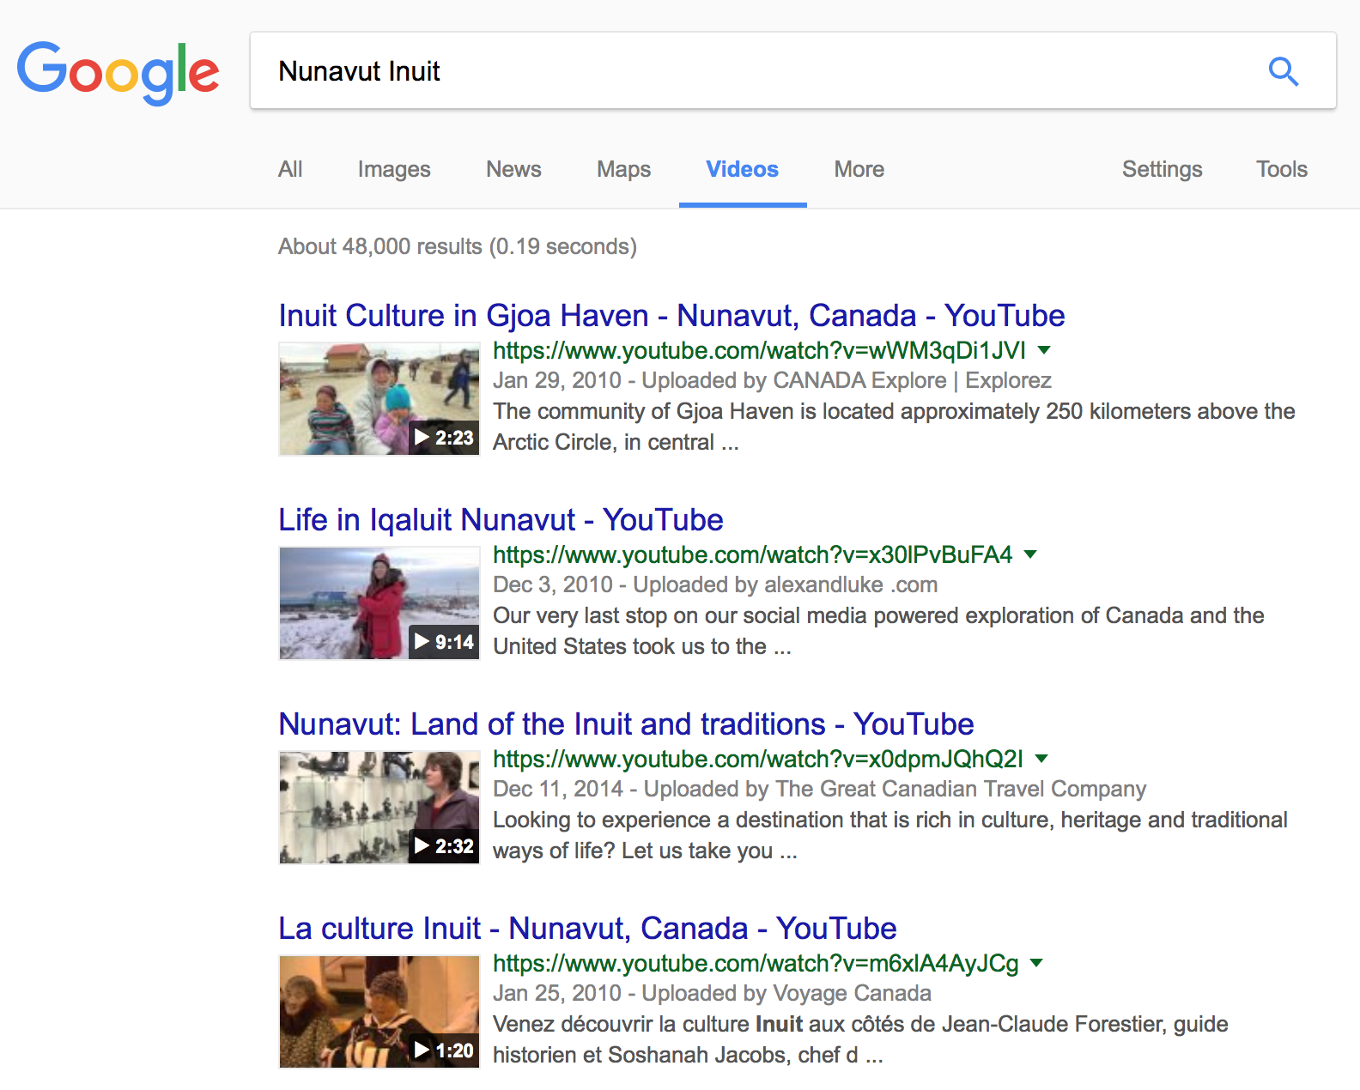
1,060,000 google video results: Inuit vs 48,000 Nunavut Inuit

Slide 17
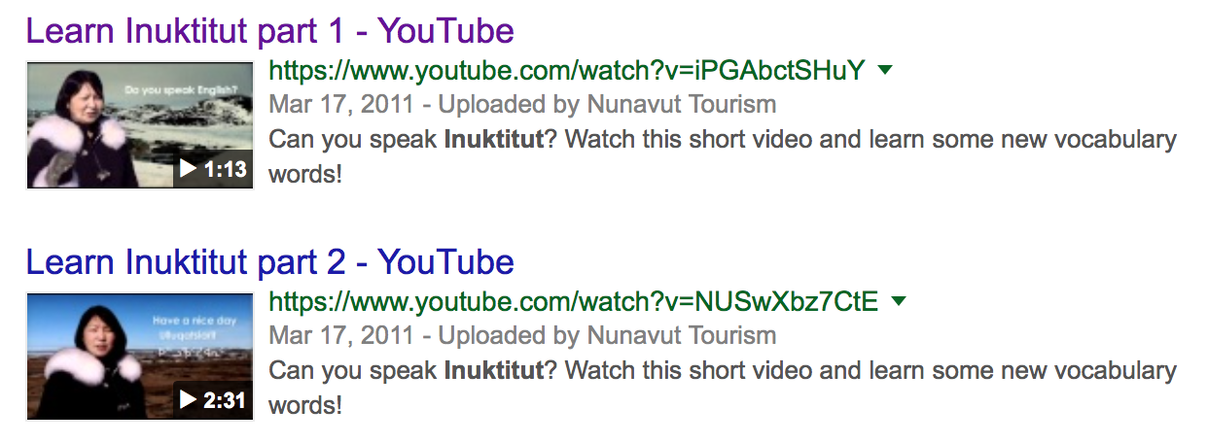
Learn Inuktitut online

Slide 18
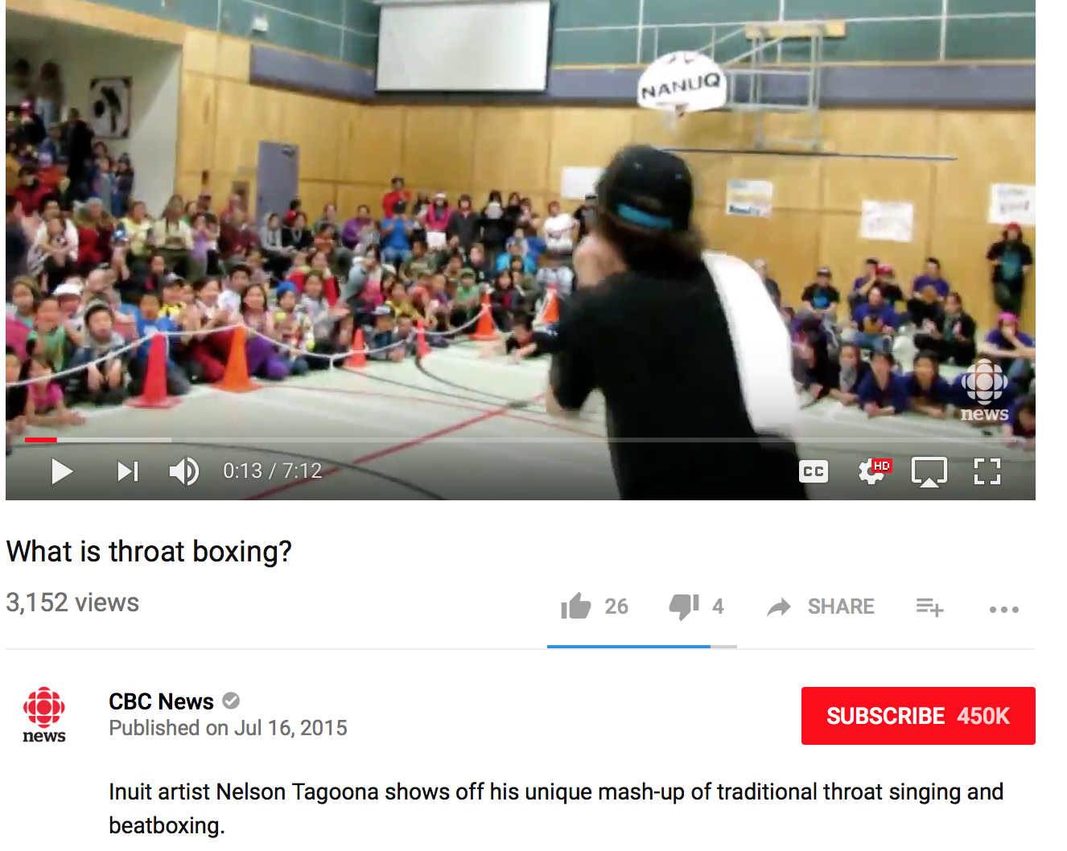
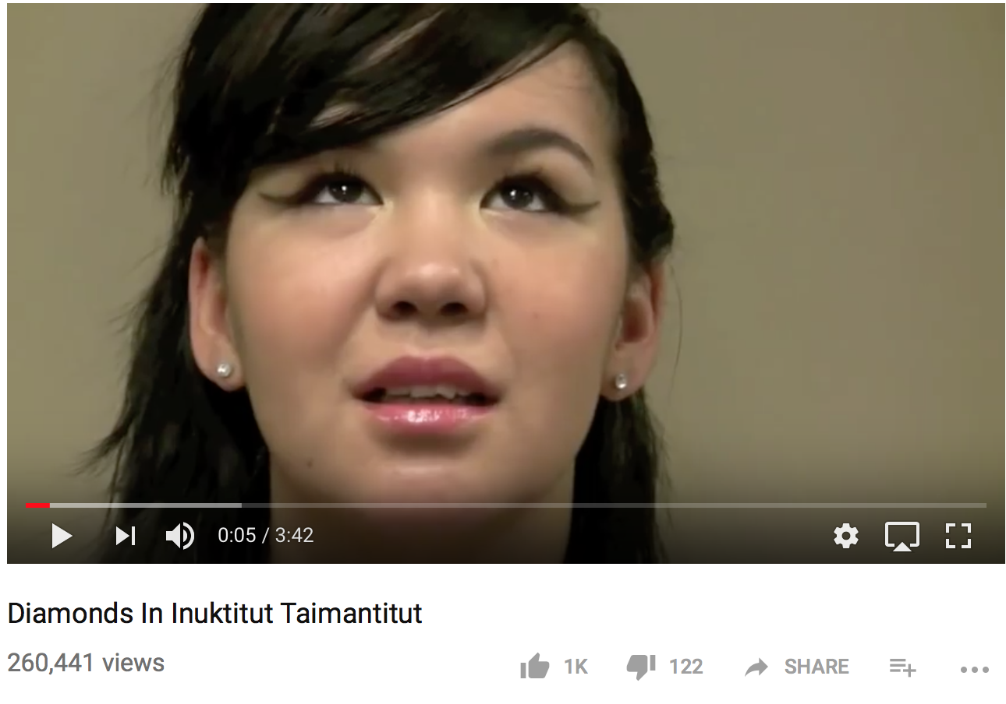
Inuit Music: Contemporary

Slide 19
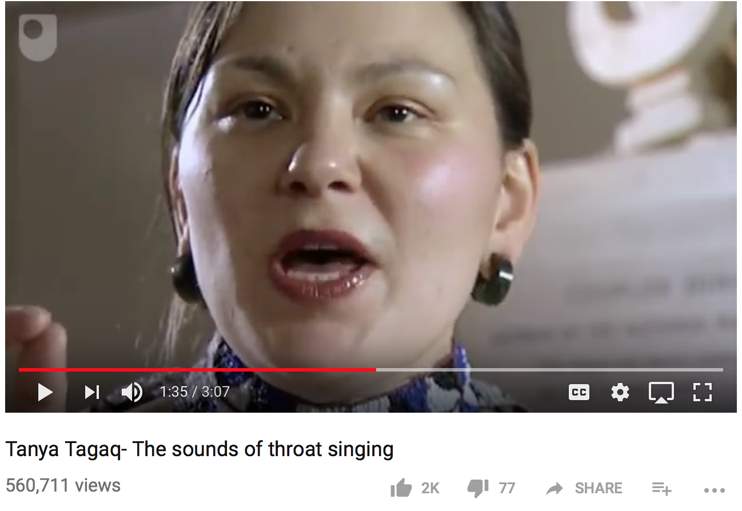
Traditional Inuit Throat Signing Explained

Slide 20
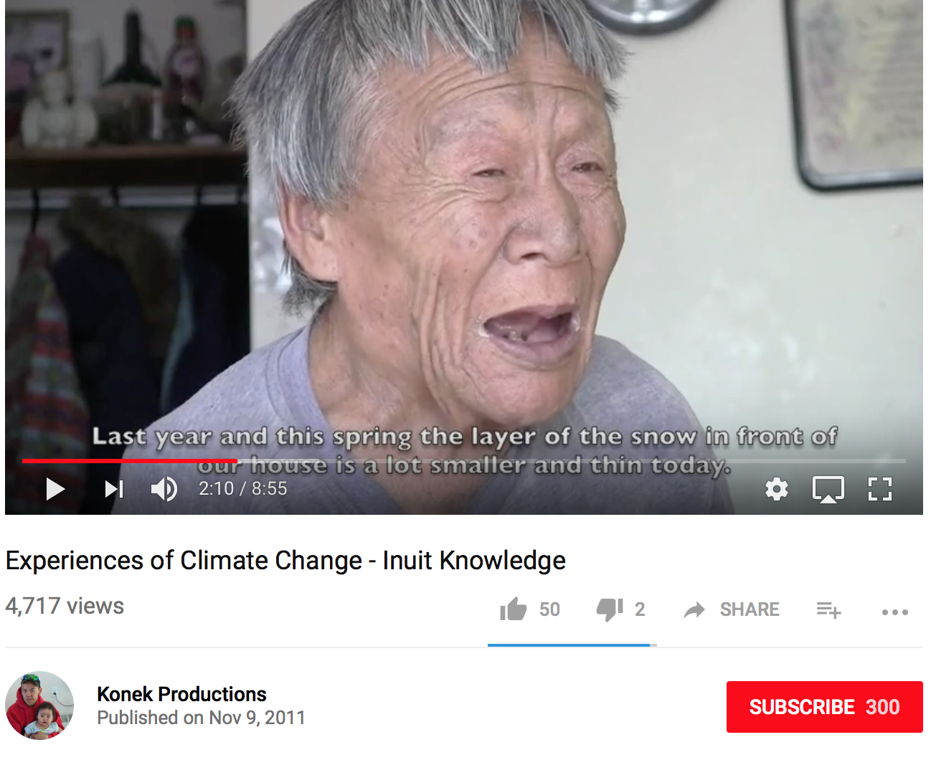
Inuit knowledge sharing: elders

Slide 21
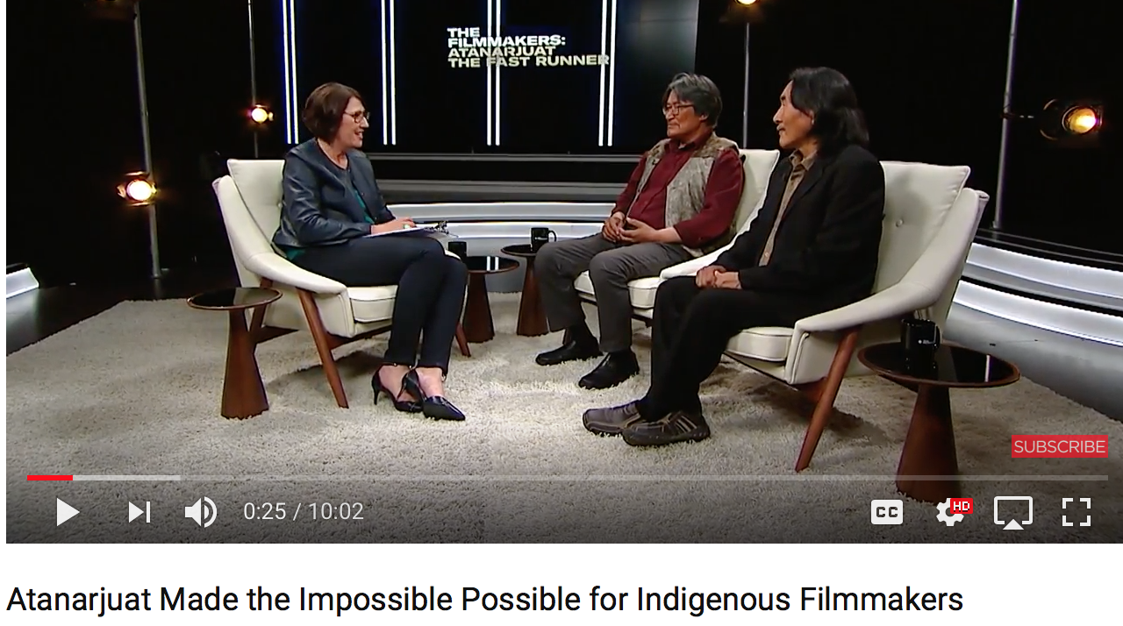
More Inuit films: short & Long

Slide 22
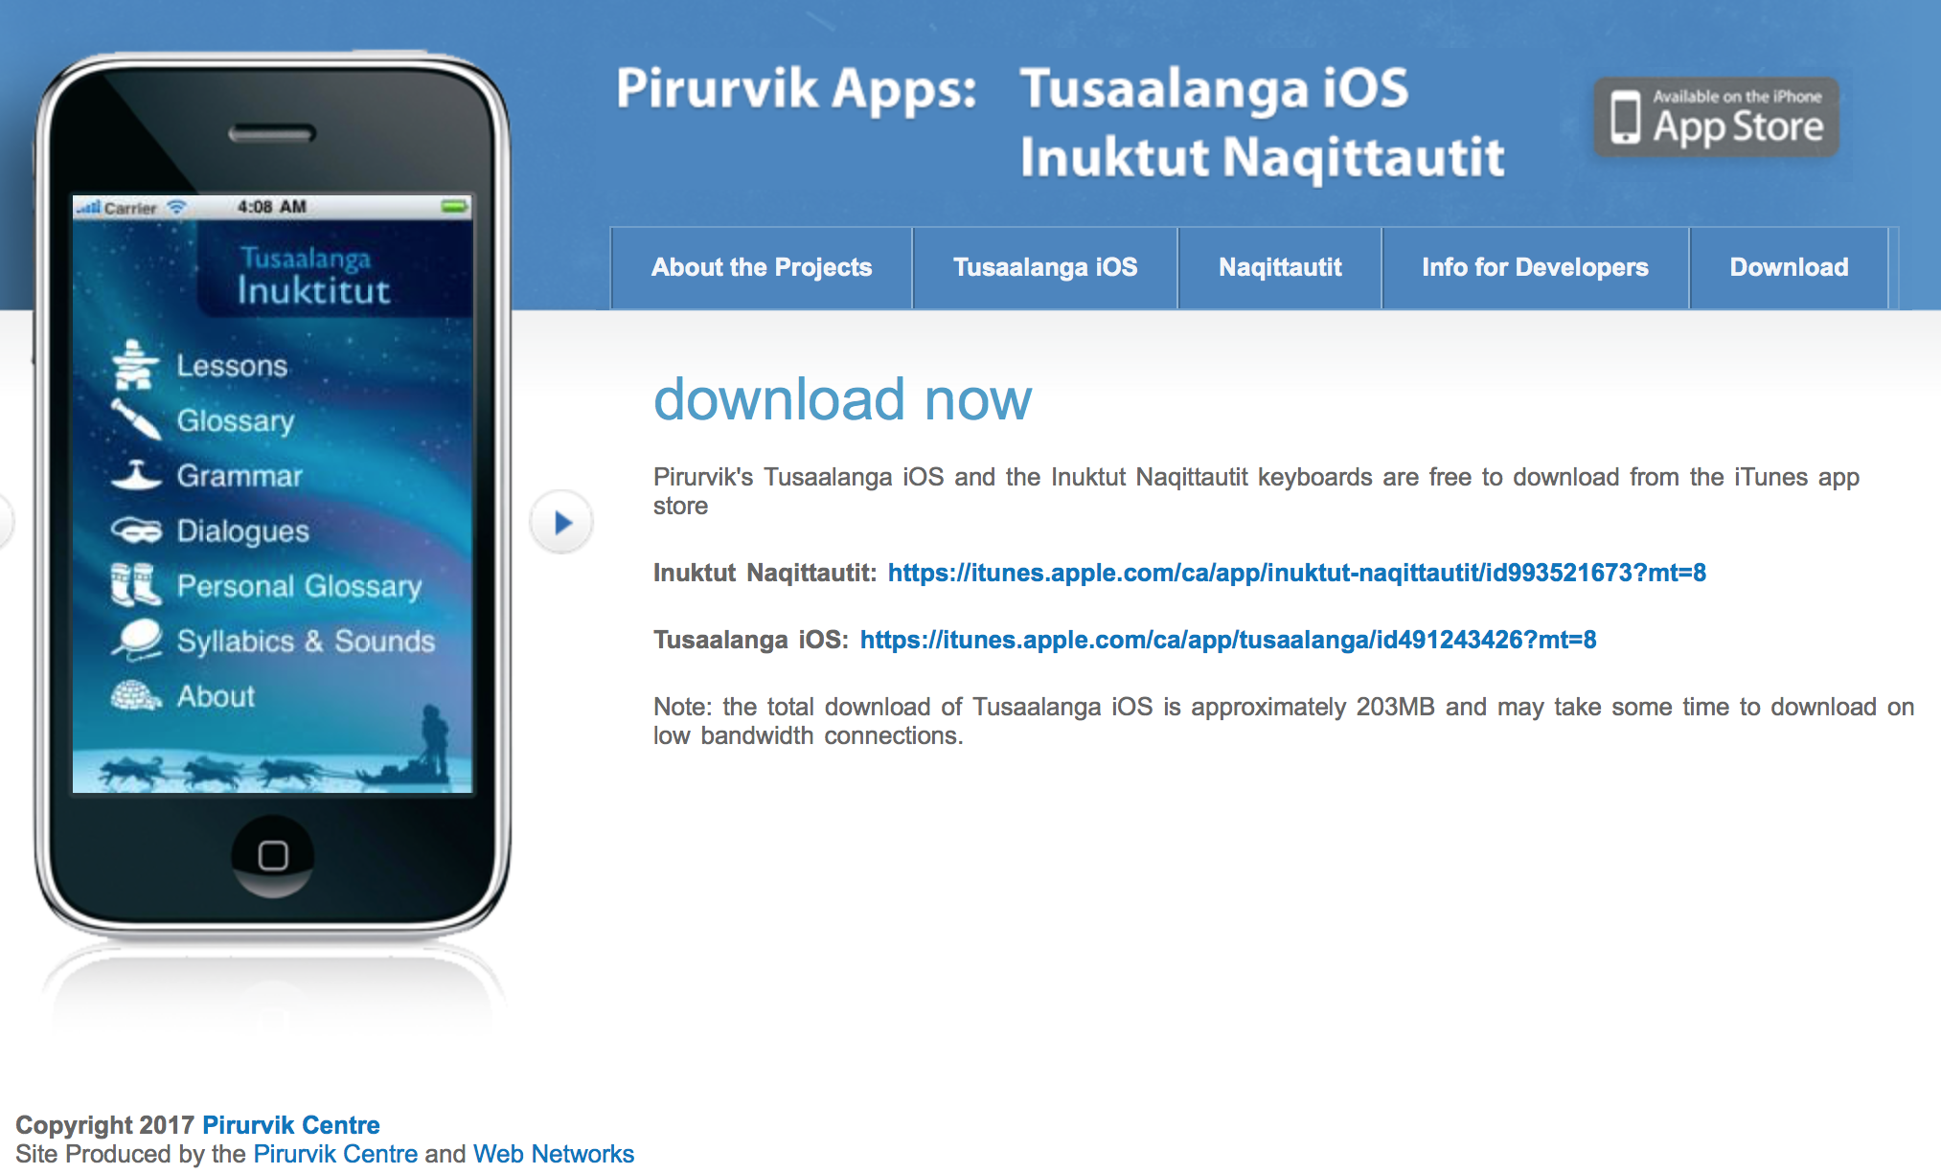
Inuktitut language apps

Slide 23
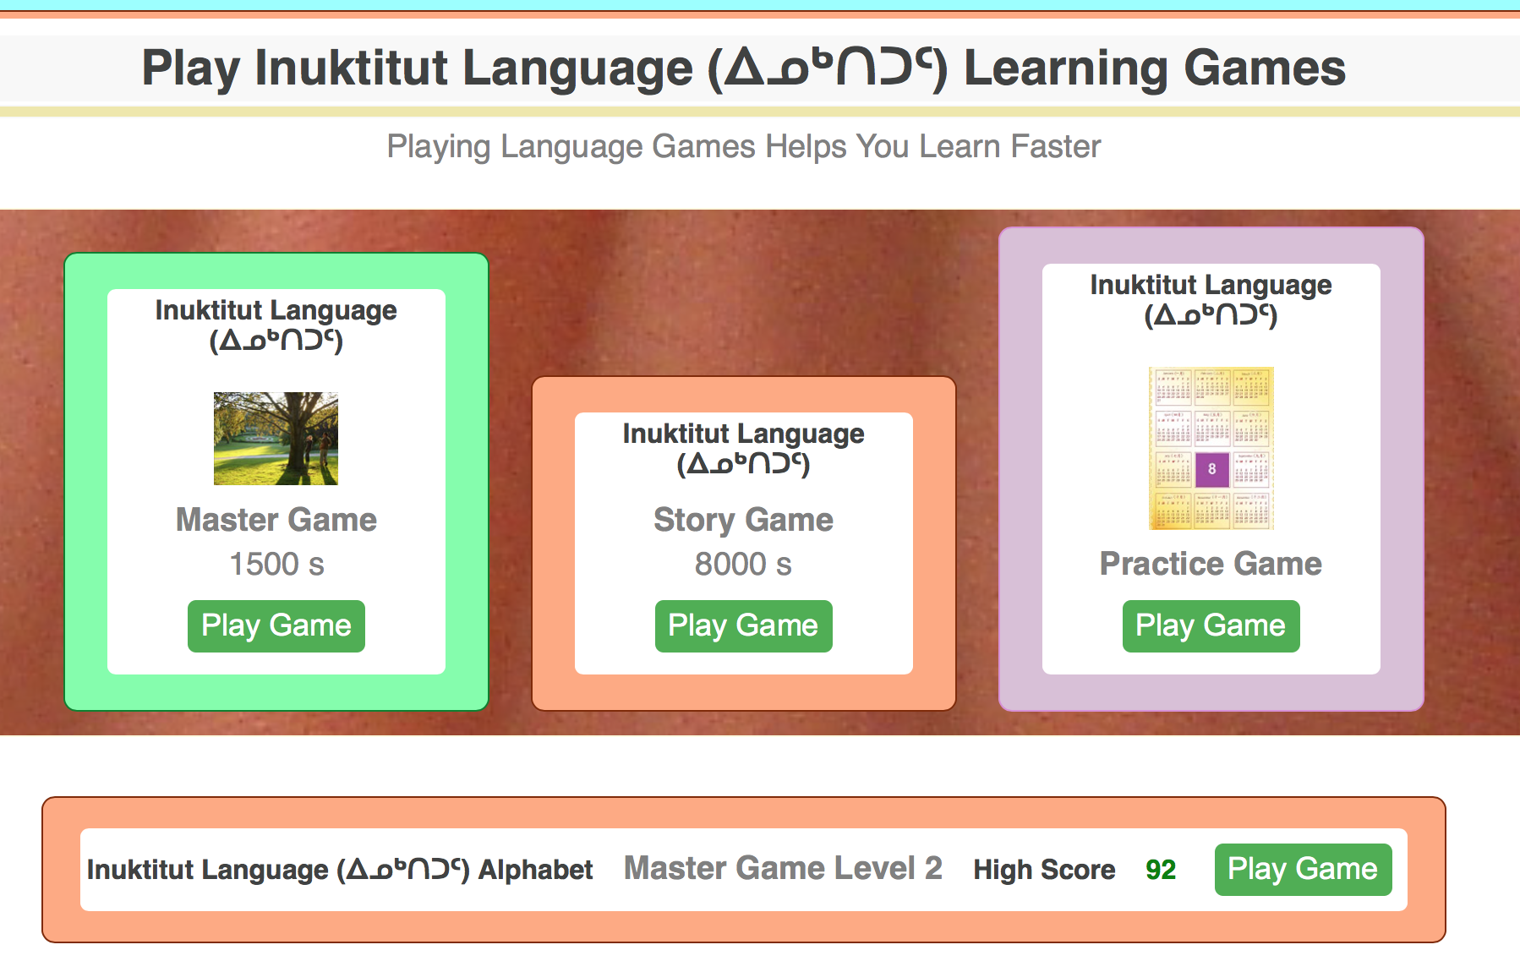
Language Learning Games

Slide 24
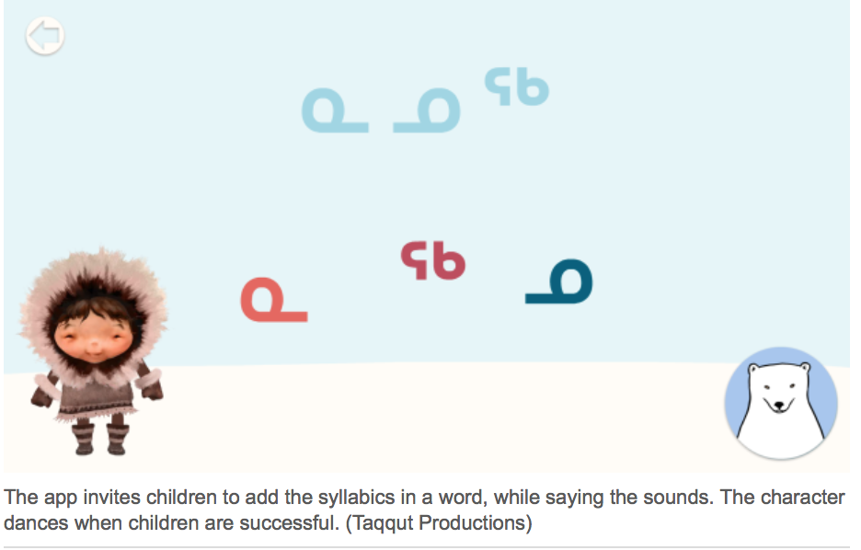
Over 300 children’s books

Slide 25
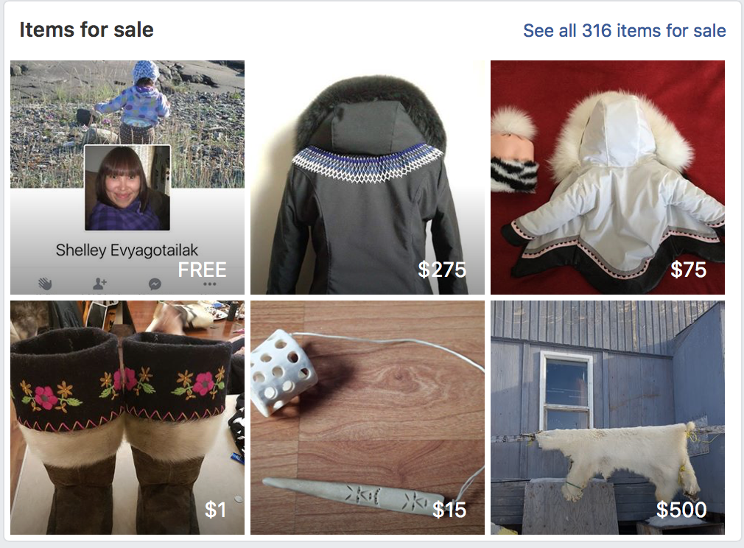
Facebook: Iqaluit Auction Bid
29K members

Slide 26
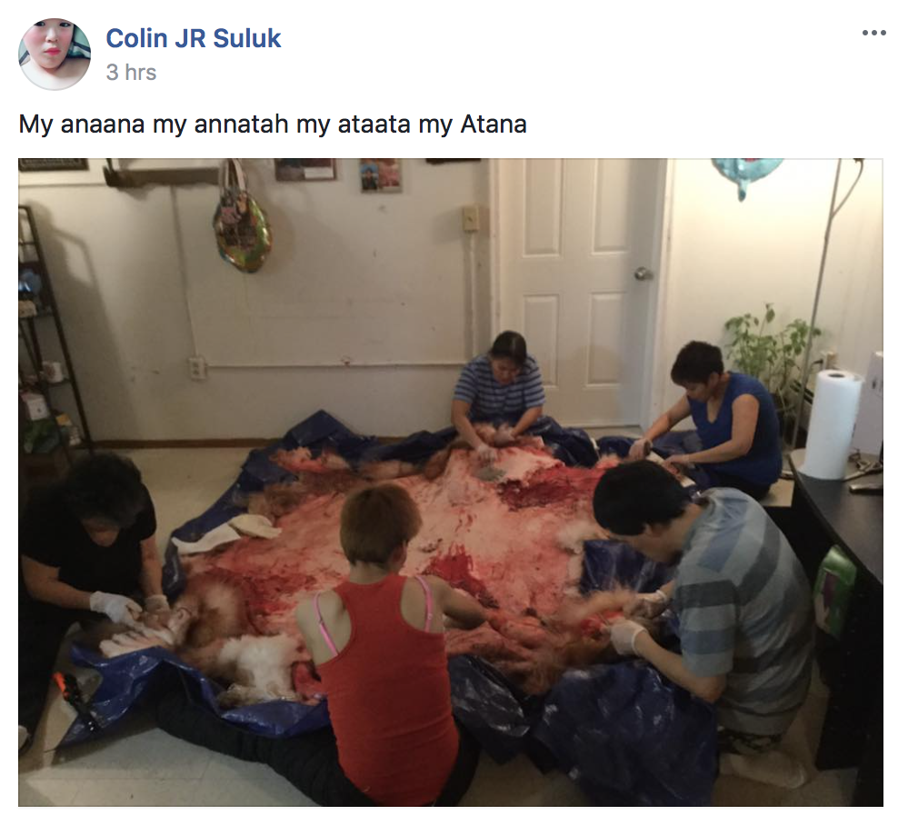
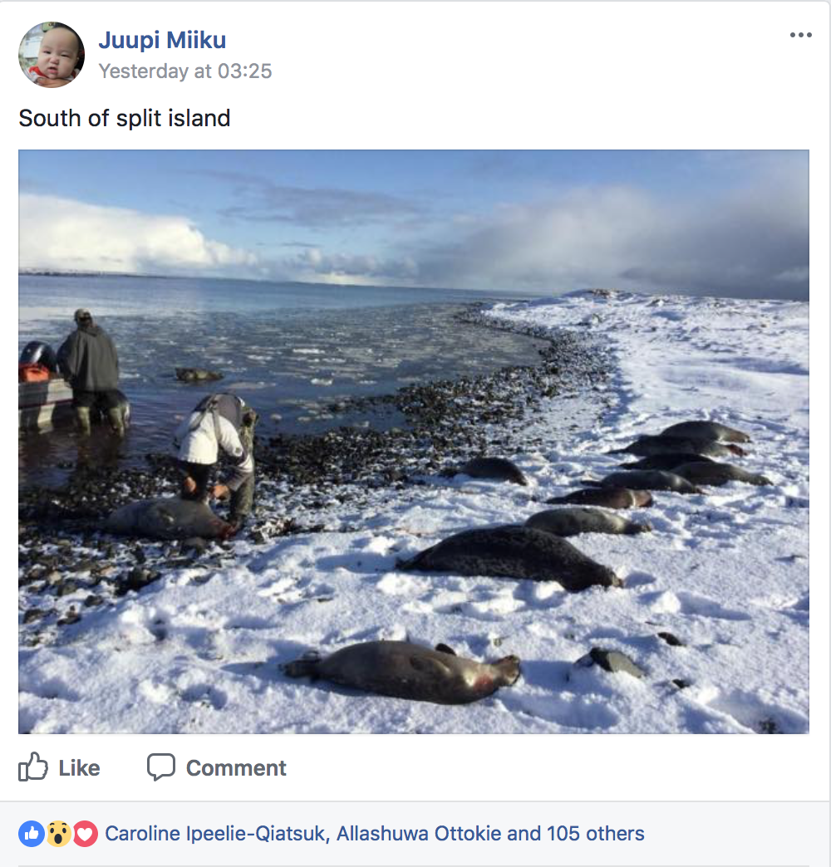
Facebook: Nunavut Hunting Stories
44K members

Slide 27
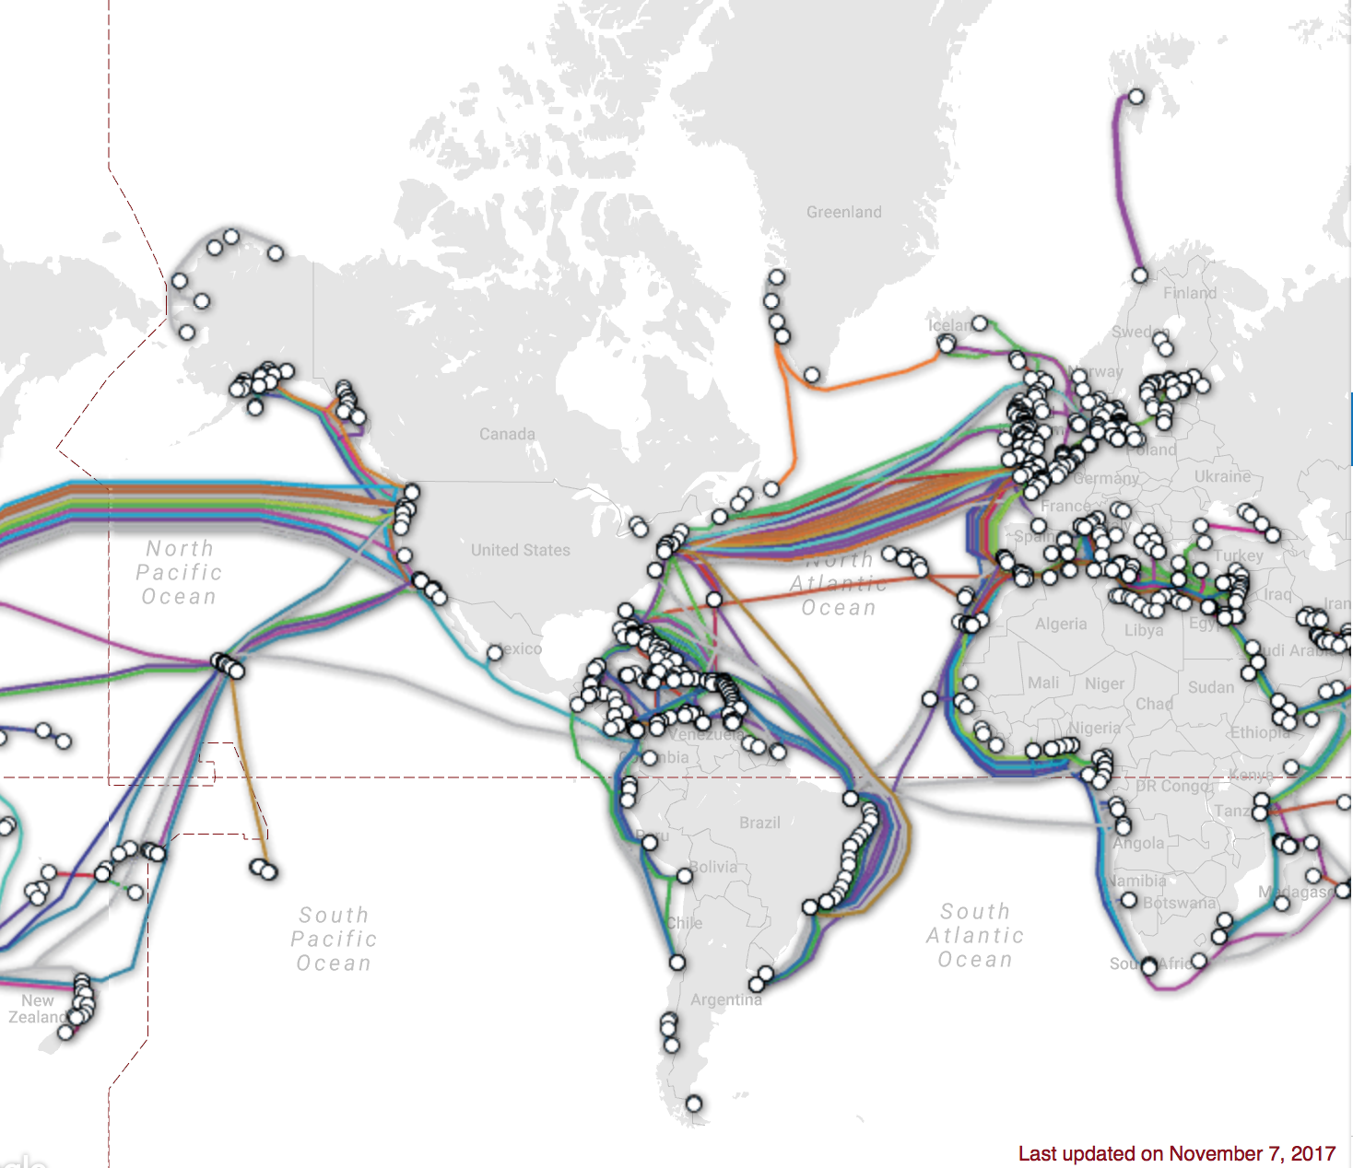

Slide 28
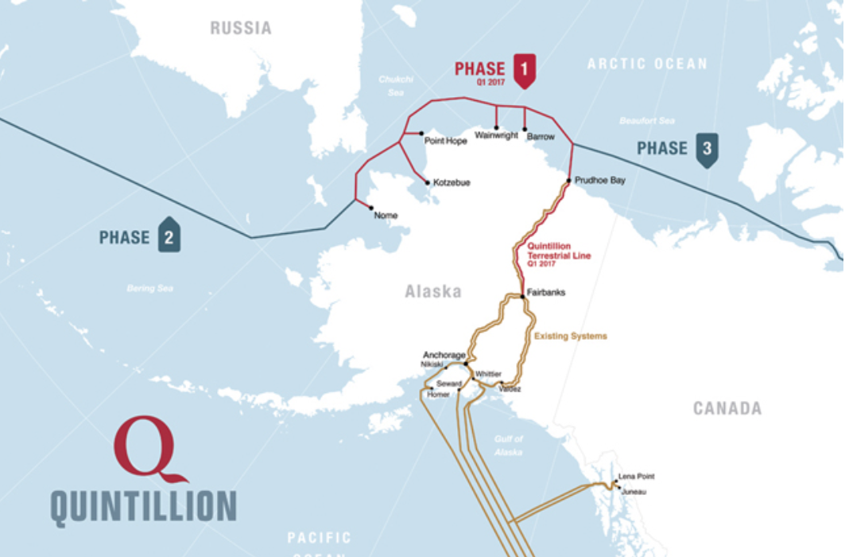
Alaska Fibre Optic build

Slide 29
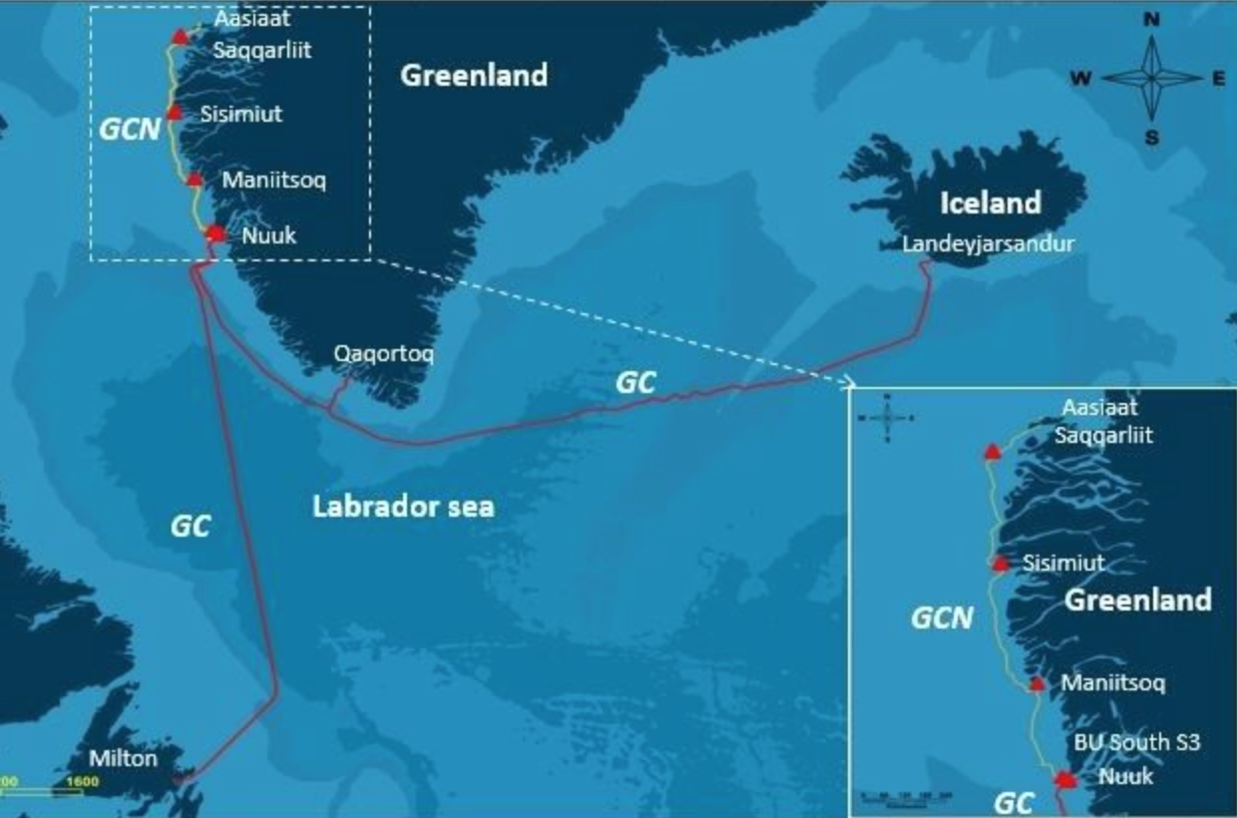
Greenland Fibre Expansion

Slide 30
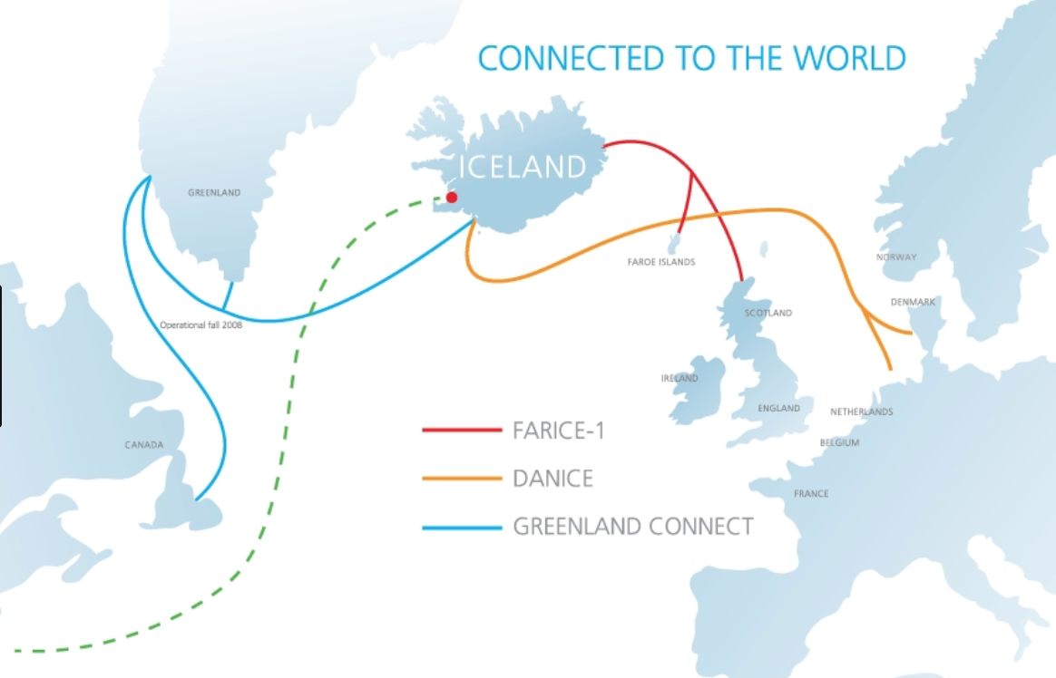
Iceland Fibre Networks

Slide 31
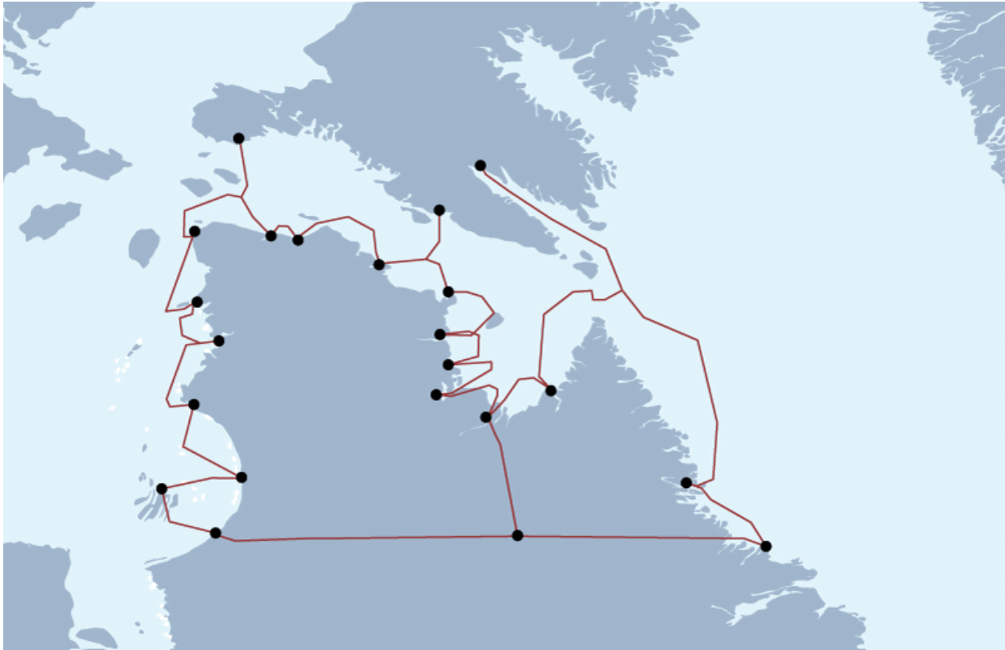
KRG Feasibility Study: Incomplete

Slide 32
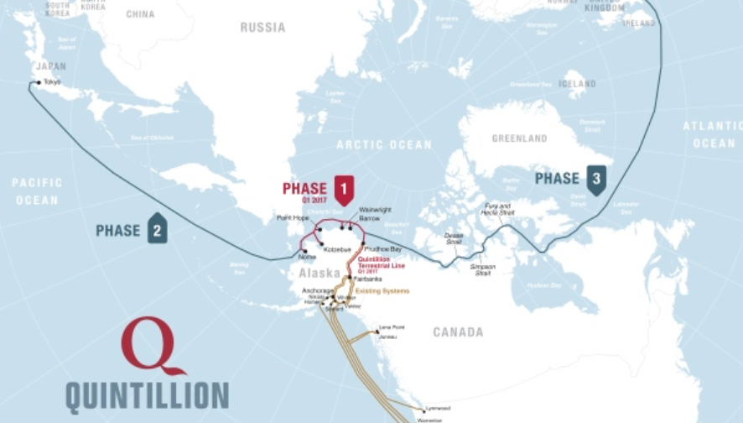
Possible Future Phases

Slide 33
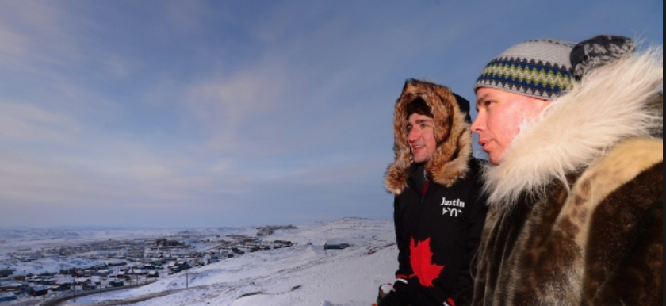
What is needed? Leadership
Local to Regional to National

Slide 34
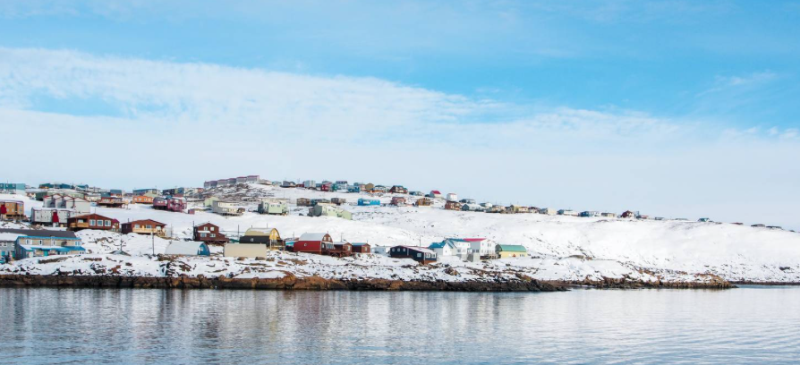
Vision: strong, vibrant, sustainable arctic Region

