Slide 1

Data Centre and Privacy
Indigenous Connectivity Summit
November 7, 2017
Confidential – Not For Distribution

Slide 2

My Understanding
This presentation is my understanding and some observations over the years...
I am - not - a lawyer.
This is - not - legal advice
Confidential – Not For Distribution
Notes:
This presentation is my understanding...
For First Nations, one of the reasons to have a data centre is OCAP.
OCAP is a set of principles supported by First Nations in Canada. Under eHealth, for the Panorama project, we have been working with both the Provincial and Federal eHealth to include “respecting the First Nation Principles of OCAP” in the Information Sharing Agreement (ISA). The process has been a couple years in the making and is 99% done. For Canada, this is president setting.

Slide 3
My Qualifications
My background;
  about 20 years in IT, including;
  Computer Programming;
  Manager Information Systems;
  IT / Privacy / Security in eHealth;
  IT / Privacy / Security in education; and,
  Zero Legal Experience.
C.I.M., CSM, MCSE:2012 SI/CPI, MCITP:EA/SA/EDA7/EDST7, MCSE:2003+Sec, CCNA, CCDA, Sec+, ITIL-F, A+, CIWSP, PR2P, Prosci
Confidential – Not For Distribution
Notes:
My background;
about 20 years in IT, including;
Computer Programming;
Manager Information Systems
Currently I wear a couple hats. FNHSSM and MFNERC as IT Specialist (as defined by Coach).
Coach is an organization that helps define standards and processes, including a job matrix.
IT / Privacy / Security in eHealth; and,
IT / Privacy / Security in education.
That line is most of my Technical Certifications.

Slide 4
Summary
My Assumptions;
What I do;
Entry Level Information;
Privacy (First Nation Health Perspective);
What you actually need to know about Privacy;
eHealth; and,
Security.
Confidential – Not For Distribution
Notes:
My Assumptions;
What I do;
Some of the Rules I live by;
Have had PHIA Training (?);
Privacy (First Nation Health Perspective);
What you actually need to know about Privacy;
eHealth;
Security; and,
The most important Rule #.
Out of everything in this presentation, there are only 3 or 4 slides you need to know.
A lot of this presentation is to provide some perspective on the ‘iceberg of stuff’ hidden below the surface that Managers, Directors, and IT need to worry about to keep operations running smoothly.
Show of hands, who has not had any PHIA Training?

Slide 5
My Assumptions
PHIA
Government Funding Agreement
Confidential – Not For Distribution
Notes:
My Assumptions
Have had PHIA Training.
The JP Funding Agreement is similar First Nation Health Centres Contribution Agreement.
Are providing Health Care Services.
Know how to write and send email.
Know how to browse the Internet.
Have a sense of humour.

Slide 6
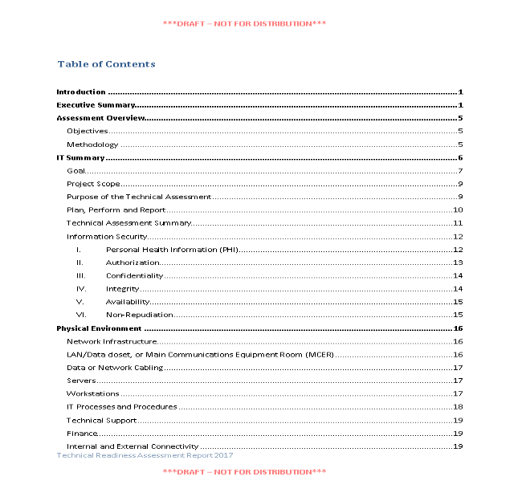
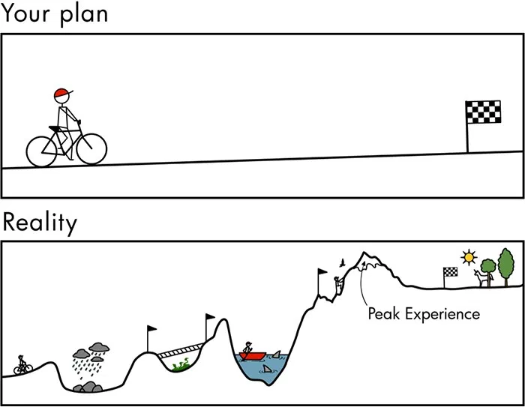
Documentation
Confidential – Not For Distribution
Notes:
What I do…
With eHealth, anything IT, Privacy, or Security related with any of the projects would come across my desk.
Nothing Political or Financial related.
I hands-off IT.
I help plan and help prepare documentation.
Current State, Future State, Gap Analysis, Change Management, PIA, TRA.
When it comes to funding provider, to answer the questions of why? And
Is this a good investment?

Slide 7
COACH
Confidential – Not For Distribution
Notes:
Work with other organizations

Slide 8
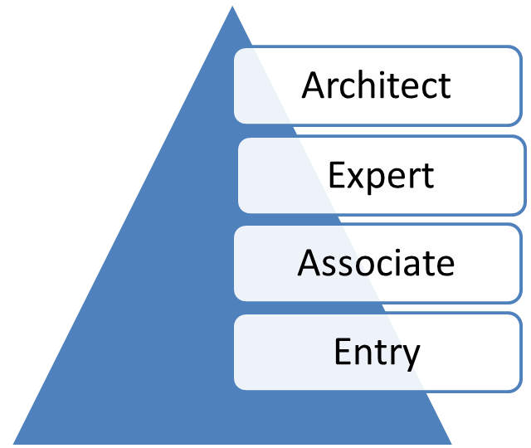
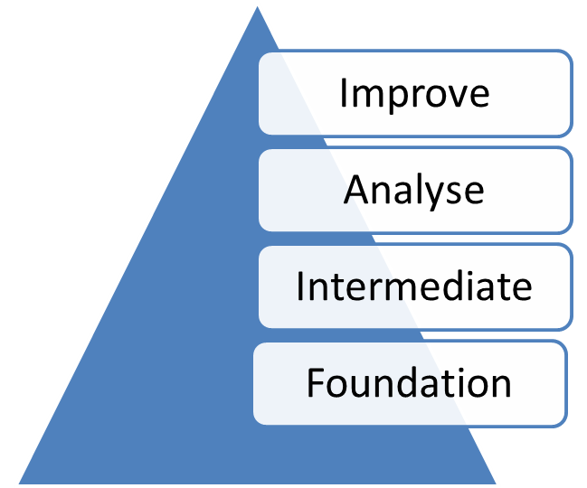
Foundation
Confidential – Not For Distribution
Notes:
“Don't be buffaloed by experts. Experts often possess more data than judgment. The Elite can
become so inbred that they produce hemophiliacs who bleed to death as soon as they are
nicked by the real world."

Slide 9
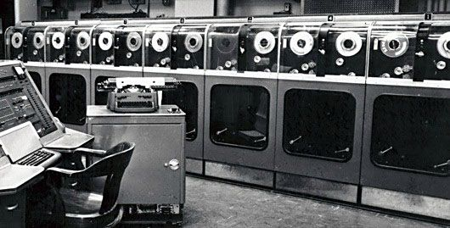
A brief history of Data Centres
Confidential – Not For Distribution
Notes:
Data Centres have evolved since the 1950’s with the changes in technology. Transitioning from green and black screen terminals to the Personal Computer. Then servers came along. Even with server technology changing from stand alone, to multiple servers using shared storage, and now Cloud Technologies. The Data Centre role is still fundamental to protecting a companies most important asset, their information.

Slide 10
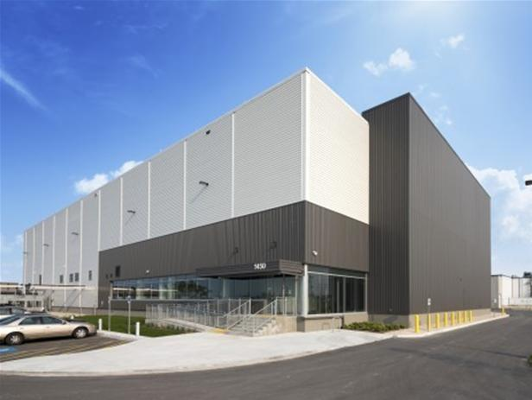
What is a Data Centre?
Confidential – Not For Distribution
Notes:
A Data Centre is a specialized building for computer equipment, are typically very noisy from all fans, with:
Higher physical access controls;
-
More secure building location
- such as away from rail lines.
Redundant power sources from the electrical grid, battery backups, and generators;
Redundant, fast and reliable connectivity paths;
- connections from different ISP.
- Connections to the building from different side of the building.
as most connections will be from outside the building.
Controlled Humidity, Temperature, and air quality.
This is the MTS , now BellMTS Data Centre in Winnipeg. Cost over $50M, is over 60,000 square feet, with 24,000 square feet of usable space for servers and other data infrastructure.

Slide 11

What is a Server Room?
Confidential – Not For Distribution
Notes:
A data centre is very similar to a server room.
A Server Room is a specialized room for computer equipment, are typically very noisy from all fans, with:
Higher physical access controls;
More secure location in the building;
Redundant power sources from battery backups, and generators;
Controlled Humidity, Temperature, and air quality; and,
interconnects within a limited area such as a an office building.

Slide 12


Quality
Confidential – Not For Distribution
Notes:
There is much effort in planning and installing Information system to maintain the confidentiality, integrity, and availability of the system.
Are we building a temporary system, like for a conference, that only has to work until it rains? On the other hand, do we need something that will last?

Slide 13
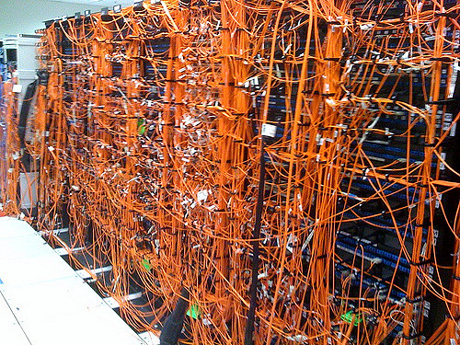
Can we add another server?
Confidential – Not For Distribution
Notes:
From a simple standpoint, the difference between a Data Centre, and a Server Room, is a Data Centre is a dedicated building. A Server Room is a dedicated room in a building. A Data Centre may have multiple tenants collocating their computer equipment, where as a Server Room is usually a single tenant, and in the same building as the organization. Both require design and planning to meet the current need and purpose, but also to scale.

Slide 14
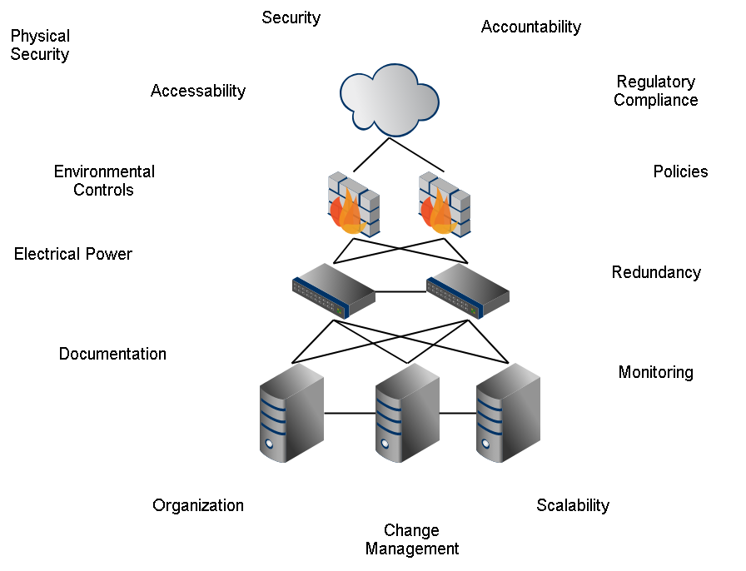
Data Centre Goal
Confidential – Not For Distribution
Notes:
The Data Centre goal is to standardize and help reduce the number of hardware and software platforms in a hosting location for applications and centralized services to better maintain availability, confidentiality, integrity and accountability of information assets; e.g. scanning for viruses, secure backup and restoration of data, secure data archiving, and secure data destruction.
A data centre can be an off-site backup location for band offices, health centres, and other businesses.
“Put all of your eggs in a bombproof basket and guard it with your life”
Large or small business, IT in the business world is different from IT in your home.

Slide 15
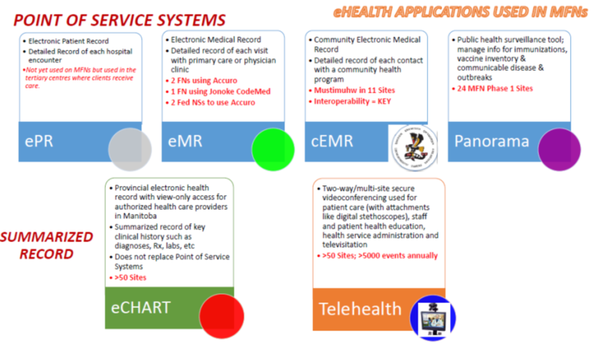
eHealth Applications
Confidential – Not For Distribution
Notes:
Not all eHealth applications are created equal; each application fits a different need and purpose; like Microsoft Office Suite, where you have Excel for spreadsheets, and Outlook for Email.
An application that performs the same function may be different in the background. For example email, we touched on regular and encrypted email earlier.

Slide 16


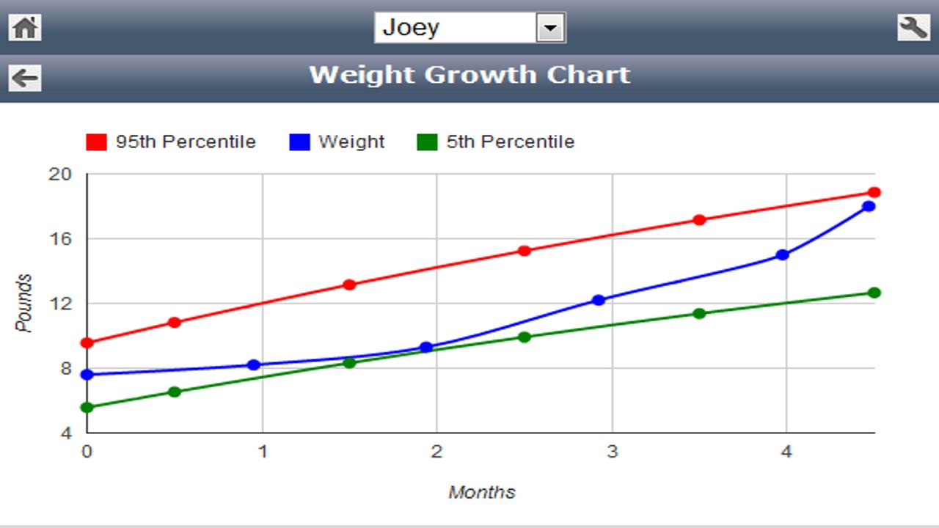
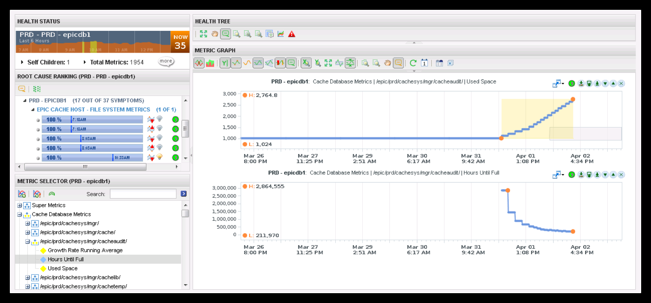
Paper to Electronic Health Records
Confidential – Not For Distribution
Notes:
With a paper file and some effort, you may be able to enter some data on a spread sheet for simple charts and graphs.
Once the information is captured electronically, there is the opportunity to analyze the data.

Slide 17
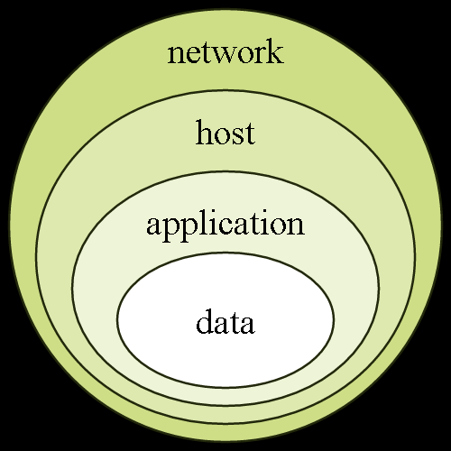
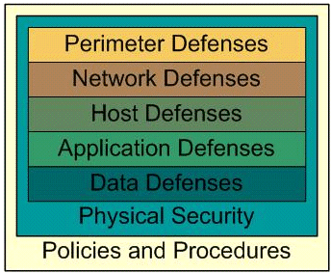
Defense In Depth
Outside the
Network
Confidential – Not For Distribution
Notes:
As technology changes, there are new vulnerabilities discovered. To protect the information to the best of our ability, we have to employ many security measures on the whole record path. So a single failure will not result in a breach of information.

Slide 18
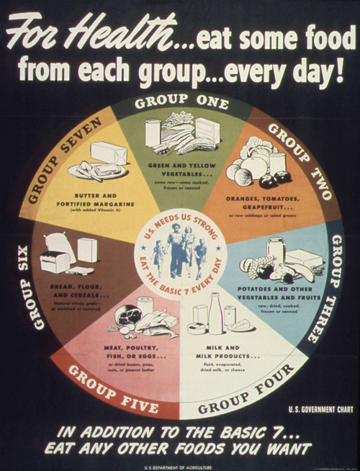
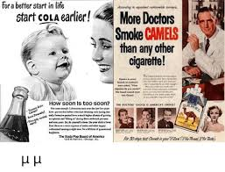
Standards
Confidential – Not For Distribution
Notes:
What is the reality today, may not be the reality of tomorrow.

Slide 19
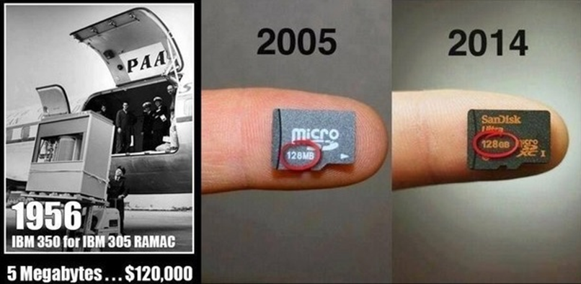
Rate of Change
5 MB | 128 MB | 131,072 MB
Confidential – Not For Distribution
Notes:
I guess it is a good thing that the progress of technology is pretty slow.
1GB = 1024MB
128GB = 131,072MB
256GB = 262,144MB
Grain of rice = 1 bit
Petabyte of rice would fill the Pacific Ocean.

Slide 20
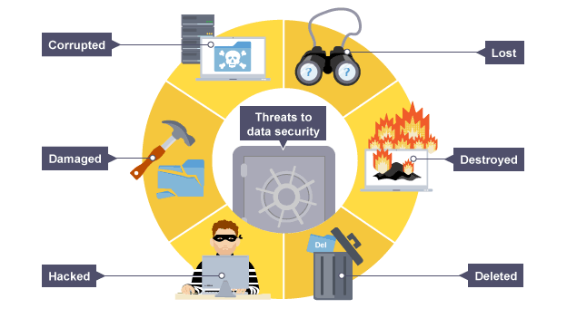
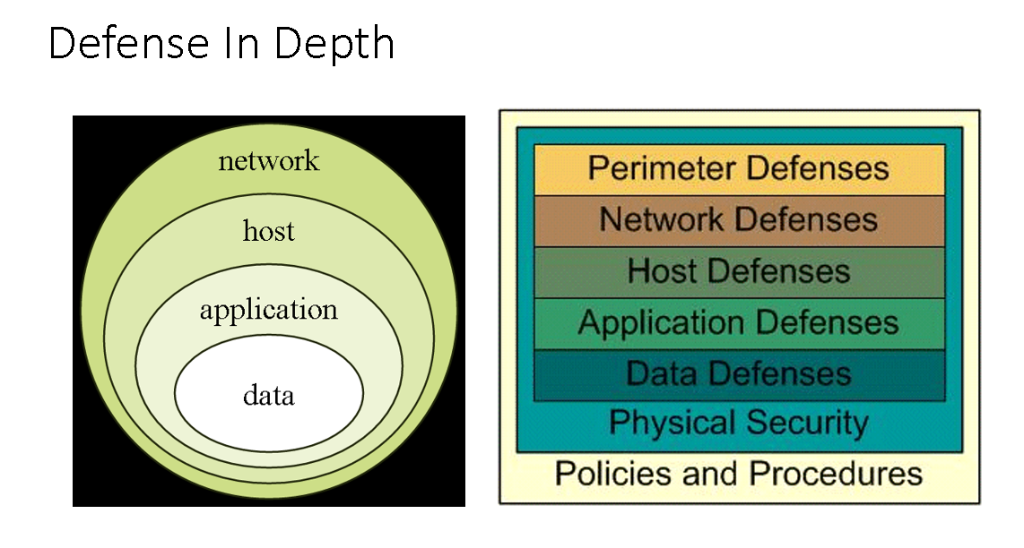
Threats to Data Security
Confidential – Not For Distribution
Notes:
Corruption, damage, hackers, lost, destroyed, deleted.

Slide 21
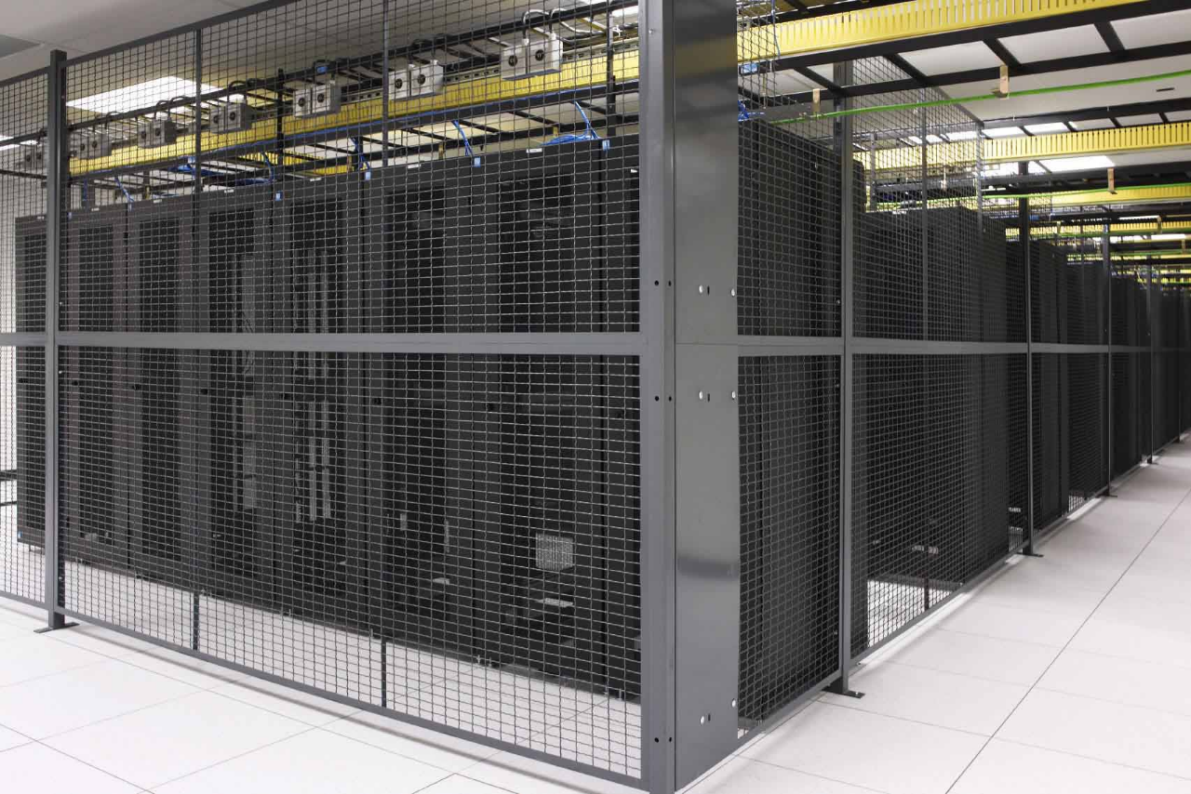
Security
Confidential – Not For Distribution
Notes:
No accent wall
Security
- First level – fenced compound with electronically locked gate
- Second level – door to the building/structure
- Third level – rack doors
- For customers with high-security requirements. Customers could be assigned their modular building or a portion of a building that is separate from the other areas of the Datacentre.
- Since the facility is mostly a lights-out operation, staff can be notified when and if Datacentre personnel need access.
- Biometric security is another viable option.

Slide 22
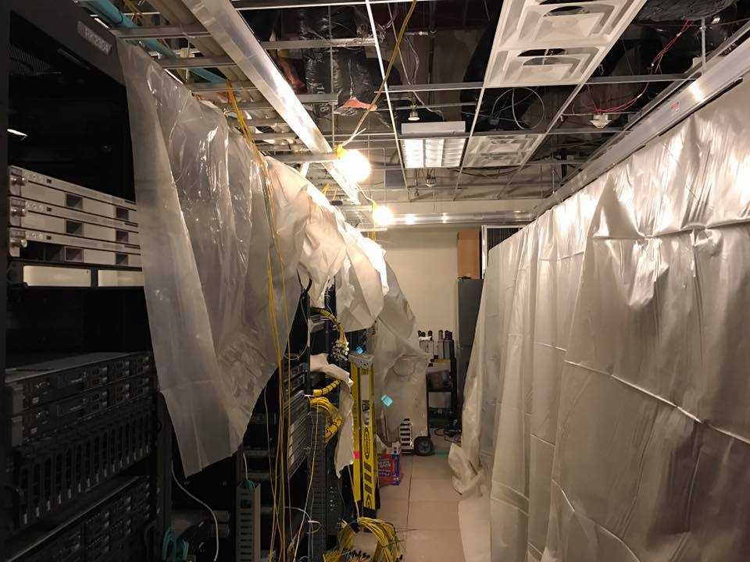
Environmental Controls
Confidential – Not For Distribution
Notes:
Keeping things cool and maintaining appropriate humidity levels, and account for fire suppression, air flow, power distribution and light.
-Humidity, Temperature, and airflow go hand-in-hand. 70% non-condensing humidity, with a temperature of 70 Degrees Fahrenheit, and no hotter than 89.6 (or 32 Celsius). Using a Computer Room Air Conditioning (CRAC) Unit
- A special note, air conditioners require coolant flowing through pipes to the heat exchanger. Do these pipe run over your current data closet?
Fire suppression, there are two practical choice, gas or water. Another option is a bucket of sand and a shovel. In the early days, Halon gas was the preferred gas for fire suppression. After Halon was found to damage the ozone layer, other gases started to be used. I believe in the last 10 years, problems have been found with 3 of the 4 gases, requiring data centres using these types of gases to change. It is not just a matter of changing the tank. Once the fire suppression system is touched, the whole system has to be brought up to the current code, which usually means replacing all the pipes.
A simple solution is water with a dry pipe system. There are basic to advanced dry pipe systems. All dry pipe systems keep the water out of the pipe until the water is needed. Mitigating the risk of a water leak.

Slide 23
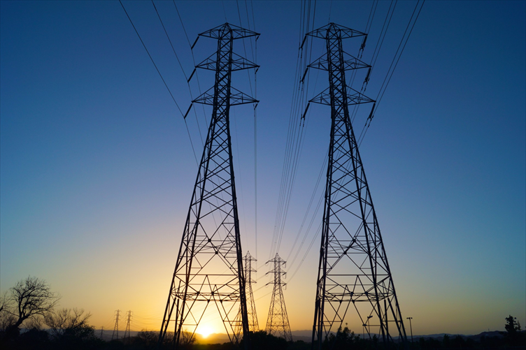
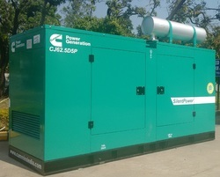
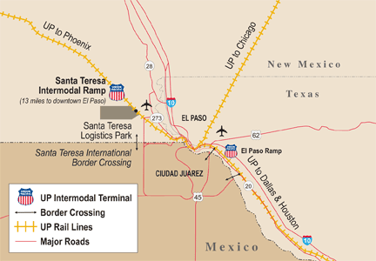
Site Considerations
Confidential – Not For Distribution
Notes:
Site Considerations for Research
- Site prep, fencing
- Historical air and water temps, which could change if the site location changes.
Location:
- Secure fenced compound
Good all-weather road access
Not too far from a major urban centre with decent shipping options.
Good drainage
Adequate distance from rail line.
Possibility of connecting to two power grids
Natural gas of diesel backup generator.
If diesel, risk of fuel contaminated with water.
Environment:
- Moderately cool temperatures.
- Low risk of natural disasters: Floods; tornados; fires; and earthquakes.

Slide 24
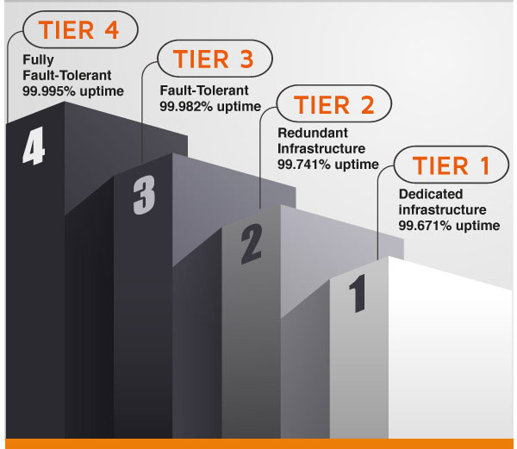
Redundant Systems
Confidential – Not For Distribution
Notes:
Internet connection
Electrical power
- electrically ground data cabinets
Cooling
- cooling failure will shut down a data centre
Consider maintenance of equipment.
Risk of increasing load to power and cooling by adding more servers
365 days per year (what about leap year?)
Tier 1, does the job
Tier 2, some redundancy
Tier 3, Redundant communication paths
Tier 4, Complete redundancy with automatic failover.

Slide 25
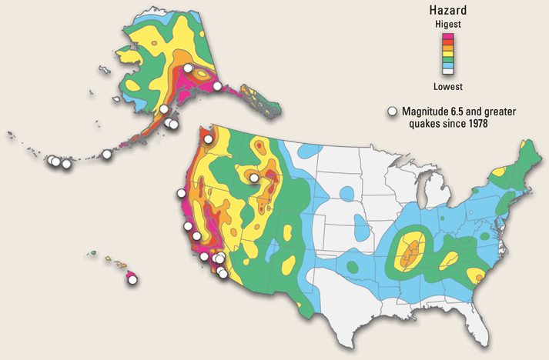
Data Centre Location
Confidential – Not For Distribution
Notes:
Site Considerations
- Site prep, fencing
- Historical air and water temps
Location:
- Secure fenced compound
Good all-weather road access
Not too far from a major urban centre with decent shipping options.
Good drainage
Environment:
- Moderately cool temperatures.
- Low risk of natural disasters: Floods; tornados; fires; and earthquakes.

Slide 26
Insurance
“I plan ahead, that way I don't have to do anything right now.“ tremors
Confidential – Not For Distribution
Notes:
Insurance
- Threat Risk Analysis (TRA) and Privacy Impact Assessment (PIA).
Standard business liability insurance covers things such as being sued. However, most of these insurance offerings do not cover Internet service companies. It is recommended for Internet service companies to purchase specialized insurance packages.
- Property insurance to cover damage from fires, and theft.
- If the data centre is a collocation facility, verify the insurance coverage covers equipment and the protection of their equipment causing a fire that damages other equipment.

Slide 27
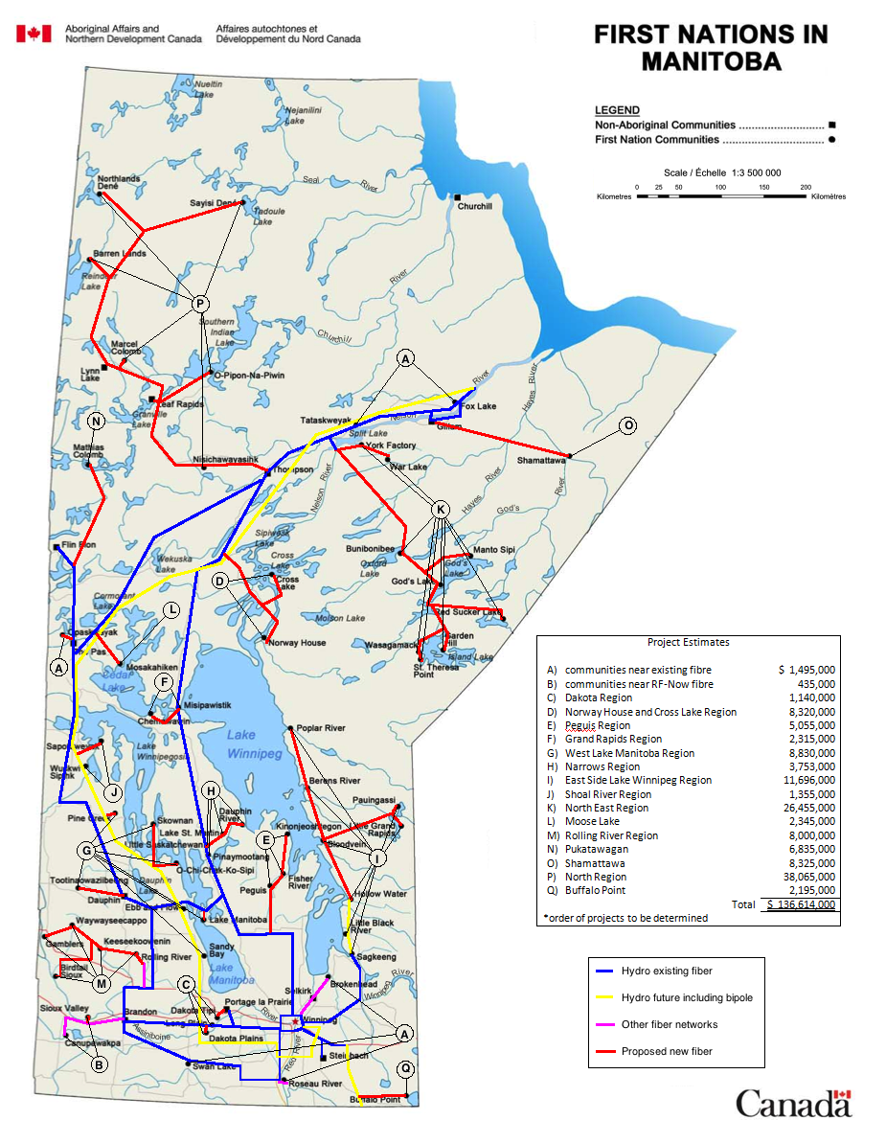
In Manitoba
Confidential – Not For Distribution
Notes:
In Manitoba, through Health Funding, as for the need for Bandwidth FNHSSM has been able to secure funding for a Feasibility Study and some engineering work for a fibre network that will connect all 63 First Nation Communities in Manitoba.
Part of the self-sustainability includes a Data Centre to centrally store data and Health Systems.
We have an agreement in principal with another First Nation Data Centre in BC to be the off-site backup.

Slide 28
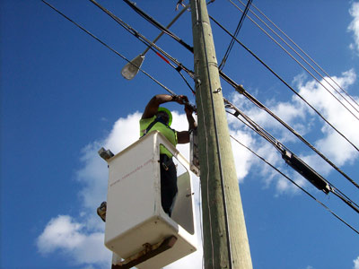
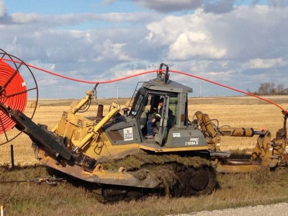
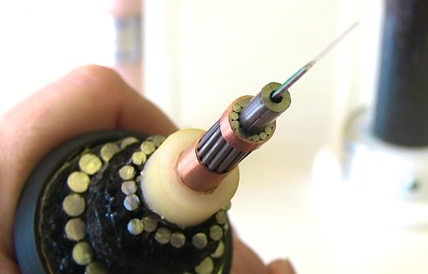

Fibre Deployments
Aerial
Shallow Dig
Submarine/Armoured
Cable
Directional Dig
Confidential – Not For Distribution

Slide 29
Modular Data Centre
Confidential – Not For Distribution
Notes:
The data centre plan is for it to be modular, with about 20 racks at a time.
Physical location for access to power, Internet, and Road.

Slide 30
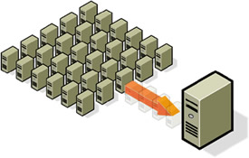
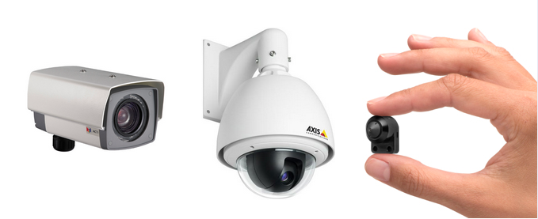


Other Stuff
Confidential – Not For Distribution
Notes:
Virtualization, where several virtual servers run on one physical server
Power Over Ethernet (POE) for security cameras and wireless access points
Thin Clients, where the client only processes keyboard, mouse clicks, and screen updates. All the processing is done on the server.
Data Centre Standards
- which one?
- TIA 942, BICSI 002, EN 50600 series, EN 50173-5, ISO/IEC 24764.
- there may also be local standards and building codes to consider
Which Data Centre Cabling Standard?
Which Data Centre Operations Standard?
Data centre testing, both components and systems
Data centre auditing, reasons for auditing, different types of audits
- for DR and BC
- Information Security
- health and Safety
- Building Regulations
- Energy Efficiency

Slide 31
Rule and Exception
“A good teacher must know the rules;
A good pupil, the exceptions.” mhf
Confidential – Not For Distribution
Notes:
A good teacher must know the rules; A good pupil, the exceptions.”
Good leadership involves responsibility to the welfare of the group, which means that some people will get angry at your actions and decisions. It's inevitable - if you're honorable. Trying to get everyone to like you is a sign of mediocrity. You'll avoid the tough decisions, you'll avoid confronting the people who need to be confronted, and you'll avoid offering differential rewards based on differential performance because some people might get upset. Ironically, by procrastinating on the difficult choices, by trying not to get anyone mad, and by treating everyone equally "nicely" regardless of their contributions, you'll simply ensure that the only people you'll wind up angering are the most creative and productive people in the organization.

Slide 32
What is 2 with the addition of 2?
2 + 2 = 4
2 beside a 2 = 22
2 – 2 = 0
2 and 2 = 2
2 or 2 = 2
2^2 = 4
2 x 2 = 4
2 / 2 = 1
Confidential – Not For Distribution
Notes:
How should you proceed?
What are the rules?
Look for intelligence and judgment and, most critically, a capacity to anticipate,

Slide 33
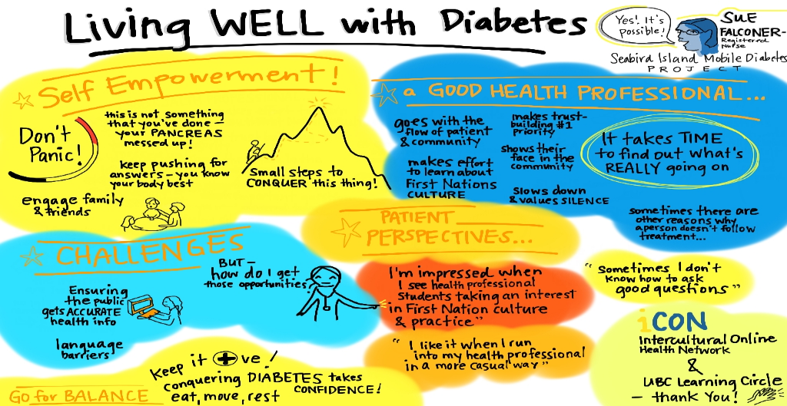
Patient vs Client
Confidential – Not For Distribution
Notes:
- First Nation Context
- Client
- Nursing Station, Provincial or Federal
- Combination of Health Centre and Nursing Station
- Health Centre vs Wellness Centre

Slide 34
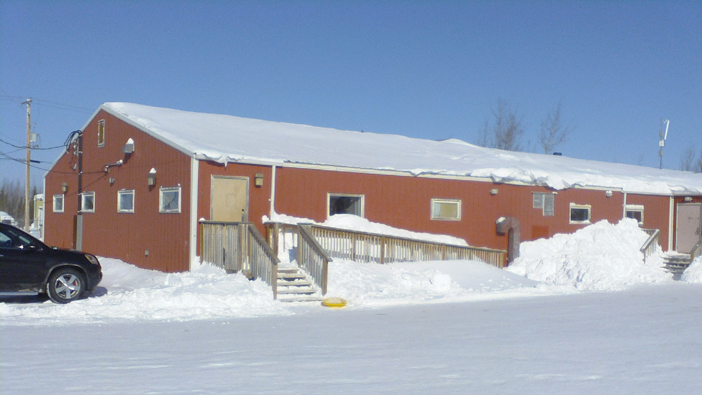
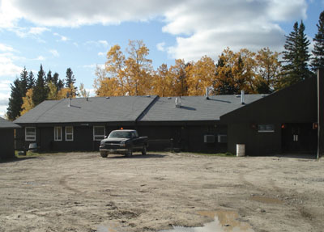
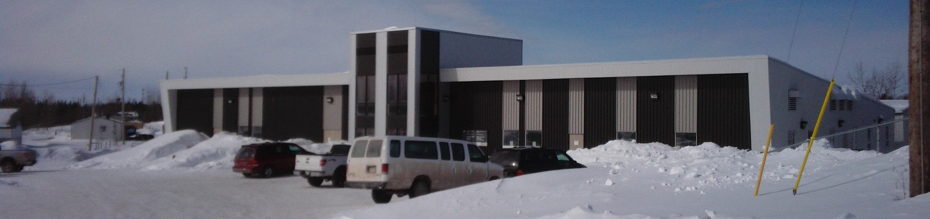
What is a Health Centre?
Confidential – Not For Distribution
Notes:
- First Nation Context
- Client
- Nursing Station, Provincial or Federal
- Combination of Health Centre and Nursing Station
- Health Centre vs Wellness Centre

Slide 35
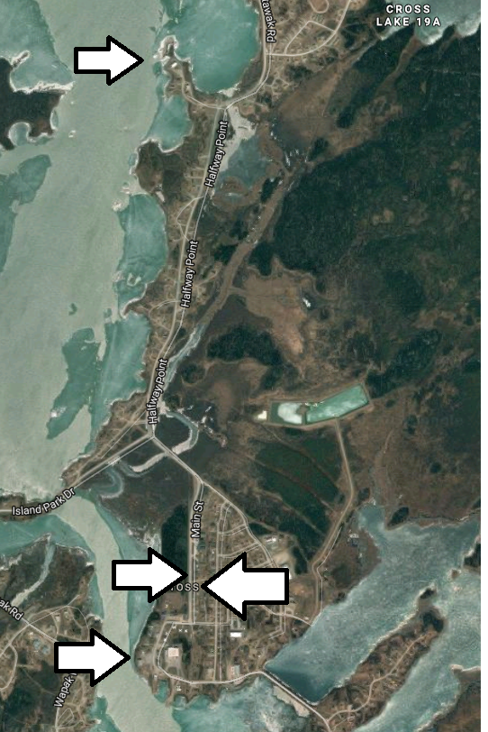
Nursing Station and Health Centre?
Confidential – Not For Distribution
Notes:
CLBOI

Slide 36

Privacy and Health
Confidential – Not For Distribution
Notes:
With the changing technological environment and the ever increasing use electronic health records, there is a need to ensure that the safety and integrity of information are secure. To better protect data at rest and in transit, new policies and technologies must be in place.
The need for users to be connected to work from home or on the road is becoming increasingly common place.
Users need to be able to synchronize files between their computer and servers, to allow data to be backed up and available for other uses.

Slide 37
Resource
"Organization doesn't really accomplish anything. Plans don't accomplish anything, either. Theories of management don't much matter. Endeavors succeed or fail because of the people involved. Only by attracting the best people will you accomplish great deeds.“ cp
Confidential – Not For Distribution
Notes:
"Organization doesn't really accomplish anything. Plans don't accomplish anything, either. Theories of management don't much matter. Endeavors succeed or fail because of the people involved. Only by attracting the best people will you accomplish great deeds.“ cp

Slide 38
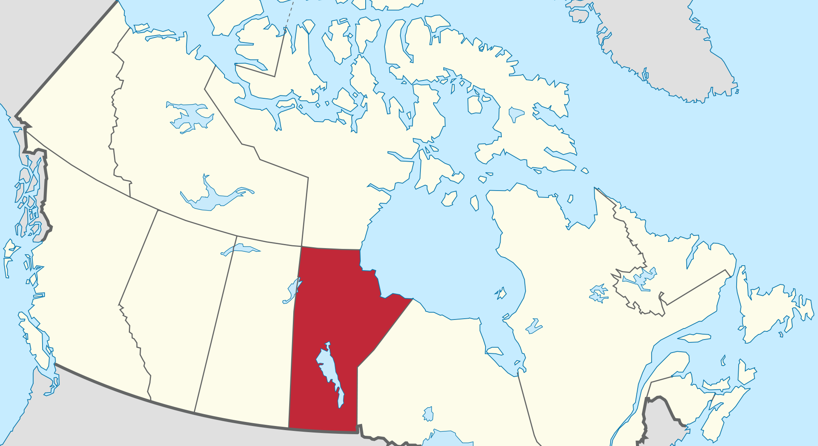
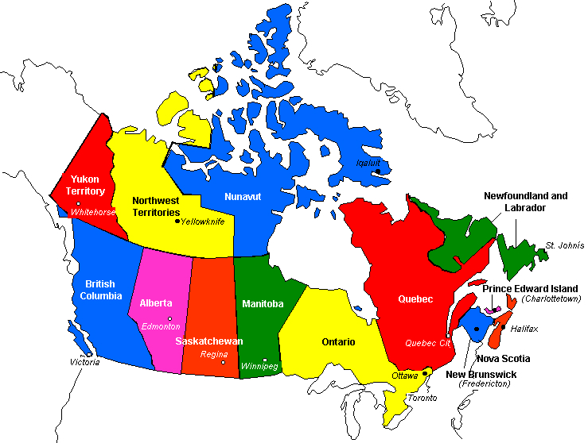
MFNERC and MFNSS
Confidential – Not For Distribution
Notes:
Both MFNERC and MFNSS are First Nation Organizations operating within the Province of Manitoba,
Working with all 63 Manitoba First Nation Communities, with a total population of about 140,000.
There are 40 Health Centres and 58 Schools.
FNHSSM directly supports 10 of the 12 communities with cEMR
MFNERC directly supports 10 of the 58 Schools.

Slide 39
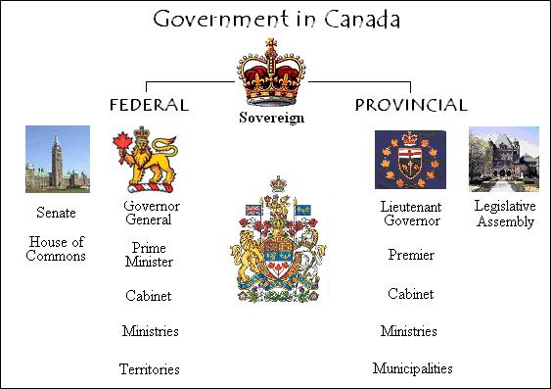
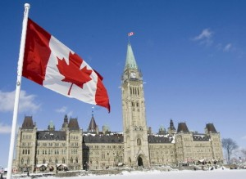

Parliaments in Canada
Confidential – Not For Distribution
Notes:
The powers of the parliaments in Canada divides legislative abilities between the federal and provincial governments.
Even though both MFNERC and FNHSSM are located in the province of Manitoba, they operate on the Federal Side.
The two sides are like Oil and Water, they do not mix.

Slide 40
Privacy Legislation
Privacy legislation falls into three jurisdictions within Canada:
  1) Federal;
  2) Provincial; and,
  3) First Nations.
Confidential – Not For Distribution
Notes:
Privacy legislation falls into three jurisdictions within Canada:
1) Federal;
2) Provincial; and,
3) First Nations.

Slide 41
PHI Authorities
Trustee of PHI
  Have custody or control
Steward of PHI
  Responsible for the management and oversight
Owner of PHI
  The Client
Confidential – Not For Distribution
Notes:
“trustees” who maintain (have custody or control of) PHI.
A Trustee includes: health care facilities; some health professionals; health services agencies; and, public bodies.
Steward is responsible for the management and oversight of PHI
Owner of PHI, is the Client

Slide 42
Identifiable vs Aggregate
Identifiable
  To recognize or establish as being a particular person.
Aggregate
  Formed or calculated by the combination of many separate units or items
Confidential – Not For Distribution
Notes:
Identifiable = To recognize or establish as being a particular person.
Aggregate = Formed or calculated by the combination of many separate units or items
Not the legal definitions, but close enough.
If there is a privacy breach, the government will only follow the law.
Currently, none of the laws protect aggregate data, only personal identifiable data.

Slide 43
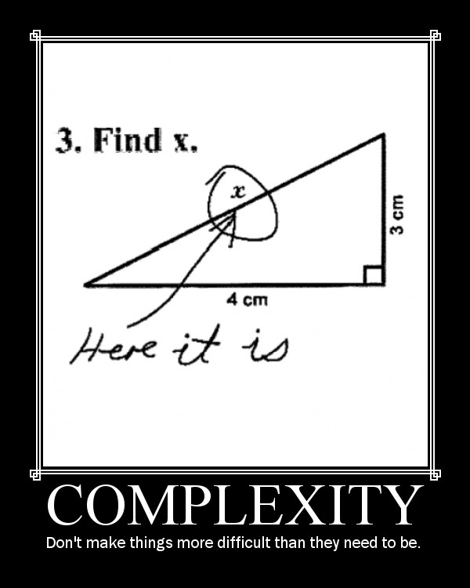
Keep it Simple
Confidential – Not For Distribution
Notes:
Don’t make things more difficult or complicated than they need to be.
With that said, this is going to be more difficult and complicated than it needs to be, but there is a method to my madness.

Slide 44

1) Federal Jurisdiction
  the (federal) Privacy Act; and,
  Personal Information Protection and Electronic Documents Act (PIPEDA).
Confidential – Not For Distribution
Notes:
The federal government has constitutional jurisdiction over matters of national concern and has enacted two pieces of privacy legislation:
the (federal) Privacy Act; and,
Personal Information Protection and Electronic Documents Act.

Slide 45
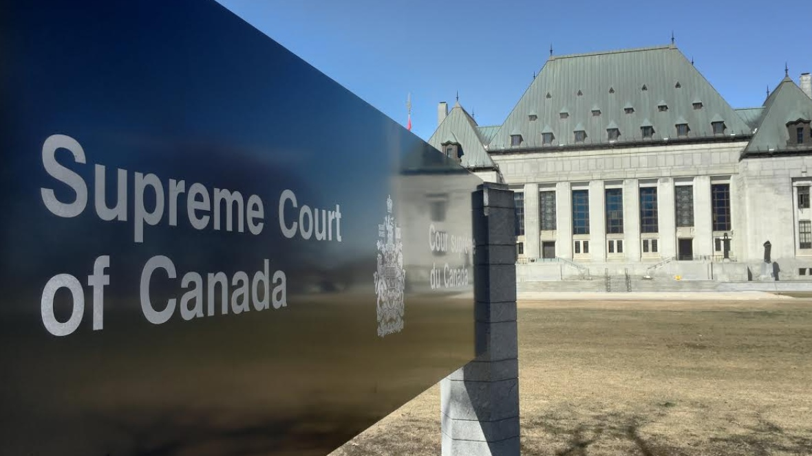

Federal Privacy Act
The Federal Privacy Act applies to organizations and not individuals.
Confidential – Not For Distribution
Notes:
The Federal Privacy Act applies to federal departments and agencies, and not individuals.

Slide 46

2) Provincial Jurisdiction
The province of Manitoba has enacted:
  the (provincial) Privacy Act;
  the Freedom of Information and Protection of Privacy Act (FIPPA); and,
  the Personal Health Information Act (PHIA).
Confidential – Not For Distribution
Notes:
The provinces have constitutional jurisdiction over property and civil rights, and matters of a local nature.
The province of Manitoba has enacted:
the (provincial) Privacy Act;
the Freedom of Information and Protection of Privacy Act; and,
the Personal Health Information Act.

Slide 47
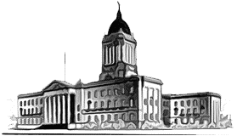
Provincial Legislature
The legislatures of the provinces may only pass laws relating to topics explicitly reserved for them by the constitution, such as education.
Confidential – Not For Distribution
Notes:
In general, the legislatures of the provinces may only pass laws relating to topics explicitly reserved for them by the constitution, such as education.

Slide 48

But, MFNERC and FNHSSM
Confidential – Not For Distribution
Notes:
But, Both MFNERC and FNHSSM are First Nation Organizations, operating on the Federal side.

Slide 49
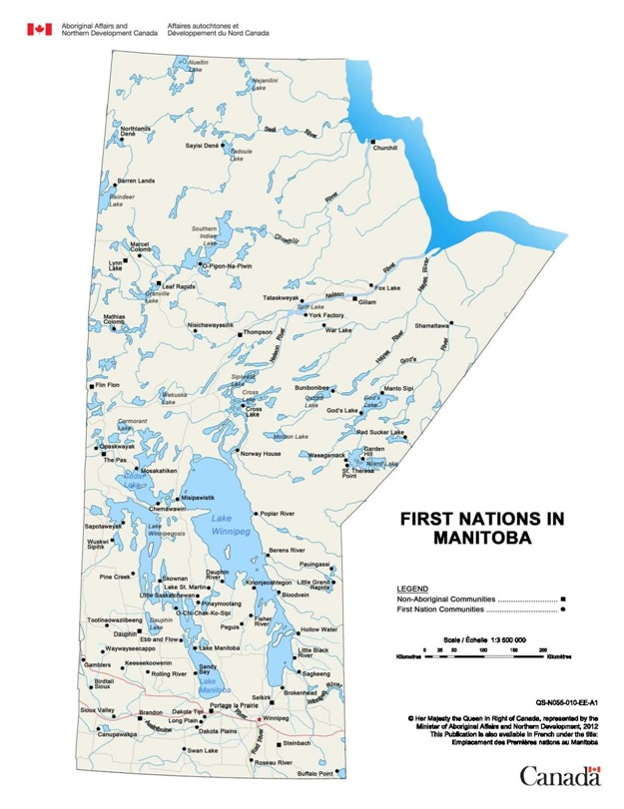
The (provincial) Privacy Act
Confidential – Not For Distribution
Notes:
All people within Manitoba, including all First Nation people in the 63 communities fall under the Provincial Privacy Act.
Where there is a conflict between the provincial and federal privacy acts, the provincial act prevails.

Slide 50
Tort (legal wrong)
Tort of “violation of privacy.”
Individuals can sue, “unjustly violated”, without proof of actual damages
Confidential – Not For Distribution
Notes:
Some legal definitions to help with the next couple slides.
Within the Manitoba Privacy Act, Manitoba is one of the few provinces which have codified the tort of “violation of privacy.”
Allowing individuals whose privacy has been “unjustly violated” to sue for monetary damages and obtain other remedies, without proof of actual damages.

Slide 51

FIPPA
FIPPA applies to “all records in the custody or under the control of a public body” except :
  Educational Materials or Research Information;
  Archival Records; and,
  Records excluded by other legislation such as PHIA.
Confidential – Not For Distribution
Notes:
FIPPA is under Provincial Legislature, applies to “all records in the custody or under the control of a public body” except :
Educational Institution Teaching Materials or Research Information;
Examination or Test Questions;
Archival Records Acquired from a Person other than a Public Body , if that person or entity is not a public body; and,
Records excluded by other legislation such as PHIA.

Slide 52
FIPPA
FIPPA is a provincial statute for both:
  access to information; and,
  information privacy.
Confidential – Not For Distribution
Notes:
FIPPA is a provincial statute for both:
access to information; and,
information privacy.

Slide 53
PHIA
The Act applies to “trustees” who maintain PHI.
Confidential – Not For Distribution
Notes:
The Act applies to “trustees” who maintain (have custody or control of) PHI.

Slide 54

PHIA
PHIA Imposes obligations on trustees specifically:
  collection;
  use;
  disclosure; and,
  security.
Confidential – Not For Distribution
Notes:
PHIA Imposes obligations on trustees for the protection of Personal Health Information (PHI), specifically:
collection;
use;
disclosure; and,
security.

Slide 55
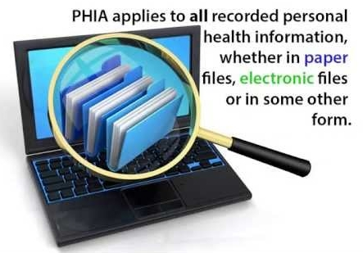
PHIA
Confidential – Not For Distribution
Notes:
PHIA applies to all recorded PHI, whether in paper files, electronic files or in some other form.
PHIA deals with one type of personal information.
– Personal Health Information (PHI) –
and is based on the same ‘information privacy' principles as FIPPA.

Slide 56
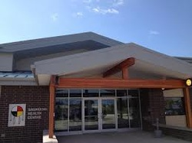
PHIA and First Nations
First Nations are – not – defined as a ‘trustee’ under PHIA.
PHIA does – not – apply to First Nations delivering health care services.
Confidential – Not For Distribution
Notes:
First Nations are – not – defined as a ‘trustee’ under PHIA.
PHIA does – not – apply specifically to First Nations who are delivering health care services.

Slide 57
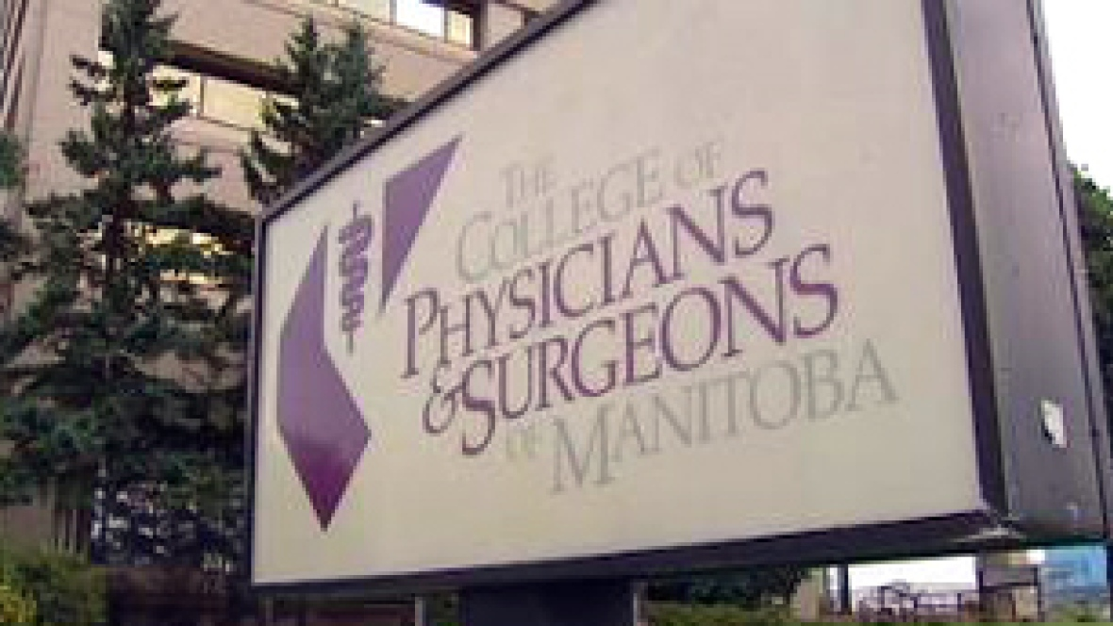
PHIA and Regulated Professionals
PHIA does apply to regulated health professionals who are employed by First Nations.
Confidential – Not For Distribution
Notes:
PHIA does apply to regulated health professionals who are employed by First Nations.

Slide 58
PHIA Compliance
In order for health professionals to be in compliance with PHIA, they must be satisfied that their participation meets the requirements of PHIA.
Confidential – Not For Distribution
Notes:
In order for health professionals to be in compliance with PHIA, they must be satisfied that their participation meets the requirements of PHIA.
Health professionals should also be familiar with their ongoing privacy obligations under PHIA to maintain compliance.

Slide 59
Experts
"Don't be buffaloed by experts. Experts often possess more data than judgment. The Elite can become so inbred that they produce hemophiliacs who bleed to death as soon as they are nicked by the real world.“ cp
Confidential – Not For Distribution
Notes:
“Don't be buffaloed by experts. Experts often possess more data than judgment. The Elite can become so inbred that they produce hemophiliacs who bleed to death as soon as they are nicked by the real world.“
When it comes to provincial and the federal government, they are wrong until proven right.
Now with the Federal and Provincial Jurisdictions out of the way. Too add to the confusion, lets through First Nations into the mix.

Slide 60


3) First Nations Jurisdiction
First Nations have the inherent right to self-governance and thereby have authority to enact their own privacy laws and regulations.
Confidential – Not For Distribution
Notes:
First Nation Jurisdiction.
First Nations have the inherent right to self-governance and thereby have authority to enact their own privacy laws and regulations.
To my knowledge none of the First Nations in Manitoba have implemented their own privacy law.

Slide 61

First Nations’ Principles of OCAP
OCAP: Ownership, Control, Access and Possession
Confidential – Not For Distribution
Notes:
OCAP: Ownership, Control, Access and Possession
Sanctioned by the First Nations Information Governance Committee, Assembly of First Nations and published by the National Aboriginal Health Organization in April 2007.
Individual identifiable information is protected under the various privacy laws. OCAP is one of the few tools we have to protect First Nation aggregate information.

Slide 62
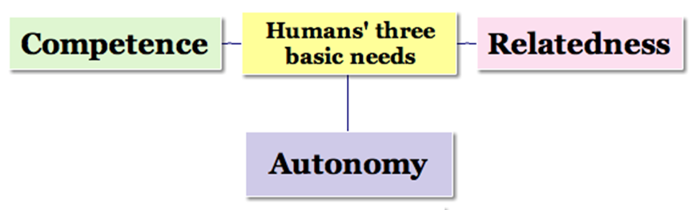
Self-Determination.
Confidential – Not For Distribution
Notes:
OCAP is a tool and is to be used to support First Nations inherent right to self-determination.
OCAP is a driver for recognition and acknowledgement that the First Nation is the steward of the health information.

Slide 63
First Nation Identifiable Information
Confidential – Not For Distribution
Notes:
Adding “First Nation Identifiable Information” to agreements protects the First Nation Individual information and First Nation Aggregate Information.
Health Information for the benefit of the health clients who are members of the First Nation.
The First Nation commits to protecting the privacy of personal information contained within the system, and to protect the community's interests about the use or disclosure of aggregated data.

Slide 64

Law vs Act
Law = “… is a system of regulations that are made to govern people, to help them in their conduct according to the norms of the society.”
Act = “… is a piece of legislation that is more specific and applies to particular circumstances and specific people.”
Confidential – Not For Distribution
Notes:
Some more legal definitions:
Law = “… is a system of regulations that are made to govern people, to help them in their conduct according to the norms of the society.”
Act = “… is a piece of legislation that is more specific and applies to particular circumstances and specific people.”

Slide 65
The Funding Agreement
“The recipient shall ensure that all information of a personal medical nature shall be treated as confidential and not disclosed except with the consent … or otherwise in accordance with applicable law.”
Confidential – Not For Distribution
Notes:
Project Funding Agreements may have some wording along the lines of:
“The recipient shall ensure that all information of a personal medical nature shall be treated as confidential and not disclosed except with the consent … or otherwise in accordance with applicable law.”
Note the words, “recipient”, a person or thing that receives, and “law”.
What laws are applicable to a recipient?

Slide 66
Applicable Law - Federal
First Nations are - not - subject to The (Federal) Privacy Act.
  Applies only to federal government departments and agencies.
First Nations are - not - subject to PIPEDA.
  Organizations that collect, use and disclose personal information in the course of a commercial activity.
Confidential – Not For Distribution
Notes:
First Nations are not subject to The (Federal) Privacy Act.
It only applies to federal government departments and agencies.
First Nations are not subject to PIPEDA.
Organizations that collect, use and disclose personal information in the course of a commercial activity.

Slide 67
Applicable Law - Provincial
First Nations are - not - subject to PHIA.
  First Nations are not categorized as "trustees" under the Act.
First Nations are - not - subject to FIPPA.
  Only applies to the provincial government and other provincially-regulated public bodies within Manitoba.
Confidential – Not For Distribution
Notes:
First Nations are not subject to PHIA.
As First Nations are not categorized as "trustees" under the Act.
First Nations are not subject to FIPPA.
It only applies to the provincial government and other provincially-regulated public bodies within Manitoba.

Slide 68
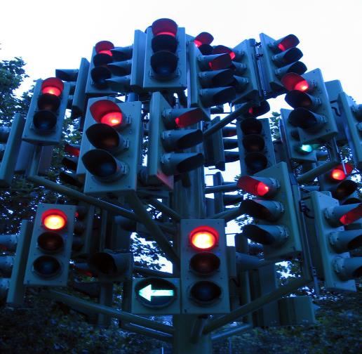


Confusion
There is confusion regarding the applicability of privacy legislation and reporting requirements in the First Nation context.
Confidential – Not For Distribution
Notes:
There is confusion regarding the applicability of privacy legislation and reporting requirements in the First Nation context.
In my experience Government has given incorrect or misinformed advice regarding applicable privacy and reporting requirements.
The government is wrong until proven right.

Slide 69
Manitoba's Privacy Act
The interpretation is that the 'recipients' require client consent or other legal authority to disclose any Personal Health Information, or else potentially be in violation of the Funding Agreement.
Confidential – Not For Distribution
Notes:
What are we left with, the Manitoba Privacy Act
Since there is no applicable law, we have to look at Manitoba’s Privacy Act which covers everyone in Manitoba.
The interpretation is that the 'recipients' require client consent or other legal authority to disclose any Personal Health Information, or else potentially be in violation of the Funding Agreement.

Slide 70

Funding Risk
This would not, constitute a violation of any law.
But, a potential breach of the Funding Agreement.
Confidential – Not For Distribution
Notes:
Therefore, a breach would not constitute a violation of any law, as none of the laws are applicable.
But, a potential breach of the Funding Agreement. Which could result in the project funding being pulled.

Slide 71
Consent
“Consent” is the basis of all privacy legislation, whether the Privacy Acts, PIPEDA or PHIA.
If a client consents to the collection, use and disclosure of their personal information – no other legal authority is required in order to authorize the use or disclosure.
Consent can be Express or Implied.
Confidential – Not For Distribution
Notes:
“Consent” is the basis of all privacy legislation, whether the Privacy Acts, PIPEDA or PHIA.
If a client consents to the collection, use and disclosure of their personal information – no other legal authority is required in order to authorize the use or disclosure.
Consent can be Express or Implied.

Slide 72

Implied vs Express Consent
Implied Consent is an assumption of permission.
Express Consent is Written.
Confidential – Not For Distribution
Notes:
Implied Consent: Provided by the behavior (i.e. phone in water test)
Express Consent is anything other than implied consent. It may be oral or written. (i.e. phone in water test)
To keep it simple, we will say Implied Consent is an assumption of permission, and Express Consent is Written.

Slide 73
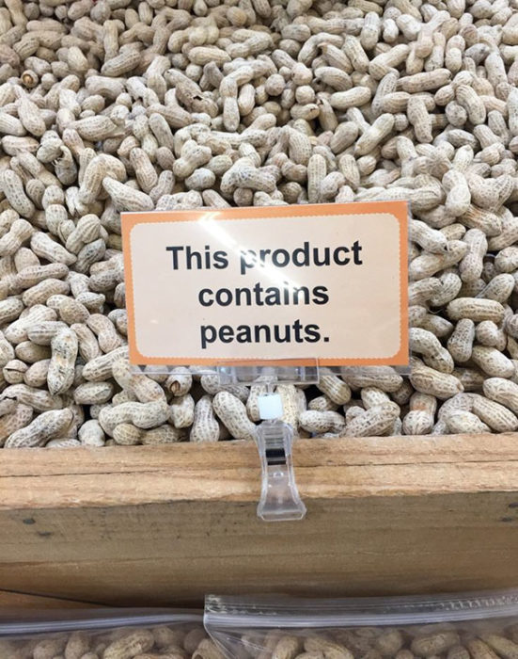
Legal Action
Confidential – Not For Distribution
Notes:
Doing everything we can so we don’t get sued.

Slide 74

Questions?
Please contact legal counsel.
Confidential – Not For Distribution
Notes:
Please contact legal counsel.

Slide 75
Ekosani – Wopida – Miigwech – Ekosi – Mahsi – Thank You
Confidential – Not For Distribution

