Slide 1

BUILDING THE MANITOBA FIRST NATIONS
NETWORK OF THE FUTURE INITIATIVE
Indigenous Connectivity Summit
November 8, 2017

Slide 2




The Network
Fibre to Point of Presence (POP)
Fibre to schools, healthcare facilities and band offices
Wireless to residences
POP
School
Healthcare
Band Office

Slide 3
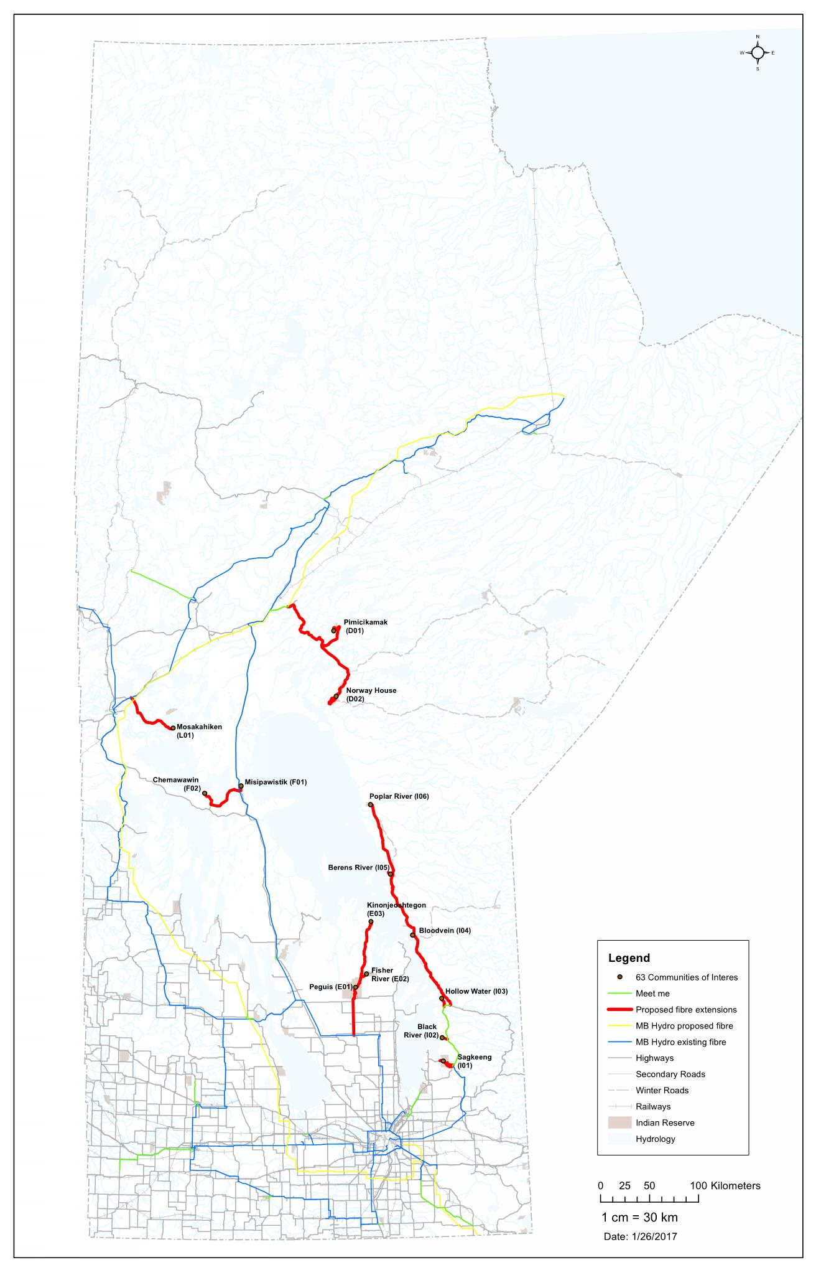





Tier 1
Design
1 year
Construction
2 years
32,395 residents connected
Creates an opportunity for e-learning and job growth in the communities.
5,890 households connected
Connections of 25-100MB are planned, delivered via fibre.
$50M
14 band offices connected
Connections of 25-100MB are planned, delivered via fibre.
19 schools connected
Connections of 60-100MB are planned, delivered via fibre.
775 KM
new fibre
1,578 KM
existing fibre

Slide 4
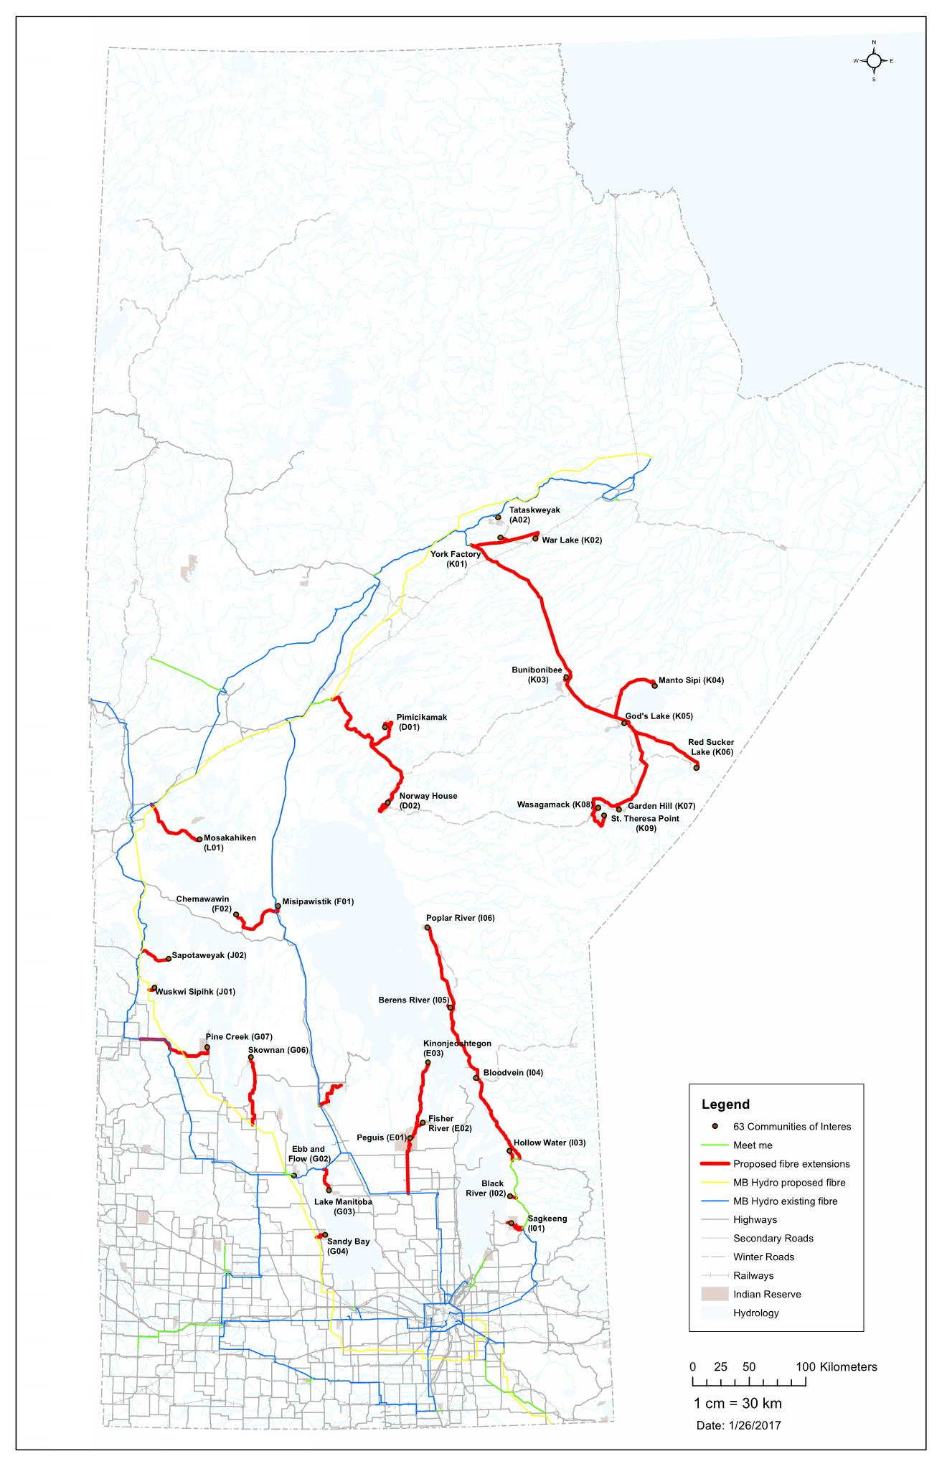
Tier 2
Design
1 year
Construction
2 years
61,133 residents connected
Creates an opportunity for e-learning and job growth in the communities.
11,115 households connected
Connections of 25-100MB are planned, delivered via fibre.
$100M
33 band offices connected
Connections of 25-100MB are planned, delivered via fibre.
44 schools connected
Connections of 60-100MB are planned, delivered via fibre.
1,665 KM
new fibre
3,120 KM
existing fibre

Slide 5
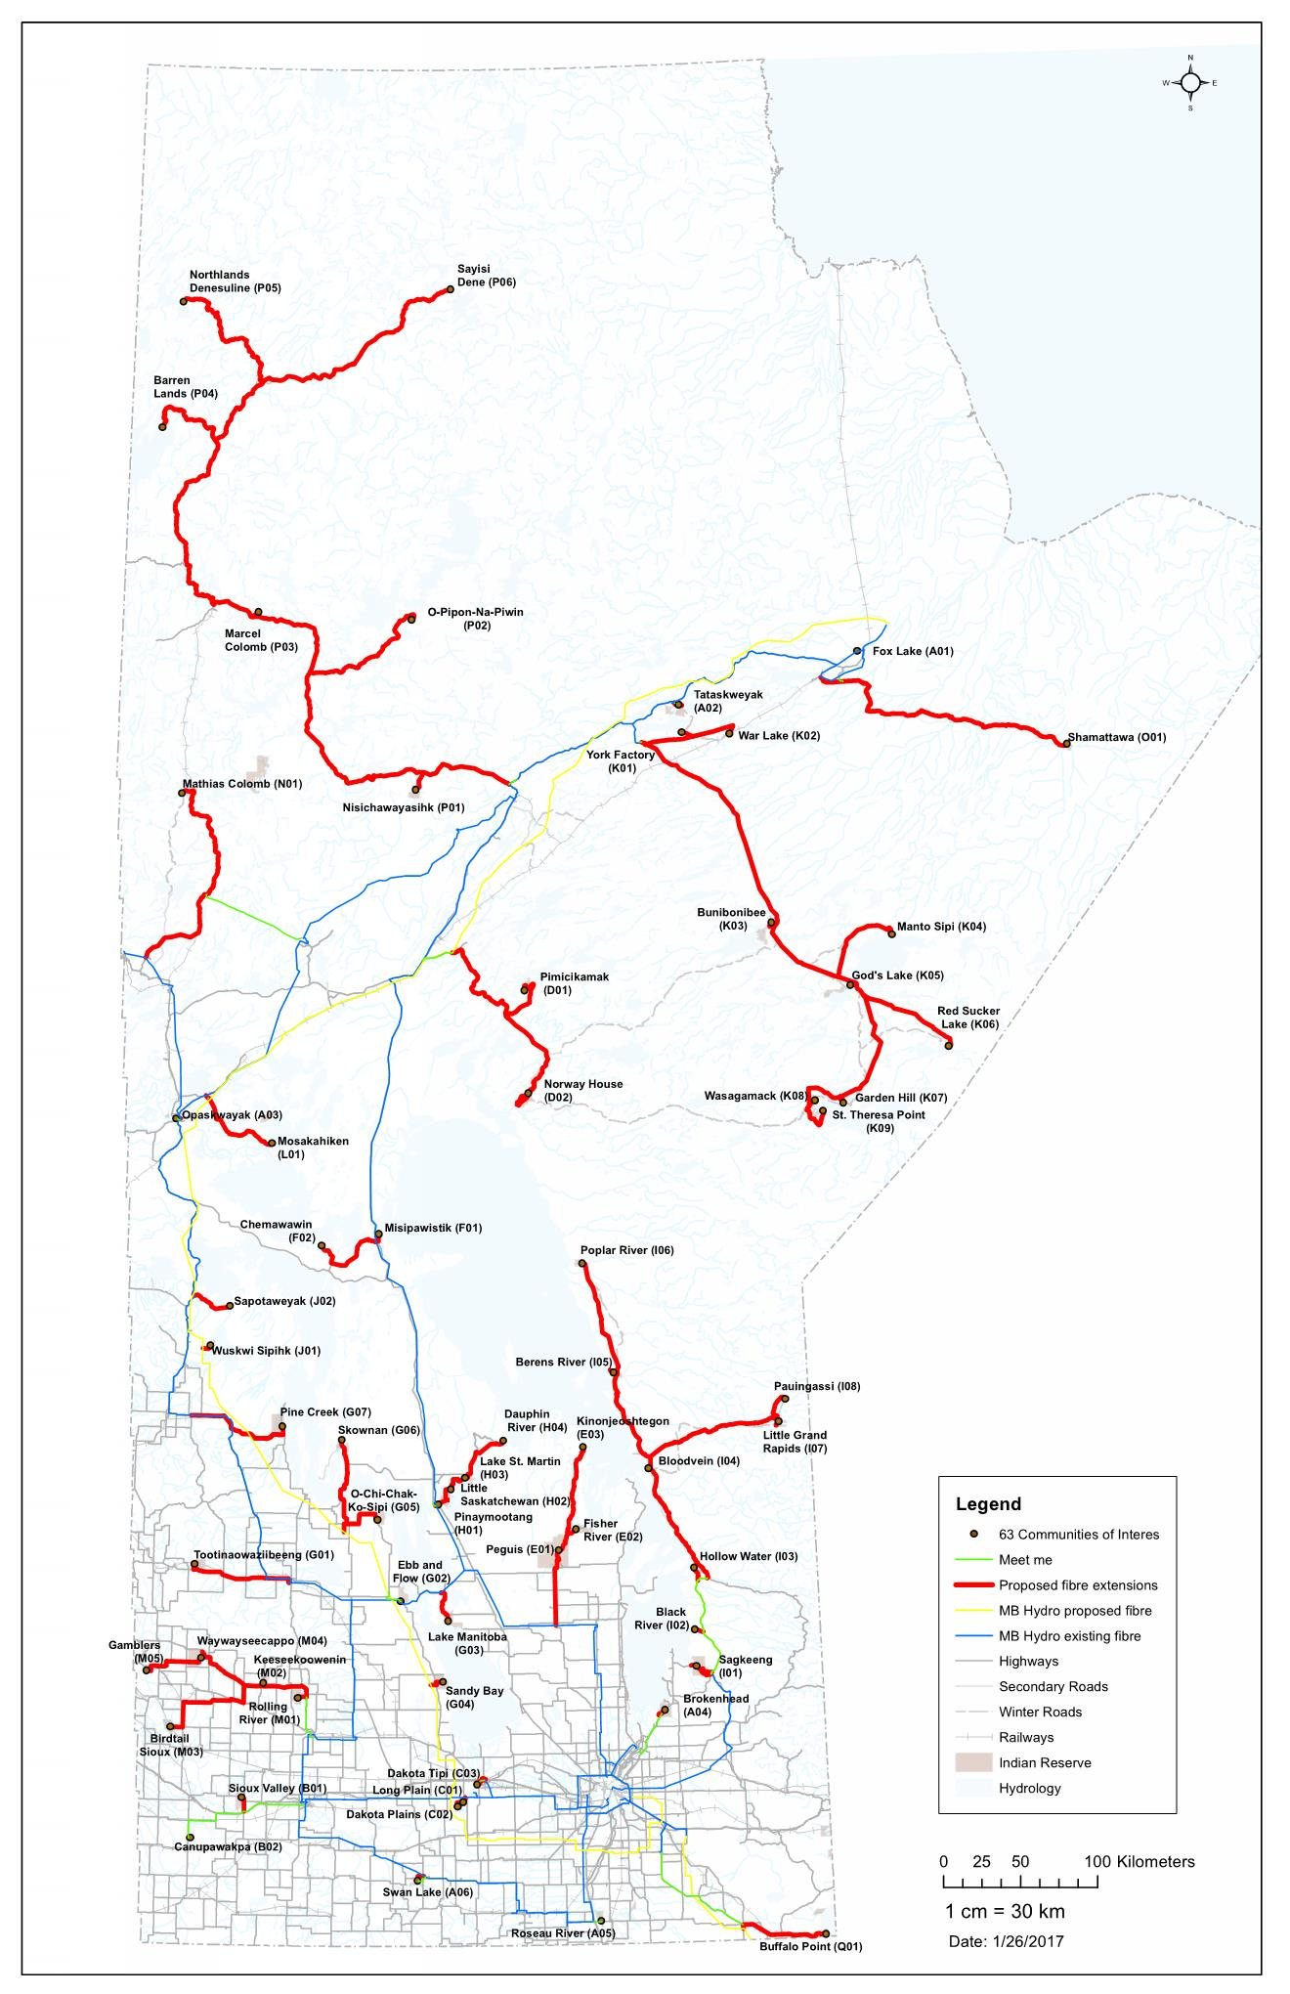
Tier 3
Design
1 year
Construction
2 years
91,198 residents connected
Creates an opportunity for e-learning and job growth in the communities.
16,581 households connected
Connections of 25-100MB are planned, delivered via fibre.
$301M
61 band offices connected
Connections of 25-100MB are planned, delivered via fibre.
75 schools connected
Connections of 60-100MB are planned, delivered via fibre.
3,619 KM
new fibre
3,513 KM
existing fibre

Slide 6

Legal Structure
Backbone Access Providers
Federal Government Funders
Connectivity
Manitoba
Strategic
Partner
Dedicated
ISP
Community /
Other ISPs
Community
Users
Community
Users

Slide 7
Connectivity Manitoba
Incorporation: a federal not-for-profit corporation
Organization: members are the Manitoba First Nations
12 Directors:
7 appointed by each of the 7 Tribal Councils prior to each AGM
2 nominated by the 11 Independent First Nations prior to each AGM
3 selected by the Board after each AGM who bring relevant expertise such as corporate governance, communications industry, design and construction, finance, operation and maintenance

Slide 8
Connectivity Manitoba (Cont’d)
Purpose:
Design, build, finance, operate and/or maintain high-speed Internet to and in communities in Manitoba
Facilitate and support the design, construction, finance, operation and maintenance of high-speed Internet to and in communities in Manitoba
Train, employ and facilitate training and employment of residents in communities in Manitoba in construction, operation and maintenance of high-speed Internet to and in communities in Manitoba
Mission:
Affordable, dependable high-speed Internet in all First Nations communities in Manitoba where high-speed Internet is not available or otherwise being deployed

Slide 9
Connectivity Manitoba (Cont’d)
Strategy:
High-speed Internet network owned by Connectivity Manitoba
Design and build high-speed Internet network to First Nations communities in phases
Number and timing of phases dependent upon availability of Federal funding
Scope of first build phase dependent upon Connect to Innovate Program funding
Scope of second and subsequent build phases dependent upon other Federal funding programs
Require training and employment of First Nations community residents in the deployment, operation and maintenance of high-speed Internet network

Slide 10
Backbone Access Providers
Manitoba Hydro Telecom (MHT)
Manitoba Telecom Services (MTS)

Slide 11
Federal Government Funders
Innovation, Science and Economic Development: Connect to Innovate Program
Canadian Radio-television and Telecommunications Commission (CRTC)
Indigenous and Northern Affairs Canada (INAC)
Infrastructure Canada – The 2014 New Building Canada Fund: Provincial-Territorial Infrastructure Component Small Communities Fund

Slide 12
Strategic Partner
Long term concession agreement between Connectivity Manitoba and Strategic Partner
Strategic Partner:
Designs, builds, operates and maintains the network to the First Nations communities
Delivers affordable, dependable high-speed Internet to POP in First Nations communities
Assumes build risk, including cost overruns, and revenue risk on operations
Trains and employs residents of First Nation communities in construction, operation and maintenance of network

Slide 13
Strategic Partner (Cont’d)
Connectivity Manitoba
Pays Strategic Partner for build to the extent funds provided by Federal Government and other funding sources
Oversees compliance by Strategic Partner to provide affordable, dependable high-speed Internet and to train and provide employment to First Nations community residents

Slide 14
Internet Service Providers
Dedicated ISP: Broadband Communications North (BCN)
Community ISPs
Other ISPs

Slide 15
Community Users
Anchor Users:
Federal government anchor users
Manitoba government anchor users
Band offices
Community business users
Residential Users
Community residential users

Slide 16
Revenues and Costs During Operational Stage
Retail Revenues from Residential Users
Retail Revenues from Anchor Users
Wholesale Revenues from ISPs
Connectivity Manitoba / Strategic Partner
Network O&M Costs
Backbone Access Costs
Business Operations Costs
Other Costs

Slide 17
Sustainability of the Business Case
User Base Across 63 First Nations Communities
Potential Residential Users: over 90,000 people in the communities (over 16,000 households)
Potential Anchor Users: over 400 potential anchor users identified
Business Strategy:
Close collaboration of Connectivity Manitoba, Strategic Partner, ISPs and Band Councils to maximize user subscription to the Internet services
Reasonable retail rates for residential users and anchor users
Reasonable ISP wholesale rates that allow business sustainability for both Connectivity Manitoba / Strategic Partner and ISPs
Cost efficiency on network O&M and business operations
Value-added services to increase revenues

Slide 18
Funding for Construction Costs
Federal Connect to Innovate Program
Other Government Funding Sources
Connectivity Manitoba / Strategic Partner
Network Construction Costs
Project Management and Ancillary Costs

Slide 19

Ekosani! Miigweetch! Mahsi! Wopida! Thank You!
First Nations Health and
Social Secretariat of Manitoba
17th Floor-275 Portage Avenue
Winnipeg , MB R3B 2B3
Chief David Crate
Chief Nelson Genaille
Co-Chairs
Manitoba First Nations Technology Council
Lisa Clarke
eHealth Director
204-797-6937
lclarke@fnhssm.com
Higies Agbator
Business Development Manager
hagbator@fnhssm.com
Lindsay Catcheway
MFNTC Program Assistant
lcatcheway@fnhssm.com
Jonathan Fleury
MFNTC Project Manager
jfleury@fnhssm.com
Bill Murdoch
IT Specialist
bmurdoch@fnhssm.com
Together we will build the network of the future……..the Gateway to Economic Development Opportunities for Manitoba’s First Nations

