Slide 1

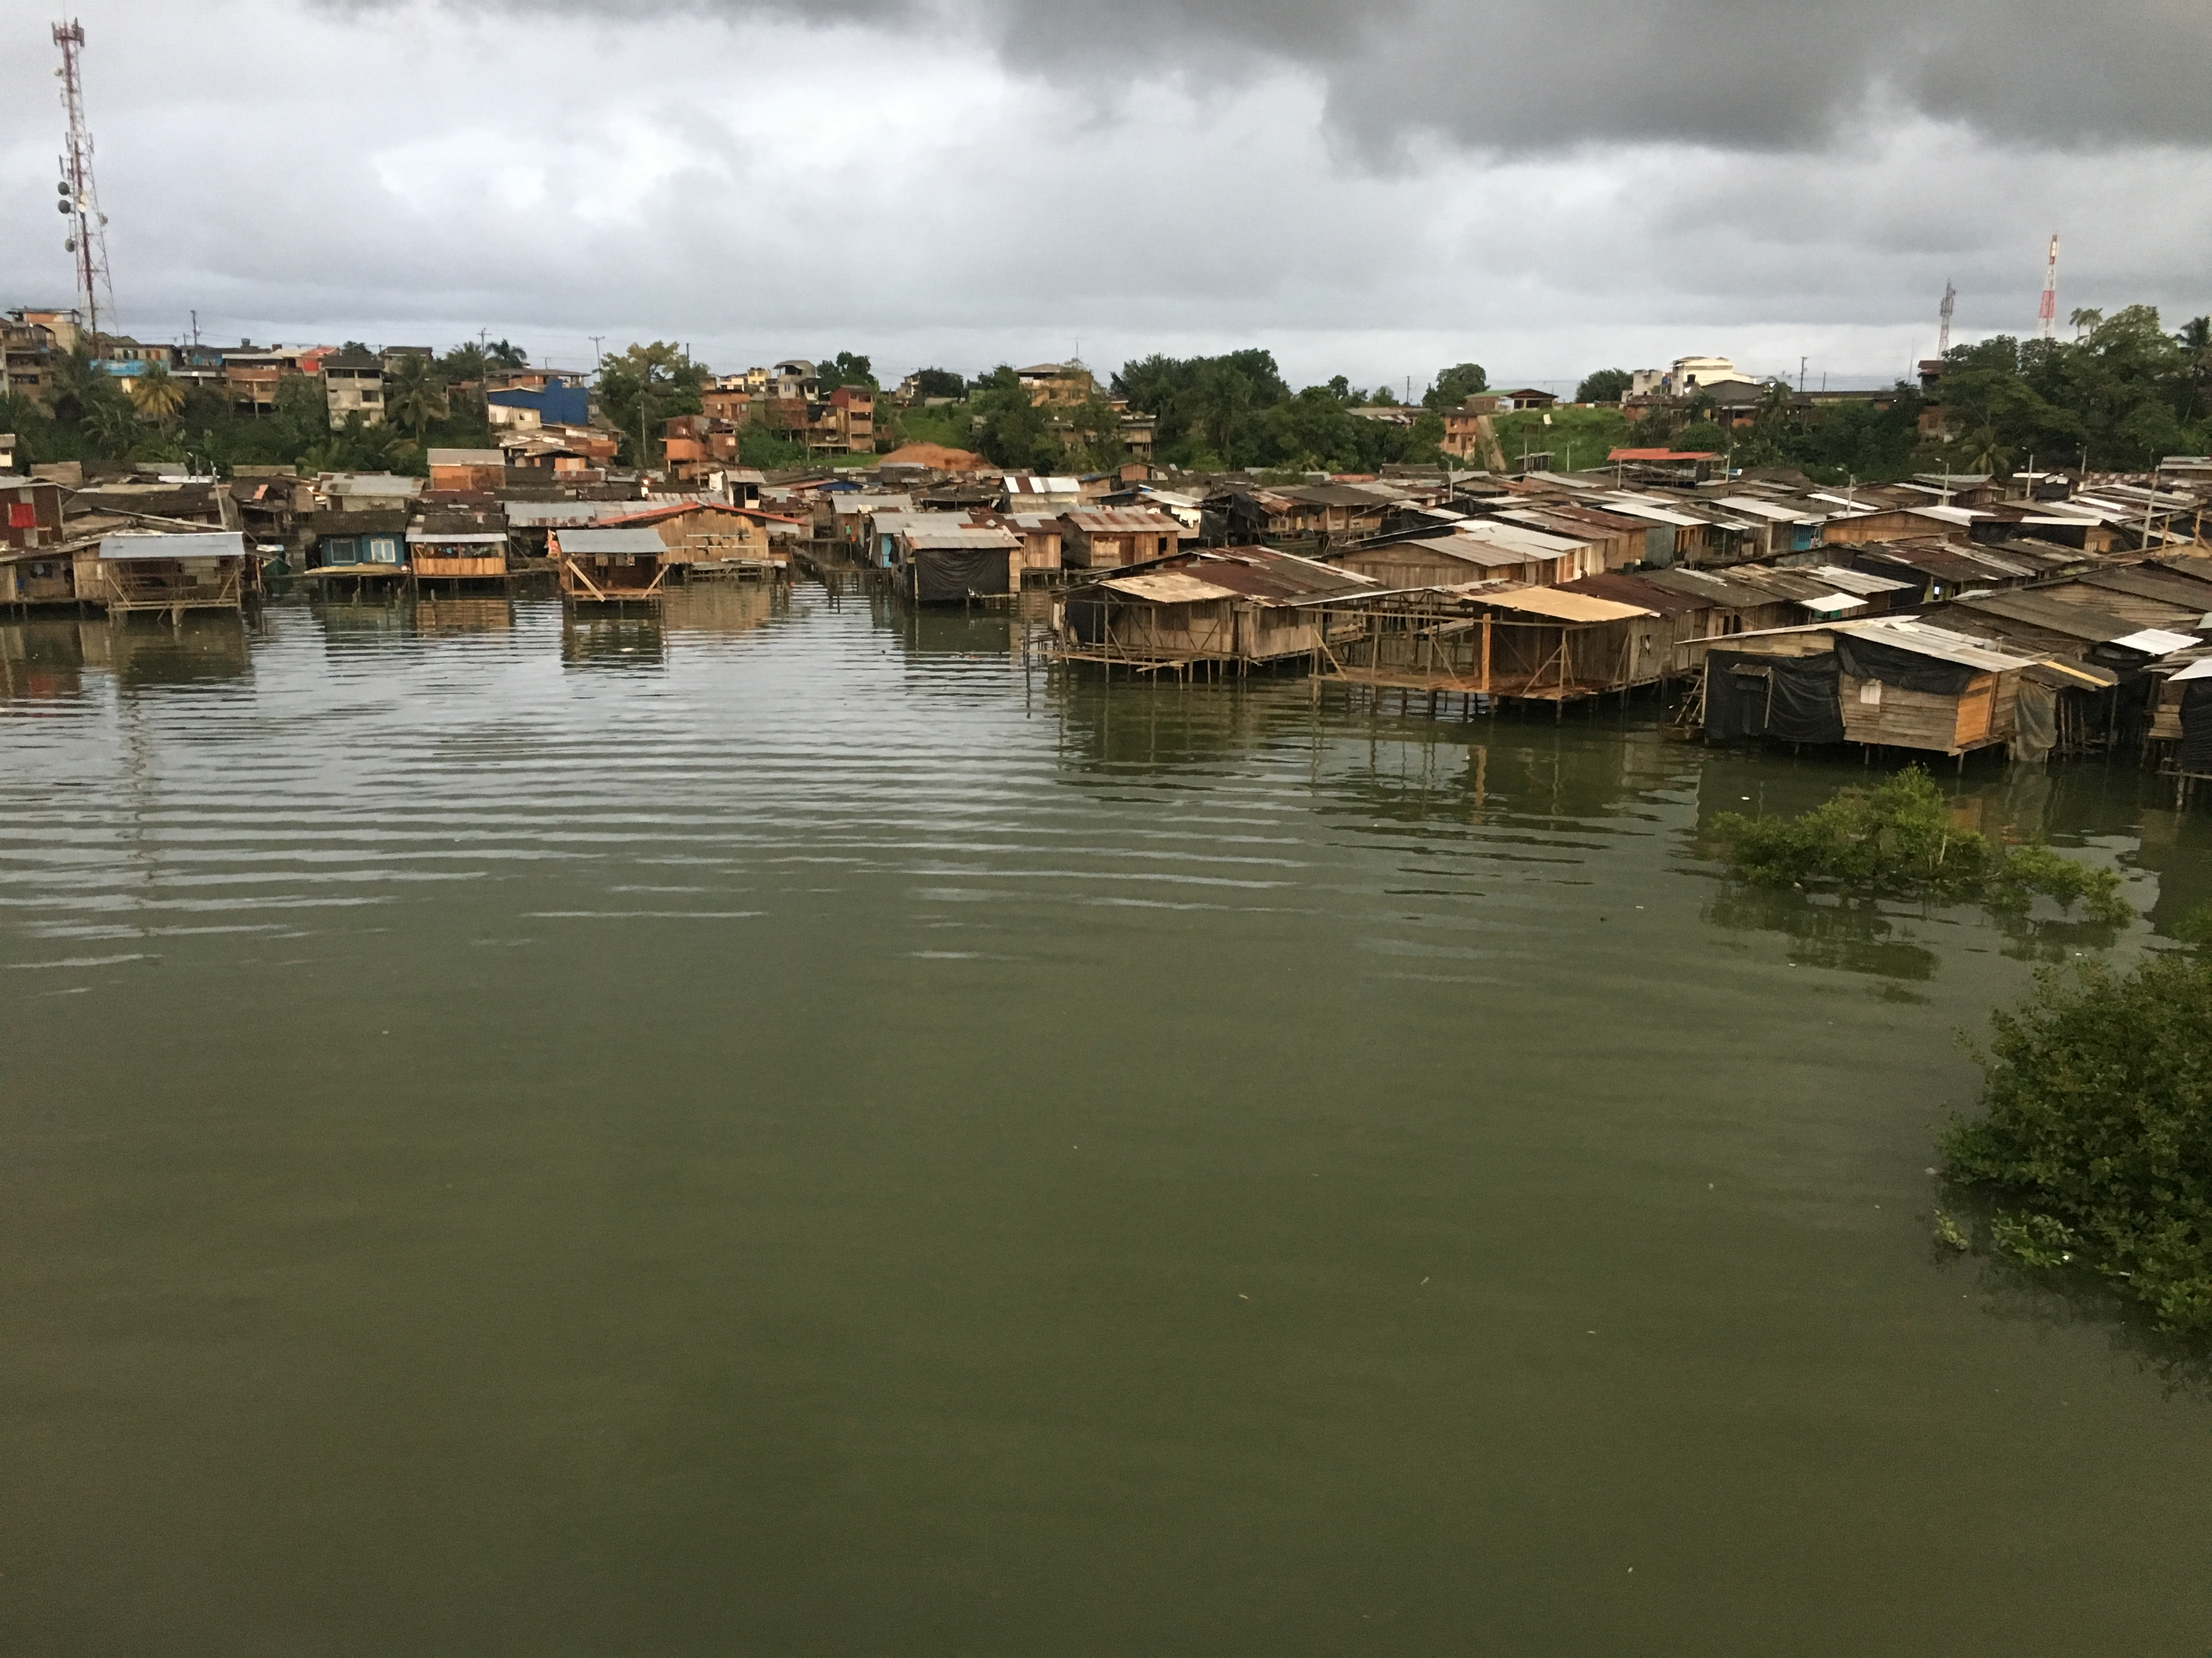
How to bring internet where there is no market?

Slide 2
We called this:
The Market Dilema.

Slide 3
We live in Canada
our office

Slide 4
And our workplace is in Colombia
office
workplace

Slide 5
OUR PLACE

Slide 6
Do you know what happens with your country? Everything is grave here, but nothing is serious..
Tom Quinn (correspondent for Time magazine)
1970.

Slide 7
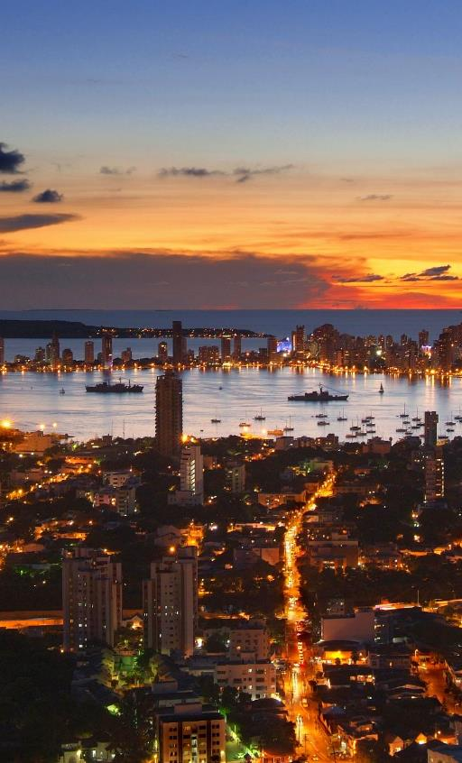
Colombia
49 million people

Slide 8
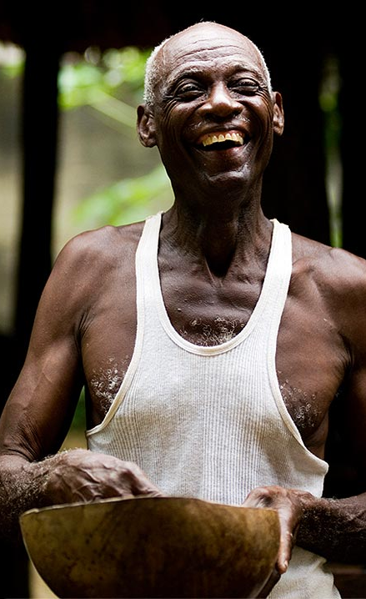
Colombia
49 million people
26% afro

Slide 9
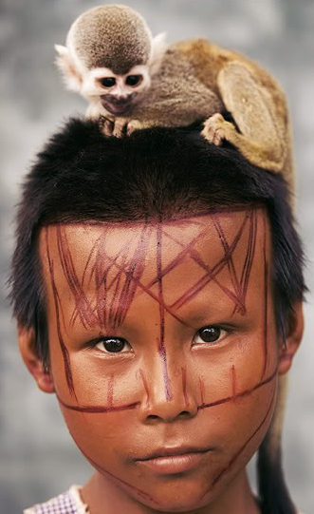
Colombia
49 million people
3.5% indigenous

Slide 10

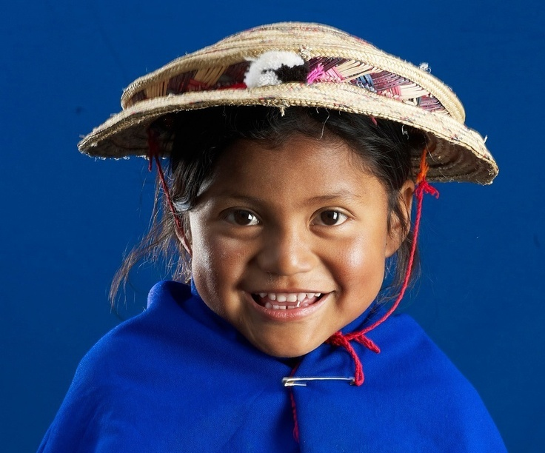
Colombia
Almost 14.5 million minority ethnic people

Slide 12
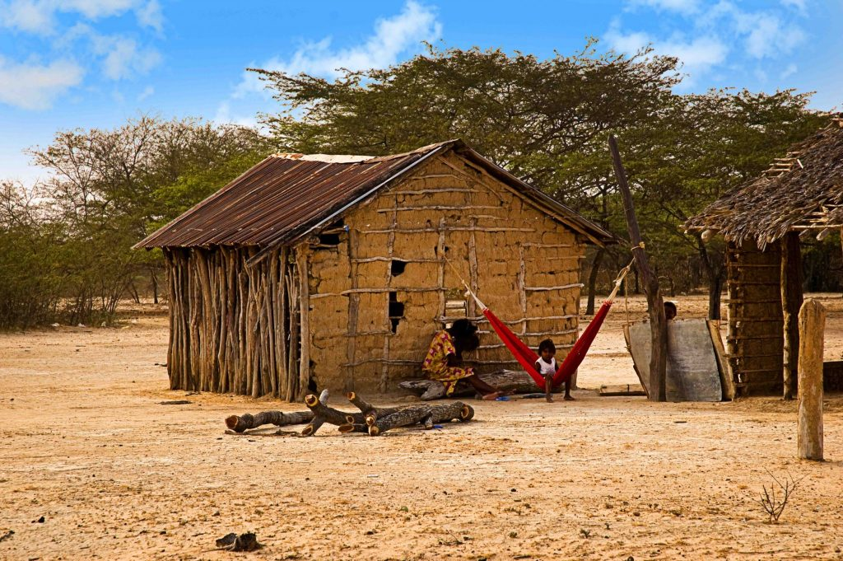

Slide 13
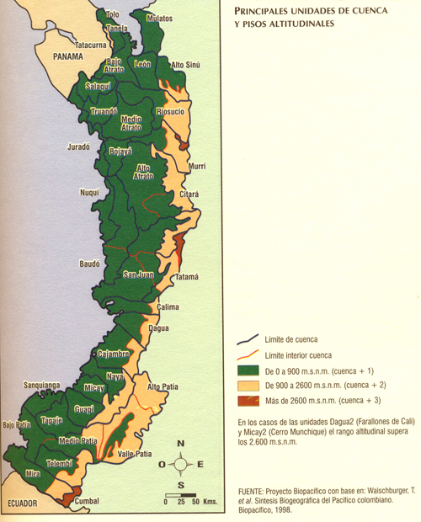
Colombian West Coast
A huge jungle, stretching from the border with Panama to the border with Ecuador.
88% Afro
2% Indigenous

Slide 14
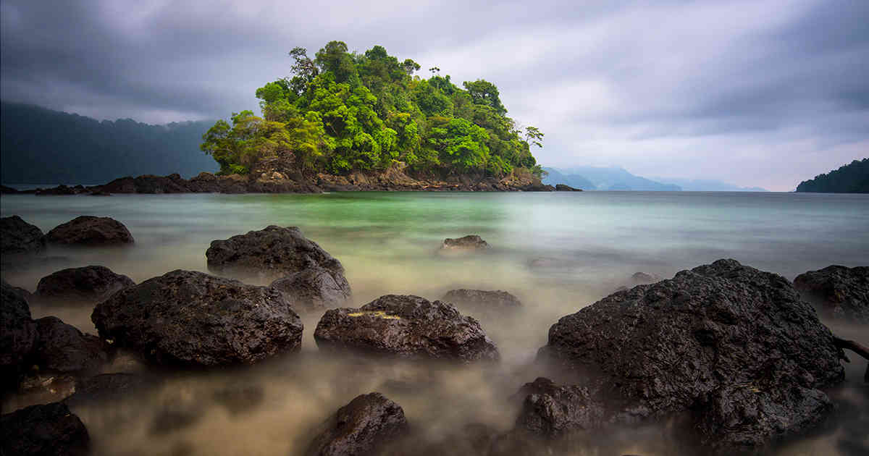
Utría´s Cove

Slide 15
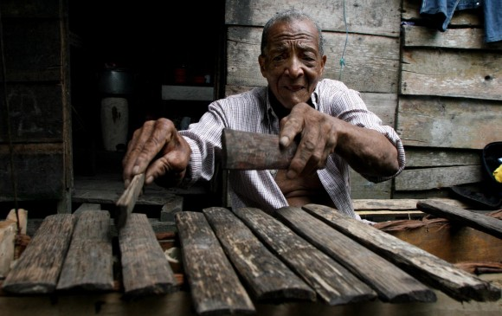
Chonta´s Xylophone

Slide 16
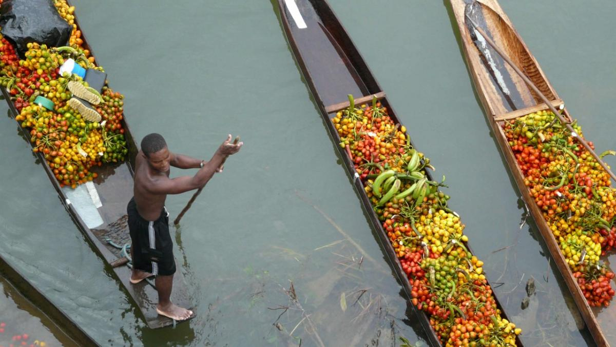
Chontaduro fruit

Slide 17
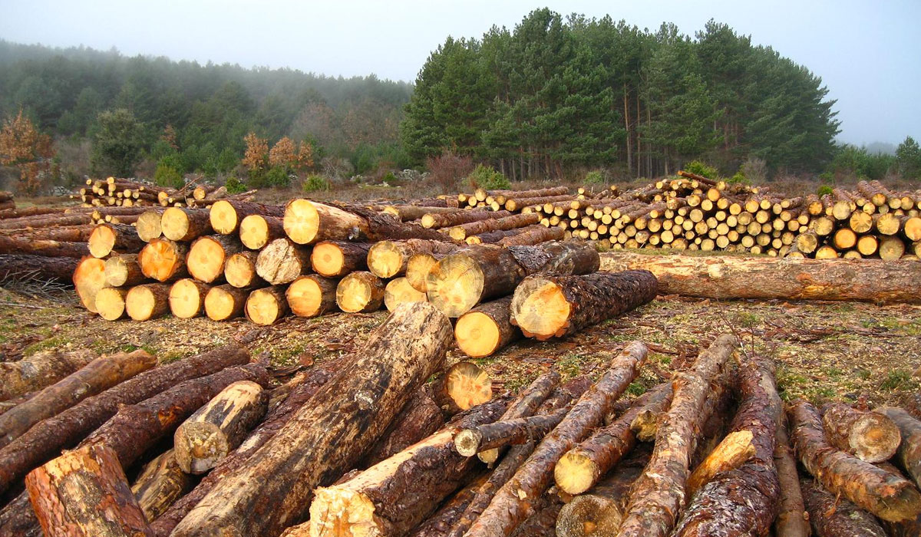
Logging

Slide 18
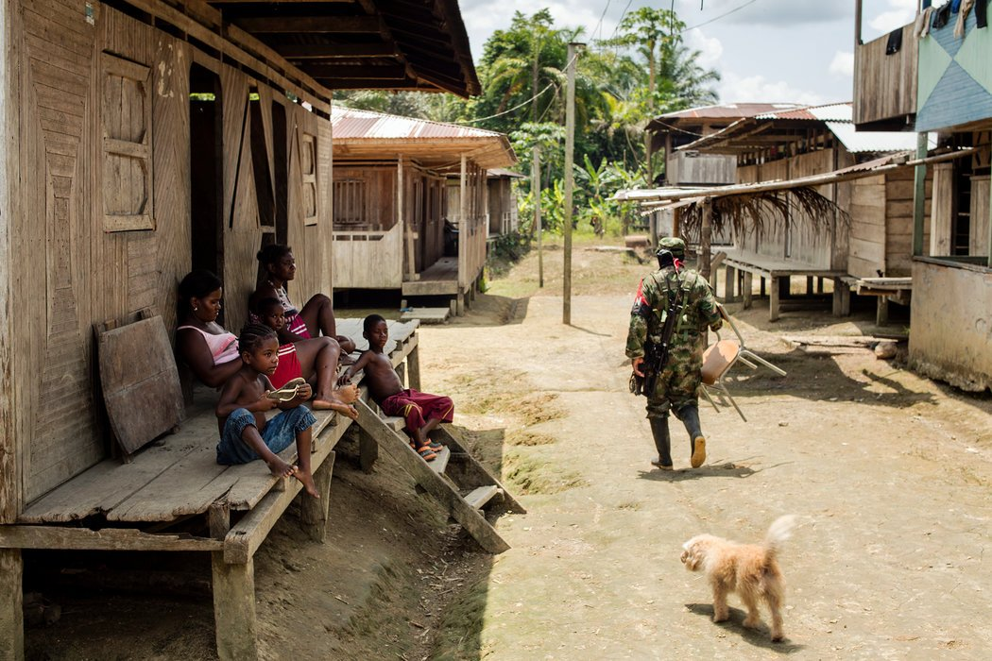
Village

Slide 19
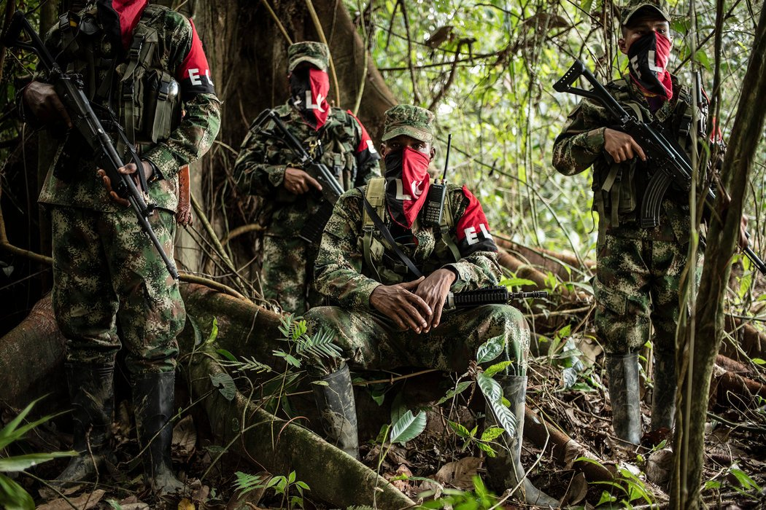
Conflict

Slide 20
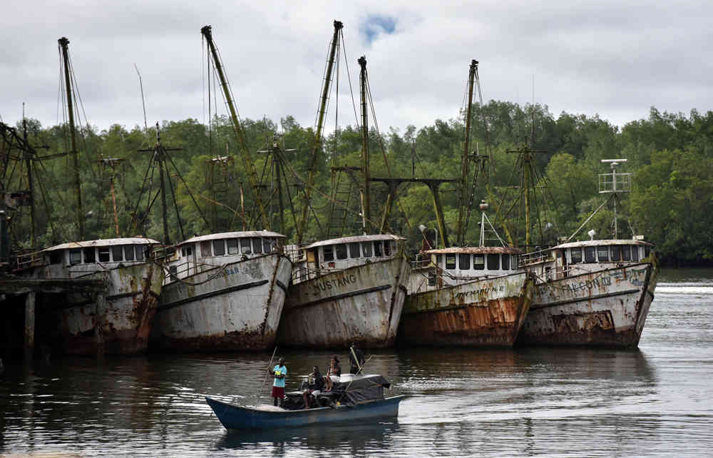
Fishing

Slide 21
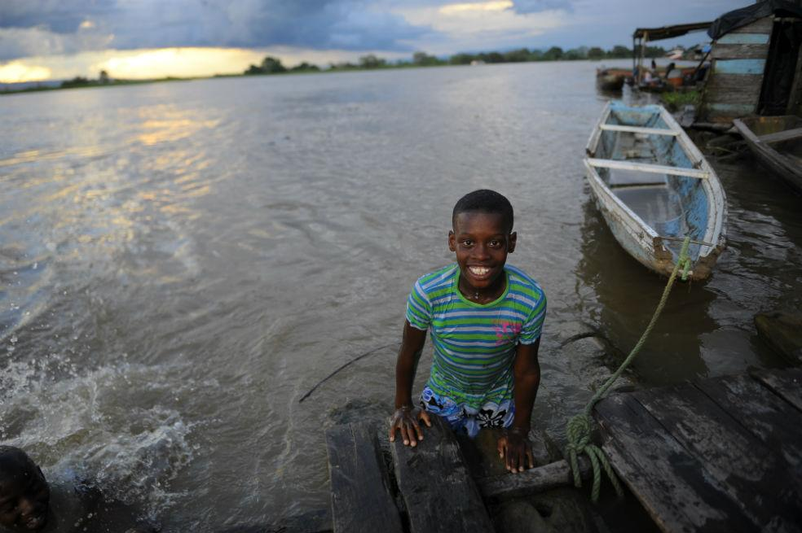
Future

Slide 22
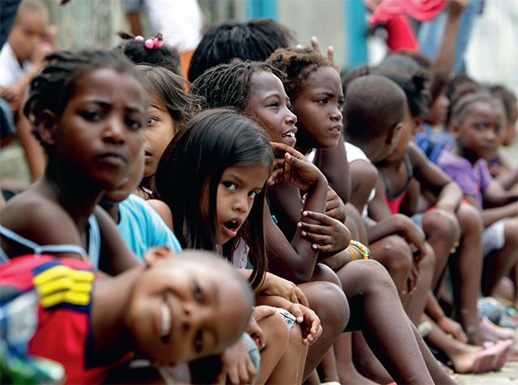
West Coast cities
Buenaventura:
The richest city in the Colombian West Coast

Slide 23
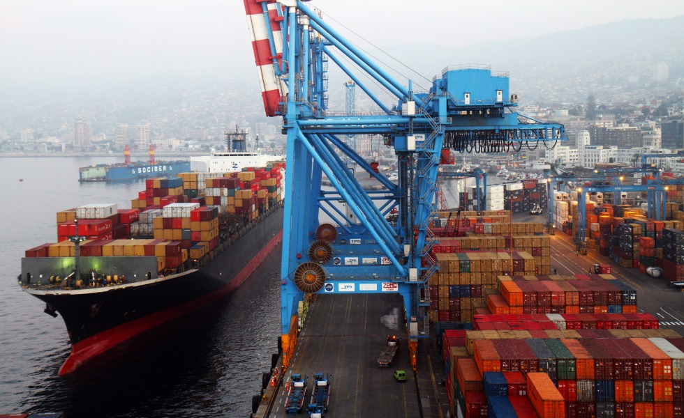
West Coast cities
Buenaventura:
Its maritime port moves more than 53% of all Colombian foreign trade

Slide 24
Please give us a sense of how you structured the business model for your community networking project:

Slide 25
OUR BUSINESS MODEL
A sample from 1998

Slide 26

Colombian West Coast cities
Buenaventura:
It remained completely disconnected from the Internet until the year 2000

Slide 27
Find a "big guy affected"…
Buenaventura´s Port
was to hire a company who agreed to provide Internet access to the rest of the city.

Slide 28
In 1999…
The big guy affected¨ must bring the CAPEX. The market produces the OPEX.

Slide 29
In 1999…
The market was developed with a simple strategy:

Slide 30
What advice would you give others working on community networks?

Slide 31
OUR STRATEGY
We saw the Digital Divide not as a technological problem, but as a communication challenge.

Slide 32
Our process is easy
Identify social entrepreneurs.
Identify interests and needs.
Build applications and content IN THEIR LANGUAGE.
The social entrepreneurs need to know the content that we have developed for them
First:
Design the right SERVICES

Slide 33
Our process is easy
We cannot expect government or large corporations to bring networks to poor communities, neither to provide computers.
It is important to ensure that this equipment is the most economical, long lasting and simple solutions to maintain.
In this cases simplicity is usually better than orthodoxy.
Second:
Buid the
INFRASTRUCTURE

Slide 34
Our process is easy
Social entrepreneurs need to know how the services will be useful for them and their people.
Those are early successes
When the entrepreneur finds that this "oddball" of the Internet is actually something useful and fun for their community, they will help us to sell it .
Last:
Release the KNOWLEDGE

Slide 35
Our process is easy
First:
Design the right SERVICES
Second:
Buid the
INFRASTRUCTURE
Last:
Release the KNOWLEDGE

Slide 36
BUENAVENTURA´S CASE
Ours model has grown, matured and strengthened over time.

Slide 37

PORTEL
It was the first Colombian´s E-business community.

Slide 38
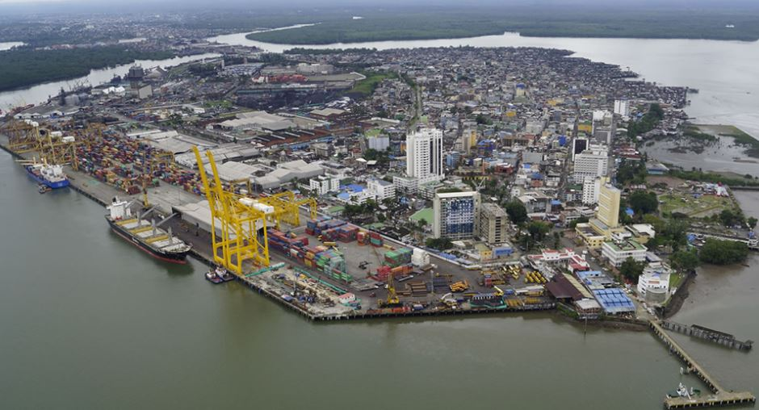
16 years in operation.
It was the first time that the import and export paperwork could be done from the office using computers.
It totally transformed the activity of foreign trade.

Slide 39
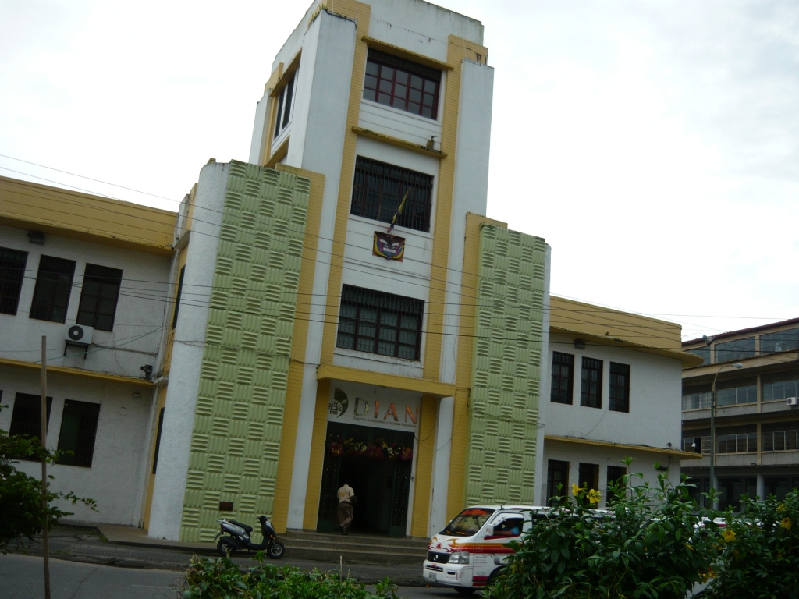
First:
Design the right SERVICES

Slide 40
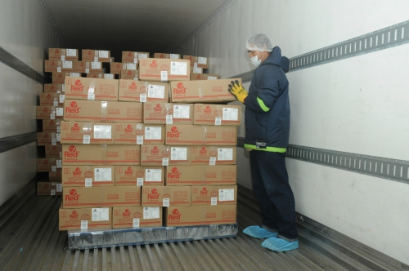
First:
Design the right SERVICES

Slide 41
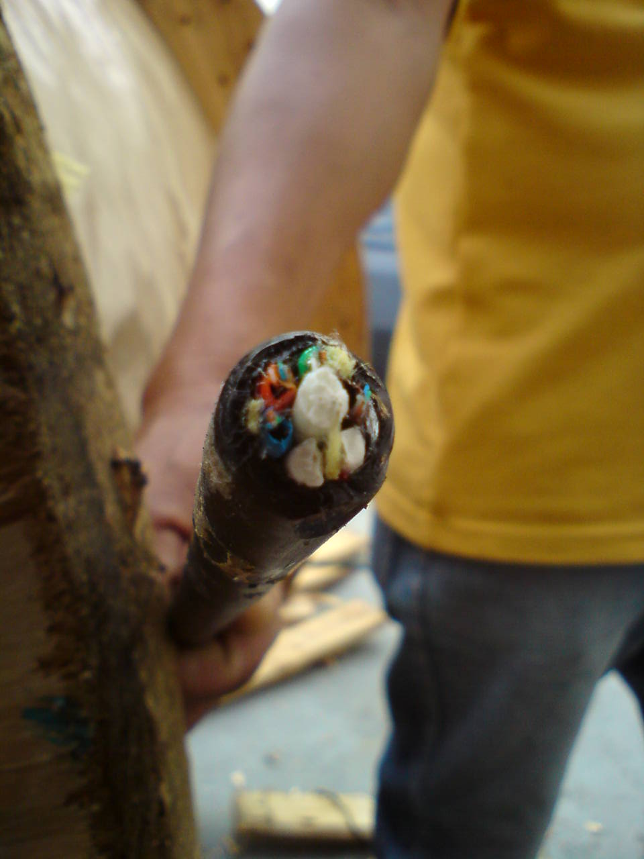
Second:
Buid the
INFRASTRUCTURE

Slide 42

Second:
Buid the
INFRASTRUCTURE

Slide 43
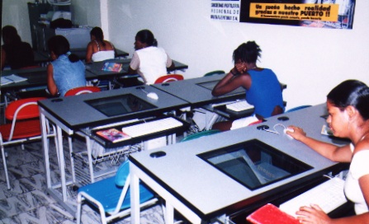

Last:
Release the KNOWLEDGE

Slide 44

INFOAULAS
It was the first program that put internet and computers in Colombian´s public schools.

Slide 45
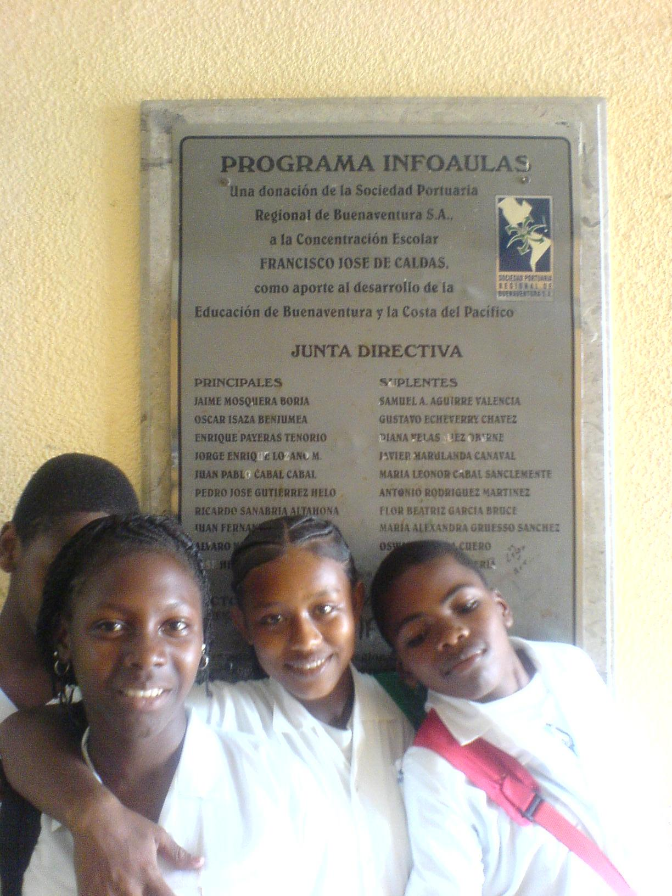
16 years in operation.
65,000 children have benefited to this day.
It became the national model and inspired the national program that now covers the whole country.

Slide 46
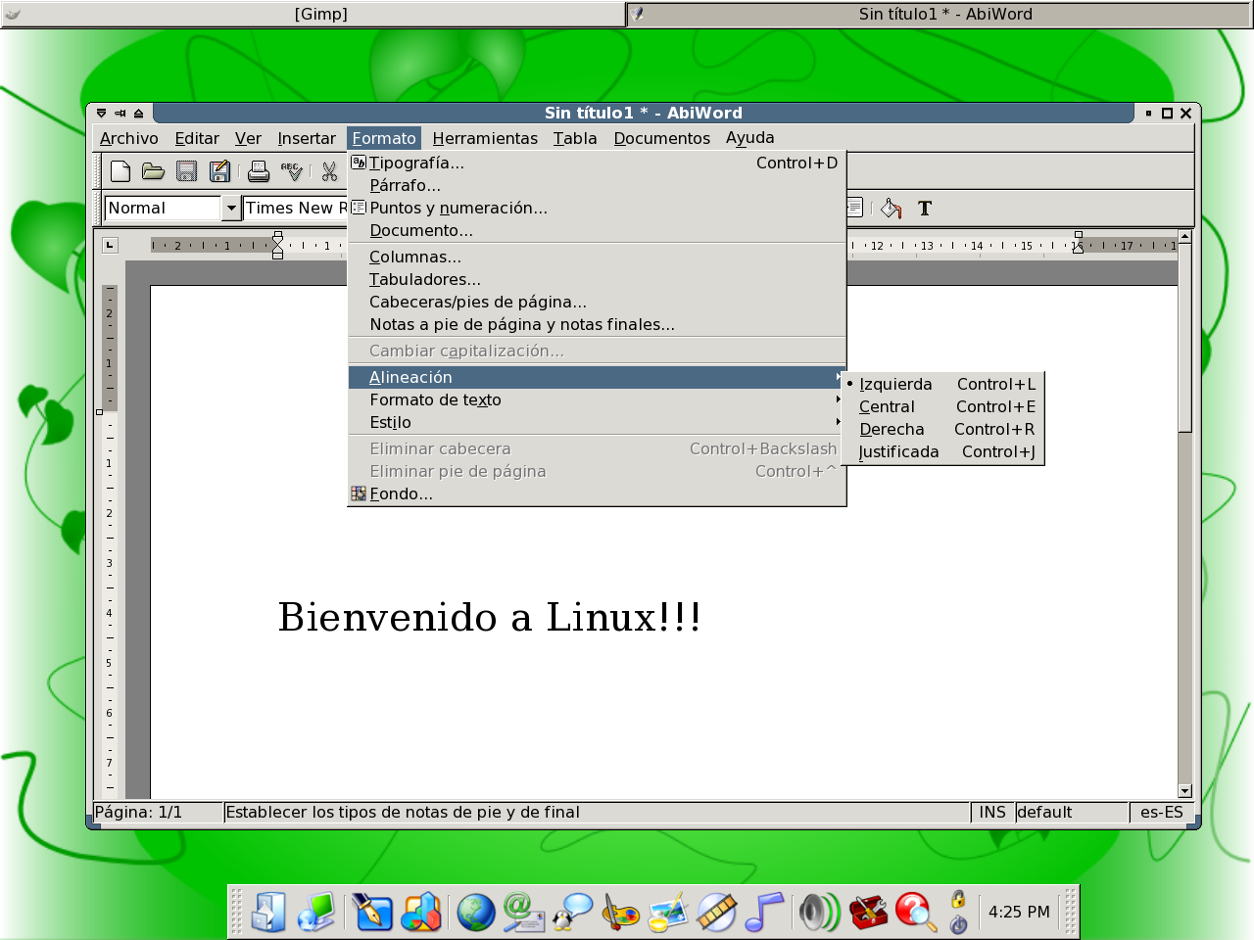
First:
Design the right SERVICES

Slide 47
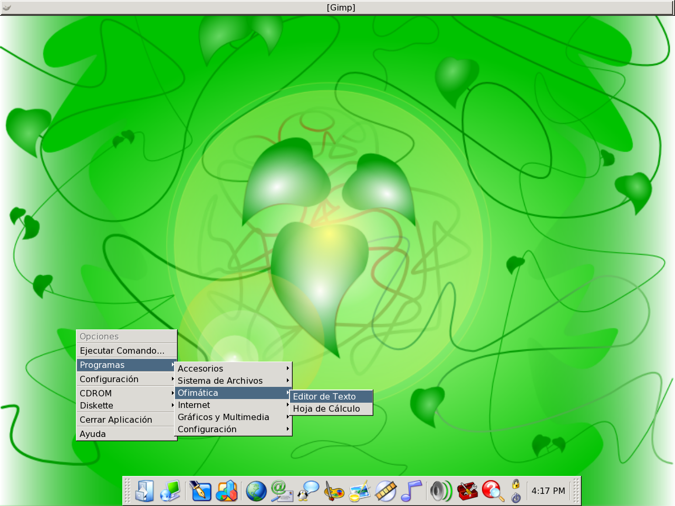
First:
Design the right SERVICES

Slide 48
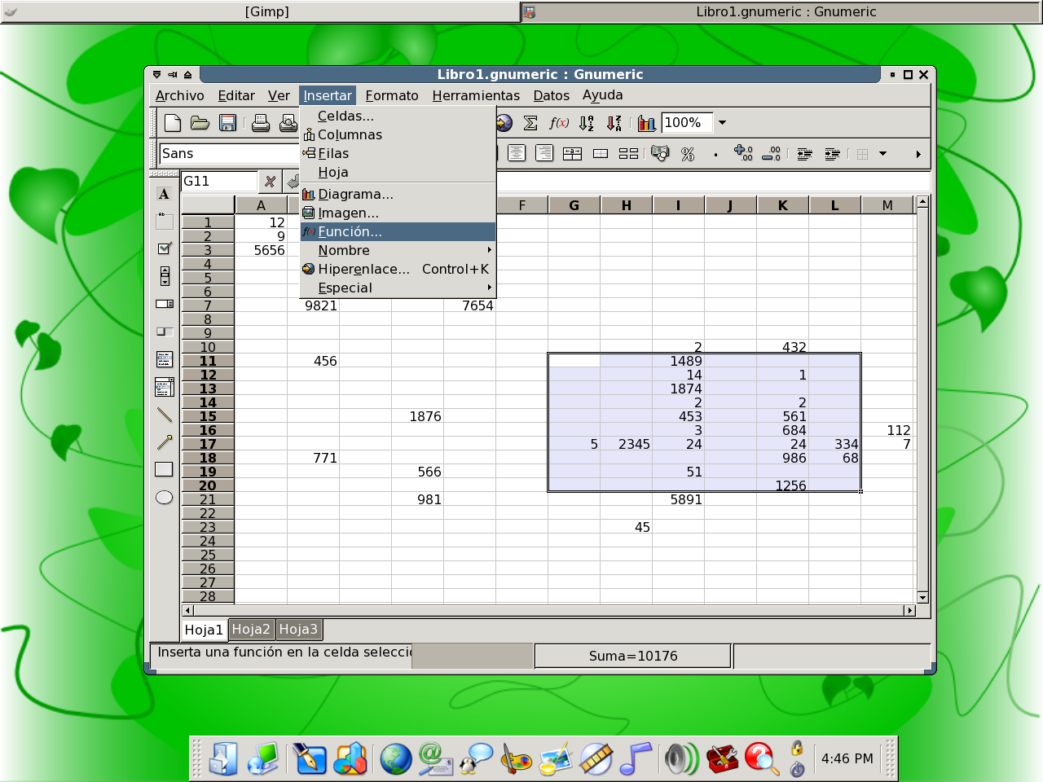
First:
Design the right SERVICES

Slide 49
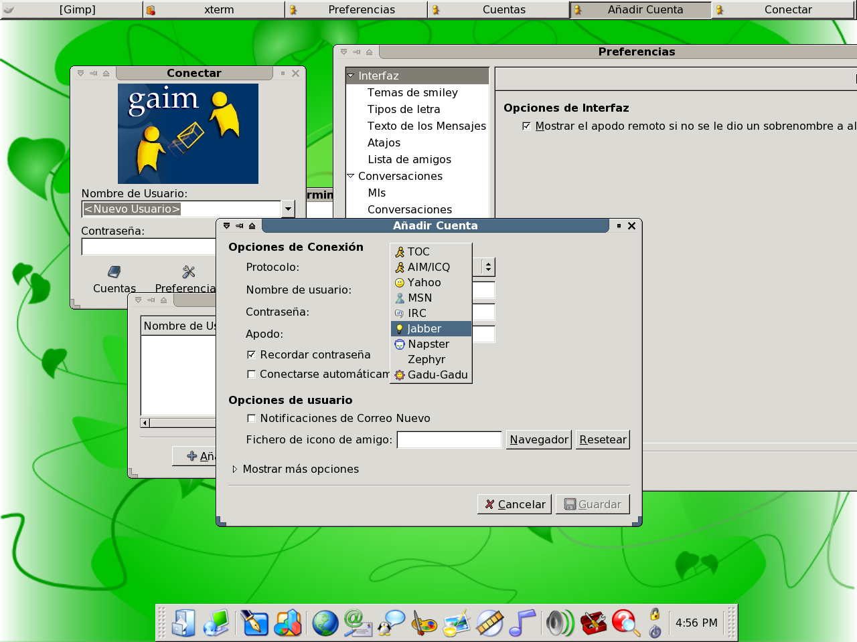
First:
Design the right SERVICES

Slide 50
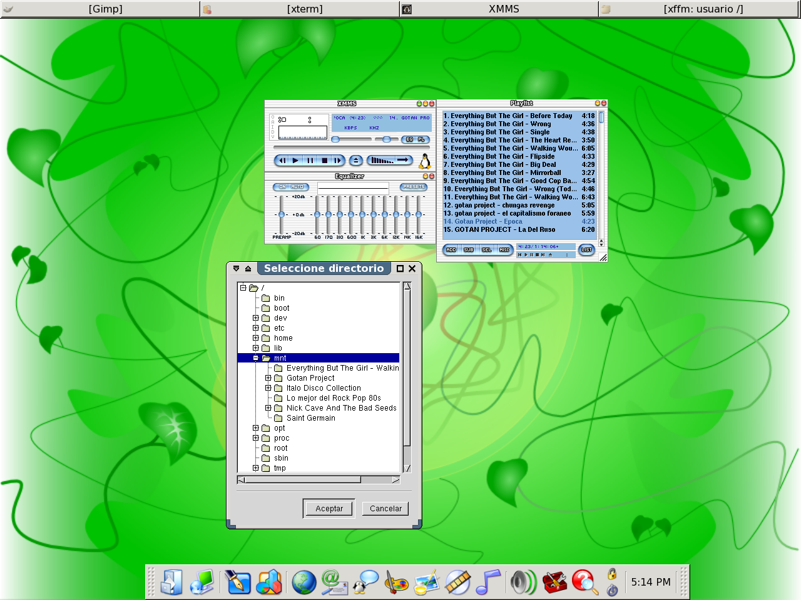
First:
Design the right SERVICES

Slide 51
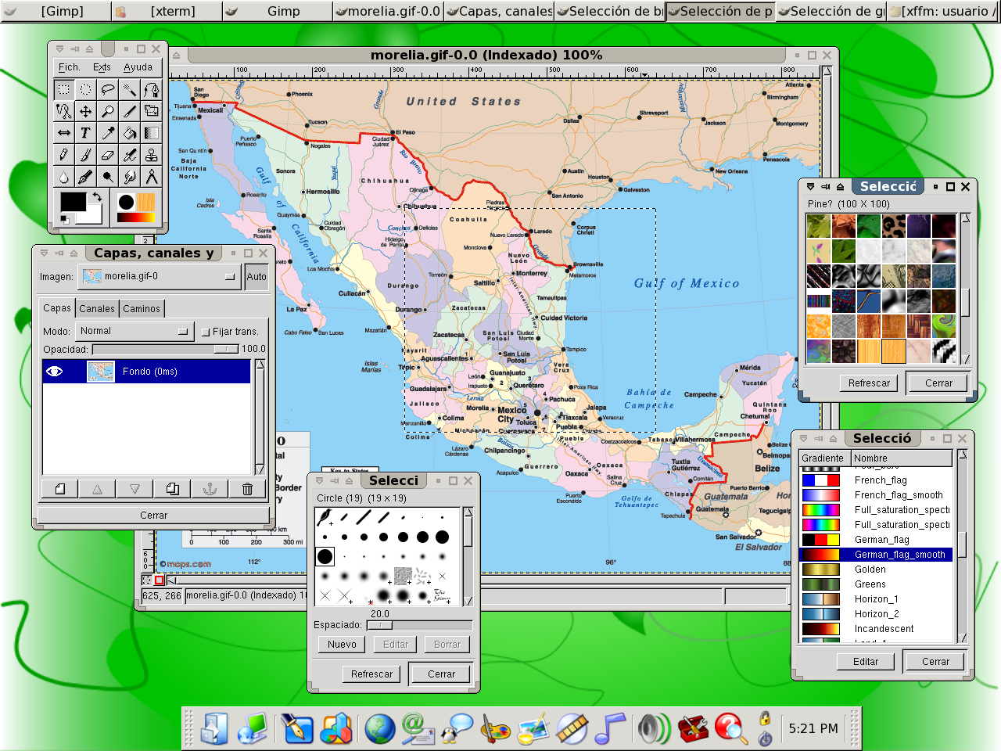
First:
Design the right SERVICES

Slide 52
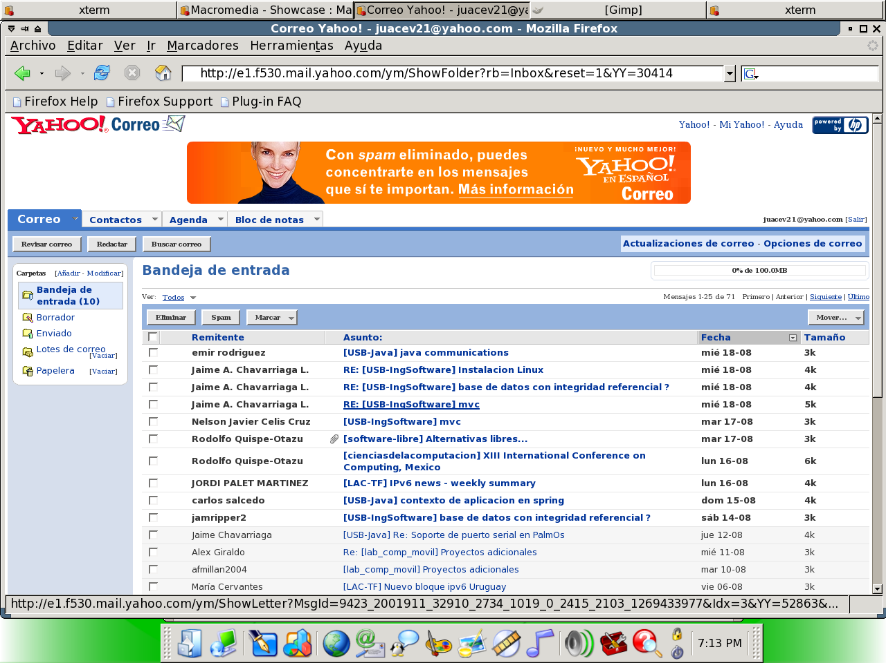
First:
Design the right SERVICES

Slide 53
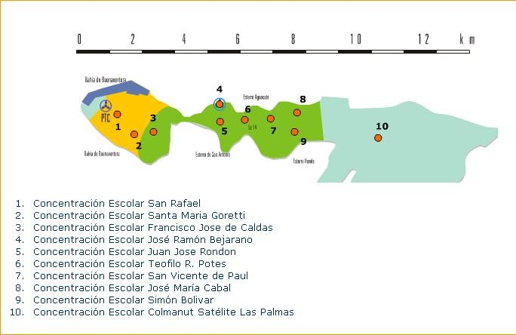
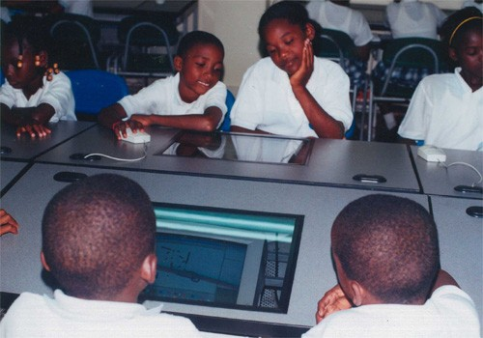
Second:
Buid the
INFRASTRUCTURE

Slide 54
Second:
Buid the
INFRASTRUCTURE

Slide 55
Second:
Buid the
INFRASTRUCTURE

Slide 56
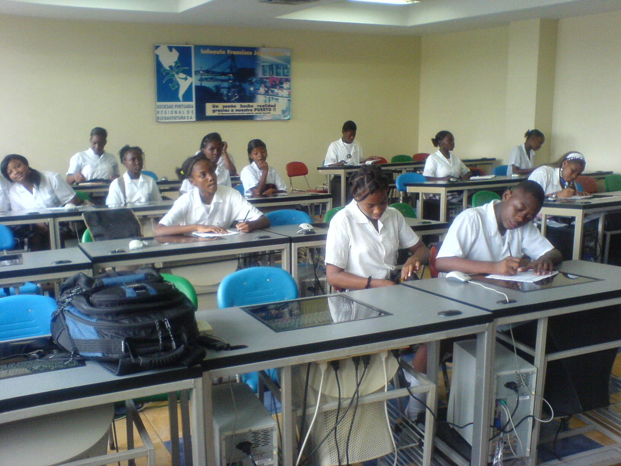
Second:
Buid the
INFRASTRUCTURE

Slide 57
Last:
Release the KNOWLEDGE

Slide 58
1. Tools to live
2. Keep it simple
3. It's a marathon
4. Do not run alone
5. Dreams can come true

Slide 59
What key lessons have you learned?

Slide 60
1. Tools to live
2. Keep it simple
3. It's a marathon
4. Do not run alone
5. Dreams can come true

Slide 61
Thanks!
Any questions?
You can find us at
Claudia.lezama@lalomaprojects.ca
Lope.trujillo@lalomaprojects.ca

